Slide 1


Basic Time Series Forecasting Methods
Lesson 3.303

Slide 2
Motivation
Forecasting is the process of making predictions about future values based on historical data and patterns. It is widely used in various fields such as finance, economics, weather prediction, supply chain management, and machine learning.
At its core, forecasting analyzes past observations to detect trends, seasonal patterns, and other structures in data that can help anticipate future outcomes.
The objective is to minimize uncertainty and support decision-making.

Slide 3
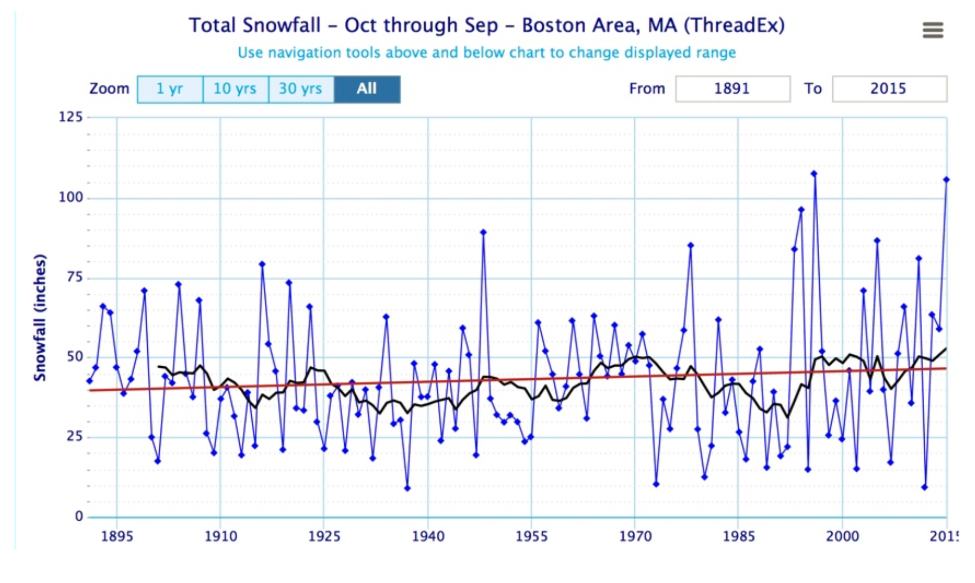
Time Series Graph

Slide 4
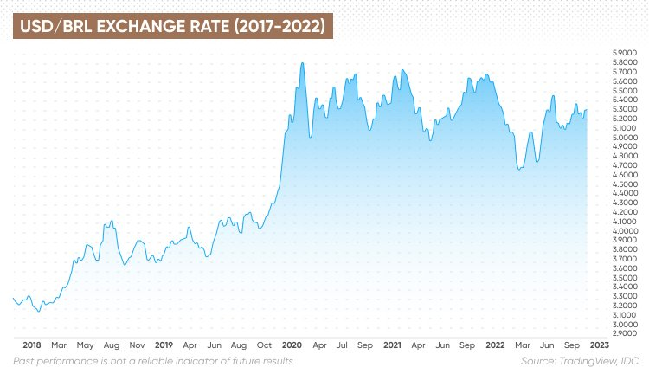
Time Series Graph

Slide 5
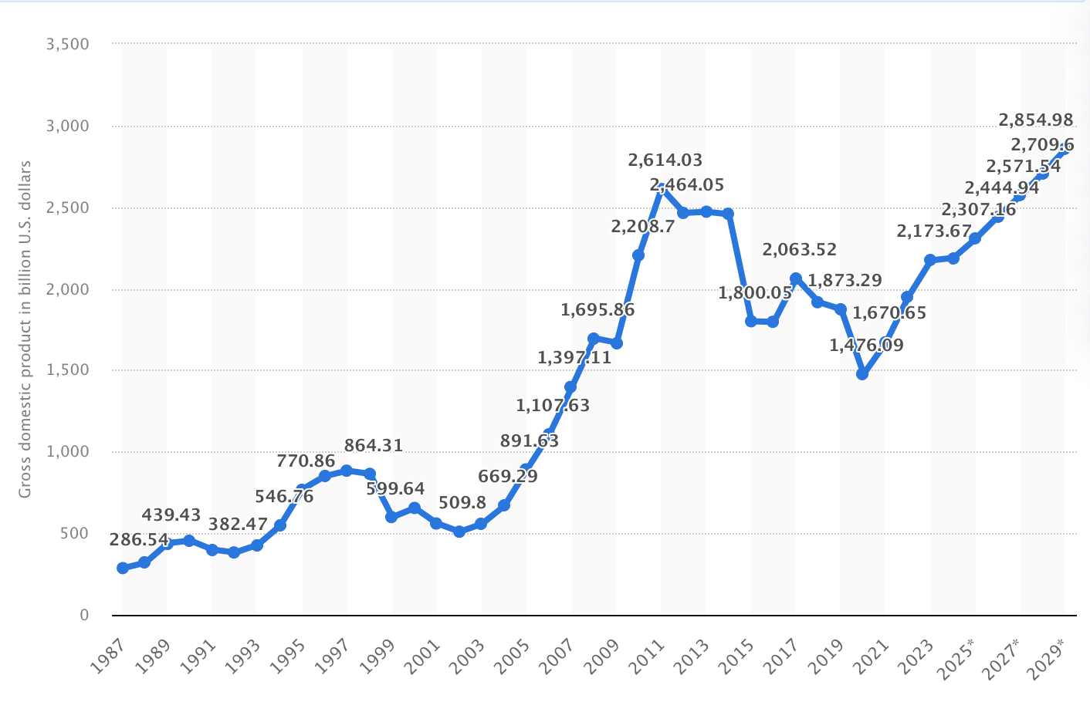
Time Series Graph with Forecasts

Slide 6
Time Series Data
Forecasting deals with time series data, where observations are collected sequentially over time.
The temporal aspect is key, and the order of data points matters.

Slide 7
Forecast Models
A forecasting model uses a sequence of values measuring some event over time (time series) and using the sequence to "estimate" the next few values in the sequence.
Forecasting solely focuses on the trend of the data values over time.
For example, if a real estate agent has average monthly home sales prices for the past fifteen years, they can use a forecasting model to "predict" the average sales price for the next few months.
But that "prediction" would not consider any other factors, so it would not be useful to predict the likely selling price for a specific home having a specific lot size, living area, pool, age of home, etc.

Slide 8
Forecasting Approaches
There are four general approaches:
  Time-Series Models: only values over time
  Causal Models: other factors
  Qualitative Models: subjective expert opinions
  Monte-Carlo Simulation: random simulations

Slide 9
Time Series Forecasting Strategies
Qualitative Models
Single and Wide-Band Delphi
Expert Judgment
Time-Series Models
Moving Average
Exponential Smoothing
Causal Models
Linear Regression
Multiple Regression
Non-Linear Regression
Bottom-Up Composite
Stakeholder Survey
Linear Trend Line
ARIMA

Slide 10
Time Series Forecasting Strategies
Qualitative Models
Single and Wide-Band Delphi
Expert Judgment
Time-Series Models
Moving Average
Exponential Smoothing
Causal Models
Linear Regression
Multiple Regression
Non-Linear Regression
Bottom-Up Composite
Stakeholder Survey
Linear Trend Line
ARIMA

Slide 11
Time-Series Models
Time-series models attempt to predict growth based on historical data.
Common time-series models are
  Simple and Weighted Moving Averages
  Linear Regression Trend Line
  ARIMA
  Exponential Smoothing
  Holt-Winters Method

Slide 12
Causal Models
Causal models take other factors into account and are often more accurate.
The objective is to build a model with the best statistical relationship between the variable being forecast and the independent variables.
Regression analysis is the most common technique used in causal modeling.

Slide 13
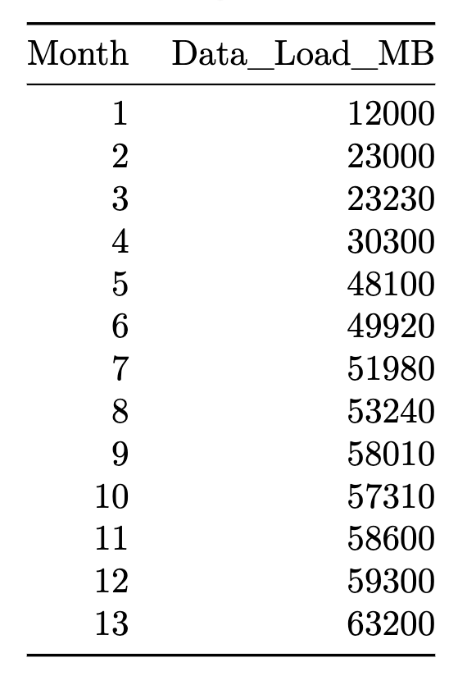
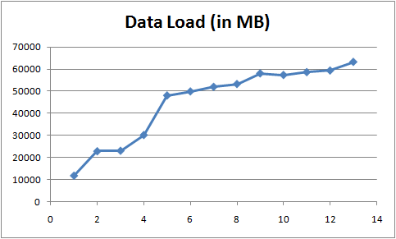
Forecasting Example
The data sample above represents the growing data load of a server farm at a large financial firm.

Slide 14
Key Steps in Creating a Forecasting Model

Slide 15
Key Steps
Define the Problem and Objectives
Collect and Prepare Data
Explore and Visualize the Data
Choose the Forecasting Method
Split the Data into Training and Testing Sets
Train and Tune the Model
Evaluate the Model Performance
Generate and Interpret Forecasts
Deploy the Model
Monitor and Improve the Model

Slide 16
Define the Problem and Objectives
Before starting with data analysis, it is essential to define the forecasting objective.
This includes identifying:
  the variable to forecast
  the forecasting horizon
  the required accuracy and evaluation metrics
  any domain-specific constraints or assumptions

Slide 17
Collect and Prepare Data
A forecasting model requires historical data.
The data preparation process involves:
  Data Collection: Gather relevant time-series data from sources such as databases, APIs, or spreadsheets.
  Data Cleaning: Handle missing values, remove outliers, and ensure consistency.
  Data Transformation: Convert data into a suitable format, such as aggregating daily data into monthly data.
  Feature Engineering: Create additional features such as lag variables, rolling averages, or external factors.

Slide 18
Explore and Visualize the Data
Before building a model, it is crucial to understand the data through:
  Time Series Plots to check trends, seasonality, and patterns.
  Autocorrelation Function (ACF) to identify lag dependencies.
  Decomposition: Splitting data into trend, seasonal, and residual components.

Slide 19
Choose the Forecasting Method
Several methods exist for time-series forecasting, ranging from statistical to machine learning approaches.

Slide 20
Statistical Methods
Naïve Forecasting: Uses the last observed value as the forecast.
Moving Averages: Computes the average over a fixed window to smooth fluctuations.
Exponential Smoothing (ETS): Uses weighted averages of past observations, adjusting for trends and seasonality.
ARIMA (Auto-Regressive Integrated Moving Average): A combination of autoregressive, differencing, and moving average components to model time series.

Slide 21
Machine Learning Methods
Random Forest or Gradient Boosting Models: Use lagged features as input predictors.
Neural Networks (LSTM, RNN): Learn temporal dependencies in the data. Facebook Prophet: A robust framework for automatic forecasting that accounts for seasonality and external events.

Slide 22
Split the Data
Use historical data to train the model.
Set aside recent observations as a test set to evaluate model performance.
Common split strategies include using a rolling window or time-based split instead of random shuffling.

Slide 23
Train and Tune the Model
Fit the chosen forecasting model to the training data.
Optimize hyperparameters (e.g., p, d, q values in ARIMA, learning rate in machine learning models, weights).
Perform cross-validation using techniques like time-series cross-validation.

Slide 24
Evaluate the Model Performance
After training, assess the model using appropriate metrics:
  Mean Absolute Error (MAE): Measures average absolute forecast errors.
  Mean Squared Error (MSE): Penalizes larger errors.
  Root Mean Squared Error (RMSE): Square root of MSE, providing error in the original unit.
  Mean Absolute Percentage Error (MAPE): Measures relative error as a percentage.
  Theil’s U Statistic: Compares the forecast performance against a naïve model.

Slide 25
Generate and Interpret Forecasts
Use the trained model to predict future values.
Interpret the forecasted values in the context of confidence intervals and potential uncertainty.
Visualize forecasts using line plots with prediction intervals.

Slide 26
Deploy the Model
If the model is found to be reliable, integrate it into a dashboard, web application, or automated system.
Schedule automatic updates to refresh forecasts with new data.

Slide 27
Monitor and Improve the Model
Regularly track forecast accuracy using real-time data.
Retrain models periodically to incorporate the most recent trends.
Adjust models based on feedback, new external factors, or business changes.

Slide 28
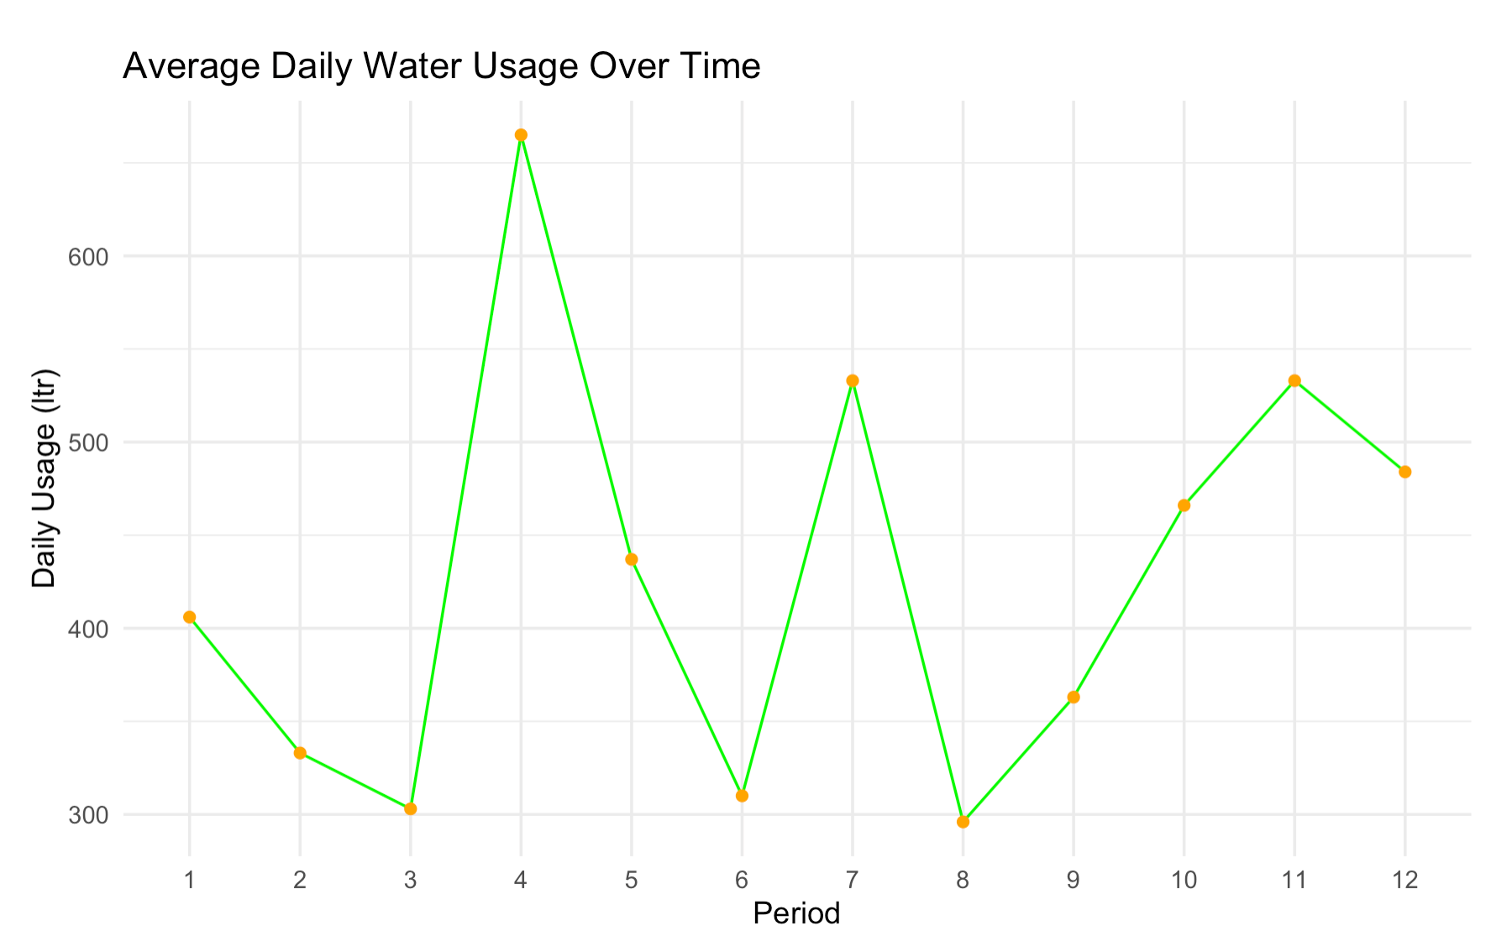
Practical Considerations

Slide 29
Weighted Average Models

Slide 30
Moving Average
Moving averages work best when the data does not contain any trend or cyclic patterns.
The forecast is the average of the most recent n data values, Y_{t}.
This method tends to smooth out short-term irregularities in the data series.

Slide 31
Example
Forecast for the next time period using a simple 3-month moving average.
F

Slide 32
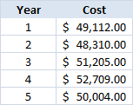
Try for Yourself Activity
  Software license costs for the past five years:
  What is your forecast for the next year using a simple 2-year moving average?
  Use a calculator, R, Python, or set up an Excel spreadsheet.

Slide 33
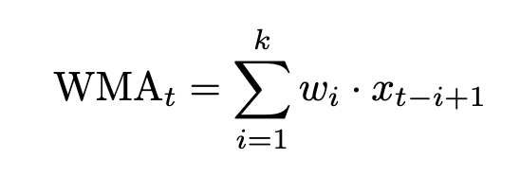
Weighted Moving Average
Given a time series 𝑋={𝑥₁,𝑥₂,...,𝑥_{𝑛}}, the weighted moving average with a window size of 𝑘 and weights 𝑊={𝑤₁,𝑤₂,...,𝑤_{𝑘}} is calculated as:

Slide 34
Example
Forecast for the next period using a 3-period weighted moving average with weights (0.1,0.3,0.6):
Weights must be between 0 and 1 and all weights must sum to 1.
𝐹 = (0.1)(58600)+(0.3)(59300)+
(0.6)(59300) = 59230

Slide 35
Selecting Weights
Start with equal weights (standard moving average) and then put progressively more weight on the most recent data.
Try different combinations of weights and calculate a model evaluation metric such as MSE, then choose the model with the weights that minimize MSE.

Slide 36
Workshop Activity
  Software license costs for the past five years:
  What is your forecast for the next year using a weighted 2-year moving average?
  Use a weight of 0.7 for the most recent year and a 0.3 for the other.

Slide 37

Code Demo

Slide 38
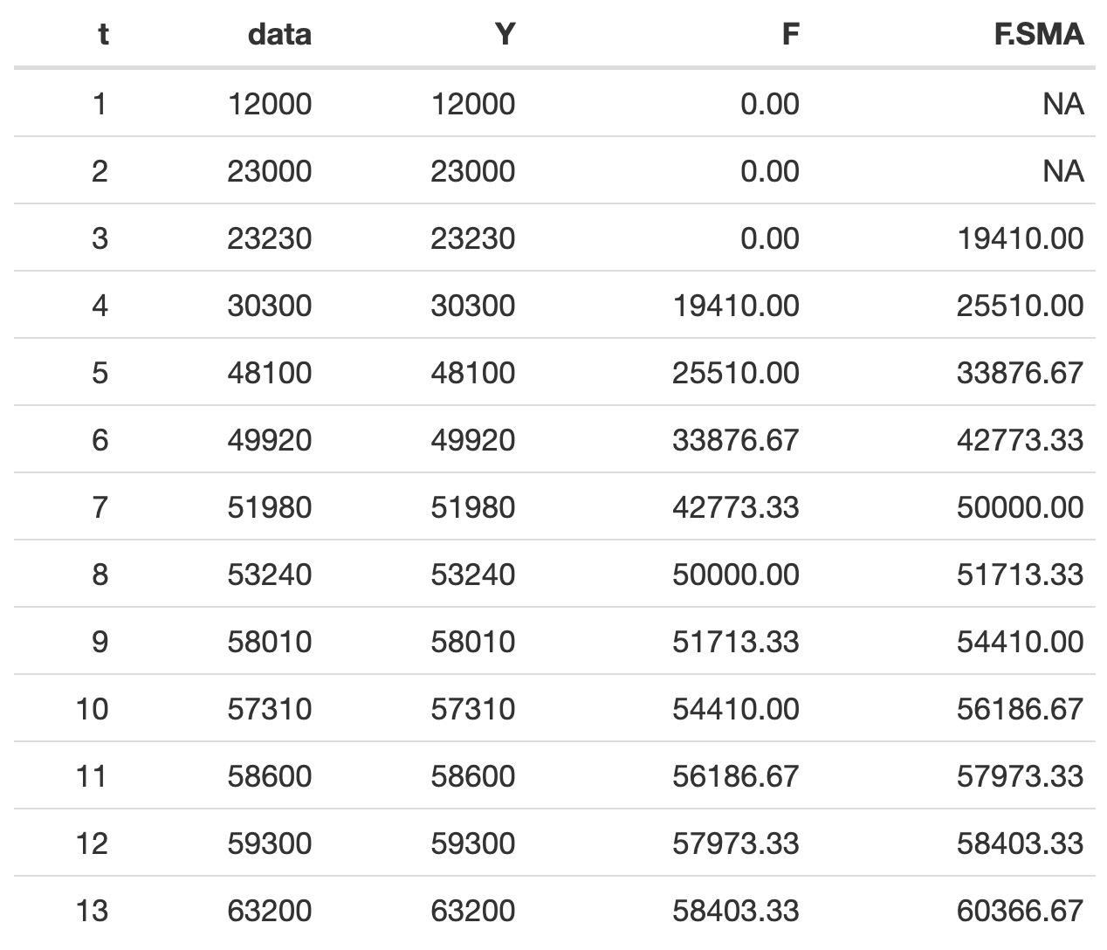
monthly.data.load <- data.frame(
period = 1:13,
data = c(12000, 23000, 23230, 30300,
48100, 49920, 51980,
53240, 58010, 57310,
58600, 59300, 63200)
)
library(TTR)
k <- 3
fc <- SMA(monthly.data.ts, n = k)
## forecast for "t+1" is in row for "t"
print(fc[nrow(monthly.data.load)])
tail(fc,1)
mean(c(58600, 59300, 63200))

Slide 39
Method II:
Recursive Smoothing Models

Slide 40
Exponential Smoothing
The smoothing constant (α) is the percentage by which the forecast takes into account the most recent data point.
Start with a smoothing constant α = 0.3 and then adjust the model.
Bootstrap the model by using the first data point as the forecast for the first time period.

Slide 41
Example
Forecast for the next time period using exponential smoothing with α = 0.3.
 | α = | 0.3
Month | Data Load (in MB) | F(t) | Error
Oct-09 | 12000 | 12000.0 | 0.0
Nov-09 | 23000 | 12000.0 | 11000.0
Dec-09 | 23230 | 15300.0 | 7930.0
Jan-10 | 30300 | 17679.0 | 12621.0
Feb-10 | 48100 | 21465.3 | 26634.7
Mar-10 | 49920 | 29455.7 | 20464.3
Apr-10 | 51980 | 35595.0 | 16385.0
May-10 | 53240 | 40510.5 | 12729.5
Jun-10 | 58010 | 44329.3 | 13680.7
Jul-10 | 57310 | 48433.5 | 8876.5
Aug-10 | 58600 | 51096.5 | 7503.5
Sep-10 | 59300 | 53347.5 | 5952.5
Oct-10 | 63200 | 55133.3 | 8066.7
Nov-10 |  | 57553.3

Slide 42
Group Workshop Activity
  Software license costs for the past five years:
  What is your forecast for the next year using exponential smoothing with an α = 0.4?
  Use a computer program for this calculation.

Slide 43
Holt’s Method
Holt’s Method adds a trend component to exponential smoothing to produce a second-order model.
High values for β makes the model more responsive to recent changes in trend.

Slide 44
Example: Holt’s Method
This model takes a linear trend into account.
 | α = | 0.3 | β = | 0.2
Month | Data Load (in MB) | FwT(t) | Error | T
Oct-09 | 12000 | 12000.0 | 0.0 | 0
Nov-09 | 23000 | 12000.0 | 11000.0 | 0
Dec-09 | 23230 | 15300.0 | 7930.0 | 0
Jan-10 | 30300 | 17679.0 | 12621.0 | 660
Feb-10 | 48100 | 22125.3 | 25974.7 | 475.8
Mar-10 | 49920 | 30393.5 | 19526.5 | 1417.26
Apr-10 | 51980 | 37668.7 | 14311.3 | 2034.282
May-10 | 53240 | 43996.4 | 9243.6 | 2588.849
Jun-10 | 58010 | 49358.3 | 8651.7 | 2892.959
Jul-10 | 57310 | 54846.8 | 2463.2 | 3143.466
Aug-10 | 58600 | 58729.2 | -129.2 | 3412.06
Sep-10 | 59300 | 62102.5 | -2802.5 | 3291.259
Oct-10 | 63200 | 64553.0 | -1353.0 | 3404.307
Nov-10 |  | 67551.4

Slide 45
Trend Line
Regression Models

Slide 46
Regression Models Predict
Regression models are a mathematical equation used to predict a value based on empirical observations.
The prediction is never correct, but, depending on the “fit of data,” it can be reasonably good.
Dependent variable
Independent variable
Independent variable
= +

Slide 47
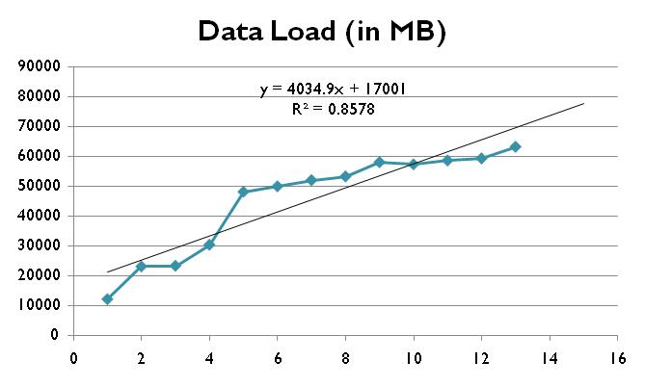

Linear Regression Trend Line
Forecast next period using a linear regression trend line:
$$F_{t+1}=mt+b$$

Slide 48
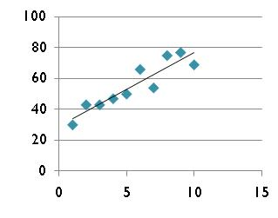
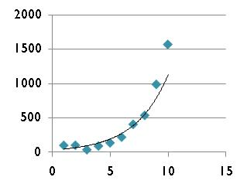
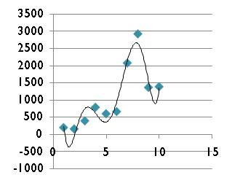
Non-Linear Regression Models
Often the data follows a non-linear pattern, i.e., the model is not a line.
Linear Model
Exponential Model
Polynomial Model

Slide 49
Code Demo

Slide 50
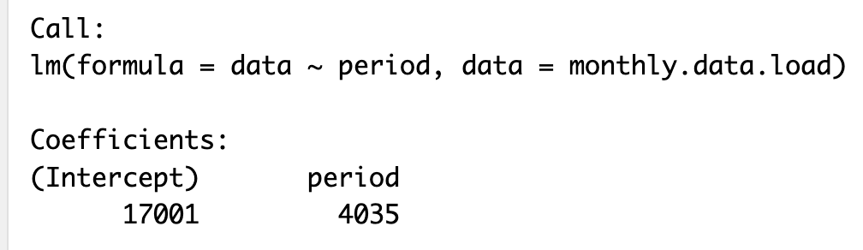

monthly.data.load <- data.frame(
period = 1:13,
data = c(12000, 23000, 23230, 30300,
48100, 49920, 51980,
53240, 58010, 57310,
58600, 59300, 63200)
)
$$F_{t+1}=4035(t)+17001$$
# fit a linear trend model using linear regression
trend.model <- lm(formula = data ~ period,
data = monthly.data.load)
# Forecast future values using the trend model
forecast.val <- predict(trend.model,
newdata = data.frame(period = 14))

Slide 51
Lesson 5:
Stochastic Models

Slide 52
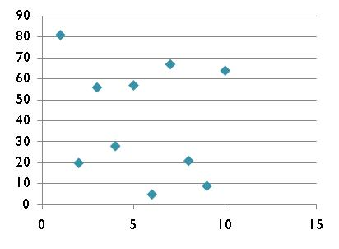
Random Patterns
There may be no discernible trend in the data that can be modeled with a mathematical equation.
In those cases, a Monte-Carlo simulation is better approach than regression.

Slide 53
Simulation
When there are significant variations in the historical data and there is no clear trend, then a Monte-Carlo simulation model works best.
General simulation approach:
  Construct an empirical probability distribution from the historical data points
  Create a random number range based on the probability distribution
  Generate a random number and use it as an index into the random number range

Slide 54
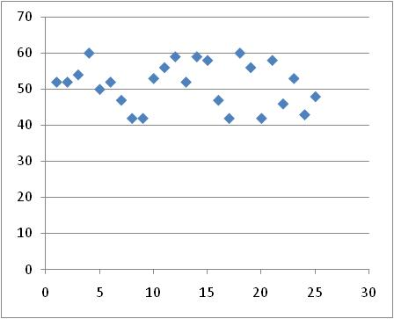
Probability Distribution
Consider this history of calls to a call center and the call distribution:
Average Number of Calls | Frequency | Probability | Cumulative Probability
44 | 5 | 0.20 | 0.20
47 | 3 | 0.12 | 0.32
50 | 2 | 0.08 | 0.40
53 | 6 | 0.24 | 0.64
56 | 3 | 0.12 | 0.76
59 | 6 | 0.24 | 1.00

Slide 55
Random Number Interval
Create random number intervals for each bin whose size is relative to the frequency:
Average Number of Calls | Frequency | Probability | Cumulative Probability | Random Number Range
44 | 5 | 0.20 | 0.20 | 00 - 20
47 | 3 | 0.12 | 0.32 | 21 - 32
50 | 2 | 0.08 | 0.40 | 33 - 40
53 | 6 | 0.24 | 0.64 | 41 - 64
56 | 3 | 0.12 | 0.76 | 65 - 76
59 | 6 | 0.24 | 1.00 | 77 - 99

Slide 56
Simulate Forecast Value
Pick a random number between 0 and 99 using a computer or a random number table.
Use the random number as an index into the random number interval.
Average Number of Calls | Random Number Range
44 | 00 - 20
47 | 21 - 32
50 | 33 - 40
53 | 41 - 64
56 | 65 - 76
59 | 77 - 99
Random Number: 41
Forecast: 53

Slide 57
Expected Value
The average value is the expected value of the probability distribution:
So, the average expected number of calls per day would be 52.

Slide 58
Model Evaluation

Slide 59
Model Evaluation
A good model should “fit the data” with only a small error (deviation).
Common measures of forecast model accuracy:
  Mean Absolute Deviation (MAD/MAE)
  Mean Squared Error (MSE)
  Mean Absolute Percentage Error (MAPE)
  Root Mean Squared Error (RMSE)

Slide 60
Mean Absolute Deviation
The MAD is the average absolute error – just positive values without regard to over- or under predictions.

Slide 61
Model Selection
Select the model with the smallest overall error measure be it either MAD or MSE.
Make sure that bias is small as well.
For regression models evaluate Adjusted R² and statistical significance of overall model as well as each variable.

Slide 62
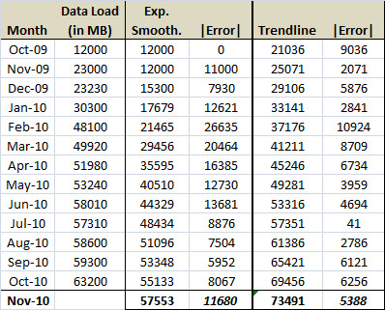
Example: MAD Calculation
Comparing two models using the MAD:
|Error| = 23000 – 25071 = 2071
MAD = Average of absolute all errors
Forecast with Exponential Smoothing (α=0.3) and corresponding MAD
Forecast with Trendline Projection and corresponding MAD

Slide 63
Mean Squared Error
The MSE is the average squared error – just positive values without regard to over- or under predictions.
Large errors are accentuated in this method.

Slide 64
Other Model Evaluation Approaches
Aside from MAD and MSE there are other ways to evaluate the fit of a model:
  Median Error – outliers have less influence
  Mean Percentage Error – normalizes magnitude of errors and focuses on relative size of error
  Mean Absolute Percentage Error – shows relative size of error

Slide 65
Caution: Other Definitions of MAD
The acronym MAD is also often used to describe central tendency of a data set.
In this definition of the MAD it represents the average distance from the mean of a set of data value.
CAUTION: This is not the same definition that is used in predictive modeling to assess fit of a model.

Slide 66
Group Workshop Activity
  Calculate the MAD for the previous two forecast estimates.
  Which model would be preferable?

Slide 67
Forecast Interval

Slide 68
Standard Deviation of Estimates
The standard deviation of the forecast errors is:
This can be used to estimate the 95% forecast (prediction) interval.
http://onlinestatbook.com/2/regression/accuracy.html

Slide 69
Forecast Range
A forecast should be given as a range.
The range to provide is the 95% Prediction Interval, i.e., the range into which there is a 95% probability that the actual value will fall.

Slide 70
Example: Forecast Range
The range for exponential smoothing forecast of 57553 with a MAD of 11680 would be calculated as follows:
The range for the forecast would therefore be from 39239 to 75867.

Slide 71
Group Workshop Activity
  What is the 95% prediction interval for the weighted moving average forecast?

Slide 72
Tracking Signal
Forecasting models must be continually evaluated to assure that they still provide accurate forecast estimates.
The tracking signal (TS) is a measure of the quality of the forecasts:

Slide 73
Interpretation of TS
Interpretation of the tracking signal:
  Positive: under prediction (Y > F)
  Negative: over prediction (Y < F)
Tracking signals should not exceed ±4 MADs.

Slide 74
Cyclical Adjusted Models

Slide 75
Cyclical Fluctuations
Often there are seasonal (cyclical) variations in growth, demand, or costs.
Averaging techniques fail to take fluctuations into account.
Those can be accounted for with a seasonality adjustment to the forecast or a multiple regression model with season as a factor.

Slide 76
Example
Inbound calls into a call center on a quarterly basis over 4 years with quarterly fluctuations.
 | Year
Quarter | 1 | 2 | 3 | 4
1 | 218 | 225 | 234 | 250
2 | 247 | 254 | 265 | 283
3 | 243 | 255 | 264 | 289
4 | 292 | 299 | 327 | 356

Slide 77
Seasonality Adjustment
A common model is to adjust the forecast by multiplying with a seasonality index.
This is a multiplicative model.
The seasonality index measures how much above or below each "season" is relative to an average season.
A season is simply a cycle in the business, not an actual season like Winter.

Slide 78
Procedure for Seasonality
For each season, calculate the average.
For each time period, divide the actual seasonal demand by the average seasonal demand. This ratio is the seasonality index for that quarter.
Compute the average seasonality index for each season.
Calculate a forecast for the entire next time period and then divide that by the number of seasons to get an average.
Multiply the average by the seasonality index for that season.

Slide 79
Example: Seasonality Index
 | Year
Quarter | 1 | 2 | 3 | 4
1 | 218 | 225 | 234 | 250
2 | 247 | 254 | 265 | 283
3 | 243 | 255 | 264 | 289
4 | 292 | 299 | 327 | 356
Avg | 250 | 258.3 | 272.5 | 294.5
Seasonality Index = Actual / Average
SI_{Q1Y4} = 250 / 294.5 = 0.85
Average # Calls per Year
Quarter | 1 | 2 | 3 | 4 | Avg
1 | 0.87 | 0.87 | 0.86 | 0.85 | 0.86
2 | 0.99 | 0.98 | 0.97 | 0.96 | 0.98
3 | 0.97 | 0.99 | 0.97 | 0.98 | 0.98
4 | 1.17 | 1.16 | 1.20 | 1.21 | 1.18
Seasonality Indices Per Quarter and Average Seasonality Indices

Slide 80
Example: Seasonal Forecast
Forecast for the following time period using preferred forecasting method.
Example:
  Forecast for quarter 1 of year 5 using a linear regression trend line that takes the growth trend into account would be 311
  Adjusted with quarter 1’s average seasonality index of 0.86, the forecast becomes 311 × 0.86 = 267

Slide 81
Group Workshop Activity
  What is the forecast for Q4 assuming that a trendline predicts 392?

Slide 82
Multiple Regression
Use multiple regression to account for cycles (seasons) as well as trend:
  Turn the cycle (season) component into a dummy variable
  Build the regression model
  Evaluate the fit with Adjusted R² and MAD
This is an additive model rather than a multiplicative model.

Slide 83
Example (cont.)
Flatten data and add Quarter column.
Time Period | Calls | Quarter
1 | 218 | 1
2 | 247 | 2
3 | 243 | 3
4 | 292 | 4
5 | 225 | 1
6 | 254 | 2
7 | 255 | 3
8 | 299 | 4
9 | 234 | 1
10 | 265 | 2
11 | 264 | 3
12 | 327 | 4
13 | 250 | 1
14 | 283 | 2
15 | 289 | 3
16 | 356 | 4

Slide 84
Example (cont.)
Create dummy variables for the quarter column:
  1 variable less than number of categories
  4 quarters = 3 dummy variables
Time Period | Calls | Q1 | Q2 | Q3
1 | 218 | 1 | 0 | 0
2 | 247 | 0 | 1 | 0
3 | 243 | 0 | 0 | 1
4 | 292 | 0 | 0 | 0
5 | 225 | 1 | 0 | 0

Slide 85
Interpreting Excel Multiple Regression Results
Regression Statistics
Multiple R | 0.98
R Square | 0.97
Adjusted R Square | 0.96
Standard Error | 7.67
Observations | 16.00
ANOVA
 | df | SS | F | Significance F
Regression | 4 | 20055.2 | 85.21107 | 3.34E-08
Residual | 11 | 647.2
Total | 15 | 20702.4
 | Coeff. | SE | P-value
Intercept | 281.56 | 5.75 | 3.18E-14
Time Period | 3.69 | 0.43 | 3.212E-06
Q1 | -75.67 | 5.57 | 3.246E-08
Q2 | -48.86 | 5.49 | 2.343E-06
Q3 | -52.06 | 5.44 | 1.148E-06
Values close to 1 are ideal, but anything above 0.7 is strong in practice
Important for calculating the 95% confidence interval
Regression model
Must be less than 0.05 to be statistically significant
Coefficient’s p-values must be less than 0.05 otherwise they must be omitted from the model

Slide 86
Example (cont.)
Final model:
Make forecasts with model:
  Quarter 1 for Year 5 (Time Period = 17)
Y = 281.6 + 3.69(T) - 75.7(Q1) - 48.9(Q2) - 52.1(Q3)
 | Coeff.
Intercept | 281.56
Time Period | 3.69
Q1 | -75.67
Q2 | -48.86
Q3 | -52.06
Y = 281.6 + 3.69(17) - 75.7(1) - 48.9(0) - 52.1(0)
Y = 269

Slide 87
Group Workshop Activity
  What is the difference between the additive and the multiplicative seasonality modeling approaches?
  Which is better?
  Why and when would you prefer one over the other?

Slide 88
Forecast Range
Instead of a value, we can calculate a likely range for the forecast.
The 95% CI is the range into which the actual forecast will fall with a 95% likelihood:
SE is the standard error:
  On the regression output, or
  Calculable from the MAD

Slide 89
Example
To calculate the 95% confidence interval for the previous prediction for Q1 Y5:
So, the range into which our forecast falls with 95% certainty is from 254 to 284.
It is generally better to provide a range for a forecast rather than a single value.

Slide 90
Group Workshop Activity
  Forecast the estimated number of incoming calls for quarter 2 of year 5.
  What is the 95% confidence interval for your forecast?

Slide 91
Lesson 8:
Multiple Regression Models

Slide 92
Models with Multiple Factors
Often a dependent variable that is to be predicted is based on more than one independent predictor variable.
Multiple regression helps to capture multiple variables and often result in a more valuable forecast.
Some examples:
  models that establish compensation
  predicting pension income
  explain variations in home sales prices
  establish pay guidelines for new hires
  forecast student performance and likelihood of success

Slide 93

Walkthrough of the Steps
Problem: Can we develop a model that allows predicting the annual pay of an individual based on years of experience and/or grade level?
Dependent Variable
Independent Variable x₁
Independent Variable x₂
Data ID | Annual Salary | Years Experience | Grade Level
1 | $ 41,100 | 6 | 3
2 | $ 37,500 | 14 | 3
3 | $ 29,870 | 11 | 3
4 | $ 23,430 | 3 | 4
5 | $ 45,180 | 18 | 2
6 | $ 24,900 | 8 | 4
7 | $ 19,800 | 6 | 4
8 | $ 13,120 | 5 | 5
9 | $ 14,900 | 2 | 5
10 | $ 23,400 | 10 | 4
11 | $ 79,900 | 14 | 1
Annual Salary is based on two factors (independent variables).
Steps:
plot the variables
identify outliers
is relationship linear?
create regression model
evaluate p-values
calculate forecast
define confidence interval
SalaryData.xlsx

Slide 94
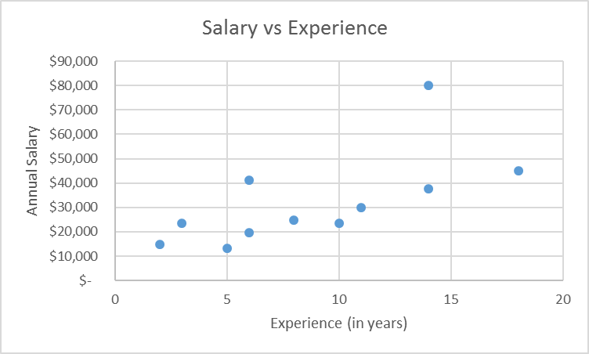
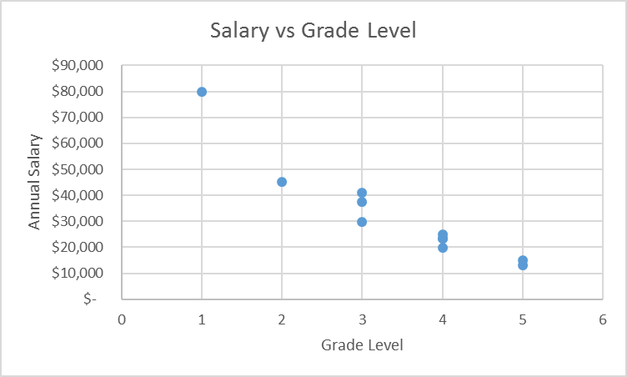
Scatter Plots & Outliers
President’s salary; exclude?
Both independent variables visually allude to a relationship. This is confirmed through a correlation analysis with Salary vs Experience having an R = 0.67 (R = 0.74 with outlier removed) and Salary vs Grade Level having an R = -0.95.

Slide 95
Identify Outliers
=(B2-B$15)/B$14
Data ID | Annual Salary | SD from Mean | Years Experience | Grade Level
1 | $ 41,100 | 0.48 | 6 | 3
2 | $ 37,500 | 0.29 | 14 | 3
3 | $ 29,870 | -0.12 | 11 | 3
4 | $ 23,430 | -0.46 | 3 | 4
5 | $ 45,180 | 0.69 | 18 | 2
6 | $ 24,900 | -0.38 | 8 | 4
7 | $ 19,800 | -0.65 | 6 | 4
8 | $ 13,120 | -1.00 | 5 | 5
9 | $ 14,900 | -0.91 | 2 | 5
10 | $ 23,400 | -0.46 | 10 | 4
11 | $ 79,900 | 2.53 | 14 | 1
Std Dev | $ 18,924 |  | 5.06 | 1.21
Mean | $ 32,100 |  | 8.82 | 3.45
President’s salary is almost 3 standard deviations from the mean so it should be considered an outlier
=AVERAGE(B2:B12)
=STDEV.S(B2:B12)

Slide 96
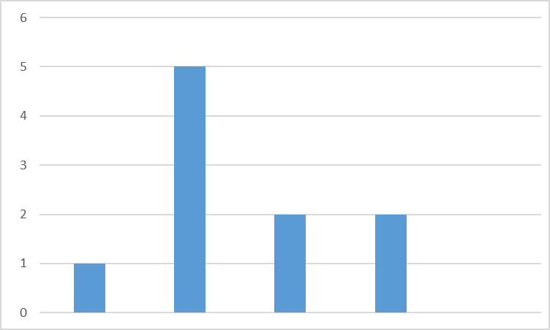
Establish Normality
Based on the histogram, the data is reasonably distributed (assuming that the outlier of data item 11 is excluded).

Slide 97
Quick Summary of Analysis Steps
For each pair of dependent and independent variables, ask:
  Is there reasonably strong correlation?
  Is the correlation positive or negative?
  Are there outliers and should they be excluded?
  Is the relationship linear, i.e., is it along a line?
  Does the scatter plot reflect what you expect?
  Is the data reasonably normally distributed?

Slide 98

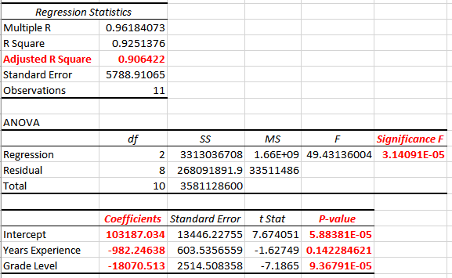
Develop the Regression Model
fit of model; must be close to 1; defines predictive power of model; this model has good predictive power
this value must be < 0.05; it indicates whether the model is statistically significant; if it’s > 0.05 then there’s not enough data to build a model
the p-values must be < 0.05 for each variable that is a significant factor in the prediction; if > 0.05 then it must be excluded
coefficients of the model:
y = 103187 – 982.2x₁ – 18070.5x₂

Slide 99

Develop the Regression Model
> df <- read.table(file="SalaryData.csv",sep=",",header=TRUE,stringsAsFactors=FALSE)
> pred <- lm(Salary ~ Exp + Level, df)
> summary(pred)
Call:
lm(formula = Salary ~ Exp + Level, data = df)
Residuals:
Min 1Q Median 3Q Max
-8301 -4357 1853 3174 8535
Coefficients:
Estimate Std. Error t value Pr(>|t|)
(Intercept) 103187.0 13446.2 7.674 5.88e-05 ***
Exp -982.2 603.5 -1.627 0.142
Level -18070.5 2514.5 -7.186 9.37e-05 ***
---
Signif. codes: 0 ‘***’ 0.001 ‘**’ 0.01 ‘*’ 0.05 ‘.’ 0.1 ‘ ’ 1
Residual standard error: 5789 on 8 degrees of freedom
Multiple R-squared: 0.9251, Adjusted R-squared: 0.9064
F-statistic: 49.43 on 2 and 8 DF, p-value: 3.141e-05
>

Slide 100
Making Predictions
> pred$coefficients
(Intercept) Exp Level
103187.0344 -982.2464 -18070.5126
> sal <- pred$coefficients[[1]] + pred$coefficients[[2]]*(11) + pred$coefficients[[3]]*(2)
> sal
[1] 56241.3

Slide 101
Evaluate p-Values of Variables
Each independent variable must be a factor in the model and have a statistically significant impact on the prediction.
If a variable’s p-value is less than 0.05 then it is not statistically significant and must be removed from the model to avoid overfitting.
The threshold of 0.05 is somewhat arbitrary but generally accepted in the analytics community.
However, the non significance of the variable “Years of Experience” could be due to the presence of outliers, so the model should be re-built without outliers.

Slide 102
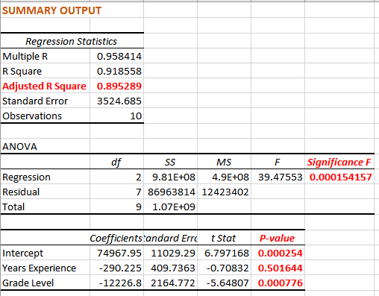
New Model with Outliers Removed
Data item 11 was found to be an outlier, so a new model is generated with that data item excluded.
still a good model
still significant
not all p-values are < 0.05 and thus should be excluded from the model
coefficients of the new model:
y = 74968 – 290x₁ – 12227x₂

Slide 103
Prediction with Model
The predictive model is:
y = 74968 – 290x₁ – 12227x₂
or
Salary = 74968 – 290(Year Experience) – 12227(Grade)
So the expected salary of someone with 11 years of experience hired as a Director would be:
y = 74968 – 290(11) – 12227(2) = 47,322

Slide 104
95% Prediction Interval
From the regression output, the Standard Error (SE) is 3525.
95% CI is y ± 1.96(SE)
so
95% CI is 47322 ± 1.96(3525)
This implies that the likely salary for a person hired with 11 years of experience as a Director can be expected, with a 95% probability, to be in the range from $40,414 to $54,230.

Slide 105
Making Predictions

Slide 106
Developing a Regression Model
Steps for developing a regression model:
specify the variable that is to be predicted
generate the independent variables that are thought to influence the dependent variable
collect data and inspect the data for outliers
visually inspect the relationships between the independent and dependent variables to ensure there’s correlation
create a multiple regression model from the coefficients
evaluate the model by interpreting its Adjusted R², and the p values of the regression variables
remove any non-significant variables and create a new model
use the model to calculate a forecast with a confidence interval

Slide 107
Simplifying Regression Models
One approach to simplifying multiple regression equations are the stepwise procedures which add or remove variables one-at-a-time until some stopping rule is satisfied.
  Forward selection starts with an empty model. The variable that has the smallest p-value when it is the only predictor in the regression equation is placed in the model. Each subsequent step adds the variable that has the smallest p-value in the presence of the predictors already in the equation. Variables are added one-at-a-time as long as their p-values are less than 0.05.
  Backward elimination starts with all of the predictors in the model. The variable that is least significant – that is, the one with the largest p-value – is removed and the model is refitted. Each subsequent step removes the least significant variable in the model until all remaining variables have individual p-values < 0.05.
  Stepwise regression is similar to forward selection except that variables are removed from the model if they become nonsignificant as other predictors are added.

Slide 108
Evaluating a Regression Model
Adjusted R² > 0.7?
Significance F < 0.05?
Model is not statistically valid. Get more data points and try again.
Yes
No
Yes
No
p-value of each variable
< 0.05?
Remove each variable with p-value > 0.05 and run regression again and then re-evaluate.
Model is not strong enough to make useful predictions. Build a different model.
No
Yes
Good model.
Start using it.

Slide 109
Lesson 9:
Choosing a Model

Slide 110
Choosing a Predictive Model
[random fluctuations]
Stochastic
Model
Additive Regression Model with Dummy Variables
Collect Data
[seasonality present]
Seasonality Adjusted Model
Multiplicative Model with Seasonality Index
[no seasonality]
[multiple variables]
Multiple Regression Model
[single variable]
Simple Linear Regression or Second-Order Smoothing Model
[non-linear trend]
[linear trend]
Non-Linear Regression Model
[no trend]
Moving Average or Exponential Smoothing Model

Slide 111
Summary
In this module we learned that:
  moving average and exponential smoothing work best when there is little upward trend and small variations
  regression is a good forecasting model when there are trends
  simulation works best when there are random fluctuations in the historical data and there is no clear trend
  multiple regression models can take seasonal cycles into account

Slide 112

Summary, Review, & Questions…

