Slide 1

Understanding Probabilistic Classification with Naïve Bayes
DA5030: Introduction to Data Mining & Machine Learning
Martin Schedlbauer, PhD
m.schedlbauer@neu.edu

Slide 2
Understanding probabilistic classification using naïve bayes
Classification Algorithms

Slide 3
Bayesian Methods for Classification
Classifiers based on Bayesian methods determine empirical probabilities of each outcome based on frequencies of feature values.
When the classifier is then applied to unlabeled cases, it uses the empirical probabilities to predict the most likely class for the new case.

Slide 4
Application of Bayesian Classifiers
Bayesian Classifiers are commonly used for:
  Text classification, e.g., junk message filtering
  Intrusion of anomaly detection in security
  Diagnosis of medical conditions based on observed symptoms
Bayesian methods work best when the features are categorical or can be binned into categories.

Slide 5
Feature Inclusion
Bayesian methods use all features simultaneously, like kNN, but unlike regression where features with weak effects are omitted.
Bayesian classifiers also assume that the features are independent, which is not often the case in practice.
However, the method still works remarkably well.

Slide 6

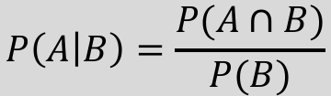
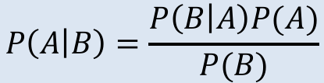
Bayes’ Theorem
The probability of dependent events can be described as follows:
$$P\left(A | B\right)=\frac{P(A∩B)}{P(B)}$$
Rearranging, we can write is as:
$$P\left(A∩B\right)=P\left(A | B\right)P(B)$$
Commutativity gives us:
$$P\left(A∩B\right)=P\left(B∩A\right)=P\left(B | A\right)P(A)$$
So, Bayes’ Theorem can be formulated as:
$$P\left(A | B\right)=\frac{P\left(B | A\right)P(A)}{P(B)}$$

Slide 7
Bayes for Spam Filtering
Without any additional knowledge, an incoming message’s probability that it is spam, P(spam), would be calculated as the frequency of spam messages out of all messages.
For example, if we inspect all incoming traffic over some time period and we received 572 spam message in a total of 3488 message, then
P(spam) = 572/3488 = 0.164
This is the prior probability and our current best guess that a new message is spam.

Slide 8
Additional Evidence
Suppose that you inspect the previously classified spam messages for certain key words such as “Rolex” and calculate that frequency, then you would have an estimate for P(Rolex|spam).
For example, let’s say that out of the 572 spam message, 327 contained the word Rolex, then
P(Rolex|spam) = 0.572
Lastly, determine the frequency with which Rolex occurred in all messages which is P(Rolex) .

Slide 9
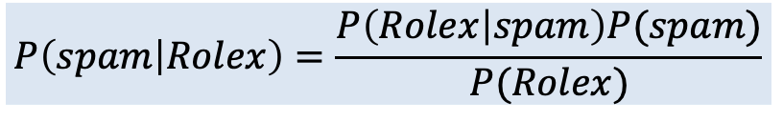
Estimating the Posterior Probability
Applying Bayes’ Theorem allows us to calculate the posterior probability:
$$P\left(spam | Rolex\right)=\frac{P\left(Rolex | spam\right)P(spam)}{P(Rolex)}$$

Slide 10
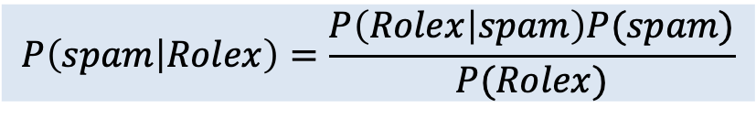
Estimating the Posterior Probability
Applying Bayes’ Theorem allows us to calculate the posterior probability:
Likelihood
Prior Probability
$$P\left(spam | Rolex\right)=\frac{P\left(Rolex | spam\right)P(spam)}{P(Rolex)}$$
Posterior Probability
Marginal Likelihood

Slide 11
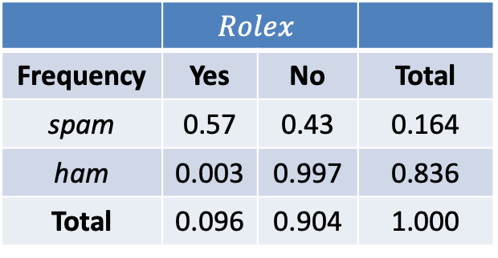
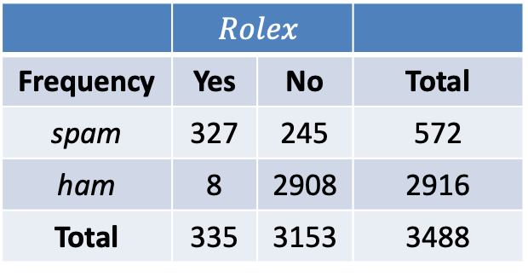
Frequency & Likelihood Tables
To calculate the components, it helps to build two tables:
 | $$Rolex$$
Frequency | Yes | No | Total
spam | 327 | 245 | 572
ham | 8 | 2908 | 2916
Total | 335 | 3153 | 3488
 | $$Rolex$$
Frequency | Yes | No | Total
spam | 0.57 | 0.43 | 0.164
ham | 0.003 | 0.997 | 0.836
Total | 0.096 | 0.904 | 1.000
Frequency Table
Likelihood Table

Slide 12
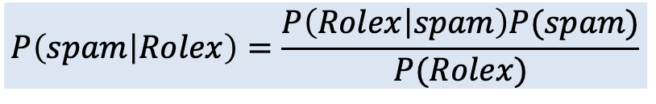
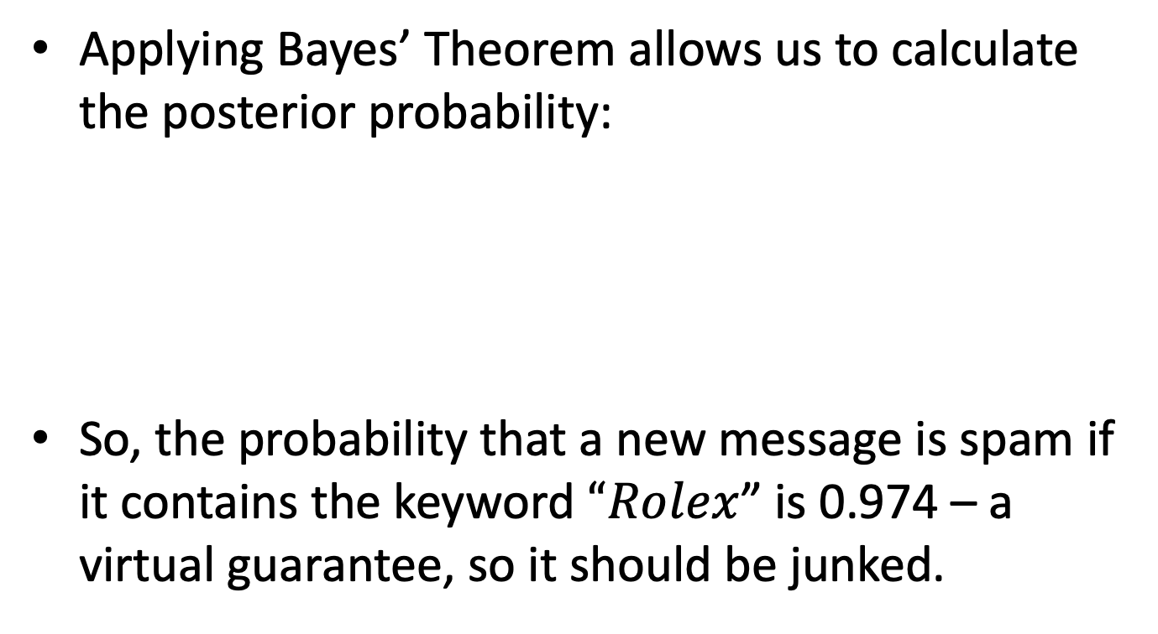
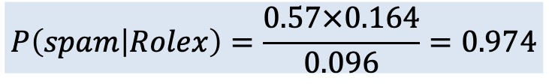
Estimating the Posterior Probability
Applying Bayes’ Theorem allows us to calculate the posterior probability:
So, the probability that a new message is spam if it contains the keyword $“Rolex$” is 0.974 – a virtual guarantee, so it should be junked.
$$P\left(spam | Rolex\right)=\frac{P\left(Rolex | spam\right)P(spam)}{P(Rolex)}$$
$$P\left(spam | Rolex\right)=\frac{0.57×0.164}{0.096}=0.974$$

Slide 13
The Naïve Bayes Algorithm
Probabilistic Classification

Slide 14
Naïve Bayes Algorithm
A common algorithm for text classification, but not the only one.
Strengths | Weaknesses
Simple, fast, and effective Accommodates noisy and missing data Scales well and works with even relatively small training data sets Estimated probabilities are fast and easy to estimate | Relies on assumption that features are independent and equally important Not well suited to data sets with numeric features Estimated probabilities may not be reliable

Slide 15
Additional Likelihoods
Bayes’ Theorem can be extended to account for multiple likelihoods and marginal probabilities to arrive at a better estimate of the posterior probability.
If you have multiple keywords W₁ through W_{n}, then the posterior probability is:
$$P\left(spam | W_{1}∩W_{2}∩…{∩W}_{n}\right)=\frac{P\left(W_{1}∩W_{2}∩…{∩W}_{n} | spam\right)P(spam)}{P(W_{1}∩W_{2}∩…{∩W}_{n})}$$

Slide 16
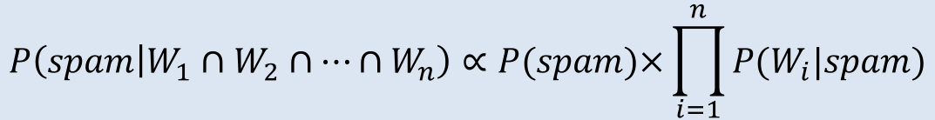
Class-Conditional Independence
The previous formula is difficulty to compute for large numbers of keywords but can be simplified when we assume class-conditional independence.
$$P\left(spam | W_{1}∩W_{2}∩…{∩W}_{n}\right)∝P(spam)×\prod_{i=1}^{n}{P(W_{i}|spam)}$$

Slide 17
Multiple Keyword Example
Suppose that the training data set contains additional monitoring keywords in addition to Viagra, including Money, Groceries, and Unsubscribe.
As new messages come in, we need to calculate the posterior probability that they are spam.

Slide 18
Sample Likelihood Table
An analysis of the labeled training data set reveals the following likelihoods:

Slide 19
Classifying a New Message
Suppose a new message was received that contains the terms Rolex and Unsubscribe, but not Money or Groceries.
  What is the probability it is spam and should be directed to the junk folder?

Slide 20
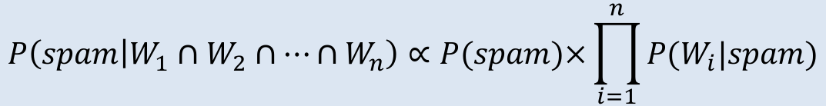
$$P\left(spam | W_{1}∩{¬W}_{2}∩{¬W}_{3}{∩W}_{4}\right)=\frac{P\left(W_{1}∩{¬W}_{2}∩{¬W}_{3}{∩W}_{4} | spam\right)P(spam)}{P(W_{1}∩{¬W}_{2}∩{¬W}_{3}{∩W}_{4})}$$
$$P\left(spam | W_{1}∩W_{2}∩…{∩W}_{n}\right)∝P(spam)×\prod_{i=1}^{n}{P(W_{i}|spam)}$$
$$P\left(spam | W_{1}∩{¬W}_{2}∩{¬W}_{3}{∩W}_{4}\right)=P(spam)P(W_{1}|spam)P({¬W}_{2}|spam)P({¬W}_{3}|spam)P(W_{4}|spam)$$
$$P\left(spam | Rolex∩¬Money∩¬Groceries∩Unsubscribe\right)=0.012$$
$$P\left(ham | Rolex∩¬Money∩¬Groceries∩Unsubscribe\right)=0.002$$

Slide 21
Normalize Probability
Normalize the Probability to make a classification based on threshold
$$P\left(spam | Rolex∩¬Money∩¬Groceries∩Unsubscribe\right)=\frac{0.012}{0.012+0.002}=0.857$$
If 0.857 > ε then classify as “Spam”…
The setting of ε is domain specific and can be adjusted to achieve a desirable bias. Generally, values of 0.5, 0.6, 0.7, and 0.8 are used.

Slide 22
Naïve Bayes Classifier
The probability of level L of class C, given the occurrence of features F₁ through F_{n} is:
$$P\left(C_{L} | F_{1},…,F_{n}\right)=\frac{1}{Z}p(C_{L})\prod_{i=1}^{n}{p(F_{i}|C_{L})}$$

Slide 23
Applying the Algorithm
Build a frequency table
From the frequency table, build a likelihood table
Multiply the conditional probabilities according to the Naïve Bayes’ rules
Divide by the total likelihood to transform each class likelihood into a probability

Slide 24
Missing Observations
The term Groceries was never observed in spam so a faulty calculation results in a spam classification of 0%, i.e.,
P(spam|Groceries) = 0
The common strategy is to employ a Laplace estimator where we presume each feature occurs some number of times, e.g., once.

Slide 25
Numeric Features
Bayesian Classification requires the use of nominal features so their occurrence can be counted in the frequency table.
Numeric features must be converted to nominal features by binning them.
For example, if time of day is a numeric feature with values from 0 to 23, then it could be binned into four bins from 0 to 5, 6 to 11, 12 to 17, and 18 to 23.

Slide 26


