Slide 1
Information Transformation with XSLT
Martin Schedlbauer, Ph.D.
m.schedlbauer@neu.edu

Slide 2
Contents at-a-Glance
Need for transformation
Use of XSL
Syntax and grammar of XSL
Building XSL Transformations
Applying XSL in R

Slide 3
Need for Transforming Information Structures
Information Transformation with XSL

Slide 4
Need for Transformations
Often a given XML document does not fit the needs of the user, who may either expect:
an XML document formatted and built according to a different DTD
another type of text file such as CSV or JSON
A transformation is required…
Source XML
<winery wineryID="1">
<wname>St. Germain</wname>
<location>
<city>Ville></city>
<country>France</country>
</location>
</winery>
<winery wineryID="1">
<wname>St. Germain</wname>
<location>
<city>Ville></city>
<country>France</country>
</location>
</winery>
XSLT (Transformation “Engine”)
XSL Rules File
<Address Type="Shipping">
<Name>Ellen Adams</Name>
<Street>123 Maple Street</Street>
<City>Mill Valley</City>
<State>CA</State>
<Zip>10999</Zip>
<Country>USA</Country>
</Address>
<Address Type="Billing">
<Name>Tai Yee</Name>
Target Document (XML, HTML, CSV, PDF, JSON, SQL)

Slide 5
How to Transform…
While programs can be constructed to transform an XML from one grammar to another, that process is laborious, time-consuming and error-prone.
XSL (Extensible Stylesheet Language) offers an alternative by offering a means to declare transformation rules that are program and system independent.

Slide 6
XSL, XSLT, and Browsers
Most browsers contain an XSLT “Engine” for transforming an XML via an XSL.
This is often used to render XML as HTML using an XSL to keep presentation independent of data.
Fundamentally, in the case of XML-to-HTML, an XSL document/file specifies rules on how a browser should render an XML document.

Slide 7
Components of XSL
Following are the main parts of XSL −
XSLT − used to transform XML document into various other types of document
XPath − used to navigate XML document
XSL-FO − used to format XML document

Slide 8
The XSLT Process
XSL File
CSV File
XML Document
XSLT Processor
XML Document
HTML Document
Browser
Displayed Document

Slide 9
A Simple Example
XSL Rules File
Source XML
<xsl:stylesheet
version="1.0"
xmlns:xsl="http://www.w3.org..."
xmlns="http://www.w3.org...">
<xsl:template match="/">
<wineries>
<xsl:template match="winery">
<winery>
<wname>
<xsl:value-of select="./wname"/>
</wname>
</winery>
</xsl:template>
</wineries>
...
</xsl:template>
</xsl:stylesheet>
<inventory>
<winery wineryID="1">
<wname>St. Germain</wname>
<location>
<city>Ville></city>
<country>France</country>
</location>
</winery>
<winery wineryID="2">
<wname>St. Jillian</wname>
<location>
<city>Lille</city>
<country>France</country>
</location>
</winery>
<wine wid="1" wineryID="2">
<grape>Bordeaux</grape>
<color>red</color>
<yearGrown>2015</yearGrown>
</wine>
</inventory>
Target XML
<wineries>
<winery wineryID="1">
<wname>St. Germain</wname>
<location>
<city>Ville></city>
<country>France</country>
</location>
</winery>
<wine wid="1">
<grape>Bordeaux</grape>
<color>red</color>
<yearGrown>2015</yearGrown>
<winery wineryID="2">
<wname>St. Jillian</wname>
<loc>101</loc>
</winery>
</wine>
<address aid="101">
<city>Lille</city>
<country>France</country>
</address>
</wineries>
XSLT

Slide 10
Applying XSL Transformations
Information Transformation with XSL

Slide 11
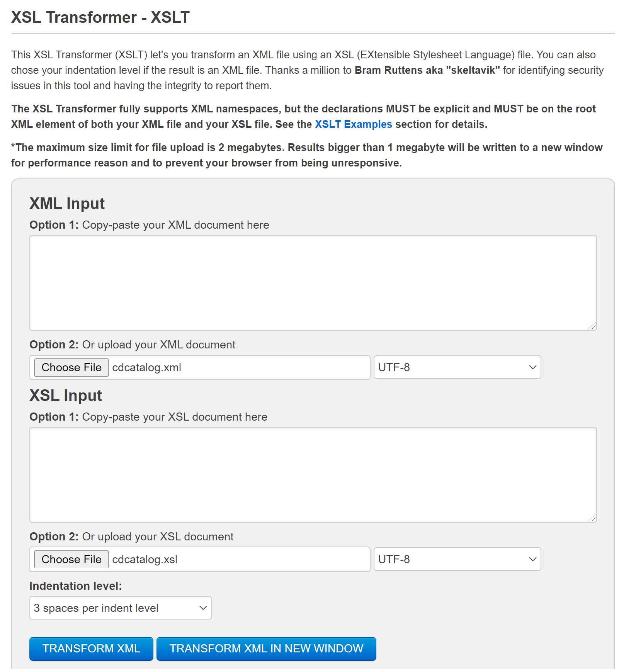
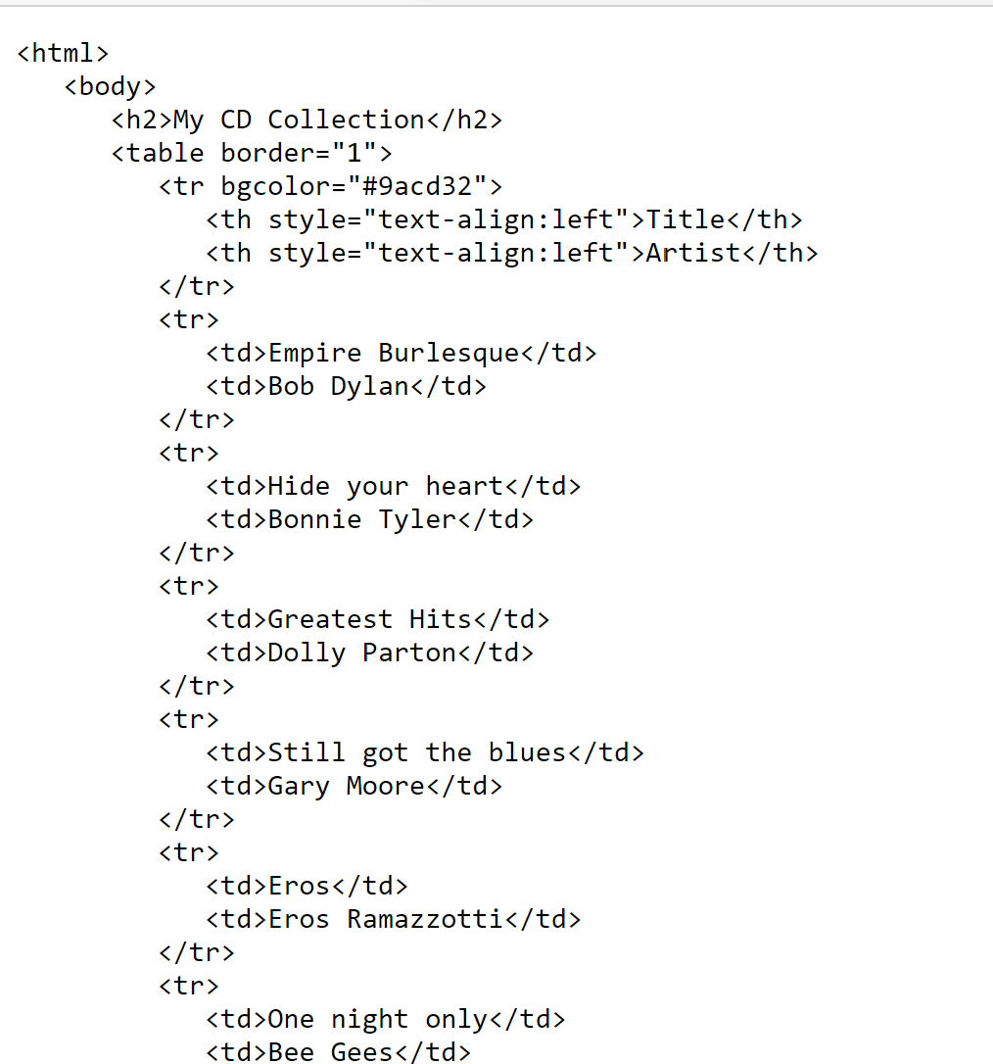
Applying a Transform
https://www.freeformatter.com/xsl-transformer.html

Slide 12
Applying a Transform in R
To transform an XML document in R, use the read_xml() and xml_xslt() functions from the ‘xslt’ package.
library(xslt)
xmlFile <- "cdcatalog.xml"
xslFile <- "cdcatalog.xsl"
txnFile <- "cdcatalog.xml"
xmlDoc <- read_xml(xmlFile)
xslStyle <- read_xml(xslFile)
transformedXML <- xml_xslt(xmlDoc, xslStyle)
write_xml(transformedXML, file = txnFile)

Slide 13
R / R Studio Programming Hint
Occasionally during XSL processing an error occurs and the XSLT processor goes into an infinite loop.
To stop the XSLT, you need to restart R.
In R Studio, click on Session/Restart R or CTRL-SHIFT-F10 or CMD-SHIFT-F10.

Slide 14
Building XSL Transformations
Information Transformation with XSL

Slide 15
Use Cases for XSL
Common use cases include XML file transformations when a system expects an XML conforming to some defined DTD, but the received file conforms to a different DTD and neither system can be changed.
Another common use is to extract information from one XML and then store that information in an XLS, CSV, or XLSX file for use in another program such as R, Excel, SPSS, or for import into a database.
A third use case is to extract data from XML and create SQL INSERT statements to store the XML data into a database.
Example Use Case: Load Select XML Data into R
Imagine that you had received an XML file as a result from export from a system or from some third-party vendor, website, or data distributor.
The XML contains lots of information and is deeply layered and cannot be directly imported into R – and parsing would prove to be time consuming and laborious.
Approach: Extract relevant data and put into two-dimensional row/column format for import with xmlToDataFrame().

Slide 16
Example XML
<?xml version="1.0" encoding="UTF-8"?>
<rosters season="2021">
<team name="Boston Bruins" division="MassMutual East">
<date>2021-02-19</date>
<team-info>
<city>Boston</city>
<country>USA</country>
<coach>Bruce Cassidy</coach>
</team-info>
<season-info>
<gp>15</gp>
<pts w="10" l="3" ot="2">22</pts>
</season-info>
<player num="63">
<firstname>Brad</firstname>
<lastname>Marchand</lastname>
<position>Forward</position>
<assistantcaptain/>
<points>
<goals>9</goals>
<assists>10</assists>
</points>
</player>
…
<player num="73">
<firstname>Charlie</firstname>
<lastname>McAvoy</lastname>
<position>Defense</position>
<points>
<goals>1</goals>
<assists>12</assists>
</points>
</player>
<player num="40">
<firstname>Tuuka</firstname>
<lastname>Rask</lastname>
<position>Goalie</position>
<points>
<goals>0</goals>
<assists>0</assists>
</points>
<stats>
<GA>23</GA>
<SV>0.906</SV>
</stats>
</player>
</team>
</rosters>
The source XML is a file containing information about players on team rosters and might be imported into a team analytics system or to play in a fantasy sports league.
The XML starts with information about a team, the season, and then the players.
We want to extract the player’s last name, their goals and assists. We want to exclude goalies.
We want a file that can be read into Excel (using its XML import wizard) or directly into a data frame.
TeamRosters.xml

Slide 17
xmlToDataFrame()
<?xml version="1.0" encoding="UTF-8"?>
<roster>
<row>
<name number="63">Marchand</name>
<goals>9</goals>
<assists>10</assists>
</row>
<row>
<name number="37">Bergeron</name>
<goals>7</goals>
<assists>11</assists>
</row>
<row>
<name number="73">McAvoy</name>
<goals>1</goals>
<assists>12</assists>
</row>
</roster>
This function is used to extract data from an XML document that has a simple, shallow structure like a CSV. The file contains a collection of nodes which have the same child elements that represent columns containing primitive values, i.e., numbers, strings, etc.
Each node corresponds to an "observation" and each of its sub-elements correspond to a variable, (aka, feature, dimension, or column).
See also: xmlToDataFrame: Extract data from a simple XML document

Slide 18
Define Preamble for XSL Style Sheet
Since an XSL style sheet is an XML document, it begins with the XML declaration: <?xml … ?>
The next element, <xsl:transform> defines that the XML document is an XSLT style sheet document.
The element <xsl:stylesheet> is synonymous with <xsl:transform>.
The xmlns:xsl attribute defines a unique namespace and may point to any URL, but most commonly the one shown.
Simply copy this code…
<?xml version="1.0" encoding="UTF-8"?>
<xsl:transform
version="1.0"
xmlns:xsl="http://www.w3.org/1999/XSL/Transform">
</xsl:transform>
<?xml version="1.0" encoding="UTF-8"?>

Slide 19
Transformation Code in R
```{r}
fp <- "C:/Users/mjsnu/RosterFiles"
xmlFn <- "TeamRosters.xml"
xslFn <- "Rosters2StatsXSL.xsl"
txnFn <- "BruinsStats.xml"
xmlFile <- paste(fp,xmlFn,sep="/")
xslFile <- paste(fp,xslFn,sep="/")
txnFile <- paste(fp,txnFn,sep="/")
xmlDoc <- read_xml(xmlFile)
xslStyle <- read_xml(xslFile)
transformedXML <- xml_xslt(xmlDoc, xslStyle)
status <- write_xml(transformedXML, file = txnFile)
```
Requires the xslt package.

Slide 20
Key <xsl:operators>
The list to the right contains the most important and commonly used <xsl:> operators for defining XSLT rules.
Full list:
<xsl:template>
<xsl:value-of>
<xsl:for-each>
<xsl:sort>
<xsl:if>
<xsl:choose>
<xsl:key>
<xsl:message>
<xsl:apply-template>
<xsl:import>
<xsl:output>
<xsl:text>
<xsl:attribute>
<xsl:template>
<xsl:value-of>
<xsl:for-each>
<xsl:if>
<xsl:attribute>
<xsl:output>
<xsl:text>

Slide 21
<xsl:template match="<xpath-expr>">
<?xml version="1.0" encoding="UTF-8"?>
<xsl:stylesheet
version="1.0"
xmlns:xsl="http://www.w3.org/1999/XSL/Transform">
<xsl:template match="/">
<roster>
Boston Bruins
</roster>
</xsl:template>
</xsl:stylesheet>
An XSL style sheet consists of one or more sets of rules called templates.
Each <xsl:template> element defines a section of the target file.
The value of the match attribute is an XPath expression.
The document is built top to bottom.
Any text that is not <xsl: …> is part of the target document (output of XSLT).
XSL Style Sheet
<?xml version="1.0" encoding="UTF-8"?>
<roster>
Boston Bruins
</roster>
XML Output

Slide 22
Full Syntax: <xsl:template match="<xpath-expr>">
<xsl:template
name = QName
match = Pattern
priority = number
mode = QName >
</xsl:template>
name
Name of the element to which template is to be applied.
match
XPath pattern which matches the element(s) on which template is to be applied.
priority
Priority of a template in case of conflicting templates.
mode
Allows element to be processed multiple times to produce a different result each time.
…
<xsl:template match="/rosters/team[@name='Boston Bruins']">
<roster>
Boston Bruins
</roster>
</xsl:template>
…
The template rule matches only the Boston Bruins team roster and ignores the other team elements in the source XML.
Inserted into the target XML.

Slide 23
<xsl:for-each select="<xpath-expr>">
…
<xsl:template match="//team[@name='Boston Bruins']">
<roster>
<xsl:for-each select="player">
<row>
<cell>Brad Marchand</cell>
<cell>9</cell>
<cell>9</cell>
</row>
</xsl:for-each>
</roster>
</xsl:template>
…
<xsl:for-each> processes a set of XML elements that match the XPath expression.
It processes each element in the matched set of elements one by one: it is an iterator.
The context of the XPath expression is set by any parent <xsl:operation>.
XSL Style Sheet
<?xml version="1.0" encoding="UTF-8"?>
<roster>
<row>
<cell>Brad Marchand</cell>
<cell>9</cell>
<cell>9</cell>
</row>
<row>
<cell>Brad Marchand</cell>
<cell>9</cell>
<cell>9</cell>
</row>
…
<xsl:for-each
select = Xpath-Expression>
process each node
</xsl:for-each>
XML Output

Slide 24
Taking a closer look at <xsl:for-each >
<rosters season="2021">
<team name="Bruins" division="MM East">
<date>2021-02-19</date>
<team-info>
<city>Boston</city>
<country>USA</country>
<coach>Bruce Cassidy</coach>
</team-info>
<season-info>
<gp>15</gp>
<pts w="10" l="3" ot="2">22</pts>
</season-info>
<player num="63">
<firstname>Brad</firstname>
<lastname>Marchand</lastname>
<position>Forward</position>
<assistantcaptain/>
<points>
<goals>9</goals>
<assists>10</assists>
</points>
</player>
<player num="37">
<firstname>Patrice</firstname>
<lastname>Bergeron</lastname>
<position>Forward</position>
<captain/>
<points>
<goals>7</goals>
<assists>11</assists>
</points>
</player>
…
<xsl:template match="//team[@name='Bruins']">
<roster>
<xsl:for-each select="player">
<row>
<cell>Brad Marchand</cell>
<cell>9</cell>
<cell>9</cell>
</row>
</xsl:for-each>
</roster>
</xsl:template>
…
XSL Style Sheet
<?xml version="1.0" encoding="UTF-8"?>
<roster>
<row>
<cell>Brad Marchand</cell>
<cell>9</cell>
<cell>9</cell>
</row>
<row>
<cell>Brad Marchand</cell>
<cell>9</cell>
<cell>9</cell>
</row>
…
XML Output

Slide 25
<xsl:value-of select="<xpath-expr>">
…
<xsl:template match="//team[@name='Boston Bruins']">
<roster>
<xsl:for-each select="player">
<row>
<name>
<xsl:value-of select="lastname" />
</name>
<goals>
<xsl:value-of select="points/goals" />
</goals>
<assists>
<xsl:value-of select="points/assists" />
</assists>
</row>
</xsl:for-each>
</roster>
</xsl:template>
…
<xsl:value-of> extracts the value of the selected node determined by the XPath expression, as text.
The context of the XPath expression is set by any parent <xsl:operation>.
<xsl:value-of
select = Expression
disable-output-escaping = "yes" | "no"/>
XSL Style Sheet
<?xml version="1.0" encoding="UTF-8"?>
<roster>
<row>
<name>Brad Marchand</name>
<goals>9</goals>
<assists>10</assists>
</row>
<row>
<name>Patrice Bergeron</name>
<goals>7</goals>
<assists>11</assists>
</row>
…
XML Output

Slide 26
<xsl:if test="<xpath-condition>">
…
<xsl:template match="//team[@name='Boston Bruins']">
<roster>
<xsl:for-each select="player">
<xsl:if test = "position != 'Goalie'">
<row>
<name>
<xsl:value-of select="lastname" />
</name>
<goals>
<xsl:value-of select="points/goals" />
</goals>
<assists>
<xsl:value-of select="points/assists" />
</assists>
</row>
</xsl:if>
</xsl:for-each>
</roster>
</xsl:template>
…
<xsl:if> allows for conditional processing of nodes based on the result of an XPath conditional expression.
The context of the XPath expression is set by any parent <xsl:operation>.
<xsl:if
test = boolean-expression >
</xsl:if>
XSL Style Sheet
<?xml version="1.0" encoding="UTF-8"?>
<roster>
<row>
<name>Brad Marchand</name>
<goals>9</goals>
<assists>10</assists>
</row>
<row>
<name>Patrice Bergeron</name>
<goals>7</goals>
<assists>11</assists>
</row>
…
XML Output

Slide 27
<xsl:choose> and <xsl:when test="<xpath-condition>">
<xsl:choose> allows for multiple conditions and “if-then-else”. It is like a “switch-case” statement in many programming languages. Each condition is part of an <xsl:when> element. If none of the test conditions are true, then an optional <xsl:otherwise> element can be specified.
The context of the XPath operation is set by any parent <xsl:operation>.
<xsl:choose>
<xsl:when test = "xpath-condition">
...
</xsl:when>
<xsl:when test = "xpath-condition">
...
</xsl:when>
<xsl:otherwise>
...
</xsl:otherwise>
</xsl:choose>

Slide 28
<xsl:attribute name="text">
…
<xsl:template match="//team[@name='Boston Bruins']">
<roster>
<xsl:for-each select="player">
<xsl:if test = "position != 'Goalie'">
<row>
<playername>
<xsl:attribute name="number">
<xsl:value-of select="./@num" />
</xsl:attribute>
<xsl:value-of select="lastname" />
</playername> <goals>
<xsl:value-of select="points/goals" />
</goals>
<assists>
<xsl:value-of select="points/assists" />
</assists>
</row>
</xsl:if>
</xsl:for-each>
</roster>
</xsl:template>
…
<xsl:attribute> produces an attribute for an element in an output XML.
The context of the XPath expression is set by any parent <xsl:operation>.
The attribute is added to the tag for which <xsl:attribute> is a child.
XSL Style Sheet
<someElement>
<xsl:attribute
name = "someName" >
</xsl:attribute> </someElement>
<?xml version="1.0" encoding="UTF-8"?>
<roster>
<row>
<playername number="63">Brad Marchand</playername>
<goals>9</goals>
<assists>10</assists>
</row>
<row number="37">
<playername>Patrice Bergeron</playername>
<goals>7</goals>
<assists>11</assists>
</row> …
XML Output

Slide 29
Source XML and XSL
<?xml version="1.0" encoding="UTF-8"?>
<rosters season="2021">
<team name="Boston Bruins" division="MassMutual East">
<date>2021-02-19</date>
<team-info>
<city>Boston</city>
<country>USA</country>
<coach>Bruce Cassidy</coach>
</team-info>
<season-info>
<gp>15</gp>
<pts w="10" l="3" ot="2">22</pts>
</season-info>
<player num="63">
<firstname>Brad</firstname>
<lastname>Marchand</lastname>
<position>Forward</position>
<assistantcaptain/>
<points>
<goals>9</goals>
<assists>10</assists>
</points>
</player>
<player num="37">
<firstname>Patrice</firstname>
<lastname>Bergeron</lastname>
<position>Forward</position>
<captain/>
<points>
<goals>7</goals>
<assists>11</assists>
</points>
</player>
…
<player num="40">
<firstname>Tuuka</firstname>
<lastname>Rask</lastname>
<position>Goalie</position>
<points>
<goals>0</goals>
<assists>0</assists>
</points>
<stats>
<GA>23</GA>
<SV>0.906</SV>
</stats>
</player>
</team>
</rosters>
<?xml version="1.0"?>
<xsl:stylesheet
version="1.0"
xmlns:xsl="http://www.w3.org/1999/XSL/Transform">
<xsl:template match="//team[@name='Boston Bruins']">
<roster>
<xsl:for-each select="player">
<xsl:if test = "position != 'Goalie'">
<row>
<name>
<xsl:attribute name="number">
<xsl:value-of select="./@num" />
</xsl:attribute>
<xsl:value-of select="lastname" />
</name>
<goals>
<xsl:value-of select="points/goals" />
</goals>
<assists>
<xsl:value-of select="points/assists" />
</assists>
</row>
</xsl:if>
</xsl:for-each>
</roster>
</xsl:template>
</xsl:stylesheet>

Slide 30
Target / Output XML
<?xml version="1.0" encoding="UTF-8"?>
<roster>
<row>
<name number="63">Marchand</name>
<goals>9</goals>
<assists>10</assists>
</row>
<row>
<name number="37">Bergeron</name>
<goals>7</goals>
<assists>11</assists>
</row>
<row>
<name number="73">McAvoy</name>
<goals>1</goals>
<assists>12</assists>
</row>
</roster>
R code to read XML into data frame
fp <- "xml"
txnFn <- "BruinsStats.xml"
txnFile <- paste(fp,txnFn,sep="/")
xmlTxnObj <- xmlParse(transformedXML, validate = F)
df <- xmlToDataFrame(xmlTxnObj,
colClasses = c("character",
"integer",
"integer"))
head(df)

Slide 31
<xsl:output …>
<?xml version="1.0"?>
<xsl:stylesheet
version="1.0"
xmlns:xsl="http://www.w3.org/1999/XSL/Transform">
<xsl:output method="text"
encoding="UTF-8"
indent="no"
omit-xml-declaration="yes"/>
<xsl:template match="//plants">
<xsl:output> defines the output file format of the target file.
The default is XML which means that XSLT will insert the standard XML preamble <?xml …?>.
<xsl:output
method = "xml|html|text|name"
version = "string"
encoding = "string"
omit-xml-declaration = "yes|no"
standalone = "yes|no"
doctype-public = "string"
doctype-system = "string"
cdata-section-elements = "namelist"
indent = "yes|no"
media-type = "string"/>
XSL Style Sheet

Slide 32
<xsl:text …>
<?xml version="1.0"?>
<xsl:stylesheet
version="1.0"
xmlns:xsl="http://www.w3.org/1999/XSL/Transform">
<xsl:text>
&#10
</xsl:text>
<xsl:template match="//plants">
<xsl:text> inserts specific unparsed text into the output file.
This allows any text to be sent to the output file.
To send special characters such as space or newline to the output file, use XML entities, e.g., &#10 for newline and &#32 for space.
<xsl:text [xml:whitespace = "preserve"]>
any text here
</xsl:text>
XSL Style Sheet

Slide 33
<xsl:variable name = "var" select = "xpath-expression">
<xsl:variable> creates a variable that can be accessed in XPath expressions.
Use $varName to access a variable with the name varName.
<?xml version="1.0"?>
<xsl:stylesheet
version="1.0"
xmlns:xsl="http://www.w3.org/1999/XSL/Transform">
<xsl:template match="/">
<xsl:variable name="numRecords"
select="count(records/record)"/>
<transactions>
<xsl:attribute name="numTxns">
<xsl:value-of select="$numRecords" />
</xsl:attribute>
…
<xsl:variable name = "variable"
select = "xpath-expression" />

Slide 34
The Math Extensions to XSLT
<?xml version="1.0"?>
<xsl:stylesheet version="1.0"
xmlns:xsl="http://www.w3.org/1999/XSL/Transform"
xmlns:math="http://exslt.org/math"
extension-element-prefixes="math" >
<xsl:value-of select="(floor(math:random()*8) mod 8) + 1" />
<xsl:variable name="someRecord"
select="(floor(math:random() * $numRecords)
mod $numRecords) + 1"/>
<product><xsl:value-of
select="../record[$someRecord]/product"/></product>
To perform mathematical calculations in XSLT, use either XSL 2.0 or a math library.
XSL Style Sheet

Slide 35
Review: xmlToDataFrame()
Information Transformation with XSL

Slide 36
Parsing Row-Column XML into a Data Frame
To load an XML document that has a shallow row/column structure into a data frame, use:
xmlToDataFrame()
parses the XML data and generates an R data frame representing the data in the document
Once the files has been successfully parsed, R stores the XML document in a data frame from where it can be processed, analyzed, or written to a database.
df <- xmlToDataFrame("treedata.xml")

Slide 37
Row/Column XML Document
Note the format of the document: it is two level only. No elements below the second level and no attributes.
<?xml version="1.0"?>
<document>
<row>
<Girth>8.3</Girth>
<Height>70</Height>
<Volume>10.3</Volume>
</row>
<row>
<Girth>8.6</Girth>
<Height>65</Height>
<Volume>10.3</Volume>
</row>
…
</document>
data <- xmlToDataFrame("treedata.xml")
Girth Height Volume
1 8.3 70 10.3
2 8.6 65 10.3
…

Slide 38
No Multiple Levels: Row/Column Only
Note what happens when it is more than two level. The element values are concatenated.
<?xml version="1.0"?>
<document>
<row>
<Girth>8.3</Girth>
<Dim>
<Height>70</Height>
<Width>65</Width>
</Dim>
<Volume>10.3</Volume>
</row>
<row>
<Girth>8.6</Girth>
…
</document>
data <- xmlToDataFrame("treedata.xml")
Girth Dim Volume
1 8.3 7065 10.3
2 8.6 6552 10.3
…

Slide 39
Usage of xmlToDataFrame()
Only useful for extraction of data from an XML document (or sub-document) that has a shallow row/column structure.
The XML must contain a collection of nodes which have the same fields (or a subset of common fields) which contain primitive values.
Each node corresponds to an "observation" or “row” and each of its sub-elements correspond to a variable or column.
xmlToDataFrame(doc, colClasses = NULL, homogeneous = NA,
collectNames = TRUE, nodes = list(),
stringsAsFactors = default.stringsAsFactors())

Slide 40
XML Values: Strings and Factors
By default, all values read from XML are text (strings).
xmlToDataFrame() coerces the strings into an appropriate data type automatically (numeric, character, or factor).
Text (character) columns are automatically converted to factors unless stringsAsFactors is set to FALSE.
If stringsAsFactors is set to FALSE, then columns that are indeed factors must be explicitly converted via as.factor().
xmlToDataFrame(doc, colClasses = NULL, homogeneous = NA,
collectNames = TRUE, nodes = list(),
stringsAsFactors = default.stringsAsFactors())

Slide 41
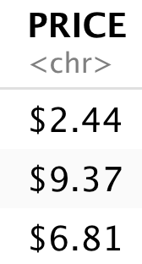
Example: Strings vs Factors
Factors are R’s way to encode categorical variables, i.e., those whose values are from a set of values. Factors are important for statistical analysis and data mining but otherwise are not necessary.
df <- xmlToDataFrame(xData)
df <- xmlToDataFrame(xData,
stringsAsFactors = FALSE)
character (text/string) and not a number due to the $ prefix

Slide 42
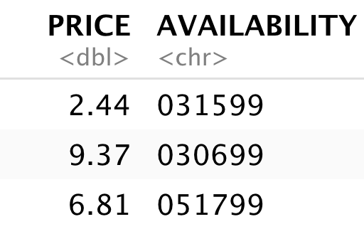
Example: Strings, Numeric, and Conversion
df <- xmlToDataFrame(xData,
stringsAsFactors = FALSE)
df$BOTANICAL <- as.factor(df$BOTANICAL)
df$PRICE <- as.numeric(substring(df$PRICE, 2))
The substring(x, start, stop = 1000000L) function extracts all characters starting from a position. Positions are numbered starting at 1 from the left side of the text string, so substring("$23.99", start) extracts all characters from the string starting at character 2 which results in "23.99", which can then be converted to a number with as.numeric().

Slide 43
Defining Column Types
By default, R attempts to determine the types of a column from its values.
The colClasses parameter (a vector) allows the programmer to define the classes (types) of each column.

Slide 44
Defining Data Types in xmlToDataFrame()
The atomic modes are "logical", "integer", "numeric" (synonym "double"), "complex", "character" and "raw".
The character class is used for text/strings.
The colClasses must be a vector with the classes of each column in the order they are in the input XML.
xmlToDataFrame(doc, colClasses = c("integer", "character"),
stringsAsFactors = F)

Slide 45
Summary, Review, & Questions…

