Slide 1
Effective Organizational Sabotage
Business Analysis
Martin Schedlbauer, Ph.D. / CBAP, CBDA, CSM, PSM, OCUP, CSTE
m.schedlbauer@northeastern.edu

Slide 2
About…
The 1944 Field Manual from the CIA teaches saboteurs how to ensure that an enemy's war efforts are subverted. One such gem is to ensure that all problems are studied by a task force and that additional meetings are called before making any decision. Amazingly, many of the subversive techniques appear to be prevalent in organizations today. In this talk, we will take a tongue-in-cheek look at those techniques and then compare them to current organizational practices. We will show how Business Analysts and Project Managers can recognize them and mitigate them to ensure progress.
Martin Schedlbauer, Ph.D.
m.schedlbauer@neu.edu
Data & Information Scientist with experience in Business Analysis, Data Analytics, Process Modeling
CBAP, CBDA, CSM, PSM, OCUP, CSTE

Slide 3
Objectives
Sabotage Field Manual
Common sabotage practices for organizations
Recognize when subversive practices are in place, whether on purpose or not
Ways to overcome, mitigate, or avoid sabotage

Slide 4
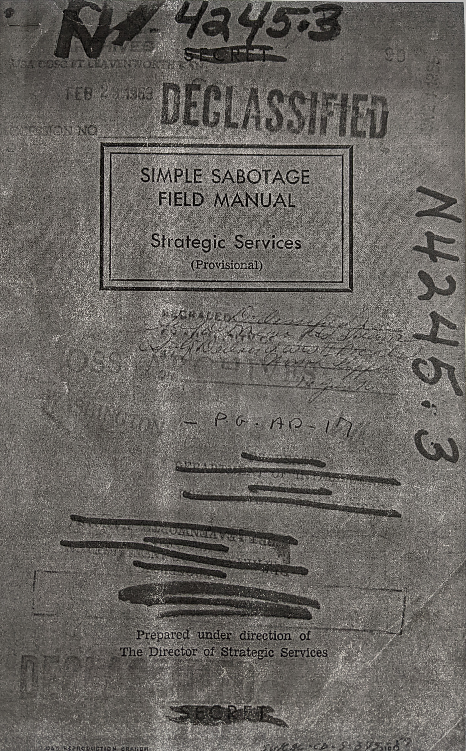
Sabotage Field Manual
Published in 1944 by Office of Strategic Services (OSS) – forerunner to the Central Intelligence Agency (CIA) – to aid resistance groups during WWII
32-page field manual that instructs saboteurs in how to interfere in the effectiveness of an occupier
Chapter 11 of the manual details how to interfere with organizations and productivity
https://www.hsdl.org/?abstract&did=750070

Slide 5
Brief History & Background
This historical document was originally published by the United States Office of Strategic Services (OSS; now the Central Intelligence Agency) in 1944, for use by OSS agents in motivating or recruiting potential foreign saboteurs.
Agents were granted permission to print and disseminate portions of the document as needed.
The since-declassified booklet describes ways for civilians to inflict sabotage through ordinary means, to minimize undue attention.
According to the document, saboteur-recruits were most often U.S. sympathizers keen to disrupt war efforts against the U.S. during World War Two.

Slide 6
Intent of the Field Guide
The booklet contains instructions for destabilizing or reducing progress and productivity by non-violent means.
The booklet is separated into headings that correspond to specific audiences and areas of sabotage.

Slide 7
We must learn how the saboteurs works so that we can recognize their subversive practices and devise and enact countermeasures.

Slide 8
Organizations may have unwittingly engaged in self-sabotage and its root causes must be laid bare.

Slide 9
Analyzing Subversive Practices
Have you observed the practice at your workplace or in your team?
Do you perhaps do this yourself (intentionally or not)?
What are the consequences?
How would you detect if the practice is being used (even unintentionally)?
Can the practice be countered, or its effects mitigated?
Do they present risks that ought to be managed?
How would you avoid or eliminate the practice?

Slide 10
General Interference with organizations and production
Sabotage Field Manual Section (11), pp 28 - 31

Slide 11
Before we start…
Some of the expressions are a bit arcane and we need to find appropriate “modern” terms. They are also targeted towards manufacturing, and we need to think in terms of modern IT work.
For example, the term “conference” from the 1940s is more like “meeting” in 2022.

Slide 12
oh, and no cringing…
and, of course, we all know that this only occurs at companies your friends work at or perhaps in shows like ”The Office” or movies like “Office Space”, and not in our organizations…

Slide 13
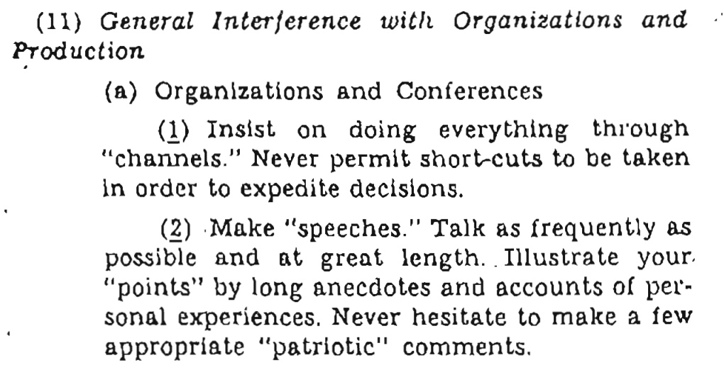
Sabotage Practices I
Have you observed the practice at your workplace or in your team?
Do you perhaps do this yourself (intentionally or not)?
What are the consequences?
How would you detect if the practice is being used (even unintentionally)?
Can the practice be countered, or its effects mitigated?
Do they present risks that ought to be managed?
How would you avoid or eliminate the practice?

Slide 14
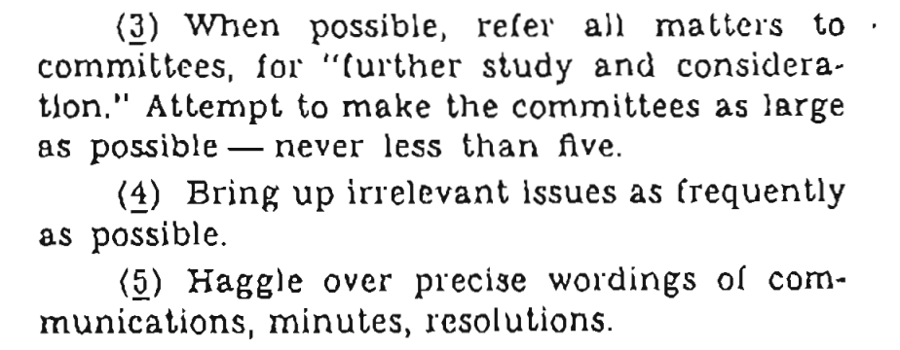
Sabotage Practices II
Have you observed the practice at your workplace or in your team?
Do you perhaps do this yourself (intentionally or not)?
What are the consequences?
How would you detect if the practice is being used (even unintentionally)?
Can the practice be countered, or its effects mitigated?
Do they present risks that ought to be managed?
How would you avoid or eliminate the practice?

Slide 15
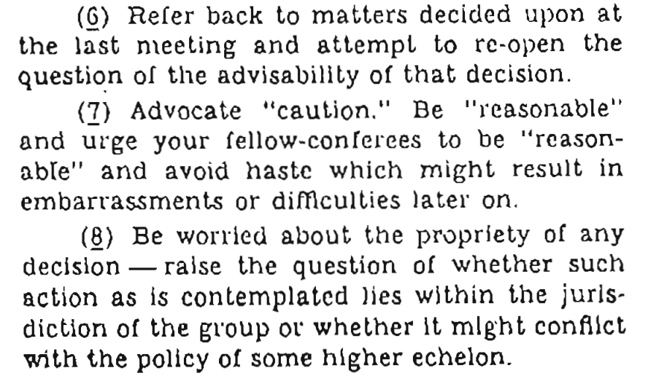
Sabotage Practices III
Have you observed the practice at your workplace or in your team?
Do you perhaps do this yourself (intentionally or not)?
What are the consequences?
How would you detect if the practice is being used (even unintentionally)?
Can the practice be countered, or its effects mitigated?
Do they present risks that ought to be managed?
How would you avoid or eliminate the practice?

Slide 16
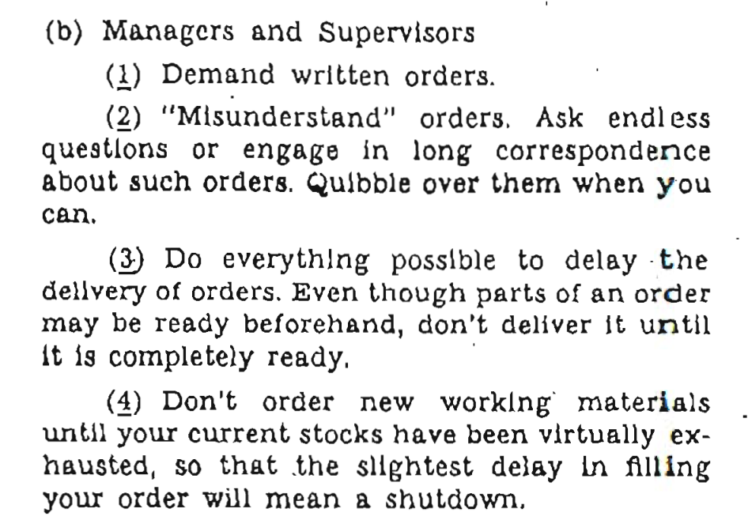
Sabotage Practices IV
Have you observed the practice at your workplace or in your team?
Do you perhaps do this yourself (intentionally or not)?
What are the consequences?
How would you detect if the practice is being used (even unintentionally)?
Can the practice be countered, or its effects mitigated?
Do they present risks that ought to be managed?
How would you avoid or eliminate the practice?

Slide 17
Sabotage Practices V
Have you observed the practice at your workplace or in your team?
Do you perhaps do this yourself (intentionally or not)?
What are the consequences?
How would you detect if the practice is being used (even unintentionally)?
Can the practice be countered, or its effects mitigated?
Do they present risks that ought to be managed?
How would you avoid or eliminate the practice?

Slide 18
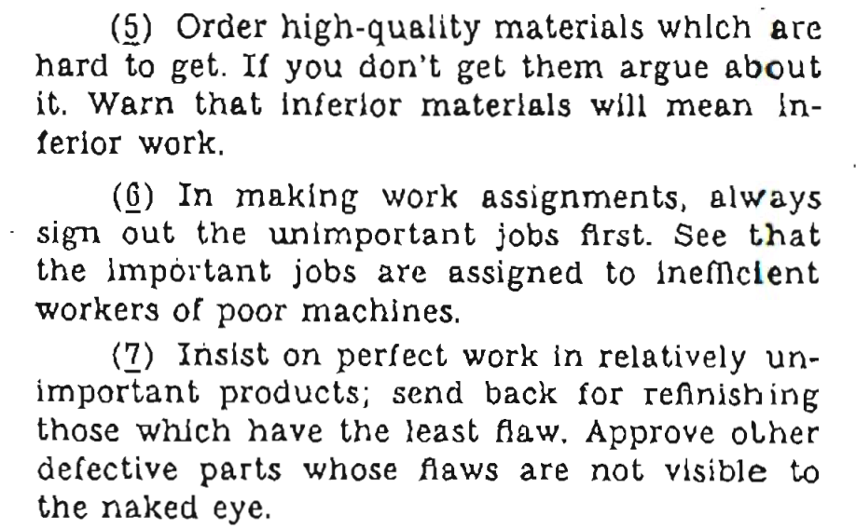
Sabotage Practices VI
Have you observed the practice at your workplace or in your team?
Do you perhaps do this yourself (intentionally or not)?
What are the consequences?
How would you detect if the practice is being used (even unintentionally)?
Can the practice be countered, or its effects mitigated?
Do they present risks that ought to be managed?
How would you avoid or eliminate the practice?

Slide 19
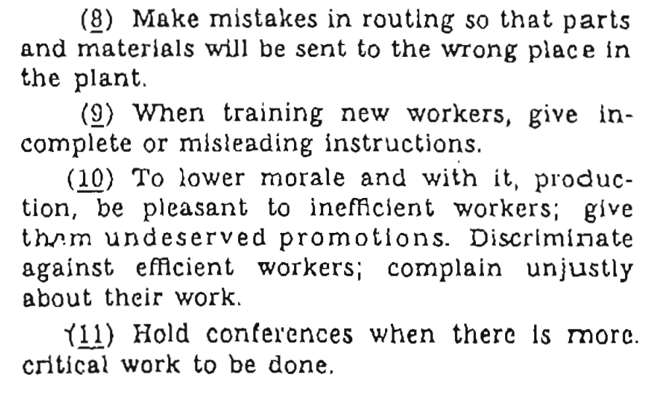
Sabotage Practices VII
Have you observed the practice at your workplace or in your team?
Do you perhaps do this yourself (intentionally or not)?
What are the consequences?
How would you detect if the practice is being used (even unintentionally)?
Can the practice be countered, or its effects mitigated?
Do they present risks that ought to be managed?
How would you avoid or eliminate the practice?

Slide 20
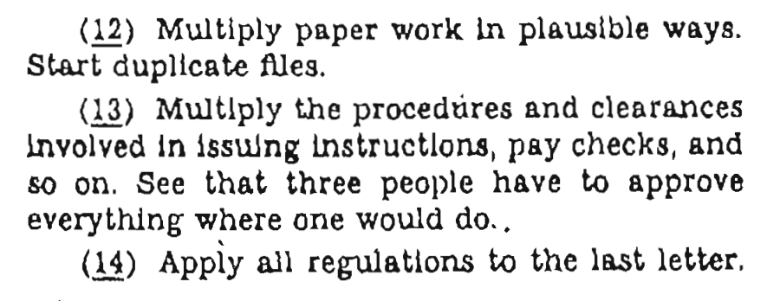
Sabotage Practices VIII
Have you observed the practice at your workplace or in your team?
Do you perhaps do this yourself (intentionally or not)?
What are the consequences?
How would you detect if the practice is being used (even unintentionally)?
Can the practice be countered, or its effects mitigated?
Do they present risks that ought to be managed?
How would you avoid or eliminate the practice?

Slide 21
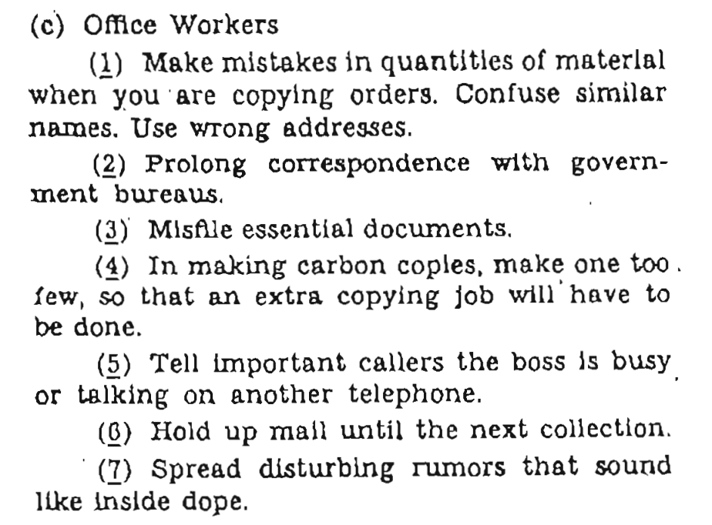
Sabotage Practices IX
Have you observed the practice at your workplace or in your team?
Do you perhaps do this yourself (intentionally or not)?
What are the consequences?
How would you detect if the practice is being used (even unintentionally)?
Can the practice be countered, or its effects mitigated?
Do they present risks that ought to be managed?
How would you avoid or eliminate the practice?

Slide 22
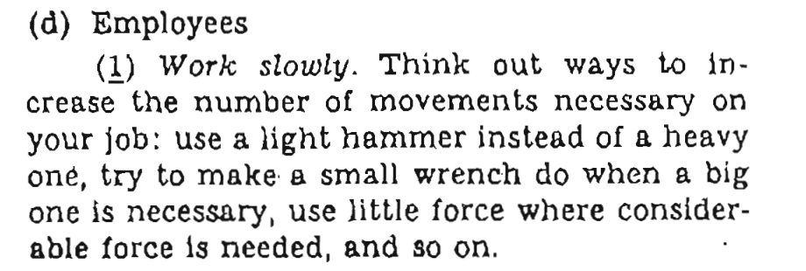
Sabotage Practices X
Have you observed the practice at your workplace or in your team?
Do you perhaps do this yourself (intentionally or not)?
What are the consequences?
How would you detect if the practice is being used (even unintentionally)?
Can the practice be countered, or its effects mitigated?
Do they present risks that ought to be managed?
How would you avoid or eliminate the practice?

Slide 23
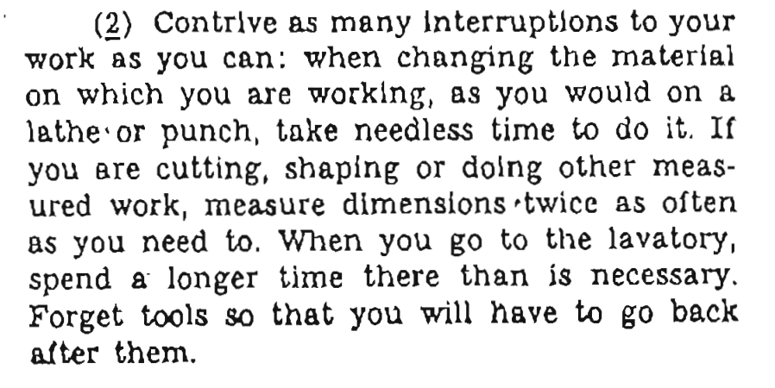
Sabotage Practices XI
Have you observed the practice at your workplace or in your team?
Do you perhaps do this yourself (intentionally or not)?
What are the consequences?
How would you detect if the practice is being used (even unintentionally)?
Can the practice be countered, or its effects mitigated?
Do they present risks that ought to be managed?
How would you avoid or eliminate the practice?

Slide 24
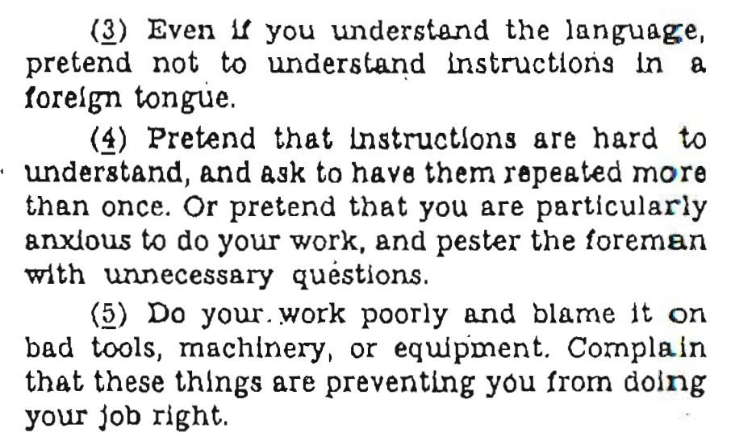
Sabotage Practices XII
Have you observed the practice at your workplace or in your team?
Do you perhaps do this yourself (intentionally or not)?
What are the consequences?
How would you detect if the practice is being used (even unintentionally)?
Can the practice be countered, or its effects mitigated?
Do they present risks that ought to be managed?
How would you avoid or eliminate the practice?

Slide 25
Sabotage Practices XIII
Have you observed the practice at your workplace or in your team?
Do you perhaps do this yourself (intentionally or not)?
What are the consequences?
How would you detect if the practice is being used (even unintentionally)?
Can the practice be countered, or its effects mitigated?
Do they present risks that ought to be managed?
How would you avoid or eliminate the practice?

Slide 26
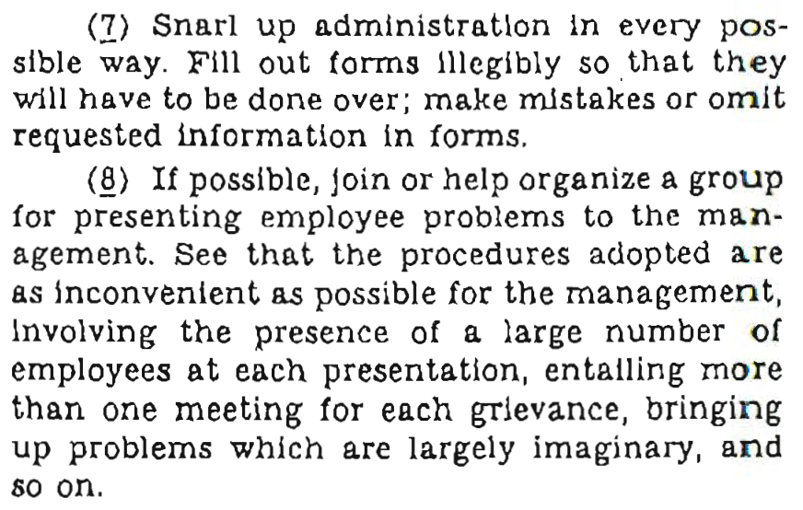
Sabotage Practices XIV
Have you observed the practice at your workplace or in your team?
Do you perhaps do this yourself (intentionally or not)?
What are the consequences?
How would you detect if the practice is being used (even unintentionally)?
Can the practice be countered, or its effects mitigated?
Do they present risks that ought to be managed?
How would you avoid or eliminate the practice?

Slide 27
Sabotage Practices XV
Have you observed the practice at your workplace or in your team?
Do you perhaps do this yourself (intentionally or not)?
What are the consequences?
How would you detect if the practice is being used (even unintentionally)?
Can the practice be countered, or its effects mitigated?
Do they present risks that ought to be managed?
How would you avoid or eliminate the practice?

Slide 28
and, because… 2022

Slide 29
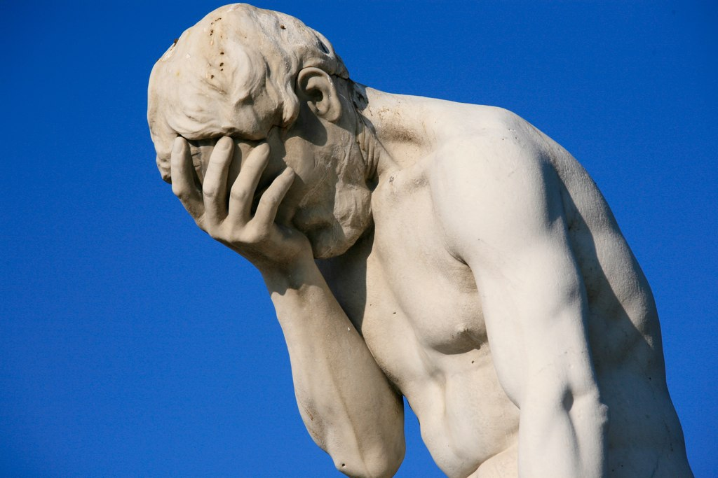
Summary
Now that you are a CIA trained saboteur, apply your vast knowledge of subversive techniques to the best of your ability
Or maybe not -- instead, recognize when such destabilizing are being applied, wittingly or not

Slide 30
Overcoming Sabotage
Identify potential anti-patterns in your own team and devise practices to counter or avoid them.

Slide 31
Slide Deck Effective Organizational Sabotage
Provided under a CC 4 license where use is permitted with full acknowledgement.

