Slide 1

The Delphi Method for Estimation
Martin Schedlbauer, Ph.D.
m.schedlbauer@neu.edu

Slide 2
Lesson Objectives
At the completion of this lesson, you will be able to:
  provide more accurate estimates using the Delphi Method
  calculate single-band and wide-band Delphi estimates
  derive a confidence interval for estimates

Slide 3
Motivation
Estimates are difficult to obtain and are subject to in-group and expert biases.
Delphi can be used to overcome some of the effects of bias and result in more accurate estimates.
The Delphi Method was developed at the RAND Corporation during the 1950s for providing better military estimates.
It is widely used in project management and for business forecasting.

Slide 4
About Delphi
It is also known as Estimate-Talk-Estimate or ETE and is a structured communication technique that relies on a group of experts.
The technique has also been adapted for use in face-to-face meetings, e.g., Planning Poker often used in Scrum.

Slide 5
Application of Delphi
The Delphi method can be used to provide any subjective estimate:
  Execution time of process activities
  Time estimates of project tasks
  Costs (e.g., budgeting)
  Probabilities
  Risks

Slide 6
Delphi Technique
Estimates are initially provided anonymously by a group of experts.
Next, the team of experts discusses the estimates, and the providers of the highest and lowest estimates are asked to “defend” their findings.
There must be a reason that they are outliers: do they know something that the others don’t know. Information is exchanged in an open forum.
Finally, a second set of estimates is provided anonymously. The final estimates are then averaged.
It is important that the estimation be done individually and anonymously so that the estimates are not biased.

Slide 7
Example: Single-Band Delphi
How many hours will the information system cut-over take?
18
20 + 20 + 13
E_{Req}=
3
20
20
13
20
8
13

Slide 8
Delphi Estimation Process
present
Present item to be estimated
estimate
Provide an estimate based on subjective experience
reflect
Discuss estimates as a group with focus on highest and lowest estimates
merge
Reach consensus or average estimates

Slide 9
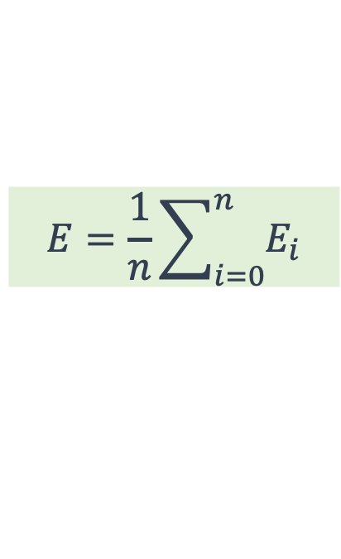
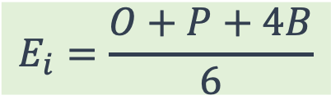
Wide-Band Delphi
For each estimate, each of n estimators provides:
  optimistic “guess” (O)
  pessimistic “guess” (P)
  best “guess” (B)
Calculate the weighted average of estimates E_{i} and then average estimates.
$$E_{i}=\frac{O+P+4B}{6}$$
$$E=\frac{1}{n}\sum_{i=0}^{n}{E_{i}}$$

Slide 10
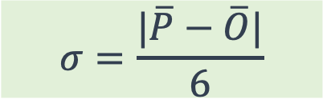

Variance & Confidence
The estimate should be provided as a range.
The “Confidence Interval” is:
and the standard deviation σ can be estimated with:
$$E±1.96σ$$
$$σ=\frac{|\overline{P}−\overline{O}|}{6}$$

Slide 11
Example: Wide-Band Delphi
The following estimates were provided in the second round by four estimators for next year’s data use:
What is the weighted estimate for each estimator?
What is the average joint estimate?
What is the 95% confidence interval for the estimate?

Slide 12
Solution to Delphi Estimate
=(B2+C2+(4*D2))/6
=AVERAGE(E2:E5)
=(ABS(AVERAGE(B2:B5)-AVERAGE(C2:C5)))/6
=D7-(C10*D8)
=NORM.INV(C9+((1-C9)/2),0,1)

Slide 13
Summary
In this lesson we learned that:
  Delphi is a useful method for deriving estimates that are group-based and less subject to bias
  estimates are derived through two or more rounds of estimate-talk-estimate with low and high estimates “defended” to draw out hidden information
  a confidence interval can help provide insight into the degree of certainty of an estimate and help users of the estimate

