Slide 1

Little's Law for Process Time Analysis
Martin Schedlbauer, Ph.D.
m.schedlbauer@neu.edu

Slide 2
Lesson Objectives
At the completion of this lecture, you will be able to:
  Describe process flow characteristics
  Evaluate execution time using Little’s Law

Slide 3
Flow Analysis
Analyzing the characteristics of a process

Slide 4

Flow Time
Flow time is the average time that it takes to complete a process, i.e., go through all the activities in the longest path.
Flow time includes processing time as well as waiting time and delays, i.e., waiting for a resource (person, system) to become.
Also known as throughput time, lead time, or execution time.

Slide 5
Estimating Process Execution Time with Little’s Law
Analyzing the effectiveness of a process

Slide 6
Measuring Flow: Little’s Law
Major law in queuing theory:
  Relates the work in process (WIP) to the flow time and the throughput rate
    I = average number of units being processed, i.e., the process inventory, or work in process
    T = average process execution time, i.e., flow time
    R = throughput rate, i.e., average number of units produced during some period; also known as flow rate, and often defined as λ

Slide 7
Applicability of Little’s Law
Little’s Law is a major insight in queuing theory, even though the result appears trivial:
Some applications:
  Manufacturing processes
  Waiting lines at airport, restaurants, theme parks
  Accounts receivables processing

Slide 8

Example: Restaurant
A fast-food restaurant serves an average of 1500 customers per 15-hour day. The manager counted an average of 75 customers in the restaurant at any time based on occupied tables. How long does the average customer spend in the restaurant?

Slide 9
Solution
Given:
  throughput rate (R) = 1500/day or 100/hour
  inventory (I) = 75 customers
Derived from Little’s Law:
  flow time (T) is the time in the restaurant, i.e., the time to flow through the “service process”

Slide 10
Why Little’s Law
Notice how it was relatively easy to estimate the average number of people in the restaurant using just two fairly easy to acquire metrics.
The result can be used to plan the size of the restaurant, the required number of tables, and staff.
It can also help determine if a marketing campaign is warranted because the restaurant has empty tables on average.
Note that the results are “on average” and may not describe any particular point in time.

Slide 11
Example: Airport Security
Brittany is going through Boston Logan Airport security. Her friend told her that it took her 20 minutes to get through security and that 6 lanes are open.
How many people would you expect are waiting in line to get through security?

Slide 12

Solution
Given:
  Throughput/flow rate (R) = 6 travelers per 20 minutes
  Inventory/WIP (I) = unknown
  Flow/execution time (T) = 20 minutes
Derived from Little’s Law:
$$I=T×R \\ I=20×6=120$$

Slide 13

Measuring Flow/Execution Time (T)
Three ways to measure execution/flow time:
  observe the process for a specified period using random work sampling
  take a random sample of units and measure the average time it takes to process the units
  compute the average of flow time using Little’s Law
Derivation through Little’s Law:
$$T=\frac{I}{R}$$

Slide 14
Case Study: Service Time at Qdoba
Observed at Qdoba on Huntington Ave in Boston during October 2013.

Slide 15

Measuring Flow Rate (R)
Measure flow rate:
  observe the process for a period of time
  count the number of units leaving the process
  calculate the average units per period of time
Derive flow rate through Little’s Law:
$$R=\frac{I}{T}$$

Slide 16
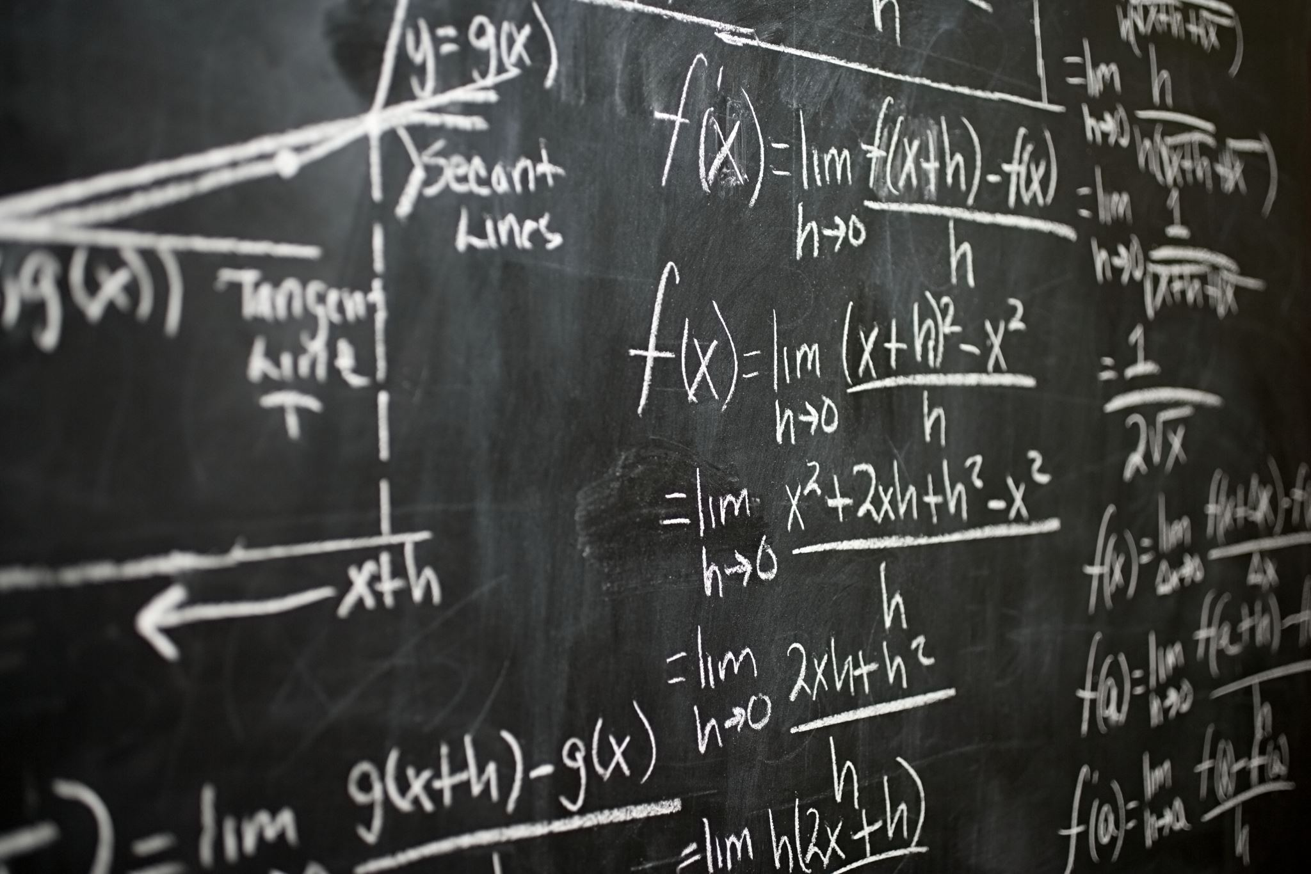
Summary
In this module we learned that:
  Little’s Law is useful in estimating process flow rate, work in process, and flow time

Slide 17
Topic 3:
Worked Examples
Examples Using Little’s Law

