Slide 1
Information Science as a Discipline
Martin Schedlbauer, Ph.D.
m.schedlbauer@neu.edu

Slide 2
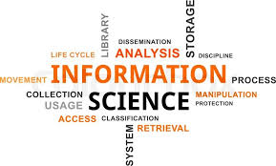
Information Science as a Discipline
Information science is an interdisciplinary field primarily concerned with the entire life cycle of information objects and the information universe.

Slide 3
What is Information Science?

Slide 4
Information Scientists
Practitioners within the field who study the provenance, quality, representation, archiving, and use of information in organizations, along with the interaction between people, organizations and information systems, with the aim of creating, replacing, improving, or understanding information systems¹ that aid in information-based decision-making.
¹Information systems do not have to be computer-based.

Slide 5
Information Science is NOT
Data Science (DS)
Computer Science (CS)
Information Systems (IS)
Management Information Systems (MIS)
Library Science (LS)
BUT: it draws from all of them and relates to all of them…

Slide 6
Connections to other Disciplines
Information science predates computer science and is a broad, interdisciplinary field, incorporating not only aspects of computer science, but often diverse fields such as archival science, cognitive science, communications, library science, museology, management, mathematics, philosophy, public policy, and the social sciences.

Slide 7
So, to summarize…
Information science deals with all the processes and techniques pertaining to the life cycle of information objects, including discovery, capture, generation, representation, packaging, dissemination, transformation, refinement, usage, storage, communication, protection, presentation, etc. in any possible manner and not restricted to computer systems.

Slide 8
The Work of a Practitioner
An information scientist often conducts:
studies of terminology and the structure and nature of information objects (ontologies) in an organization or knowledge domain
research into indexing and retrieval strategies for information objects
development of digital information repositories
creation of representations and visualizations
development of processes and policies

Slide 9
The Lifecycle of Information Objects

Slide 10
Information Life Cycle
Discovery
Analysis
Classification
Organization
Manipulation
Storage
Retrieval
Movement
Dissemination
Protection

Slide 11
Concept Maps
A concept map is a diagram that visually depicts suggested relationships between concepts. Concept maps are often used by instructional designers, engineers, technical writers, and others to organize and structure knowledge in terms of information objects.
A concept map typically represents ideas and information as boxes or circles, which it connects with lines in free-form maps. The relationship between concepts can be articulated in linking phrases such as "causes", "requires", "such as" or "contributes to".
The technique for visualizing these relationships among different concepts is called concept mapping. Concept maps are often used to assist in defining ontologies.

Slide 12
Affinity Grouping
Affinity Grouping is a brainstorming method in which participants organize concepts into groups that represent common themes.

Slide 13
Overview of the Course

Slide 14
Then what is this course?
This course is a survey and overview of the various areas that comprise modern computational information science.
By its nature, it cannot delve into all aspects but will do so for some of the more important ones, including:
information collection, analysis, organization, and valuation
information storage and retrieval of structured and unstructured information objects
information dissemination and protection
information technology and systems

Slide 15
Overview of Course
Let’s get an overview of the topics in information science that we will explore.
Remember: this is a survey course where we look at many (but not all) aspects of information science.
Follow-on and related courses dig deeper into specific areas of information science.

Slide 16
A Philosophy of Information

Slide 17
“Big Questions” of Information Science
Some of the “big questions” that concern academics and practitioners:
What are the features and laws of the recorded-information universe?
How do people relate to, seek, and use information?
How can access to recorded information be made most rapid and effective?
What is the essential nature of information?
What are the ethical obligations of an information society?
Excerpted from Bawden & Robinson (2012)

Slide 18
Philosophy and Information Science
Philosophical thought is centered around three principal questions:
Meta-Physics and Ontology
What is it for something to ‘be’ and what kinds of things exist?
What does “existence” mean?
Epistemology
What is it to know?
What can we know?
How can we be sure of our knowledge?
Ethics
How can actions be ‘right’?
How should we act?

Slide 19
The Fundamental Law of Information Science
Bawden & Robinson (2012) describe a fundamental “law” originally stated by Bertle Brookes:
A knowledge structure K(S) is changed into an altered knowledge structure K(S + ΔS) by an input of information, ΔI.
$$K\left(S\right)+∆I=K(S+∆S)$$

Slide 20
That Leaves… information
Every discipline has its own definition of information and uses is within its own context.
So, what is “information”?
not the same as data or knowledge
knowledge packaged for a user to choose a path of action (Floridi)
an assemblage of data in a comprehensible form capable of communication and use (Feather & Sturges)
patterns of self-organized complexity, providing meaning-in-context and promoting understanding (Bawden)

Slide 21
Exploration through a case study
Kaileen Ormond is the Director of Social Pedagogy at Food for the World, a 501(c)(3) Non-Profit Organization, for over 18 years. She would like to explore building information systems to better manage her expanding organization and to make it more efficient to onboard new employees and volunteers. In addition, better management of their donors and the donations is becoming critical.
"... Let me give you a scenario. So, last month we got so many food donations from local supermarkets that we could not give all of it out and some of it spoiled. While some items are also beyond their expiration date, we sometimes override that as we know that the food is still good -- we then use it to prepare hot meals in one of our mobile kitchen. It's really actually kind of neat -- like a food truck that roams the streets of Portland. We do need to keep track of our food inventory so we know what we may have to specifically solicit or might even have to buy."

Slide 22
Information Objects
Information objects are the basic unit of management.
There are two kinds of information objects:
Terms
Processes
Every information object has a
structure and properties
lifecycle

Slide 23
Information objects
Information is found in information objects which are contained in “documents”, “records”, or “people”.
Information objects include:
Terms: domain objects
Processes: process activities, activity timing, process actors
Facts: relationships, connections
Constraints and Rules: requirements, business rules, constraints
Which information objects are collected depends on intended purpose and use.

Slide 24
Properties of information objects
Terms:
Definition
Cardinality
Connected through facts, rules, and constraints
Processes:
Definition
Unit of Production
Throughput
Flow Time
Participants

Slide 25
What is the “domain of discourse” or, simply, the “domain”?
What are some of the
“terms”
“facts”
“rules”
“constraints”
“properties” of the terms?
“processes”?
What about ethical issues?
What about information management issues?
What do we mean by lifecycle of a ”term” or a “process”?
What are the “information objects” in this case?
What can we say about information “provenance”?
Cathy O'Neil – Weapons of Math Destruction

Slide 27
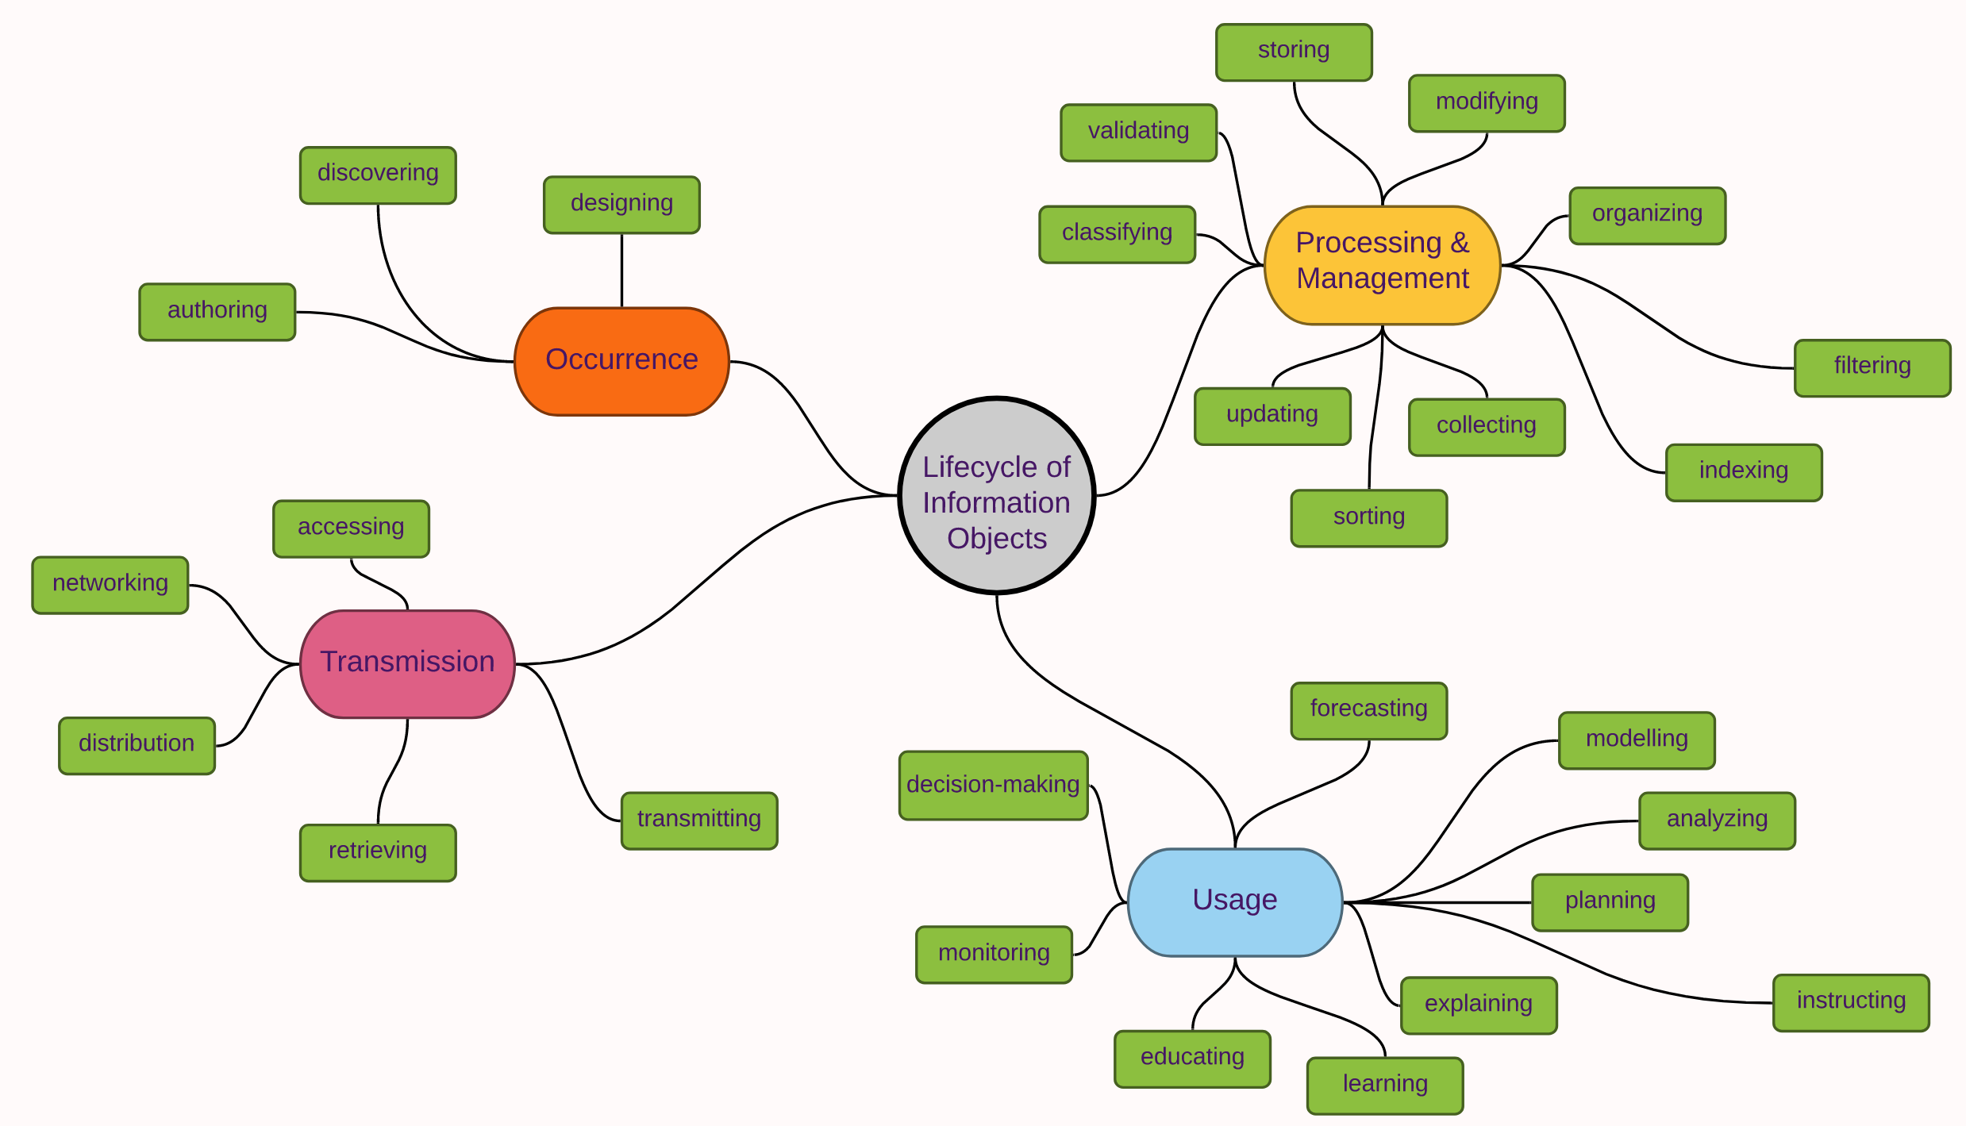

Slide 28
Veracity of Information
Information objects have a structure and properties, and those dependent on perspective.
The structure and properties may or may not be correct and the source of those may or may not be trustworthy.
Information scientists must take probability of veracity into account and understand that the perception of information is subject to bias in human cognition.

Slide 29
Data Scientist vs Computer Scientist vs Data Analyst vs Information Scientist
For the case, what would each of them do?
Data Scientist
Data Analyst
Computer Scientist
Information Scientist
In practice, doesn’t everyone do a little of everything?

Slide 31
Actual Job Titles of Information Science Practitioners
Business Analyst
Data Architect
Ontologist
Business Architect
Enterprise Architect
Knowledge Engineer
Information Architect

Slide 32
Data, Information, Knowledge
Data: Facts and figures which relay something specific, but which are not organized, and which provide no further information regarding patterns, context, etc.
Information: For data to become information, it must be contextualized, categorized, and analyzed. It is data with relevance and purpose.
Knowledge: norms by which individuals use information to drive a course of action and incorporate new information into the decision-making process.
from Alan Frost, http://www.knowledge-management-tools.net/knowledge-information-data.html

Slide 33
Discussion
What is the difference between data and information?
What is the difference between information and knowledge?
How do we establish that information is true?

Slide 34
Parting Thoughts…
The foregoing discussion may have been “academic” and “theoretical”… but it helps to study the influences on some subject...
This is what distinguishes education from training...
A University is a place where you learn, and you acquire an education – unlike a trade school where you learn a skill... of course, there must be some skills training in addition to education...
Education helps you learn future concepts and learn how to learn – it builds knowledge structures...

Slide 35
Summary, Review, & Questions…

