Slide 1
The SECI Model
Martin Schedlbauer, Ph.D.
m.schedlbauer@neu.edu

Slide 2
Types of Knowledge
Knowledge must be managed and can be divided into two categories:
Explicit knowledge:
books, operations manuals, articles, statistical analyses
easily expressed, managed, and shared
Tacit knowledge:
internalized within individuals or organizations ("tribal knowledge"); rooted in experiences
capturing tacit knowledge and sharing it is a challenge

Slide 3
Types of Knowledge Resources
Knowledge is a critical resource for organizations:
Experiential knowledge
Skills, know-how, emotional awareness
Conceptual knowledge
Products, designs, services
Systemic knowledge
Patents, licenses, document, processes, databases
Routine knowledge
Culture, workflows

Slide 4
Creating Knowledge
Nonaka and Takeuchi (1995) proposed the SECI Model of organizational knowledge creation.
SECI has become the cornerstone of knowledge creation and transfer theory.

Slide 5
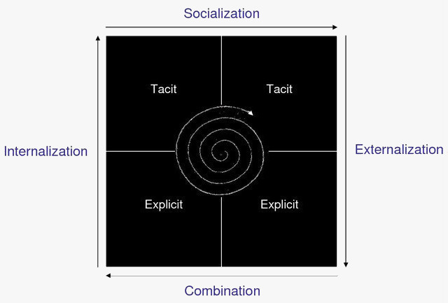
The SECI Model
SECI is based on two types of knowledge:
tacit vs explicit
Four ways in which knowledge can be shared and converted:
socialization
externalization
combination
internalization
Knowledge is continuously converted and created as people practice, collaborate, interact, and learn.

Slide 6
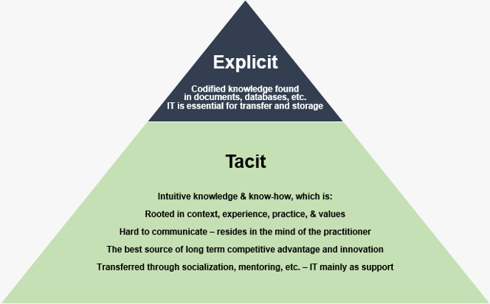
Explicit vs Tacit Knowledge
from Alan Frost, http://www.knowledge-management-tools.net/different-types-of-knowledge.html

Slide 7
Examples of SECI Applications
SECI Framework

Slide 9
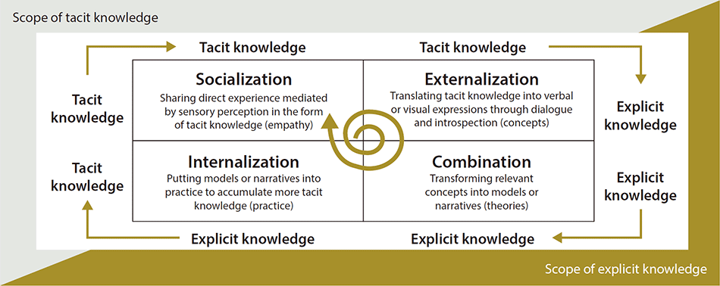

Slide 10
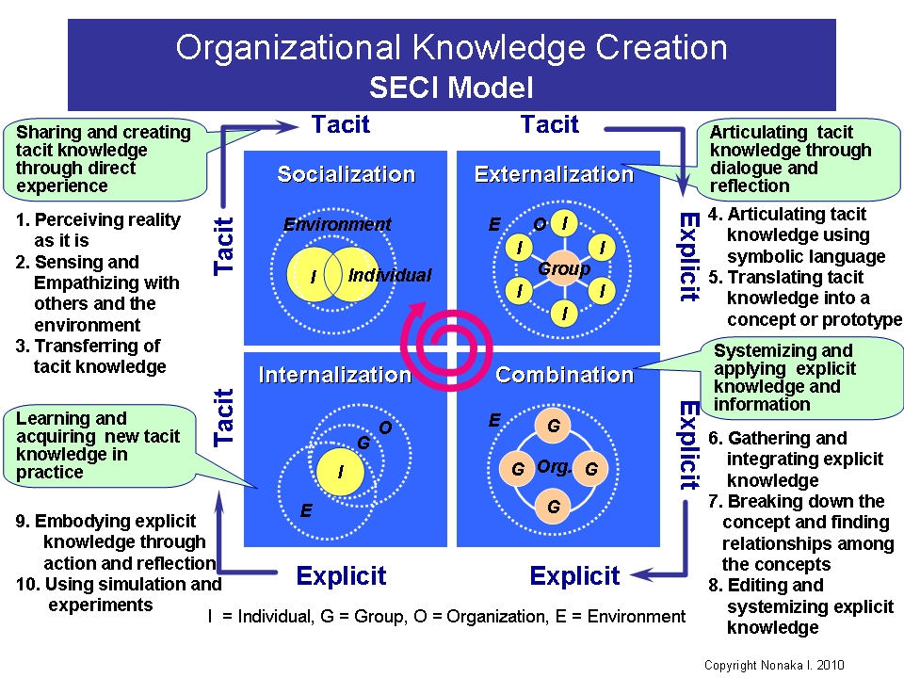

Slide 11
Discussion
What is the effect of culture on knowledge conversion and sharing?
What exactly is culture?
national?
organizational?
Have you experienced different organizational cultures?

Slide 12
IT and Knowledge Creation
IT can be used to create and share knowledge.
IT must support, and not interfere with, informal collaboration:
groupware systems can be used to enhance communication between communities or teams, particularly if they support multi-modal communication (e.g., video, audio, text)
IT aids information management by providing access to data and information allowing in-depth analysis.

Slide 13
Managing Explicit Knowledge
From a managerial perspective, the greatest challenge with explicit knowledge is similar to information:
ensuring that people have access to what they need
properly storing important knowledge in knowledge bases
processes for reviewing, updating, and discarding (stale) knowledge
securing (proprietary) knowledge from unauthorized access, sharing, and use

Slide 14
Information & Knowledge Discovery
Once knowledge is created or acquired, it must be captured and codified:
Interviews
Brainstorming
Observations (empirical)
Focus groups
Workshops
Experiments
Surveys
Document analysis

Slide 15
Tools for Codifying Knowledge
Some tools can help in codifying knowledge:
Decision trees
Decision tables
Ontologies
Information models
Cognitive maps/mind maps
Process maps & models

Slide 16
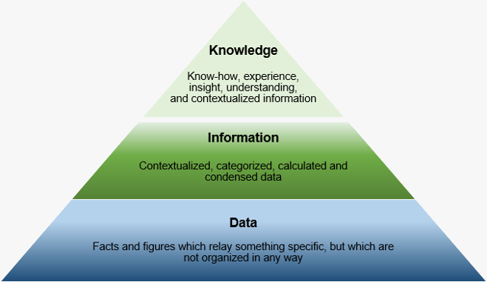
Data, Information, Knowledge
Data: Facts and figures which relay something specific, but which are not organized in any way and which provide no further information regarding patterns, context, etc.
Information: For data to become information, it must be contextualized, categorized, calculated and condensed. It is data with relevance and purpose.
Knowledge: Knowledge is closely linked to doing and implies know-how and understanding. The knowledge possessed by each individual is a product of experience, and encompasses the norms by which the individual evaluates new inputs from his surroundings (Davenport & Prusak 2000).
from Alan Frost, http://www.knowledge-management-tools.net/knowledge-information-data.html

Slide 17
Summary, Review, & Questions…

