Slide 2
In SECI, externalization is knowledge conversion from …
explicit to explicit
tacit to explicit
tacit to tacit
explicit to tacit

Slide 3
In SECI, externalization is knowledge conversion from …
explicit to explicit
tacit to explicit
tacit to tacit
explicit to tacit

Slide 4
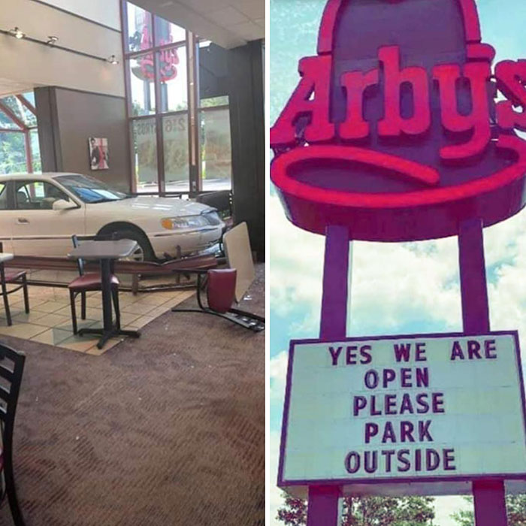

Slide 5
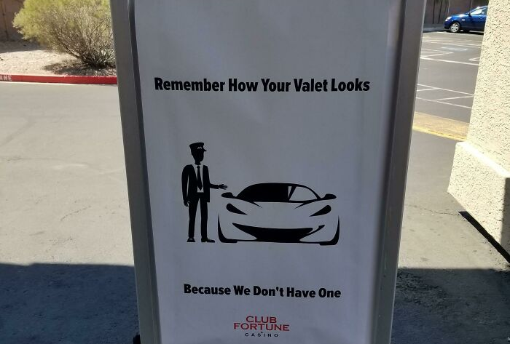

Slide 6
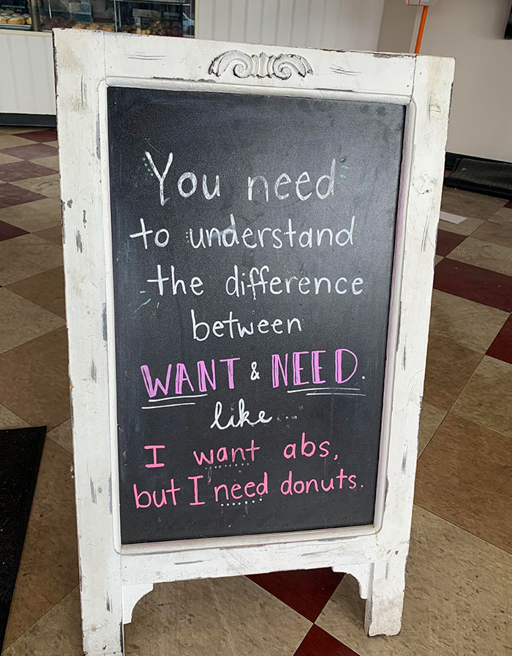

Slide 7
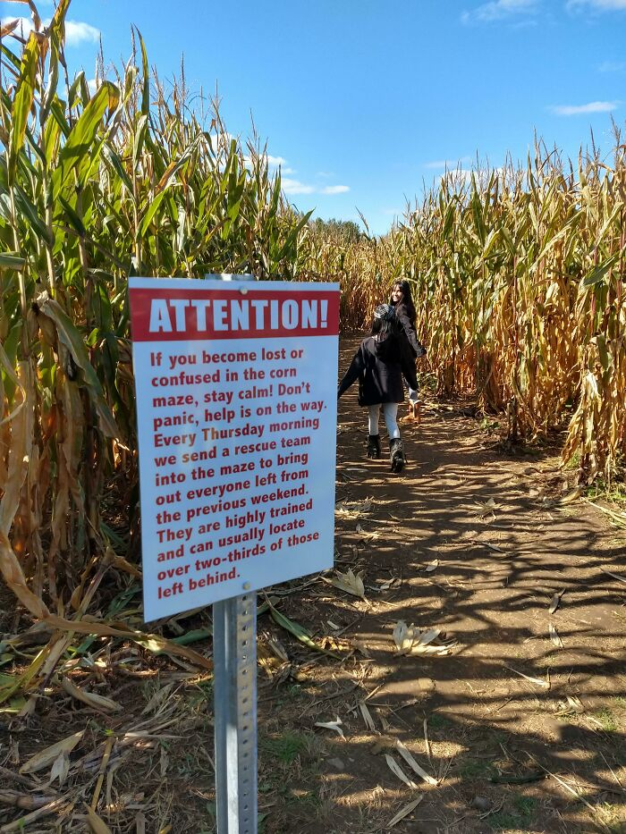

Slide 8
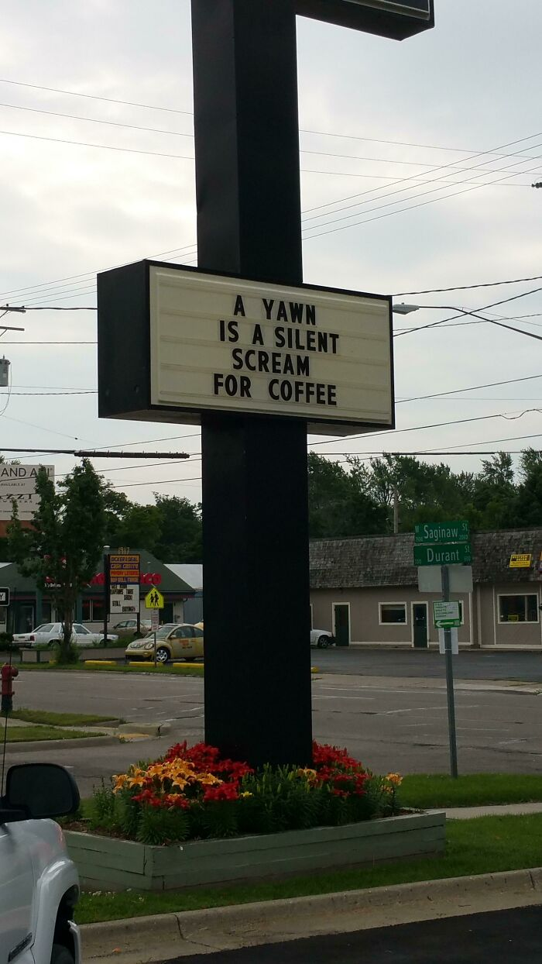

Slide 10
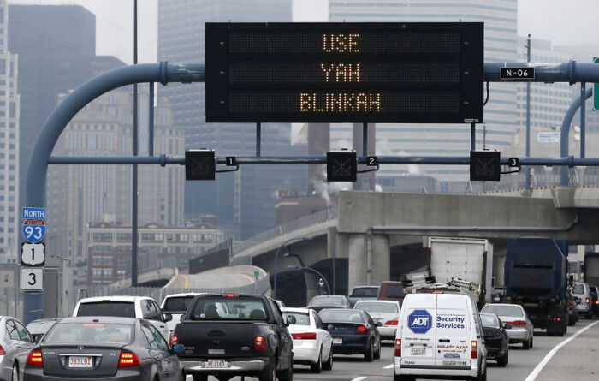

Slide 11
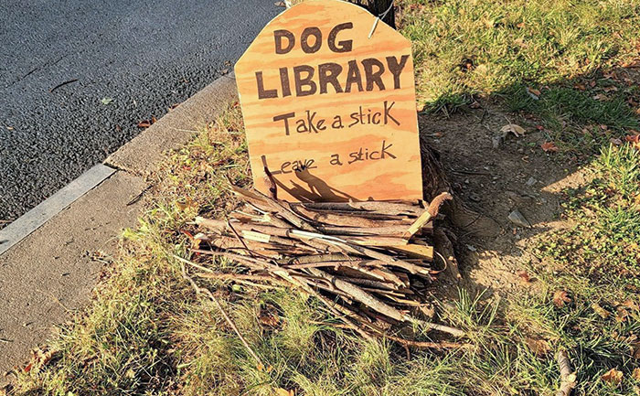

Slide 12
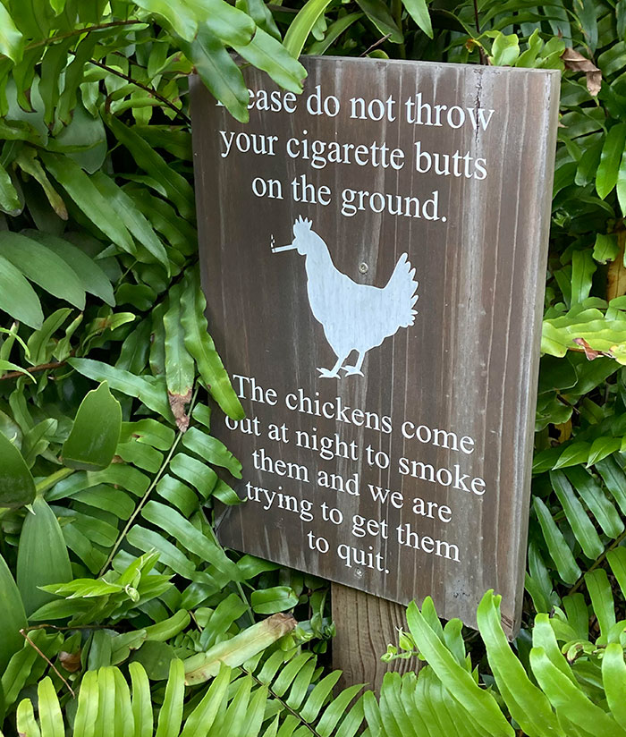

Slide 13
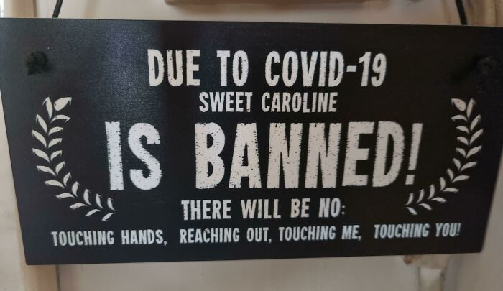

Slide 14
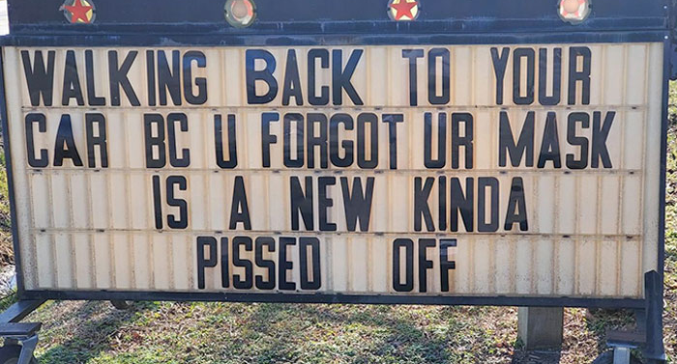

Slide 15
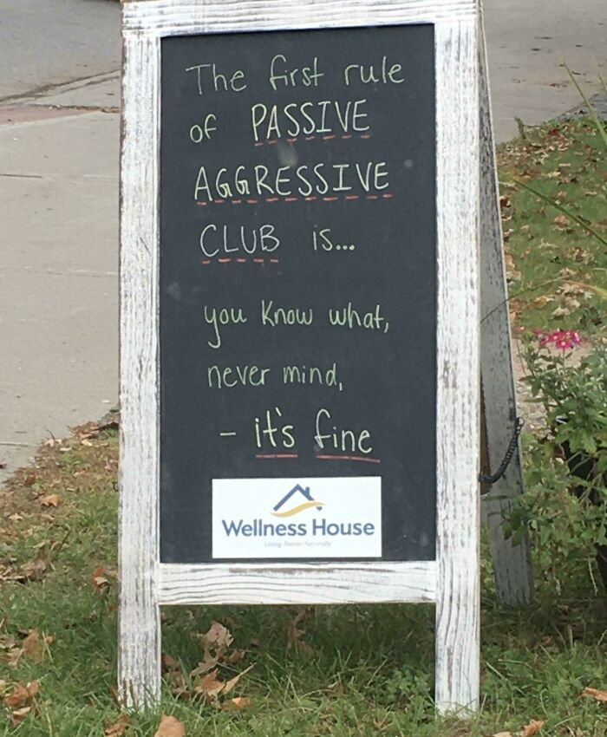

Slide 16
Information Discovery & Collection
Martin Schedlbauer, Ph.D.
m.schedlbauer@neu.edu

Slide 17
Types of Information Objects
Information Collection

Slide 18
Information is Varied
Information comes at varying degrees of granularity, structure, type, and complexity.
Information objects are present in information assets:
Documents
Systems
Processes
People

Slide 19
Information Objects
We mine information assets for information objects:
Physical Objects
Concepts & Abstractions
Events, Interactions, Transactions
Persons, Organizations, Roles
Measurements
Rules and Derivations

Slide 20
Goals of Information Mining
Development of information systems
Creation of ontologies and models for repository design
Database design
User interface design
Navigation of shared information repositories
Wayfinding
Process development
Data Mining, Predictive Modeling

Slide 21
Information Structure
For each information object, we also attempt to discover:
Properties of the object
Structure of the object
Relationships with other objects
Constraints on relationship and object

Slide 22
Operations on Information Objects
Once information objects are discovered, we need to uncover:
Differences with other objects
Similarities with other objects
Combinations with other objects

Slide 23
Perspectives
Discover what exists (current state) or define what is to be (future state).
Decide on one perspective or the other.
Use “use cases” and “competency questions” to narrow which objects are relevant.

Slide 24
Case Study
Micro-loans are small loans, which are rapidly gaining popularity, especially among borrowers in developing countries. The idea is to bring venture lenders together using information technology. Typically, the loans will be used to finance startup or development of the borrower’s company, so that there is a realistic chance for repayment. The money in a loan can, unlike traditional loans, come from many lenders. The following information has been uncovered:
Each borrower and lender must be registered with information about name and address. A loan starts with a loan request, which contains information about when the loan should be granted, the total amount being requested (US$), and how long the payback period should be. Also, a description is included of how the money will be used. The interest on the payment is calculated on the loan amount, which is to say, the full amount is not paid .
When the commitments for the loan request covers the requested amount, the request is converted to a loan. If there are not enough commitments from lenders, the loan request is cancelled. A borrower can have more than one request, and more than one loan at a time, but can at most make one request per day.
The loan is paid through an “intermediary”, typically a local department of a charity, who has a name and an address.
The borrower chooses when he or she will make a payment. Every payment must be registered with an amount and a date (at most one payment per loan per day). The lenders share the repayment based on how large a part of the loan they are responsible for.
If the loan is not repaid before the agreed upon deadline, a new date is agreed. The old deadline must be saved.
Each lender can for each borrower define a “credit risk rating”, which is a number between 0 and 100 that determines the lender’s evaluation of the risk of lending money to that person.
What are the information assets to mine for information objects in the case of micro-loan management.

Slide 25
Sources of Information
Information Collection

Slide 26
Elicitation as Fact Finding Missions
Elicitation is the act of obtaining information from subject matter experts (SMEs).
It is a “fact-finding mission” where the insights of domain experts are uncovered.
Elicitation requires a significant amount of personal interaction and collaboration between the information scientist and the knowledge holders.

Slide 27
Key Sources of Information
After stating the objective of the information gathering effort and the intended use of the information, sources are identified:
individuals, e.g., domain experts
books, articles, white papers
web sites
blogs, social media posts
surveys, focus groups, observations
databases, data files, electronic records
analog records, e.g., journals, records, notes

Slide 28
Elicitation is Collaborative
All elicitation sessions should, whenever possible, be held as collaborative sessions, ideally as face-to-face meetings.
When direct contact with the experts is not possible, then video conferencing, online conferencing, or telephone conversations can be substituted, although these communication modes are not nearly as efficient as direct interaction.

Slide 30
Cognitive Bias
Information collection is subject to a variety of cognitive biases:
In-Group Bias | Gambler's Fallacy
Post-Purchase Rationalization | Neglecting Probability
Observational Selection Bias | Status-Quo Bias
Negativity Bias | Bandwagon Effect
Projection Bias | Current Moment Bias
Anchoring Effect | Confirmation Bias

Slide 31
Elicitation Techniques
There are a number of commonly used information elicitation and fact discovery techniques available.
Generally multiple techniques must be applied to obtain the necessary and sought-after information.
Collaborative
Brainstorming
Interviews
Observation
Investigative
Document Analysis
Surveys
Discovery Prototypes
Facilitated Workshops
Reverse Engineering
Interface Analysis
Focus Groups

Slide 32
Considerations on Application
Each technique should be evaluated by looking at:
Purpose (why): Why should this technique be used? How does its application lead to an efficient gathering of information to answer the research objectives?
Timing (when): When is this technique best applied? How long will it take to apply?
Logistics (where): Where will the information gathering be conducted? What environment is necessary for the information to be effectively gathered?
Process (how): What specific procedures and activities need to be applied?

Slide 33
Recording Discoveries
Any insights or discoveries made during elicitation sessions need to be recorded.
There are a number of approaches to recording information:
Index cards and sticky notes pinned to a wall
Whiteboards or flipcharts
Video or audio recording
Computer-based visual modeling
Notes and journals
Databases and electronic record keeping systems

Slide 34
Interviews
Information Collection

Slide 35
Interviews
Interviews are a direct interaction between the information scientist and the domain experts and other knowledge holders.
Interviewing is the most widely practiced information collection technique and is often used in conjunction with observation.
Interactions can be:
face-to-face
via telephone
via online meeting spaces
via telepresence apparati

Slide 36
Interview Goals
Interviews are used to find, verify, and elaborate facts as well as identify facts and procedures.
They are also employed to solicit ideas, opinions, and preferences.

Slide 37
Interview Timing
Ideally, interviews are conducted as face-to-face sessions lasting about 30 minutes to an hour.
Longer interviews are discouraged as participants tire after about 45 minutes.
Be sure that you finish on time – stick to your deadlines; after all, your stakeholders may have another commitment right after your interview; value their time.

Slide 38
Interview Best Practices
Initially, an unstructured interview – conducted similarly to a brainstorming session with few, if any, specific questions – may be appropriate, but then a more structured interview with a specific set of questions should be used.
You can start by asking open-ended questions requiring a free form response but then follow-up with closed-ended questions where you expect the interviewee to pick a response from a list of specific choices or respond with short and direct answers.
Gauging a person’s communication style might be beneficial.
Find out if the person is an effusive talker or needs encouragement and specific questions to reveal facts.
Adjust your questioning accordingly.

Slide 39
More Best Practices
Interact with interviewees to have them respond freely and openly, but probe for more feedback.
Observe nonverbal communication; it can reveal a great deal about a participant’s attitude toward the line of questioning.
Make sure that you avoid loaded or leading questions that might reveal your own bias.
Don’t include your opinion as part of the question. Use clear and concise language and avoid long or complex questions.
Avoid using technical jargon that might not be understood by your stakeholders.

Slide 40
Listening in Interviews
In the interview listen carefully, maintain control of the interview, ask probing and follow-up questions, and make sure that you understand what the interviewee is saying.
Repeat what they are saying and practice active listening. You should listen more than talk.
Observe their mannerisms and nonverbal communication; it might reveal a lot about how they feel about the objectives, you, or your questions.
Above all, be patient, keep the interviewee at ease, and maintain self-control.

Slide 41
Recording Responses
When possible bring a scribe to take notes or record the meeting using tools such as LiveScribe, Evernote, OneNote or Audacity – these tools allow archiving and searching of the recording for keywords later.
Of course, ask for permission first before you record; it might be against an organization’s policies.

Slide 42
Interview Preparation
Prepare for the interview by writing down your agenda in an interview guide.
The guide can be a printed form or completed on a computer using a word processor or some other tool.
Keep in mind that typing while someone is speaking is often perceived as distracting.
Always ask who else you should be speaking to when you conclude an interview; this reduces the likelihood that you forget to consult an important stakeholder.

Slide 43
Example Interview Template
Interviewer: Interviewee(s) Date & Time: Location: Purpose: | Mark Solenski Moira Davis; Jeff Marino 12/03/16 at 10am LM-603B Understand payment recording process and necessary tracking data
Allotted Time | Question or Interview Goal | Response/Notes
1 to 2 min. | Open interview: Introductions State goals of interview session
5 min. | Question 1 Which payments need to be tagged as past due and routed to A/R immediately for priority processing?
30 min. | Question 2 Can you briefly describe the steps you go through to record a payment for a loan after you have received a check?
10 min. | Question 3 Can you briefly describe which payment statuses (states) you need to know about and how these are used to develop analytics or predictive models?
1 min. | Question 4 Who else do you think I should be talking to?
Total Time: 50 min.
Notes:

Slide 44
Context-Free Questions to Ask
Direct as well as context-free questions can be helpful during interviews to elicit information, gather insights, and understand procedures:
Is there anything else I should be asking you?
Are there others whom I should be talking to?
What happens if <some event> were to occur?
What data can help you answer this question?
What problem does this solve for you?
What are the privacy issues surrounding the use of the collected information?

Slide 45
Observation
Information Collection

Slide 46
Observation
Observation is a fact-finding technique in which the information scientist either participates in or watches a person perform activities to learn about a process, procedure or difficulties in using an information system.
This technique is also known as job shadowing.
Observation let’s one see how work is actually done rather than how it is described in interviews.

Slide 47
Caution: The Hawthorne Effect
When observed some subjects may not do the work as they normally do – they may do it “by the book” and it’s hard to see what they actually do when the information scientist is not around.

Slide 48
Active vs. Passive Observation
Observations can be active or passive.
In an active observation, the information scientist asks questions, probes for details, and perhaps even participates in the process.
In a passive observation, the information scientist does not interact with the person being observed; ideally, the person does not even know they are being observed, although that’s often difficult to do in practice.
Passive observation can be visible or invisible.

Slide 49
Active vs. Passive Observation
 | Pros | Cons
Active | Better understanding through hands-on experience Questions answered immediately, thereby minimizing information gathering time | Might be uncomfortable for participant Won't know how long process takes Inadvertent change of process More time needed to capture ideas and information
Passive | Accurate picture of how a process is done Understanding of how long the process takes to carry out Detailed data collection for time studies and process analytics | Unanswered questions require follow-up Can’t ask for explanations

Slide 50
Challenge Questions
During an active observation, the information scientist should challenge the domain expert in order to elicit hidden assumptions and details:
Is the work always done like this?
When would you do this differently?
How often does this activity get done in a day (or hour, week, month)?
Does everyone perform the task the same way?
Who does it differently? Why?
Is there information you rely on during this process?
Where do you get the information from?

Slide 51
More Challenge Questions
Do you produce any information? If so, to whom do you provide it?
Are there any rules you have to follow? Who defines these rules?
Is this a standard process? Is the standard documented? Where?
What would happen if the process were done differently?
Does it always take the same amount of time?
What events could occur that would change the process?

Slide 52
Benefits and Challenges of Observation
Benefits
Actually see how work is done rather than how people describe the work in an interview or in an operating procedure
Challenges
People may perform process differently when being observed
Complex tasks are easier to understand
Relatively inexpensive to conduct
Ability to take measurements of time needed or materials used
Work observed may not be representative of normal conditions
Timing can be inconvenient
Interruptions can throw off time measurements
Some tasks not always performed the same way
Different people may perform the same task differently
Easier to identify hand-offs between multiple parties

Slide 53
Surveys
Information Collection

Slide 54
What is a Survey?
A survey is a method of collecting information about attitudes, knowledge, or behavior from a group of people anonymously through questioning or polling.
A survey is a means of eliciting information from many people, sometimes anonymously, in a relatively short period of time. A survey can collect information about customers, products, work practices and attitudes. A survey may also be referred to as a questionnaire.
BABOK Version 2.0, 9.31

Slide 55
Polls vs. Surveys
Polls and surveys are quite similar, but differ in a few important aspects
Polls | Surveys
Generally a single question | Multiple questions
Quick response | More time to complete
Simple question | In-depth questions
View results immediately and often publically | Results published after careful analysis
Generally not paid | Sometimes respondents are paid to participate in a survey

Slide 56
Survey Process
Prepare
Distribute
Analyze
Report

Slide 57
Survey Process
Prepare
Distribute
Analyze
Report

Slide 58
Prepare Survey
Define the goal or purpose of the survey
Identify the target audience and build a random sample
Increase response rate through:
Incentives, e.g., gift or price drawing
Pressure, e.g., management directive
Keep survey short (5 – 10 minutes) and show progress as survey is administered
Communicate completion time before survey starts
Test the survey carefully and thoroughly
Peer review questions and administer to a trial audience

Slide 59
Writing Survey Questions
Keep to 10-12 questions at the most
Create multiple surveys and split sample if you need to ask more questions and cannot restructure your questionnaire
Keep questions in logical order; group like questions
Address a single point per question; do not combine multiple questions (avoid the use of “and”)
Do not use negative phrasing
Avoid jargon or terminology unfamiliar to audience

Slide 60
Question Types
A survey may contain several types of questions:
Closed (Restricted) Questions
Easy to tabulate and evaluate statistically
Assumes that answer range is known
Open-Ended Questions
Free-form answers, but are more difficult to tabulate and analyze
Obtain a wider range of answers; not restricted to specific answers
Partially Open-Ended Questions
A closed question with an open-ended response option (“Other”)
A good survey leverages all types of questions

Slide 61
Closed (Restricted) Questions
The respondent is asked to choose an answer from a set of specific responses
Works well when potential answers are known beforehand
Closed questions can be designed as:
Multiple choice: only a single answer
Multiple answer: multiple answers
True/False: agree or disagree with a statement
Rating Scale: rate on a numeric or other scale
Agreement (Likert) Scale: rate agreement with a statement

Slide 62
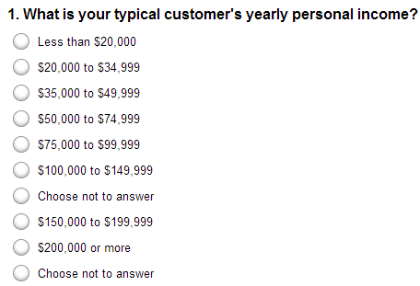
Example: Multiple Choice

Slide 63
Example: Multiple Answer

Slide 64
Example: Rating Scale

Slide 65
Example: Agreement/Likert Scale
A Likert scale provides of statements to which respondents indicate their level of agreement on a scale that ranges from “Strongly Agree” to “Strongly Disagree”

Slide 66
Survey Process
Prepare
Distribute
Analyze
Report

Slide 67
Distribute Survey
Several factors influence the distribution of surveys:
Urgency of getting responses
Geographic location of survey audience
Level of privacy/anonymity required to obtain accurate results
Organizational policies and restrictions

Slide 68
Distribution Options
Surveys are commonly administered through:
Web as questionnaires or polls
Mail
Telephone
Face-to-Face Interviews
Group-Administered Interviews

Slide 69
Web Polling & Survey Platforms
A partial list of web polling and survey platforms:
SurveyMonkey
SurveyGizmo
Zoomerang
Opinio
KeySurvey
SurveyMethods
QuestionPro
Vovici
PollDaddy

Slide 70
Selecting a Web Survey Platform
Some features to consider when selecting a web survey platform:
Flexible survey look and feel (themes)
Skip logic for complex survey definition
Piping to pull survey results from one question to another
Randomization of questions and question order to increase statistical validity
Website embedding (through iframes)
Data analysis (pre-defined reports and ad hoc through Excel)
Price
Browser compatibility

Slide 71
Survey Process
Prepare
Distribute
Analyze
Report

Slide 72
Analyze Survey Results
Analyze the responses to the questions based on question type:
Closed questions are tabulated and statistically summarized
Open question are combed for themes
Many web survey platforms provide statistics and charts and allow raw data to be downloaded as Excel workbooks or CSV files for detailed analysis

Slide 73
Statistical Analysis
Question Type | Suitable Statistics | Chart or Graph
Multiple Choice or Multiple Answer | Count how often each answer choice was selected | Frequency Plot or Histogram
True/False | Count how often each answer choice was selected | Pie Chart
Rating Scale or Agreement Scale | Mean; Median; Standard Deviation; Range; Frequency | Frequency Plot or Histogram

Slide 74
Survey Problem: Nonreponse Bias
Respondents who don’t complete the survey may do so for specific reasons, therefore the results of the survey are biased
For example, someone who is very happy with a process may be less likely to complete a satisfaction survey, while those who are unhappy with it may be more inclined to complete the survey
Approach to minimize nonresponse bias:
Contact respondents and remind them to complete survey
A minimum of four contact times is suggested

Slide 75
Survey Process
Prepare
Distribute
Analyze
Report

Slide 76
Report Survey Results
Write a report that contains:
Statement of survey purpose and goal
How target audience was identified and how sample was selected
Size of target audience to which survey was administered and how many responses were received
Survey distribution method and why it was selected
Any incentives or influences used to increase response rate
How non-response bias was addressed, if at all
Summary statistic and evaluation of themes
Conclusions and recommendations

Slide 77
Survey Advantages and Challenges
Advantages | Challenges
Easy to get responses from many stakeholders | Large number of responses to collate unless data collection is automated
Inexpensive to administer | Creating good surveys is difficult
Effective when stakeholders are geographically dispersed | Difficult to get a large enough sample to be statistically significant
Closed questions are easy to evaluate | Use of open-ended question requires manual analysis
Quick to obtain statistical measures | Unanswered questions and non-response bias can skew results
 | Cannot determine actual behavior
 | May require follow-up interviews or focus groups to get more information

Slide 78
The Problem of Bias
All information collection activities are subject to bias:
non-response bias
confirmation bias

Slide 79
Summary, Review, & Questions…

