Slide 1

Principles of Information Science
Information-Based Decision Making
Martin Schedlbauer, Ph.D.
m.schedlbauer@neu.edu

Slide 2
Information is not always correct
Thus far, we have treated all collected information as “correct” or “true” without regard to the likelihood that it is correct.
Veracity of information must be considered as “true” information is more valuable than incorrect information.
We need to assess the “value” of information and the risk that it is not true.

Slide 3
Decision Trees and Bayesian Analysis can help us understand the correctness of information and thus establish a value.
Both require an understanding of probability…

Slide 4
Key Concepts of Probability
Information Uncertainty, Risk, and Valuation

Slide 5
Concept of Probability
Probability is the likelihood or chance that some random event will occur.
It is described by:
0 means that there is no chance that the event happens, while 1 means that the events happens with certainty.

Slide 6
Complementary Probability
If an event has a chance P of occurring then there’s a chance of 1-P that it will not occur.

Slide 7
Approaches to Determining Probability
Likelihood of something being true can be expressed mathematically through a probability.
Four approaches to understanding probabilities:
  Logical Approach based on the concept of fair game or gambit
  Empirical Approach where the probability of an event is derived from its relative frequency of occurrence in the past
  Subjective Approach where the probability is based on intuition and understanding of the “game”
  Bayesian Approach where new facts revise the probability of an event over time

Slide 8
Logical Probability
The chance that some favorable outcome of a possible number of outcomes will occur.
Classic example is throwing a die or picking a card from a deck.

Slide 9
Empirical Probability
An assessment of the probability based on observation or prior history.
Requires the collection of historical data.
What is the probability that a randomly chosen cereal is made by Kellogg?
What is the probability that a randomly chosen cereal is neither made by Quaker nor by Post?

Slide 10
Subjective Probability
Subjective probabilities are common in business where not all possible outcomes are knowable or no data is available.
It is essentially a person’s guess as to the likelihood of an event occurring.
Often expressed an a percentage, e.g., there’s a 60% chance that the deal will close which means P(Deal)=0.6.

Slide 11
Example of Subjective Probability
The probability of the event is determined by essentially guessing (or more accurately, estimating) its value based on prior knowledge of relevant circumstances.
It accounts for personal experience.
Examples:
  What is the probability that the Dow Jones Industrial Average will exceed 19,000 tomorrow?
  What is the probability that some security will trade at some specific value at some point in time in the future?

Slide 12
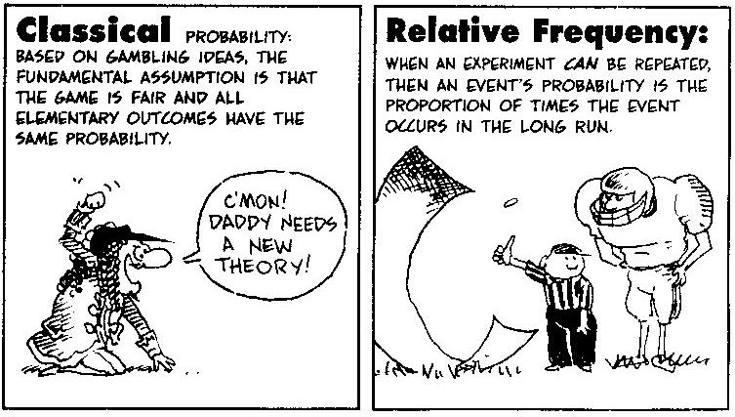
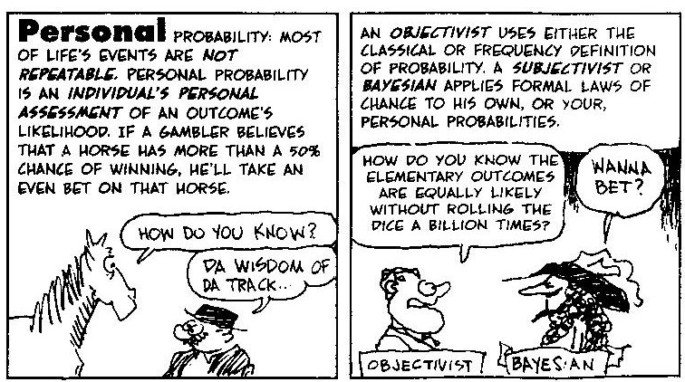
A Lighter view of Probability Theories

Slide 13
Probability Assessment
Exercise 3-1
Format: | Groups of 3-4 participants
Time: | 10 minutes + 5 minutes for review
Goal: | Determine which probabilities.
Materials: | Flipchart or whiteboard; virtual whiteboard
Instructions: | From the Cereal data set, below is a list of the number of cereals each manufacturer produces: What is the probability that a randomly chosen cereal is made by Kellogg? What is the probability that a randomly chosen cereal is neither made by Quaker or by Post?

Slide 14
Empirical Probability Distribution
A probability distribution is a table of all possible events and their associated probabilities.
The probabilities are cumulative and must add to 1.

Slide 15
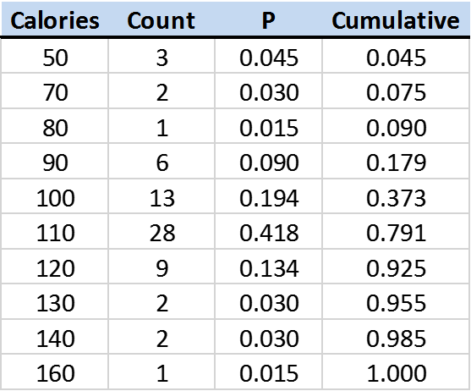
Empirical Probability Distribution
Number of cereals for each observed amount of calories:
3/67
Total cereals in sample = 67

Slide 16
Cumulative Probability
What is the probability that a box of cereal has less than 100 calories?
What is the probability that a cereal has more than 100 calories?

Slide 17

Creating a Histogram in Excel
Demonstration of histogram (frequency plot) in Excel…
Task:
Visually evaluate whether the calories data in the Cereal Data set is normally (or close to normally) distributed.
Approach:
Create a set of bins from the smallest to the largest data value
Determine how many values fall into each bin using the =frequency() function
Plot the data in a column chart
Inspect the plot and determine if it looks reasonably close to a bell curve
Data Set: Cereal Data

Slide 18
Example: Histogram
The resulting histogram (column chart frequency plot):
The conclusion is that the data is reasonably normally distributed. In a correlation analysis both variables must be reasonably normally distributed.

Slide 19
Histogram and Probability Assessment
Exercise 3-2
Format: | Groups of 3-4 participants
Time: | 15 minutes + 5 minutes for review
Goal: | Build a histogram and determine empirical probabilities.
Materials: | Flipchart or whiteboard; virtual whiteboard
Instructions: | Construct a frequency table for the number of properties sold in each price range from 0 to 90000, 90000 to 120000, 120000 to 150000, 150000 to 200000, and 200000 and above. Create a histogram of the distribution of home sale prices. What is the probability that a home will sell for more than $200,000?

Slide 20
Expected Value
The expected value or average value of a cumulative probability distribution function is the sum product of the values and their probabilities:

Slide 21
Calculation of Expected Value
What is the average number of calories in a cereal?
Since the probability is not even, we must calculate the expected value not a simple average.
Multiply each pair of calories and frequencies (P) and sum those products.
Expected value = 105.5 calories.
×
Use the =sumproduct function to multiply and add two columns of values.

Slide 22
Expected Value
Exercise 3-3
Format: | Groups of 3-4 participants
Time: | 15 minutes + 5 minutes for review
Goal: | Calculate the expected value of a probability distribution.
Materials: | Flipchart or whiteboard; virtual whiteboard; case study data set; Excel
Instructions: | Using the case study data set, construct a cumulative frequency table for the number of properties sold each year, then calculate the expected number of properties sold each year.

Slide 23
Decision Trees
Information Uncertainty, Risk, and Valuation

Slide 24
Decision Analysis with Decision Trees
A decision tree is a map of the possible outcomes of a series of related choices that allows a decision maker to evaluate possible actions based on cost.
Used to drive an individual decision or form the basis of an algorithm that determines the most rational choice using a computer model (machine learning).
A decision tree generally starts with a single node and the branches that represent the different decision alternatives.
Each alternative leads to additional choices which eventually lead to outcomes or payoffs.
Alternatives are augmented with the probability of occurrence which can be empirically or subjectively determined.

Slide 25
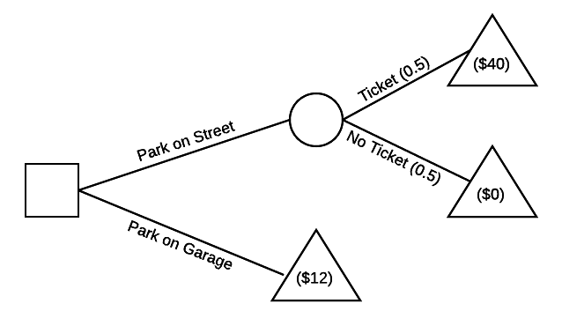
Example: Parking in Boston
The probabilities are empirically or subjectively determined. If there is no further information, each alternative is equally likely.

Slide 26
Symbols for Constructing Decision Trees
outgoing edges represent the alternatives that the decision-maker can choose
Decision node
outgoing edges with probabilities represent the alternatives that the decision maker does not control
Chance node
leaves of the tree state the payoff from the sequence of decisions and outcomes on that branch
Payoff node
Tree: the root is at the left, outgoing edges go right
Notes:
Trivial example: no chance nodes
Simple example: one decision, with one level of chance nodes
Sequential (dependent) chance nodes
Sequential decision nodes

Slide 27
Analysis Process with Decision Trees
Categorize the decisions and outcomes (complete and mutually exclusive)
Model the decision process as a tree
If the outcomes are uncertain (usually the case), assign probabilities to them in the tree.
Assign a numerical “payoff” value to each final outcome.
Notes:
How are the probabilities obtained?

Slide 28
Determining the most “Rational” Decision/Choice
The “backed-up-value” algorithm:
  Find a rightmost (non-payoff) node that does not have a value written in it, calculate its value, and write it in the node
  When backing up to a choice node, cross out outgoing edges except the one leading to the maximum-valued child.
  Once the root has a value, follow the outgoing decision edges that are not crossed out to get the answer – how to make every decision if you are behaving rationally !!

Slide 29
Review: Expected Value (based on Probability)
Assume that outcomes have numeric values (which we call “payoffs”).
The expected value of U is the average of the values, weighted by their probabilities.
Example: Expected value of a grade:
    {A (0.25), B (0.4) , C (0.2), D (0.1), F (0.05)}
Expected value: Σ V(Xi) * P(Xi)
    4 * 0.25 + 3 * 0.4 + 2 * 0.2 + 1 * 0.1 + 0 * 0.05 = 2.7

Slide 30
Example: Evaluating a Decision Tree with EMV
EMV of the two choices
  0.5×(-40) + 0.5× (0)
($20)
($12)
The highest payoff of the two alternatives
A decision that does not lead to a maximum payoff is rejected and cross out.

Slide 31
Evaluating a Decision: Parking in Hospital
Let’s complete this together…
Ticket (0.4)
-$41
> 1 hour (0.5)
No ticket (0.6)
-$1
1-hour
Meter
< 1 hour (0.5)
-$1
Garage
> 1 hour (0.5)
-$20
< 1 hour (0.5)
-$12

Slide 32
Construct Decision Tree
Exercise 4-1
Format: | Groups of 3-4 participants
Time: | 15 minutes + 5 minutes for presentation
Goal: | Create decision tree and recommend course of action
Materials: | Flipchart or whiteboard; virtual whiteboard; case study; Excel or calculator
Instructions: | Build a decision tree to determine the most rational choice for the following decision problem: Madeline’s client is upset with her real estate broker for not alerting her to the presence of UFFI in the house she bought; she feels that she overpaid by $15,000. She is considering suing her broker. Ms. Madera said that there’s a 40% chance they’ll offer a settlement of $7,000. If she doesn’t get the offer, she’ll sue. Now, if the law suit gets dropped by the court then she’ll owe Ms. Madera $1,000 for court expenses and attorney fees. If it goes to trial and she loses then her costs will be $5,000 for expenses and fees. What should Madeline’s client do?

Slide 33
Construct Decision Tree
Exercise 4-1
Format: | Groups of 3-4 participants
Time: | 15 minutes + 5 minutes for presentation
Goal: | Create decision tree and recommend course of action
Instructions: | Build a decision tree to determine the most rational choice for the following decision problem: Farm Grown LLC produces cases of perishable food products. Each case contains an assortment of vegetables and other farm products. Each case costs $5 and sells for $15. If there are any cases not sold by the end of the day, they are sold to a large food processing company for $3 per case. The probability that daily demand will be 100 cases is 0.3, 200 cases is 0.4, and 300 cases is 0.3. Farm Grown has a policy of always satisfying customer demand. If it runs out of supply, it purchases what’s necessary from a competitor at $16 per case. How many cases do you recommend they produce each day?

Slide 34
























Slide 35
Value of Perfect Information
Information Uncertainty, Risk, and Valuation

Slide 36
Collecting New Information
Often there is an opportunity or a need in a decision process to collect additional information.
Collecting additional information involves time and cost.
The question is:
  When it is worth collecting additional information?

Slide 37
“Perfect” Information
The decision whether to collect more information begins by determining the value of perfect information.
Perfect information removes all uncertainty about the outcomes for the decision alternatives.
While it is rarely possible in practice to remove all uncertainty, the value of perfect information provides an easily calculated ceiling about the worth of collecting additional information.
If all the available options for collecting information cost more than the value of perfect information, then these options do not need to be analyzed in further detail.
This is because imperfect information cannot be worth more than perfect information.

Slide 38
The Value of Information
How much should you pay to know the outcome of the chance nodes, i.e., can we define an economic value of information?
Limit case:
  perfect information, i.e., information that will allow you to make a “perfect” or best decision

Slide 39
Decisions with Perfect Information
Once a decision tree exists, if there is uncertainty (i.e., chance nodes), an alternate tree can be created where the uncertainty is resolved BEFORE a decision is made.
The difference in expected value at the root gives a measure of the economic value of the information that resolves the uncertainty.

Slide 40
Example: What Crop to Grow?
Hot 0.6
$25K
$17K
Corn
Cool 0.4
$5K
$17K
Hot 0.6
$10K
Soybeans
$14K
Cool 0.4
$20K
What if the farmer could know the weather in advance ?
If hot, still choose corn, but if cool could choose soybeans!

Slide 41
Estimating the Value of “Perfect Information”
Invert the tree…
Corn
$25K
$17K
$25K
Soybeans
vs.
Hot 0.6
$10K
$23K
Corn
$5K
Cool 0.4
$20K
Soybeans
$20K
So the value of perfect information is no more than $6,000.

Slide 42
Calculate Value of Perfect Information
Exercise 4-2
Format: | Groups of 3-4 participants
Time: | 10 minutes + 5 minutes for presentation
Goal: | Calculate value of perfect information
Instructions: | A homeowner has to decide whether to upgrade the landscaping for $20,000 prior to selling their house. If she does, then there’s a 20% chance that she can sell for $260,000 but it’s more likely that she’ll sell for $230,000. If she does nothing, she’ll probably get $220,000. What is the most she should pay a consultant for a market analysis? Use the decision tree below.
Sell for $260K (.2)
$240K
Landscape
Sell for $230K (.8)
Do nothing
$210 K
$220K

Slide 44
Summary
In this module we learned that:
  decision trees aid in rational decision making by focusing on expected payoff
  The value of perfect information can be estimated

Slide 45
SOLUTION: Construct a Decision Tree
Exercise 4-7
-$1k
Drop
No offer (0.6)
Win (.5)
$15k
$5k
$5.8k
Trial
$5k
Sue
-$5k
$5.8k
Lose (.5)
Don’t sue
$0
Offer (0.4)
Win (.5)
$15k
Refuse
$5k
$7k
Lose (.5)
-$5k
Accept
$7k
Cost of filing a lawsuit = $1k Win at trial, award will be $15K
Cost of trial = $5k If a settlement is offered it will be $7K
Probability of win or lose trial is 50/50 or 0.5

Slide 46
Motivating Exercise
A friend proposes a wager: You will pay her $9.00, and then a fair die will be rolled (fair “gambit”). If the die comes up a 3, 4, 5, or 6, then your friend will pay you $15.00. If the die comes up 1 or 2, she will pay you nothing. Furthermore, your friend agrees to repeat this game as many times as you wish to play.
Question: Should you agree to play this game? How would you analyze the “decision”? What information do you need to make a decision? How would you arrive at the decision?

Slide 47
Bayesian Analysis
Information Uncertainty, Risk, and Valuation

Slide 48
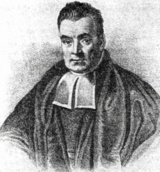
Who is Thomas Bayes?
Rev. Bayes was a Presbyterian Minister and amateur mathematician born in 1701.
He founded a novel way of looking at likelihood in an era when probability theory was based on winning games of chance.

Slide 49
The Genius of Bayes
Bayes' genius was to not look at probability as a way of figuring our what the likelihood of a favorable outcome was, but to pose the opposite question:
  Classical Probability: what is the probability of getting four aces in three consecutive hands?
  Bayes' Take: if somebody gets four aces in three consecutive hands, what's the chance he's cheating or just really lucky?

Slide 50
Bayesian Analysis
Bayesian Analysis is centered around a simple concept in decision making:
and if so
Do we modify our decision when facts change?
How do we modify our beliefs and change our decision when new information becomes known, i.e., we have acquired additional knowledge?

Slide 51
Probability Theories

Slide 52

Bayesian Analysis & Classification
Bayesian Analysis is often used in classification, i.e., deciding into which class an object belongs.
What is this?

Slide 53
Bayesian Inference
Bayesian inference is a method of statistical inference in which Bayes‘ theorem is used to update the probability for a hypothesis as more evidence or information becomes available.
Bayesian inference is an important technique in statistics, and especially in machine learning and information classification.

Slide 54
Motivation: Disease Screening
1% of women at age 40 who participate in routine screening have breast cancer.
80% of women with breast cancer will get positive mammographies.
9.6% of women without breast cancer will also get positive mammographies.
What is the probability that a 40-year-old woman actually has breast cancer given that she had a positive mammography in a routine screening?

Slide 55

Simplified Bayes' Theorem
The revised conditional probability of an event A being true given that B is true (or has happened) is given by:
$$P\left(A | B\right)=\frac{P\left(B | A\right)P(A)}{P(B)}$$

Slide 56
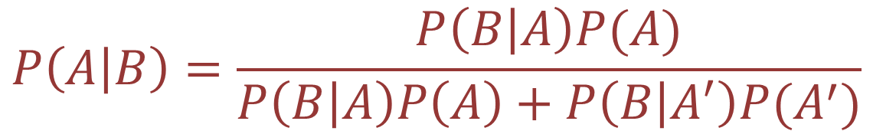
Full Bayes' Theorem
The revised conditional probability of an event A being true given that B is true (or has happened) is given by:
We often use the simplified (naïve) form in practice as it is easier to calculate and yields the same “information”.
$$P\left(A | B\right)=\frac{P\left(B | A\right)P(A)}{P\left(B | A\right)P\left(A\right)+P\left(B | A^{′}\right)P(A^{′})}$$

Slide 57
Demonstration: Disease Screening
1% of women at age 40 who participate in routine screening have breast cancer.
80% of women with breast cancer will get positive mammographies.
9.6% of women without breast cancer will also get positive mammographies.
What is the probability that a 40-year-old woman actually has breast cancer given that she had a positive mammography in a routine screening?

Slide 58
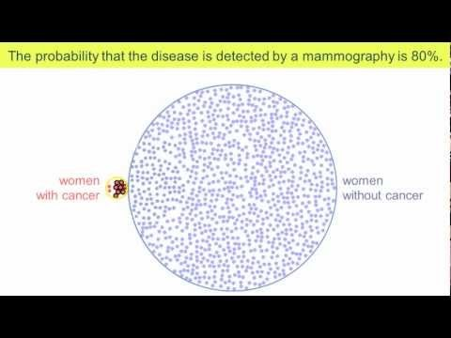
Tutorial: Disease Screening

Slide 59
Demonstration: Cause Analysis
Before going on vacation for a week, you ask your friend to water your plant. Without water, the plant has a 90 percent chance of dying. Even with proper watering, it has a 20 percent chance of dying. And the probability that your friend will forget to water it is 30 percent.
Where might the probability estimates have come from?
What’s the chance that your plant will survive the week?
If your friend forgot to water it, what’s the chance it’ll be dead when you return?
If it’s dead when you return, what’s the chance that your friend forgot to water it?

Slide 60
Given Probabilities
W = watered plant W’ = did not water plant
D = plant dead D’ = plant alive (not dead)
Plant is dead given that is was not watered:
Plant is dead given that is was watered:
Friend forgot to water plant:
P(D|W’) = 0.9
P(D|W) = 0.2
P(W’) = 0.3 and P(W) = 0.7

Slide 61
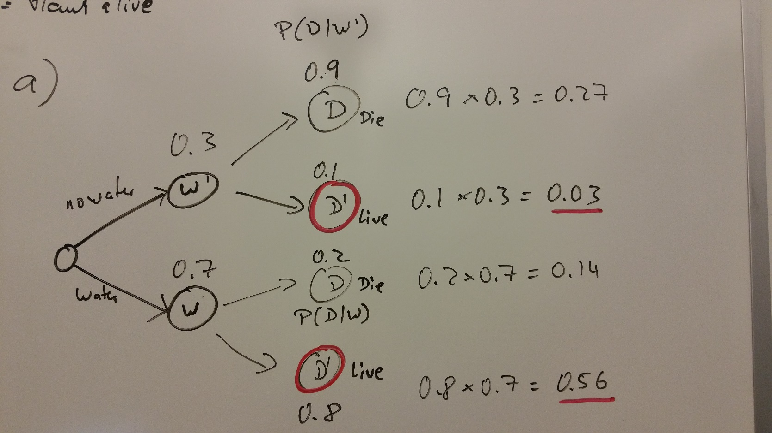
Problem (b)
Problem (b) is best solved with a decision tree:

Slide 62
Problem (c)
Problem (c) is actually given, P(D|W) = 0.2

Slide 63
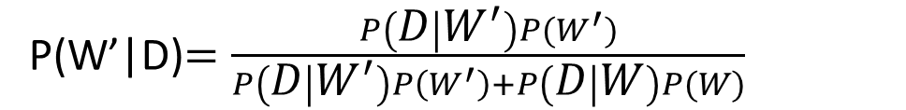
Problem (d)
This requires Bayesian Analysis:
P(W’|D)$=\frac{P\left(D | W^{′}\right)P(W^{′})}{P\left(D | W^{′}\right)P\left(W^{′}\right)+P\left(D | W\right)P(W)}$

Slide 64
Naïve Bayes in Action
We need to classify whether players will play or not based on weather conditions.
Assume you have a training data set (i.e., a data set of historical observations) of weather and whether players played in those weather conditions.

Slide 65
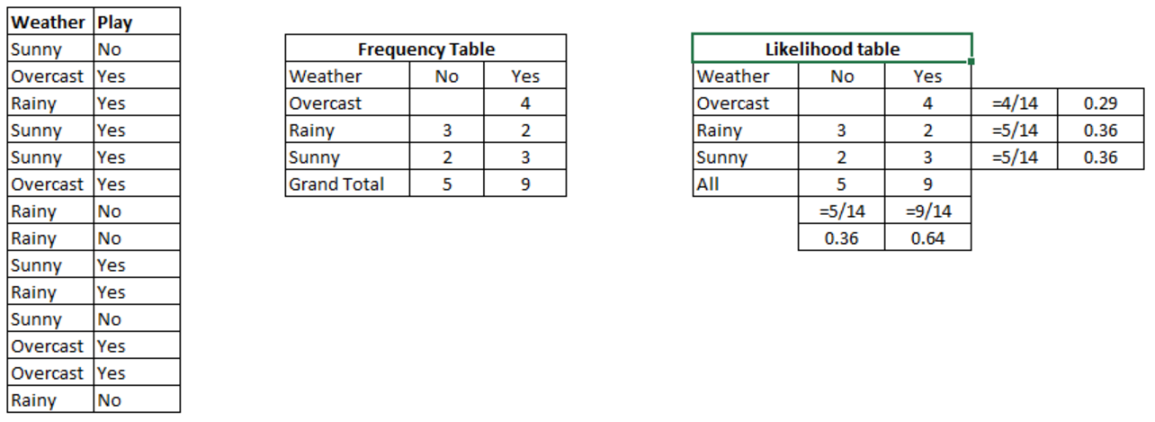
Training Data Set

Slide 66
Estimate Probabilities
Step 1:
  Convert the data set into a frequency table
Step 2:
  Create probability table and derive the probabilities, e.g., P(Overcast) = 0.29 and P(Playing) = 0.64.

Slide 67
Calculate Posterior Probabilities
Step 3:
  Use Naïve Bayesian Inference to calculate the posterior probability for each class.
  The class with the highest posterior probability is the outcome of prediction.

Slide 68
A Problem
Problem:
  Players will play if weather is sunny.
  Is this statement is correct?

Slide 69
Solution
We can solve it using above discussed method of posterior probability.
  P(Yes | Sunny) = P( Sunny | Yes) * P(Yes) / P (Sunny)
Here we have P (Sunny |Yes) = 3/9 = 0.33, P(Sunny) = 5/14 = 0.36, P( Yes)= 9/14 = 0.64
Now, P (Yes | Sunny) = 0.33 * 0.64 / 0.36 = 0.60, which has higher probability than 50/50.

Slide 70
Estimate Probability
Exercise 4-1
Format: | Groups of 3-4 participants
Time: | 15 minutes + 5 minutes for presentation
Goal: | Recommend a course of action using Bayes’ Theorem
Instructions: | Use Bayes’ Theorem to calculate the probability: John wants to build a small golf practice range. He believes the chance of building a successful range is 40%. His friend Alice suggests that he conduct a survey. There is a 0.9 probability that the survey will be favorable if the driving range is a success. There’s a 0.8 probability that the survey will be unfavorable if the driving range is not a success. What is the chance of a successful range if the market survey is favorable?

Slide 71
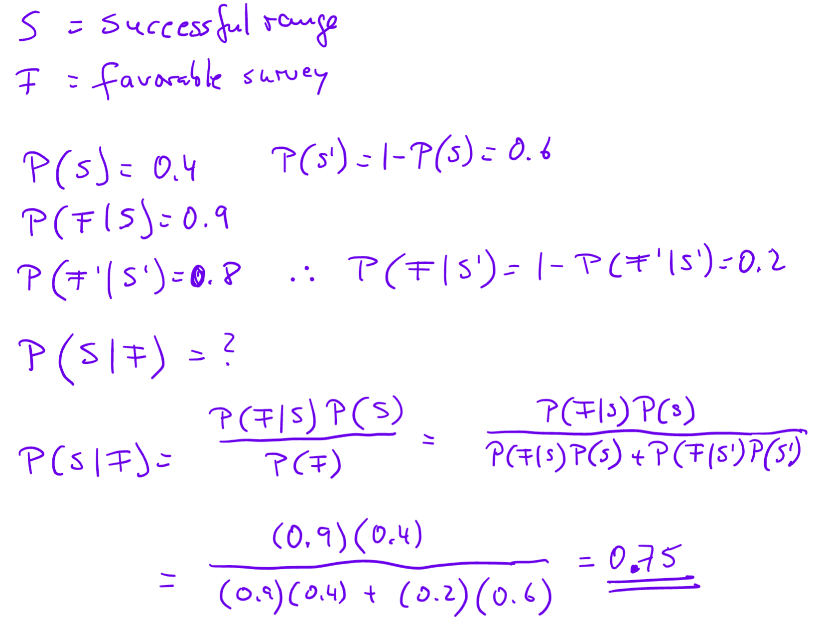
Solution

Slide 72

Summary, Review, & Questions…

