Slide 1

Principles of Information Visualization
Martin Schedlbauer, Ph.D.
m.schedlbauer@neu.edu

Slide 2
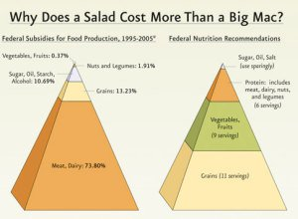
Not all Graphs and Charts are Useful
Too often charts and graphic visuals are poorly designed and overwhelm the audience rather than help them.
Excel and PowerPoint are responsible for many of these!
Find more at https://flowingdata.com/category/visualization/ugly-visualization/

Slide 3
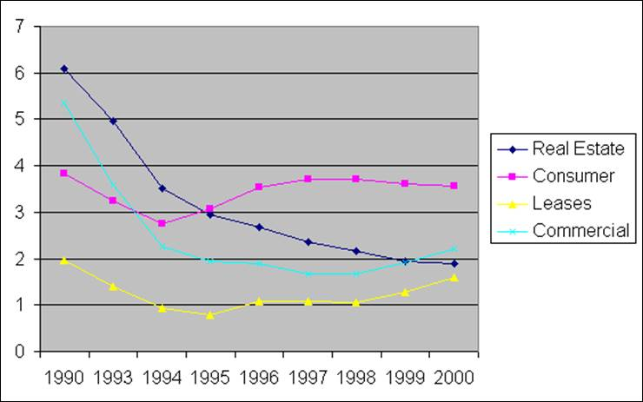
What’s Wrong with this Excel Chart?
Examples of Bad Excel Charts
http://old.briarcliff.edu/departments/cis/excel/2013/006-Charts-Bad%20Examples.htm

Slide 4
Issues with this chart
This chart, while it has time across the bottom as it should, has several problems:
The units on the vertical axis are not labeled. The reader has no idea what is being depicted.
There is no title on the chart. This also detracts from the reader's ability to figure out what is being depicted.
The x-axis is divided into 1-year intervals except the years 1991 and 1992 are missing. This may be because the data was not available, and if so, the creator of the chart doesn’t really have many options. However, the reader of the chart needs to be aware that the slope of the line segments connecting the 1990 data points with the 1993 data points will be exaggerated (imagine the years 1991 and 1992 on the x-axis – the horizontal components of the line segments connecting the 1990 and 1993 data points would be 3 times as long as they are at the left, but with the same vertical change).

Slide 5
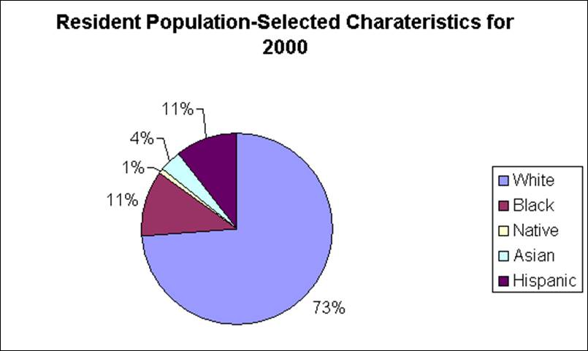
What about this chart?
Examples of Bad Excel Charts
http://old.briarcliff.edu/departments/cis/excel/2013/006-Charts-Bad%20Examples.htm

Slide 6
Issues with this chart
This pie chart has multiple problems:
The title has a misspelled word.
There is no description of what "resident population-selected characteristics" means.
The chart would be much easier to read if the legend text values were actually next to their pie segments.
What point is the chart trying to make?

Slide 7
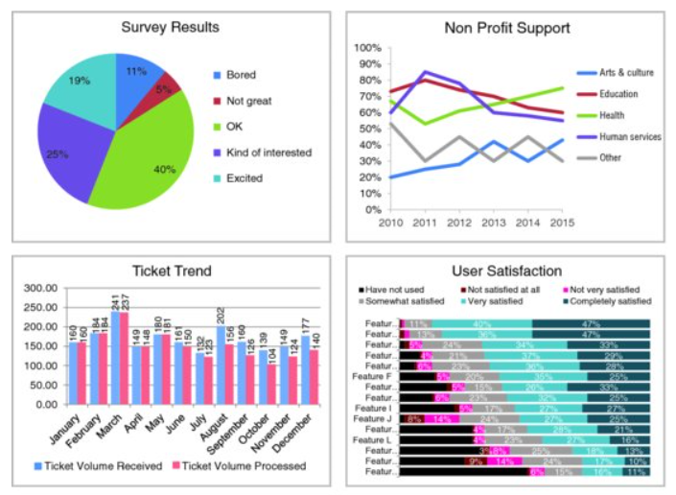

Slide 8
Presentations Need to Tell a Story
When you present, you need to make a point and provide impetus for action.
Charts don’t contain any story and the analyst must bring the story to life.
Only the analyst knows what the point of the story is.
Present the story with a combination of text and visuals.

Slide 9
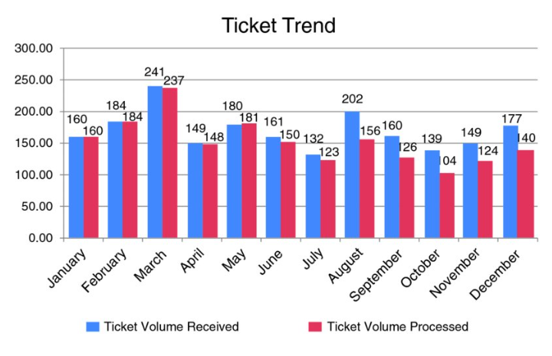
Before and After Examples: Before
Excerpted from Nussbaumer, C. “Storytelling with Data: A Data Visualization Guide for Business Professionals”, Wiley, 2015.

Slide 10
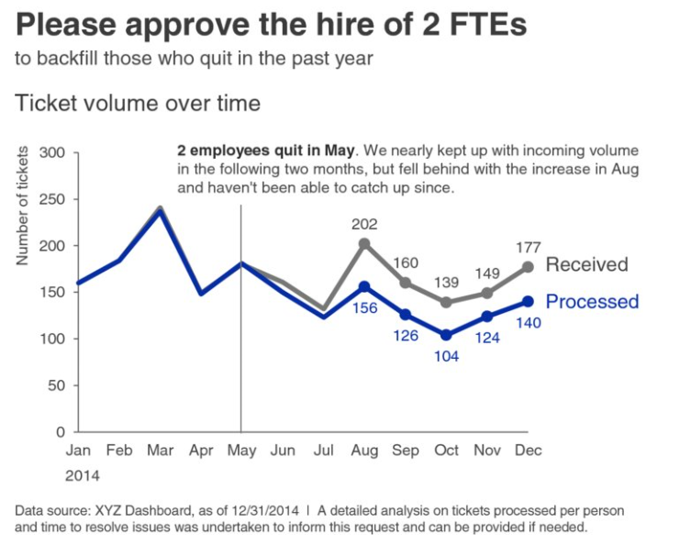
Before and After Examples: After
What are some of the key differences?
What’s the “story”?
Excerpted from Nussbaumer, C. “Storytelling with Data: A Data Visualization Guide for Business Professionals”, Wiley, 2015.

Slide 11
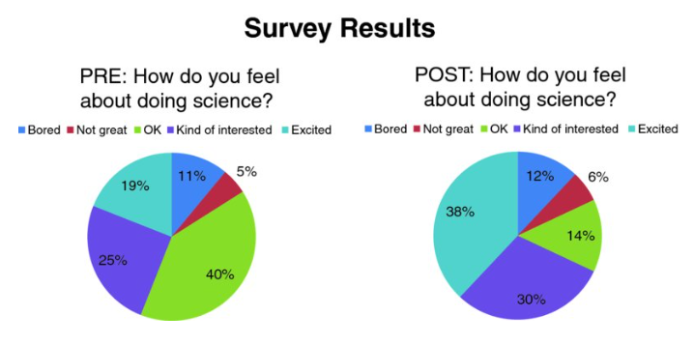
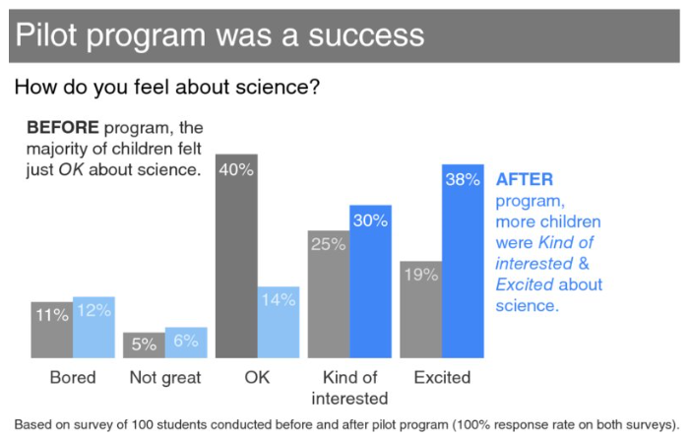
Before & After
Excerpted from Nussbaumer, C. “Storytelling with Data: A Data Visualization Guide for Business Professionals”, Wiley, 2015.

Slide 12
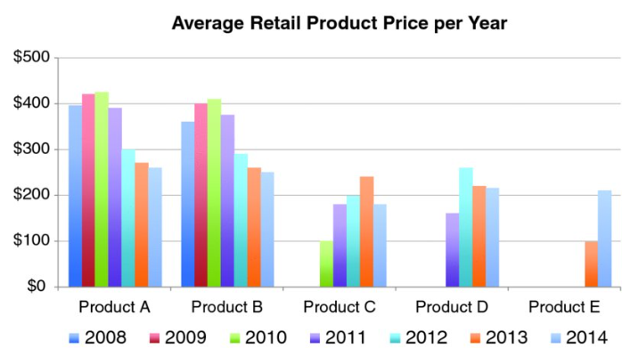
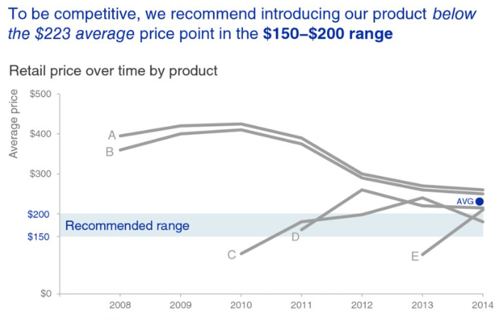
Before & After
Exercise 2-1
Excerpted from Nussbaumer, C. “Storytelling with Data: A Data Visualization Guide for Business Professionals”, Wiley, 2015.

Slide 13
Explanatory vs Exploratory Analysis
Exploratory analysis is used to understand the data, discover patterns and new insights, and leads to deeper analysis and questions.
Explanatory analysis offers an explanation after exploration and analysis are done. You want to tell a story.
The focus in this course is on
Explanatory Analysis.

Slide 14
Key Questions to Consider for Explanatory Analysis
Who is the audience?
What do you want to tell your audience?
What do you want your audience to do with the information you are providing them?
What information do you want them to walk away with?
Are you telling them enough or too little? Too Much?
Above all: focus your presentation towards a specific audience; avoid general audiences or anyone who might be interested; recommend solutions or encourage discussion only when there is no solution

Slide 15
Type of Presentations
Static versus dynamic (interactive or animated)
Open or specific
Presented live or e-mail or report
In static, non-live presentations, such as e-mail or reports, brainstorm objections or questions the audience might have and address them in your presentation.

Slide 16

Presentation Tip
In live presentations, do not read from the slides and thus use them as a teleprompter. Practice all presentations at least once and make sure your presentation flows and uses progressive elaboration. Reinforce key points throughout the presentation. Keep in mind that not everything must be on a slide; supplement slide decks with narrative reports.
Tip

Slide 17
Consider Tone
Consider the tone of your presentation:
celebration of success?
drive action?
want audience to change their mind?
hostile or friendly audience?
For your presentation, consider:
Who
What
How

Slide 18
Question to Help Analyze and Understand Audience
To help understand your audience, think about these questions:
What background information needs to be communicated?
What information do they already know and how?
Who is the decision maker?
What biases does the audience have?
Are they supportive or resistant to the message?
Are they quantitative or qualitative?
What additional support data do you need to have?
What are the risks?
What would a successful outcome look like?
Can you summarize the message in one sentence? How about a 3-minute presentation?

Slide 19
Storyboarding & Planning a Presentation
Collect the key data points and key outcomes
Use stickies or index card
Create concept maps

Slide 20
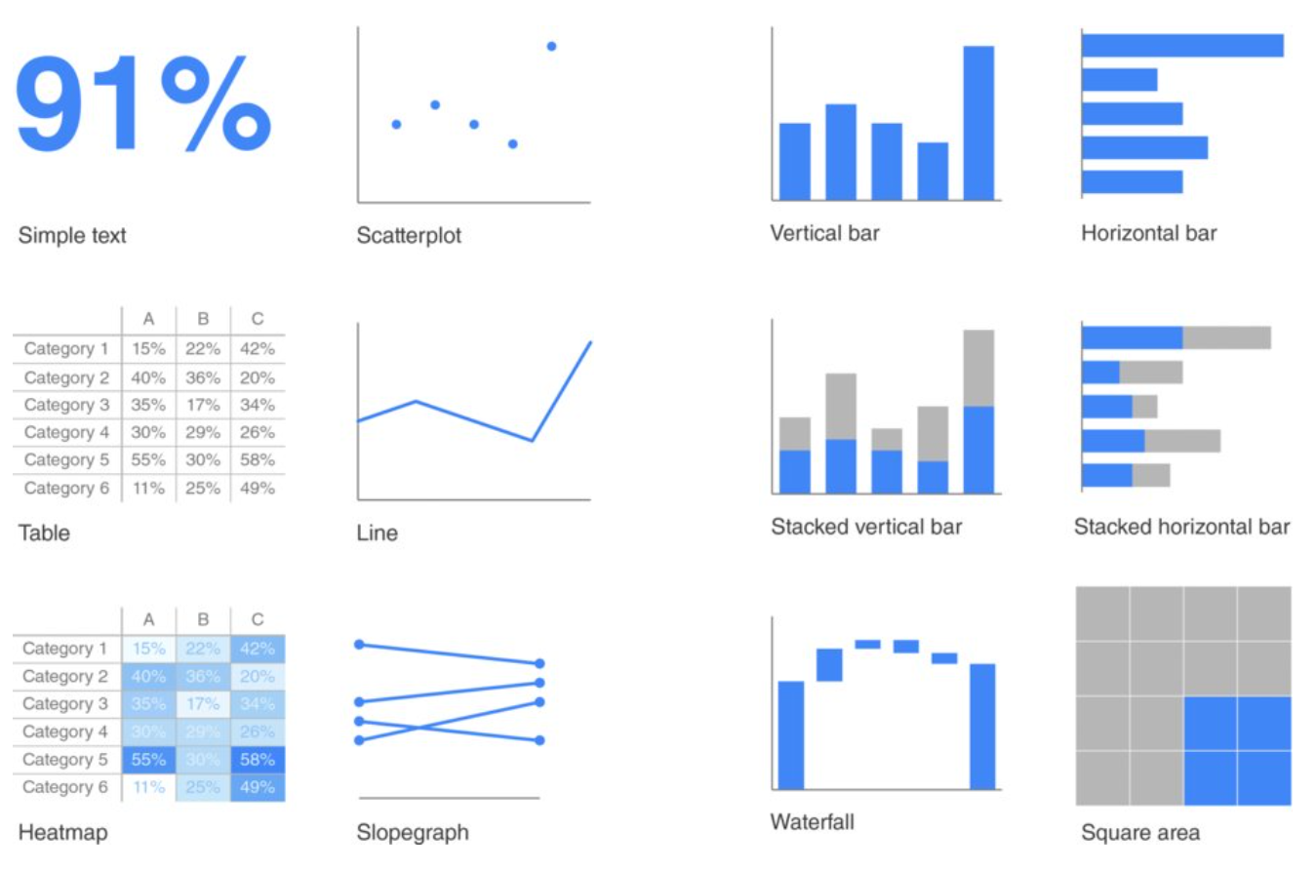
Common Visual Types
Excerpted from Nussbaumer, C. “Storytelling with Data: A Data Visualization Guide for Business Professionals”, Wiley, 2015.

Slide 21
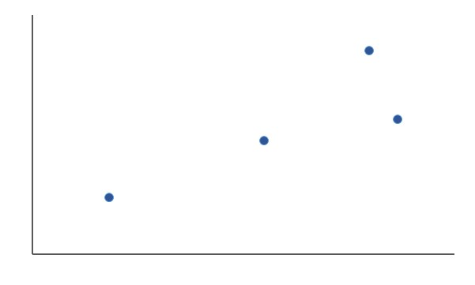
Scatterplot
Number of Variables:
2
Arrangement:
Cartesian
A scatterplot is a visualization of two variables that is often used to detect a linear correlation that is then further investigated using statistical or regression analysis. The markers can be color coded or sized differently to display a third or fourth variable.

Slide 22
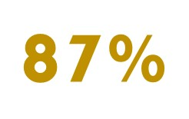
Simple Text
Number of Variables:
1
Arrangement:
Text
Simple text is most useful and most impactful when a single number must be communicated. Add a message or a call-to-action to the number.

Slide 23
Table/Spreadsheet
Number of Variables:
Many
Arrangement:
Tabular
A table is a two-dimensional layout of numbers and text. It is not a useful visual communication tool as it must be read carefully. Best to use in reports rather than presentations.

Slide 24
Heat Map
Number of Variables:
Many
Arrangement:
Tabular
A heat map is a table in which the cells are color coded to reflect priority or another dimension.

Slide 25
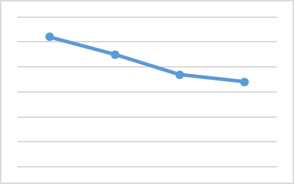
Line Graph
Number of Variables:
2
Arrangement:
Graph
A line graph is most useful when showing a trend over time. It is the most common visual for time-series data.

Slide 26
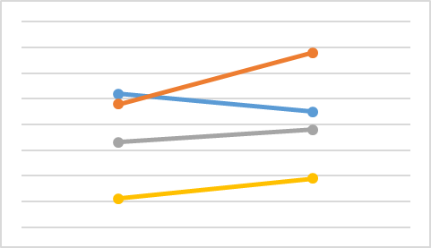
Slope Graph
Number of Variables:
Many
Arrangement:
Graph
A slope graph shows a trend or change between two points.

Slide 27
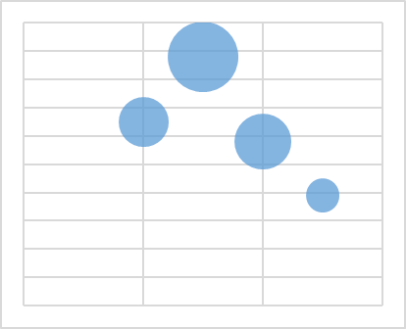
Bubble Graph
Number of Variables:
3
Arrangement:
Graph
A bubble graph is a scatter plot in which the “dots” have sizes proportional to a second variable.

Slide 28
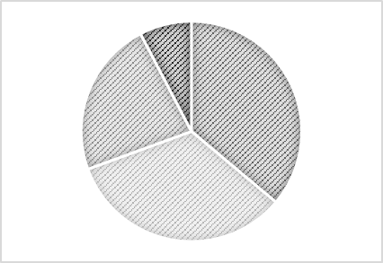
Pie Chart
Number of Variables:
1
Arrangement:
Circular
A pie chart is a circular statistical chart that visualizes proportions by dividing a circle into sectors where the arc traced by the sector corresponds to the percentage that this item represents of the whole.
Although commonly used in business, pie charts are generally not recommended as they makes comparison of different sectors difficult.

Slide 29
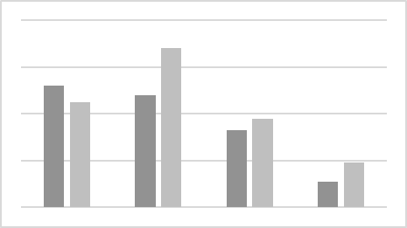
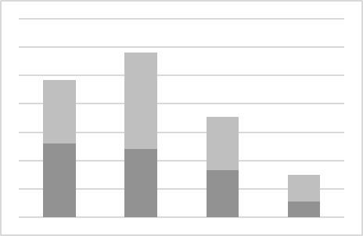
Vertical Bar & Stacked Vertical Bar Charts
Number of Variables:
Many
Arrangement:
Bars
Bar charts are useful for comparison. Careful not to show too many variables as it gets cluttered easily.

Slide 30
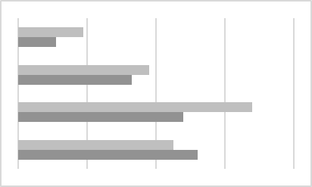
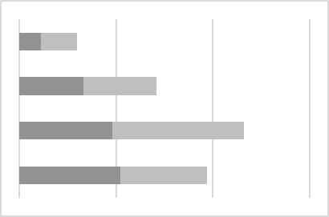
Horizontal Bar & Stacked Vertical Bar Charts
Number of Variables:
Many
Arrangement:
Bars
Bar charts are useful for comparison. Careful not to show too many variables as it gets cluttered easily.

Slide 31
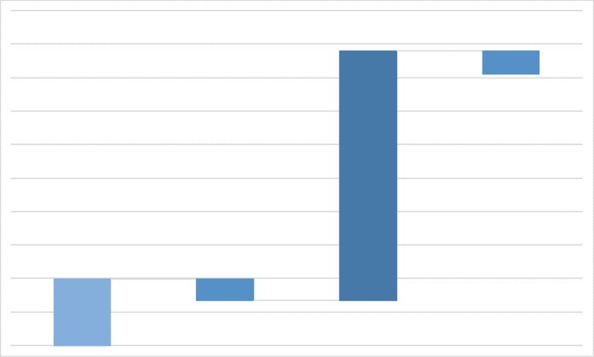
Waterfall Chart
Number of Variables:
1
Arrangement:
Bars
A waterfall chart shows how a variable moves around a watermark or anchor value, either above or below the anchor value.

Slide 32
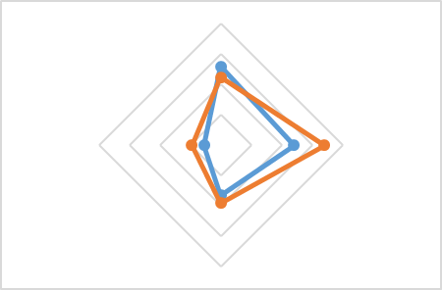
Radar Chart
Number of Variables:
Many
Arrangement:
2D Graph
A radar chart shows how much a value deviates from a central value. Useful to show dispersion or central tendency.

Slide 33
Spark Lines
Number of Variables:
Many
Arrangement:
Graph
Spark lines, invented by Edward Tufte, are a quick summary of trends for a range of data values. They are a “micro graph” rather than a full-fledged visual.

Slide 34
Logical Ordering of Categories
When you try to list categories, be thoughtful about the order in which you present the categories; there is almost always some ordering – specify how you ordered the categories and explain why you did so.
Your presentation should progressively elaborate each category – be mindful not to say everything all at once.
Use non-linear presentation tools, e.g., Prezi, to help present to audiences that ask many questions.
Tip

Slide 35
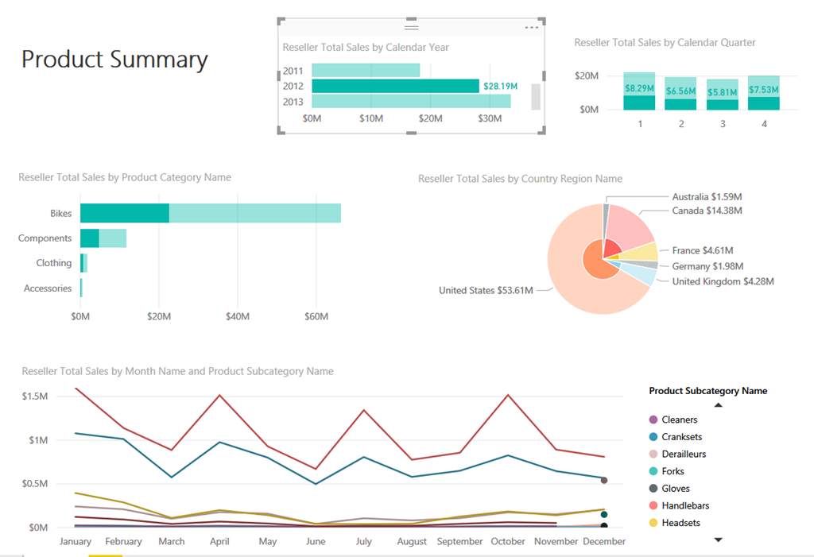
Avoiding Clutter
Clutter in slides is distracting, so remove anything that’s not necessary.
Be mindful of cognitive load and don’t overwhelm the audience.
Focus and direct their attention; don’t require them to figure it out.

Slide 36
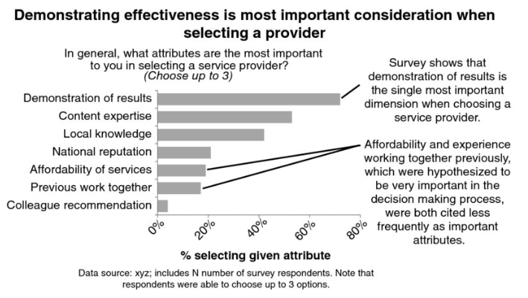
How would you improve this visual?
Excerpted from Nussbaumer, C. “Storytelling with Data: A Data Visualization Guide for Business Professionals”, Wiley, 2015.

Slide 37
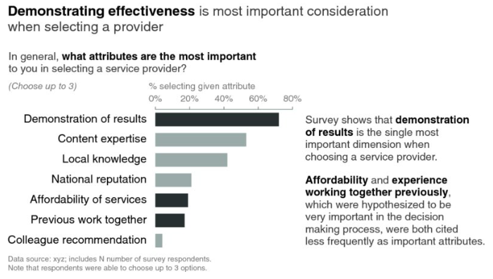
Improved Version
What is different? Why does it work better? How did it reduce cognitive load?
Excerpted from Nussbaumer, C. “Storytelling with Data: A Data Visualization Guide for Business Professionals”, Wiley, 2015.

Slide 38
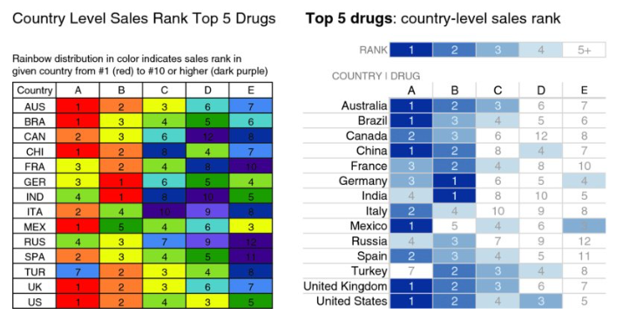
Use Color Sparingly
Excerpted from Nussbaumer, C. “Storytelling with Data: A Data Visualization Guide for Business Professionals”, Wiley, 2015.

Slide 39
Best Practices to Minimize Distractions
Not all data is equally important; use white space and pre-attentive attributes to direct the audience’s attention.
Not all details is necessary, so summarize when possible.
If some detail can be taken out without affecting your story, then it’s not important and must be removed.
Push necessary but non-story element into the background using pre-attentive attributes, e.g., use light-grey.
Apply whitespace to focus your message.
Tip

Slide 40
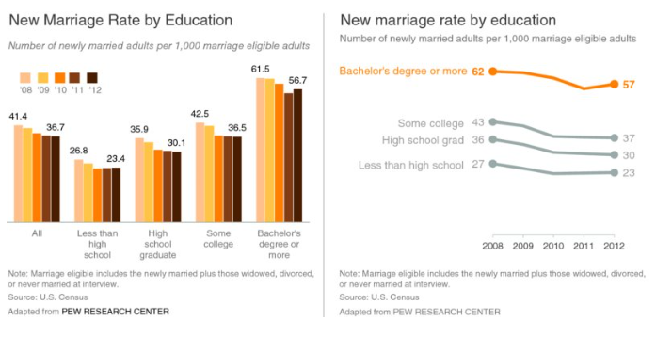
Example
Excerpted from Nussbaumer, C. “Storytelling with Data: A Data Visualization Guide for Business Professionals”, Wiley, 2015.

Slide 41
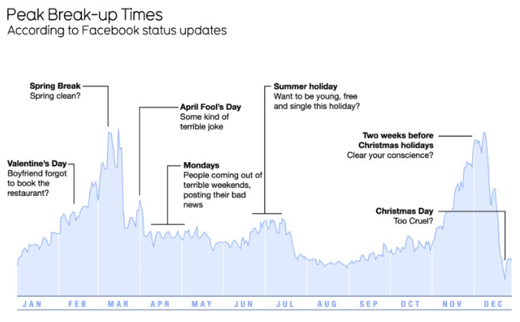
Use Words to Summarize and Direct Your Message
Excerpted from Nussbaumer, C. “Storytelling with Data: A Data Visualization Guide for Business Professionals”, Wiley, 2015.

Slide 42
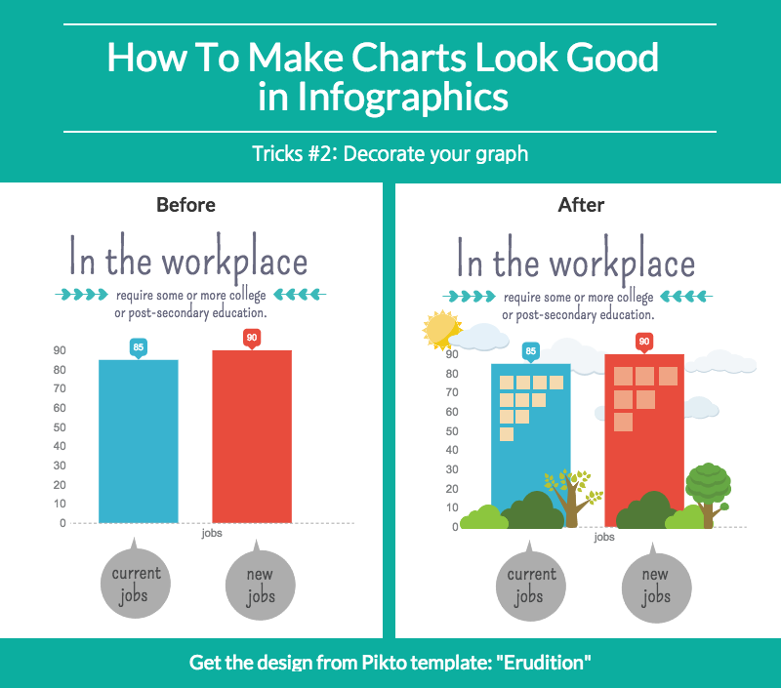
What can be omitted?
These are actual tips on the web on how to make an infographic “better”.
What do you think? Is the “After” really better?

Slide 43
How to Build a Story
Explain the problem or the situation
List who is involved, i.e., the stakeholders
Cover relevant background
Incorporate external context or comparison points
Give examples to illustrate the issue
Present data that illustrates the point
Articulate what will happen if nothing is done
Discuss risks when addressing the issue
Explain benefits of the proposed solution
Define what action is required on audience’s part and what will happen if there is inaction or delayed action

Slide 44
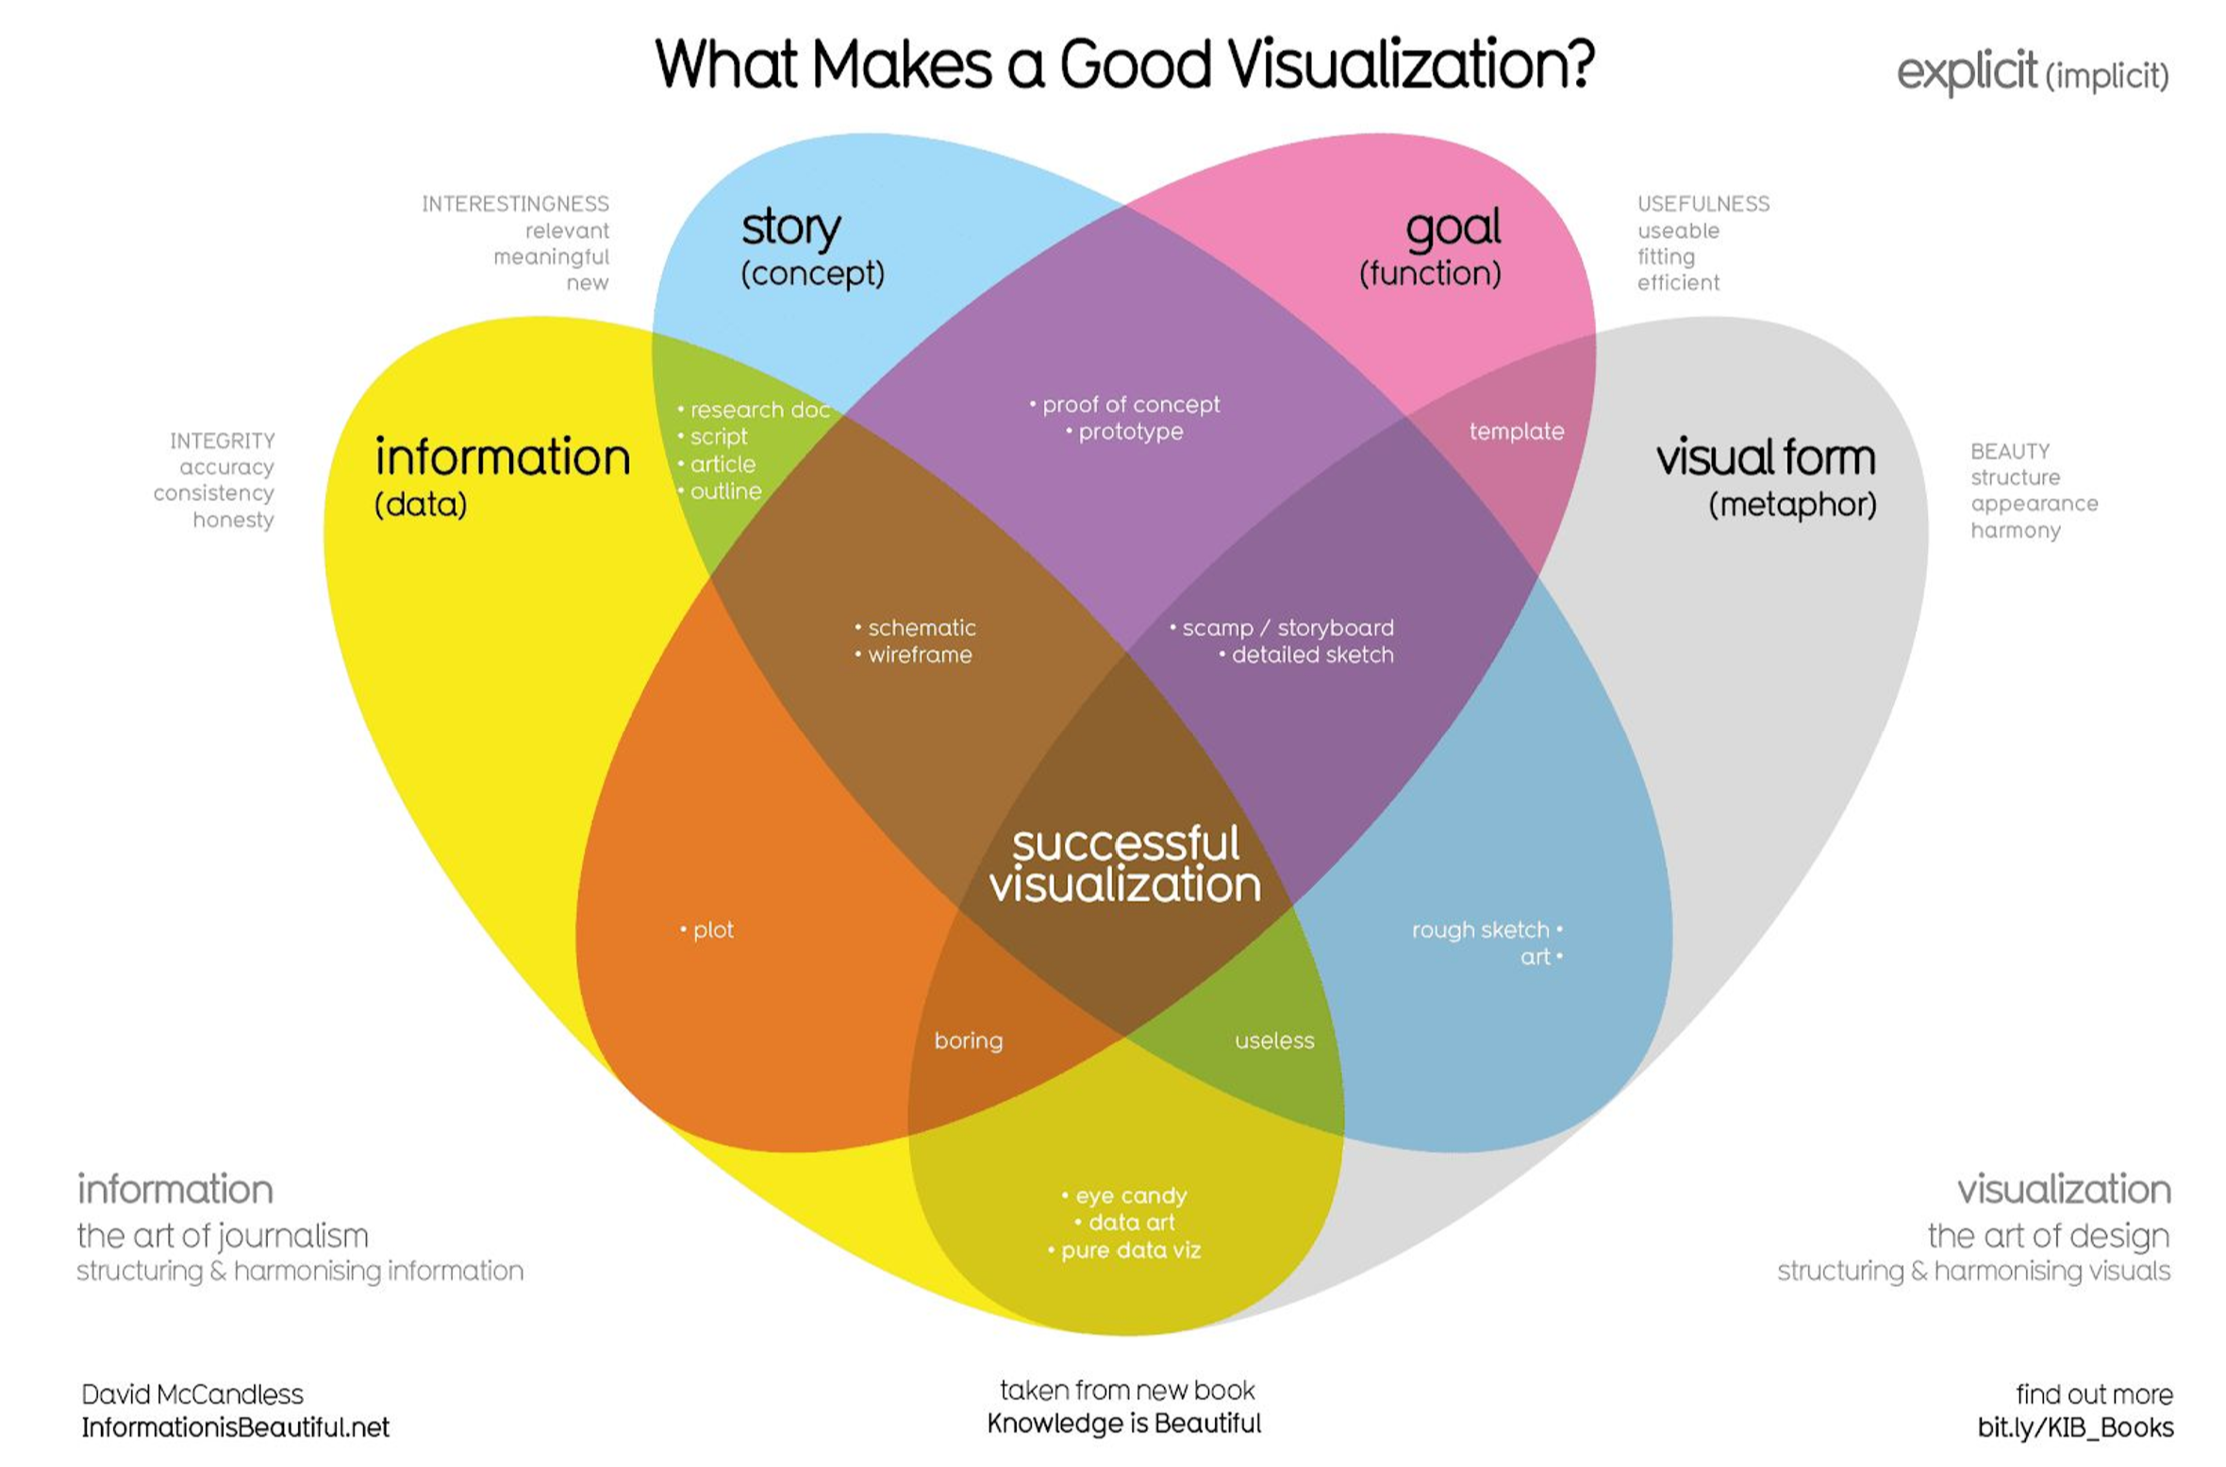

Slide 45
Where are we?
Setting Context…

Slide 46

Information Science as a Discipline
Information science is an interdisciplinary field primarily concerned with the entire life cycle of information objects and the information universe.

Slide 47

Information Life Cycle
Discovery
Analysis
Classification
Organization
Manipulation
Storage
Retrieval
Movement
Dissemination
Protection

Slide 48
A Definition of Information Science
Information Science is the science and practice that deals with the effective discovery, analysis, storage, retrieval and use of information.
It is concerned with recordable information and knowledge, and the technologies and related services that facilitate their management and use for informed decision-making.
Adapted from Saracevic (2010, 2570)

Slide 49
Then what is this course?
This course is a survey and overview of the various areas that comprise modern computational information science.
By its nature, it cannot delve into all aspects but will do so for some of the more important ones, including:
  information collection and organization
  information storage and retrieval in databases
  information dissemination
  information technology and systems

Slide 50
Overview of Course
The course provides an overview of the topics in information science that we will explore.
Remember: this is a survey course where we look at many (but not all) aspects of information science.
Follow-on and related courses dig deeper into specific areas of information science.

Slide 51
The Work of a Practitioner
An information scientist often conducts:
  User studies and the need for information
  Studies of terminology and the structure and nature of information objects (ontologies)
  Research on indexing and retrieval
  Development of storage structures and information repositories
  Creation of representations and visualizations
  Development of processes and policies

Slide 52
“Big Questions” of Information Science
Some of the “big questions” that concern academics and practitioners:
  What are the features and laws of the recorded-information universe?
  How do people relate to, seek, and use information?
  How can access to recorded information be made most rapid and effective?
  What is the essential nature of information?
  What are the ethical obligations of an information society?
Excerpted from Bawden & Robinson (2012)

Slide 53

Information Scientists
Practitioners within the field study the provenance, quality, representation, and use of information in organizations, along with the interaction between people, organizations and information systems, with the aim of creating, replacing, improving, or understanding information systems¹ that aid in information-based decision-making
¹Information systems do not have to be computer-based.

