Slide 1

^{Information Processing with}
^{Excel and Google Sheet}
A Primer for Information Scientists
Martin Schedlbauer, PhD
m.schedlbauer@northeastern.edu

Slide 2


Tutorial Topics
Introduction to the Data Analytics Pipeline
Module 1: Essentials of Excel & Google Sheet
Module 2: Loading Data
Module 3: Working with Data in Tables
Module 4: Shaping Data with Text Processing
Module 5: Exploring Data Through Charts and Graphs
Module 6: Building Flexible Models with Lookup Tables
Module 7: Practicum (optional)

Slide 3
Learning Objectives
Upon completion of this tutorial, you will be able to:
  Build flexible models in Excel and Google Sheet
  Load data from files and the web
  Analyze data in tables and pivot tables
  Shape data through text processing
  Handle errors in formulas
  Use lookup tables
  Construct customized charts and graphs

Slide 4
The Data Analytics Pipeline
Data analysis is methodical and follows a process.
Industry standard project management methodologies exists, e.g., CRISP-DM.
Collection
Shaping
Storage
Retrieval
Visualization
Analytics
Communication
Model Construction

Slide 5
Excel vs Google Sheet
Microsoft Excel is the industry-standard spreadsheet, but it is not the only one.
Other spreadsheet applications in common include:
Apple Numbers
Google Sheet
Zoho Sheet
Functions and most features are the same across all these spreadsheets, so learning one means knowing the key features of the others.

Slide 6
Excel for Information & Data Science
Essentials of Excel and Sheet

Slide 7
Module Objectives
Upon completion of this module, you will be able to:
  Distinguish between values, types, and format of a cell
  Apply conditional formatting
  Create references
  Build simple formulas
  Use anchoring of cell references
  Define named ranges

Slide 8
Value, Type, and Format
Conditional Formatting
References and Formulas
Named Ranges
Working with Dates
Testing Conditions

Slide 9
Spreadsheets are Essential End-User Tools
  Spreadsheets are among the most useful business and technical applications.
  Principally used for calculations and manipulation of tabular data.
  Common spreadsheet applications:
    Microsoft Excel
    Google Sheet
    Zoho Sheet
    GNU Gnumeric
    Apple Numbers
  All of these spreadsheet tools use the same functions, and what you learn here is applicable to all.

Slide 10
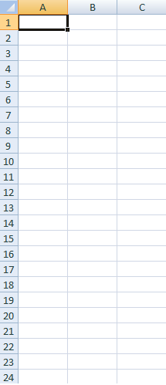
Spreadsheet Layout
Tabular layout arranged in rows and columns
  Columns are labeled with letters
  Rows are labeled with numbers
Cells are at the intersection of rows and columns
  Example cell reference: A3, D9
Cells can contain:
  Numbers, dates, text, or other data
  Formulas using functions and cell references
Note that Excel allows cells to be referenced with an alternate naming scheme that is often used in VBA macro programming, e.g., C[3]R[2]

Slide 11
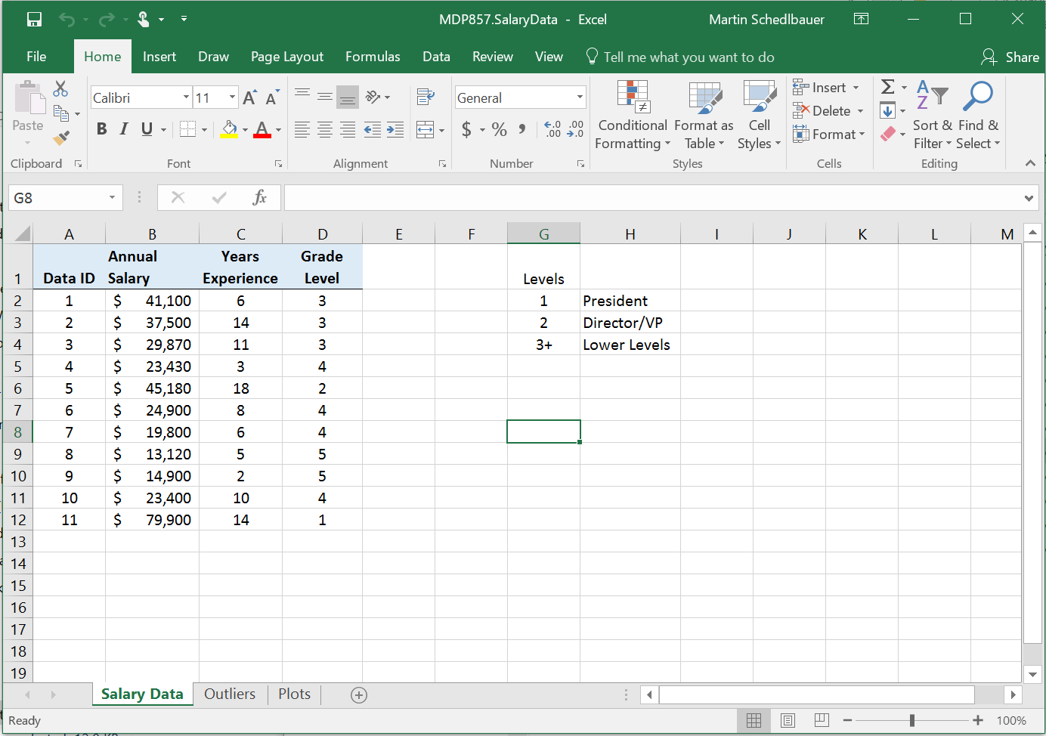

Navigating Microsoft Excel 2016
Current cell
Tabs for each worksheet
salarydata.xlsx
Zoom to increase fonts

Slide 12
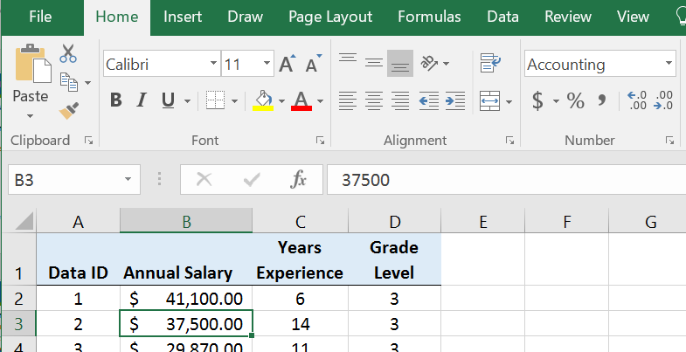
Value vs. Type vs. Format
Each cell is a similar to a variable in programming; it stores a piece of data.
A cell contains a value of a particular data type that is displayed in a specified and customizable display format.
Format
Value in cell
Current cell
Displayed value

Slide 13
Formatting
  Formatting changes the way values are displayed but does not change the actual value being used in functions.
  Common formatting options:
    Currency and Accounting
    Time and date values
    Numeric formats and decimal points
    Percent

Slide 14
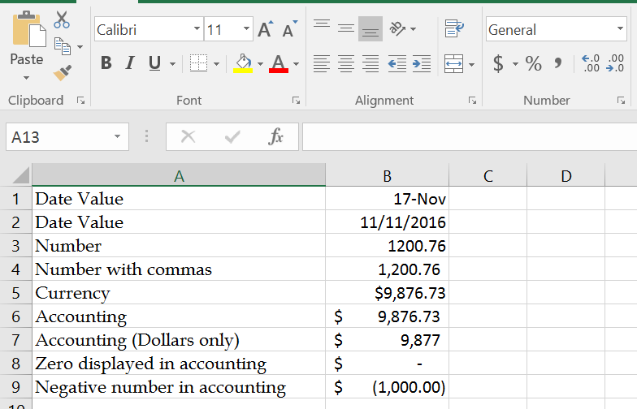
Explore Formatting
Explore formatting cells with different formats: try currency versus accounting
Reduce decimal points displayed and observe automatic rounding of displayed value (but not the one used in calculations)
Font and size
Pick display format
Adjust decimals
Painter tool to copy formatting

Slide 15
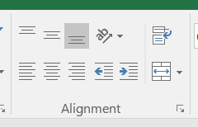
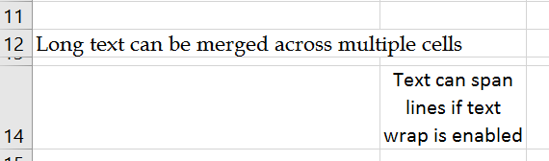
Entering and Adjusting Text
Adjust Alignment
Wrap text across multiple lines
Merge cells

Slide 16
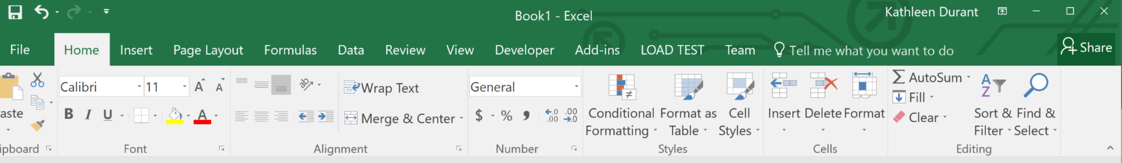
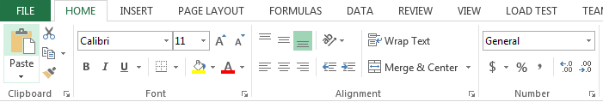
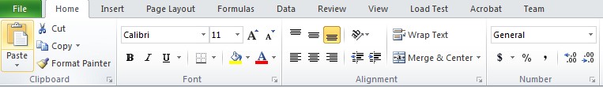
Formatting in Different Versions of Excel
Excel 2016
Excel 2013
Excel 2010

Slide 17
Value, Type, and Format
Conditional Formatting
References and Formulas
Named Ranges
Working with Dates

Slide 18

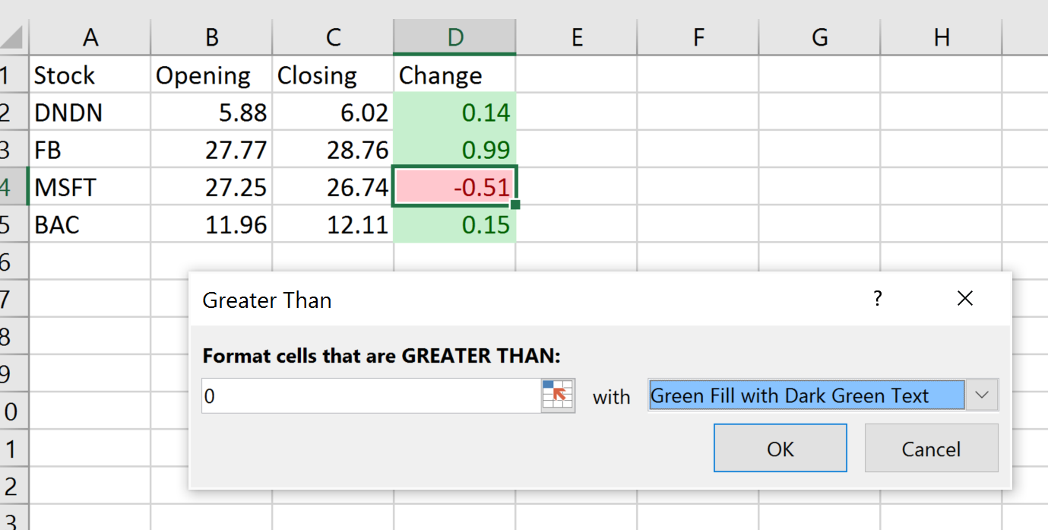
Conditional Formatting
Conditional formatting allows the application of specified formatting only when certain conditions are met.
On the Home tab, in the Styles group, click the arrow next to Conditional Formatting
examples.xlsx

Slide 19
Excel for Information & Data Science
References, Ranges, Formulas

Slide 20
Value, Type, and Format
Conditional Formatting
References and Formulas
Named Ranges
Working with Dates
Testing Conditions

Slide 21
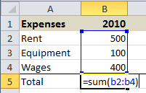
Entering Formulas and Functions
To enter formulas and functions:
  Start entry with =
Example:

Slide 22
Common Function: SUM
There are several functions that can be used to add values:
  Add columns manually: =B1+B2+C9
  Add a range of cells: =SUM(B5:B10)
  Add a range of cells conditionally with SUMIF and SUMIFS

Slide 23
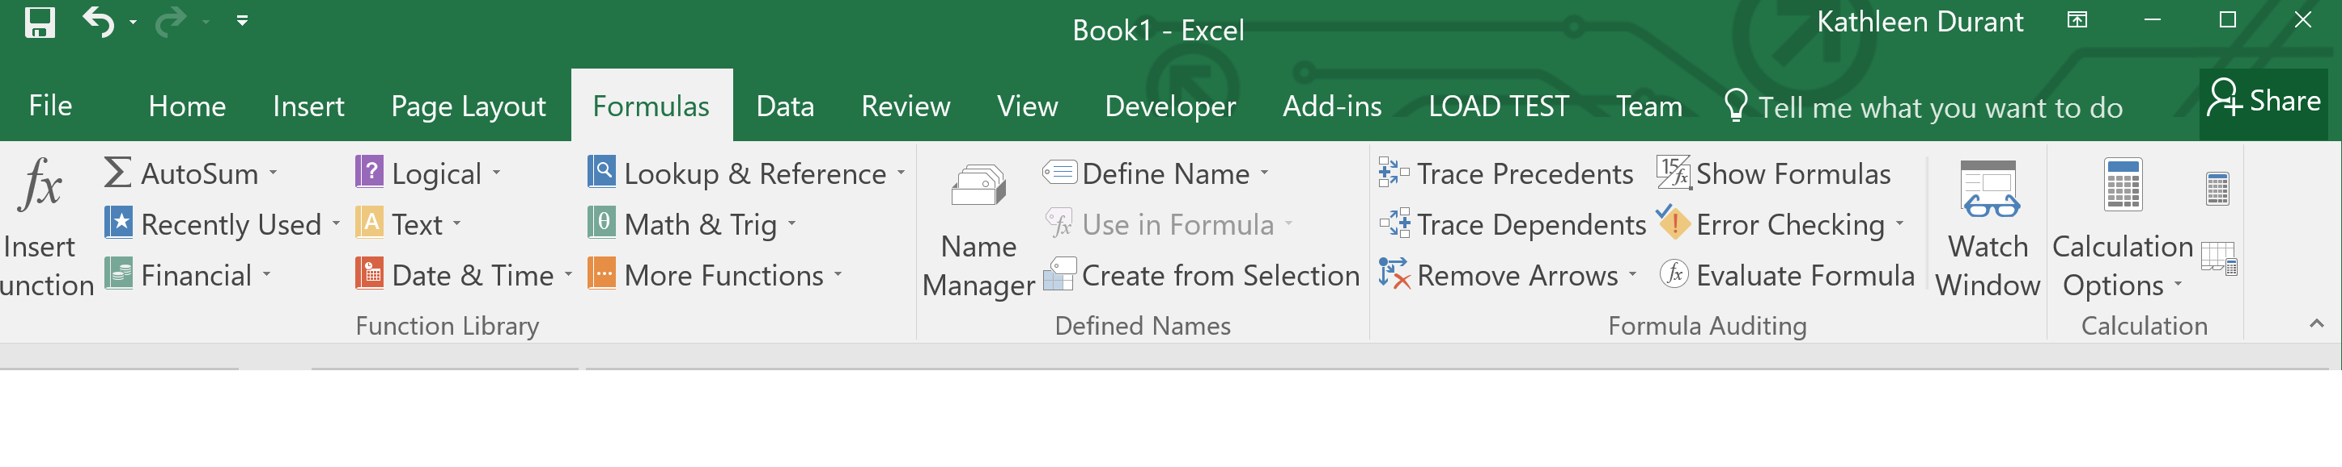
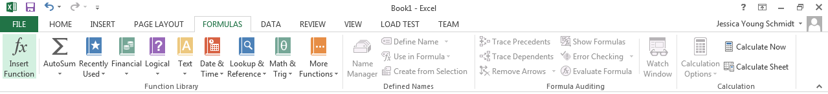
Function Library
Excel 2016
Excel 2013
Excel 2010

Slide 24
Cell Ranges
Many functions require cell ranges:
  Column Range: A1:A10
  Row Range: A5:K5
  Matrix: A1:C5
References are automatically adjusted when copied.
Absolute cell references are not adjusted when copied:
  $A1:$A5 is not adjusted when column copied
  A$1:C$1 is not adjusted when row copied
  $A$1 is never adjusted when copied

Slide 25
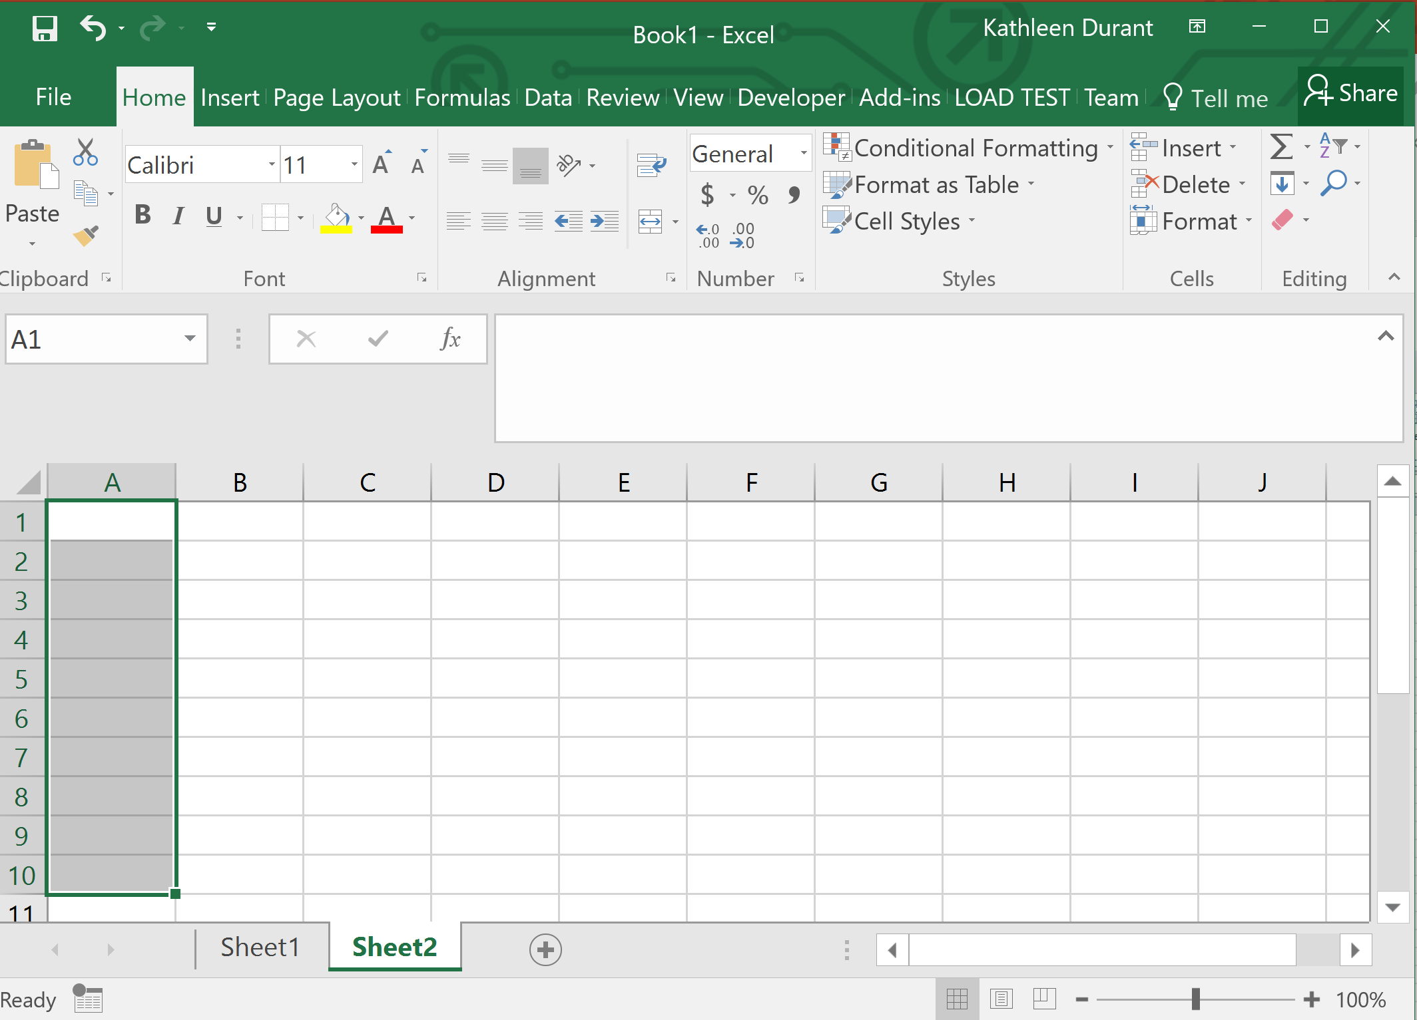
Column Range: A1:A10

Slide 26
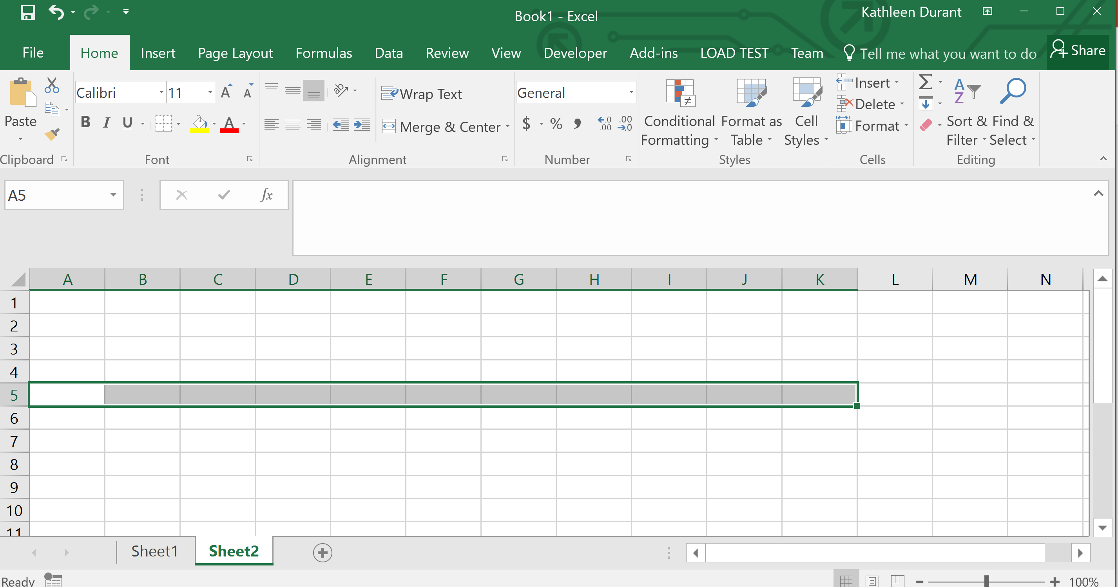
Row Range: A5:K5

Slide 27
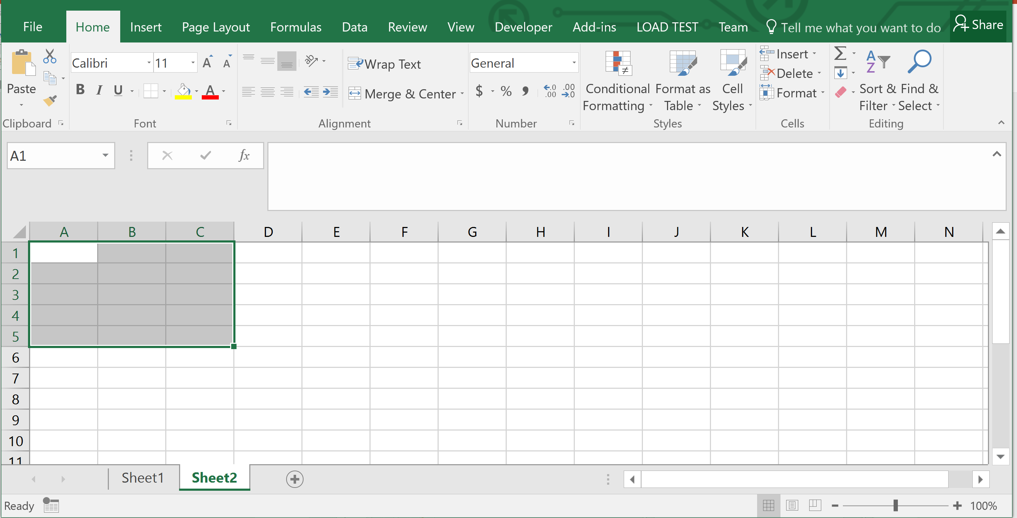
Matrix: A1:C5

Slide 28
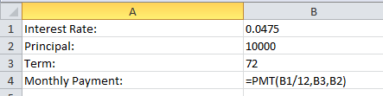
Cell References in Functions
Most functions require parameters.
To keep your model flexible and correct even when the data changes, only use cell references in functions.

Slide 29
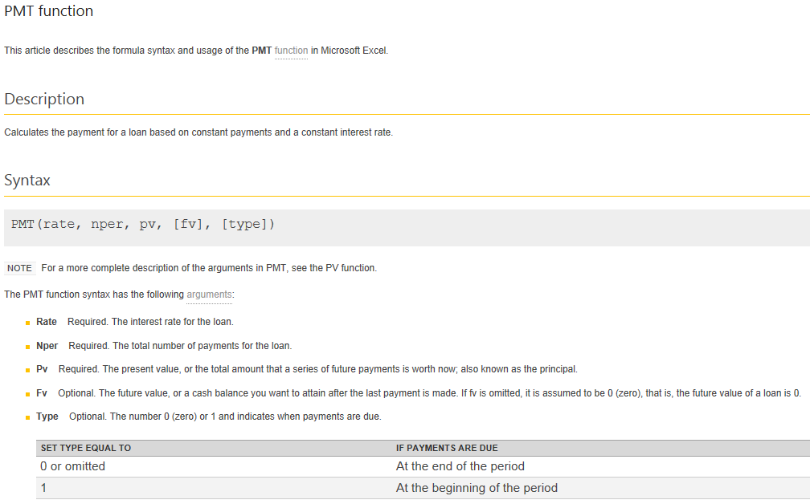
Common Function: PMT

Slide 30
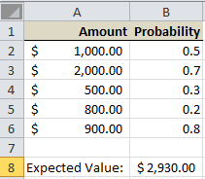
Common Function: SUMPRODUCT
SUMPRODUCT requires two ranges.
It multiplies the corresponding numbers and then adds the products.
A2 * B2 +
A3 * B3 +
A4 * B4 +
A5 * B5 +
A6 * B6
=SUMPRODUCT(A2:A6,B2:B6)
Examples.xlsx

Slide 31
Common Statistical Functions
Function | Use/Description
SUM | Sum of a range of cells
AVERAGE | Arithmetic mean
STDEV.S | Standard deviation of sample
MEDIAN | Median of a range of cells (middle value in a sorted list of values)
MAX and MIN | Maximum and minimum values of a range of cells
CORREL | Correlation of two sets of values
SLOPE | Slope value of linear regression
INTERCEPT | y-intercept of linear regression

Slide 32
The AVERAGE Function
The AVERAGE function calculates the average (arithmetic mean) of the arguments.
    AVERAGE(number1, [number2], ...)
The AVERAGE function has the following arguments:
  Number1 (Required). The first number, cell reference, or range for which you want the average.
  Number2, ... (Optional). Additional numbers, cell references or ranges for which you want the average, up to a maximum of 255.

Slide 33
Additional Averaging Functions
AVERAGE -- Omits non-numeric values in the calculation
AVERAGEA -- Uses 0 for any cell that contains text
AVERAGEIF -- Only averages cells that meet the criterion

Slide 34
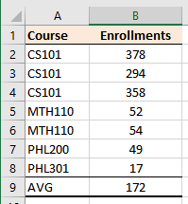
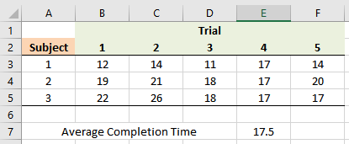
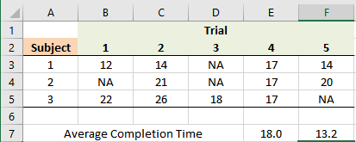
AVERAGE and AVERAGEA
=AVERAGE(B3:F5)
=AVERAGE(B2:B8)
=AVERAGEA(B3:F5)
=AVERAGE(B3:F5)

Slide 35
Dealing with Missing Data Values
AVERAGE omits the value from the calculation if a cell is empty or contains text.
AVERAGEA uses 0 in the calculation where a value is text, although an empty cell is still omitted.
=AVERAGEA(B3:F5)
=AVERAGE(B3:F5)

Slide 36
Calculating the Standard Deviation
The standard deviation is a measure of the dispersion of a data sample; i.e., how much the data values in a sample are away from the mean.
Use STDEV.S or STDEVA to calculate the standard deviation of a sample.
STDEV.S omits any cells in the range that are not numeric, while STDEVA counts them as 0.
There are many additional descriptive and inferential statistical functions in Excel.

Slide 37
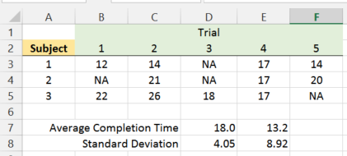
STDEV.S and STDEVA
=STDEV.S(B3:F5)
=STDEVA(B3:F5)
Examples.xlsx

Slide 38
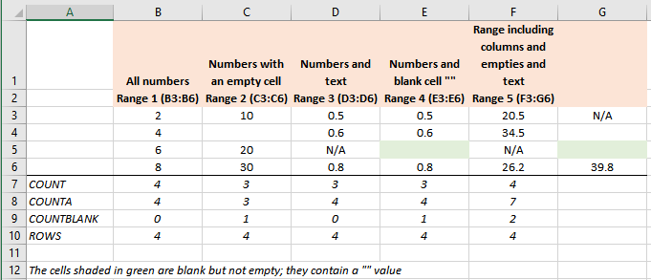
Counting Cell Ranges
COUNT -- only cells with numbers (note that dates are numbers)
ROWS -- rows in a cell range
COUNTA -- all cells in a cell range that are not empty
COUNTBLANK -- only cells that are empty

Slide 39
Copying Cells
To copy cells:
  CTRL+C to copy and CTRL+V to paste
  or
  Use cell dragging
Note that cell references in formulas are automatically adjusted unless the cell references are locked with $.

Slide 40
Copying Formulas
Relative cell references adjust when copying:
  Columns references adjust when copying across columns
  Row references adjust when copying across rows
Generally, the adjustment is desirable, but sometimes it is not:
  Lock cell references by making them absolute references
  Use $ before row and/or columns for locking

Slide 41
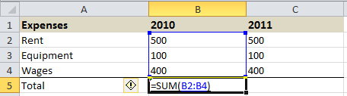
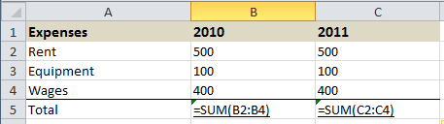
Copying Formulas
Notice what happens to the cell references when copying from row to row or column to column.
Observe the effect of cell locking with $.
Examples.xlsx

Slide 42
Anchors and Cell Dragging
Formulas can be copied to adjacent cells by dragging.
Dragging changes cell references.
Usually this is what you want, but sometimes it breaks your formulas.
Anchors ($) stop cell references from changing.
But when do you use them?

Slide 43
When to Anchor
Manually rewrite your formula in the cell to the right and the cell below the original cell.
Compare the letters in the original formula to the letters in the formula to the right.
If a letter didn’t change, put a $ before it in the original cell.

Slide 44
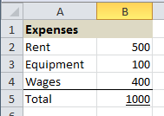
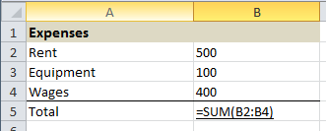
Showing Formulas
To show the formulas in your spreadsheet, press CTRL+~
Examples.xlsx

Slide 45
Build a Model with Formulas
Exercise 1-1
Format: | Individually
Time: | 15 minutes + 5 minutes for review
Goal: | Build a model that detects outliers using statistical functions and conditional formatting.
Materials: | Case study data set; Excel
Instructions: | Using the case study data, identify outliers that are at least 3 standard deviations from the mean. Highlight the outlying values in red using conditional formatting.

Slide 46
Value, Type, and Format
Conditional Formatting
References and Formulas
Named Ranges
Working with Dates
Testing Conditions

Slide 47
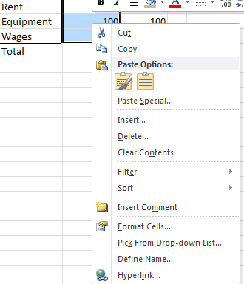
Named Ranges
  To make your formulas easier to read, use named cell ranges.
  To create a named range:
    Highlight cells to include in named range
    Click right mouse button on any cell in the selected range for context menu
    Choose “Define Name…” and provide name
Note: named ranges are never adjusted when row or column copied
Examples.xlsx

Slide 48
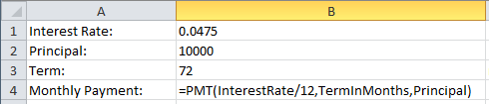
Named Ranges in Functions
Named ranges can make function parameters easier to understand:
Examples.xlsx

Slide 49
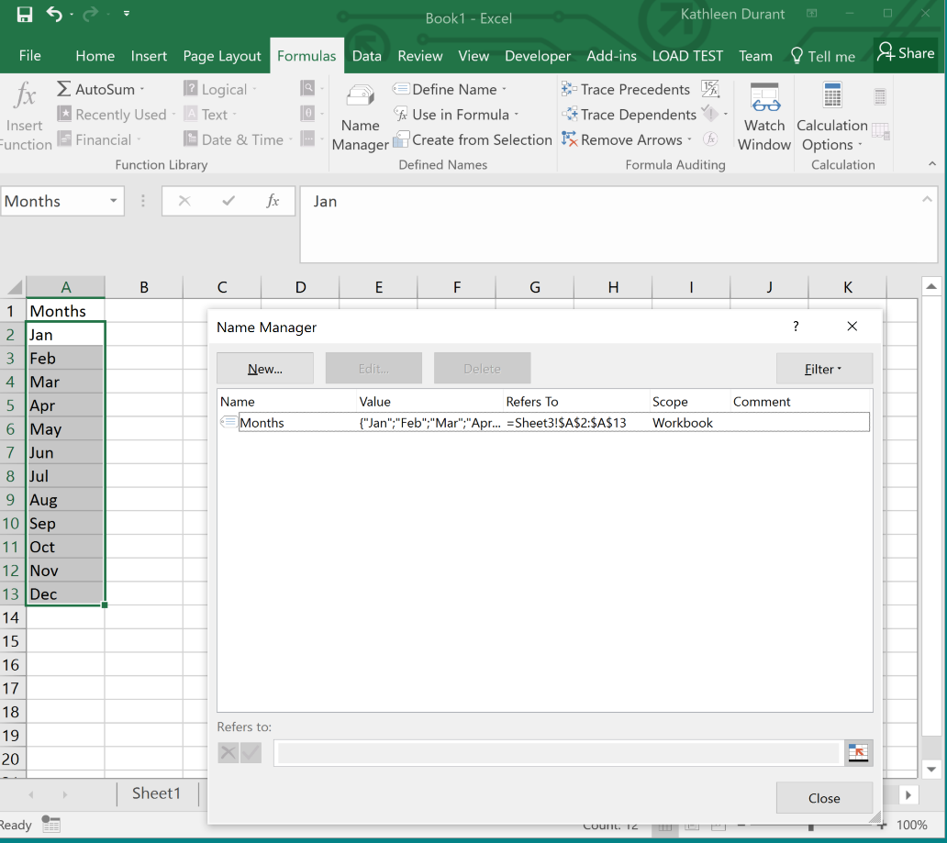
Managing Named Ranges
To manage (delete, edit, rename, etc.) named ranges
  In the Formulas ribbon
  Click on Name Manager

Slide 50
Value, Type, and Format
Conditional Formatting
References and Formulas
Named Ranges
Working with Dates
Testing Conditions

Slide 51
Date and Time Processing Functions
  Any value that is entered with/is assumed to be a date value; e.g., 12/22/17 is equal to December 22, 2017.
  Excel has many functions to work with date values:
  YEAR, MONTH, and DAY extract the year, month, and day of a date value
  HOUR, MINUTE, and SECOND extract the hours, minutes, and seconds of a time value
  DATE constructs a new date value
  EDATE constructs a new date with a monthly offset
  NOW returns the current date and time
  TODAY returns the current date
  TIME constructs a new time value

Slide 52
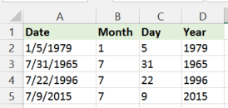
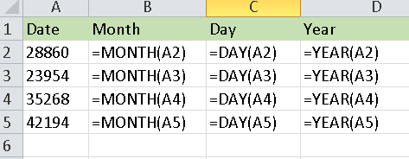
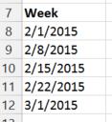
Date Processing
=DATE(YEAR(A8),MONTH(A8),DAY(A8)+7)
You can construct dates from the values of year, month, day
Examples.xlsx

Slide 53
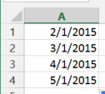
Constructing Months with EDATE
The EDATE function creates a new date that is a specified number of months ahead or behind the starting date.
=EDATE(A1,1)
Examples.xlsx

Slide 54
Internal Date Representation
  Dates are represented internally as numbers.
  What you see is a "formatting" of that number:
    Short date: 10/1/2014
    Long date: Wednesday, October 1, 2014
  The actual number inside the cell is: 41913
  41913 is the number of days elapsed between October 1, 2014 and January 1, 1900.

Slide 55
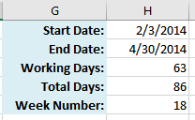
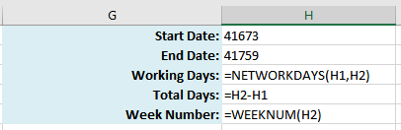
Date Calculations
  Dates can be added and subtracted like numbers.
  The function NETWORKDAYS shows the number of workdays in a span of dates.
Examples.xlsx

Slide 56
Value, Type, and Format
Conditional Formatting
References and Formulas
Named Ranges
Working with Dates
Testing Conditions

Slide 57
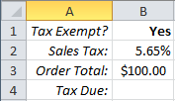
The IF Function
The IF function allows a cell to be filled with one of two possible values.
General form of IF:
  =IF(condition,value_if_true,value_if_false)
Example:
Cell B4 is either $0 if the customer is tax exempt or the tax due is the order total multiplied by the tax rate.
=IF(B1="Yes",0,B2*B3)
Examples.xlsx

Slide 58
Taking a Closer Look at IF
Does cell B1 contain “Yes”?
If so, then cell B4 will be filled with 0
If not, then cell B4 will be filled with the result of the formula B2*B3
=IF(B1="Yes", 0, B2*B3)

Slide 59
A Closer Look at the Statement
true
=IF( B1="Yes", 0, B2*B3)
false

Slide 60
How Does IF Work and What Does It Do?
  IF does not perform any calculation — it simply fills a cell with one of two values.
  The values can be:
    Literals (actual numbers or text); e.g., 0
    Results of functions or formulas; e.g., B2*C$9
    Empty cells (""), which are two double-quotes
    Some cell reference; e.g., B2

Slide 61
The IF Condition
  The IF condition is a logical expression that tests:
    Equality (=)
    Less than (<) or less than or equal (<=)
    Greater than (>) or greater than or equal (>=)
  Complex conditions can be built with the AND and OR functions.

Slide 62
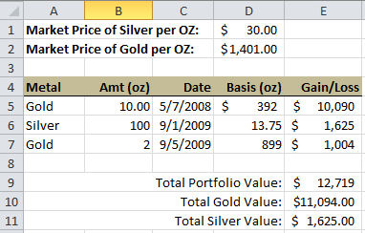
A Complete Spreadsheet Model
Spreadsheet to calculate the market value of a precious metals portfolio
=B5*(IF(A5="Gold",$D$2,$D$1)-D5)
=SUM(E5:E7)
=SUMIFS(E5:E7,A5:A7,"Gold")
Examples.xlsx

Slide 63
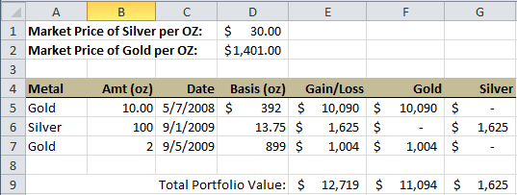
Filtering Data and Calculating Aggregates
An alternative way of summing data
=IF($A5=F$4,$E5,0)
=SUM(F5:F7)
Examples.xlsx

Slide 64
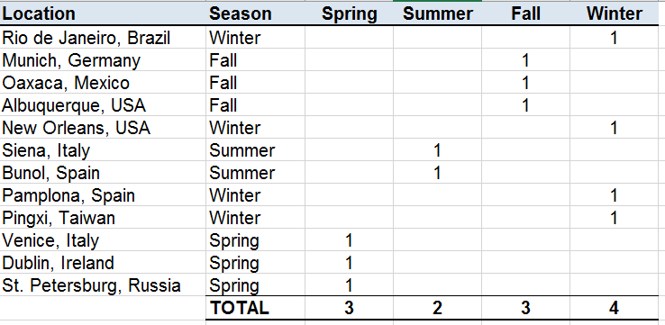
Filter Data with Conditionals
Exercise 1-2
Format: | Individually
Time: | 25 minutes + 5 minutes for review
Goal: | Use conditionals to filter data.
Materials: | Festival Data data set; Excel
Instructions: | Use IF to filter the data into different seasons and then count how many festivals are in each season. Make sure that the same formula is copyable down and across. Here’s a portion of the result:
FestivalData.xlsx

Slide 65
Module Summary
In this module you learned:
The displayed contents may be different than the actual value in the cell
Named ranges aid in understanding spreadsheet models
Cell references are automatically adjusted when formulas are copied, unless the cell references are anchored
Conditional formatting points out important data values
The IF function is used to place a conditional value into a cell
There are numerous functions in Excel to build complex spreadsheet models that function like programs

Slide 66
Module 2
Loading Data

Slide 67
Module Objectives
Upon completion of this module, you will be able to:
  Load and merge Excel files
  Load data from CSV files
  Scrape data from web pages

Slide 68
Sources of Data
Delimited Files
Web Scraping

Slide 69
Sources of Data
Data can come from many sources, including:
  Internal applications and databases
  Text files
    Text (.txt)
    Comma delimited (.csv)
  XML (.xml)
  External websites

Slide 70
Sources of Data
Delimited Files
Web Scraping

Slide 71
Delimited Files
May utilize commas, tabs, periods or other characters as separators
Most common format utilizes comma as separators (CSV)
Many applications and information system allow exporting of data as a CSV file
Import into Excel supported by Text Import Wizard

Slide 72
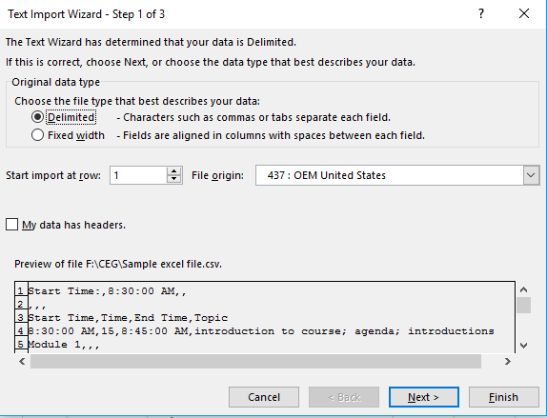
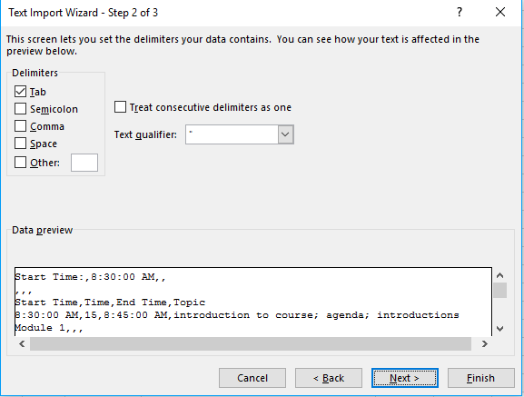
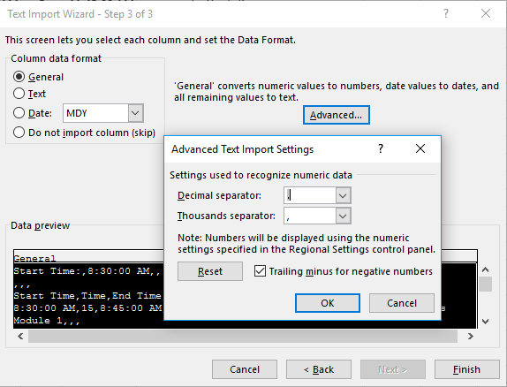
Steps to Import Text File via Text Import Wizard
In Excel, click on cell where you want to place the data
On Data tab, in Get External Data group, select From Text
Double-click the file that you want to import
Use the Text Import Wizard
Step 1 – Choose data type – delimited
Step 2 – Choose delimiter type
Step 3 – Specify or verify column data format
MDP930.FDICBankList.csv

Slide 73
Sources of Data
Delimited Files
Web Scraping

Slide 74
Scraping Data from the Web
  Often the data needed for an analytics project is not readily available as an Excel, text delimited, or CSV file.
  In such cases, the data can sometime be scraped from a web site.
    Internal web pages
      Pull from web page versus source data feed
      Verify timeliness/aging of data
    External websites
      Ensure authorization to capture this data
      Multiple ways in which to capture this data
  Requires refresh timing decisions
  Supported by Excel Web Query

Slide 75
Consideration When Using Scraped Data from the Web
  Provides current external data
  May require specific permissions to access the data
  May be the only source of compliance data
  Requires determination of refresh timing
  Frequently used examples include:
    Foreign exchange rates
    Labor statistics
    Financial indicators

Slide 76
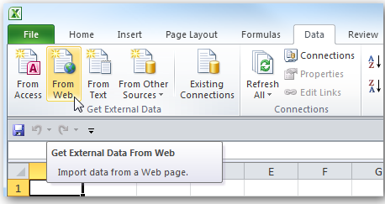
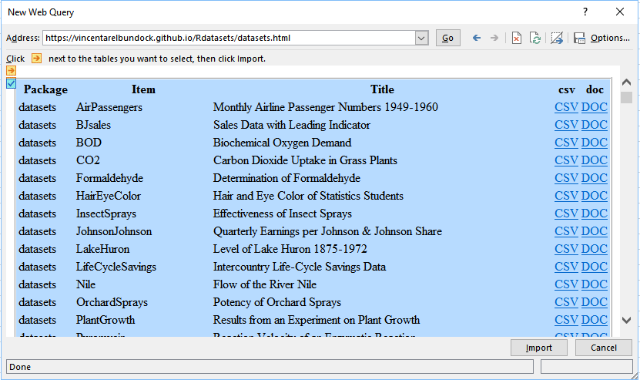
Scraping Web Data
To add current data from a website:
Under Data, Get External Data section, click From Web
Supply website URL
Click Import at bottom of dialog box
Select cell in Excel where imported data is to be placed
Message shows Excel is getting the data
Remove any unnecessary data
https://vincentarelbundock.github.io/Rdatasets/datasets.html
For more information on the Web Import tool, visit: https://goo.gl/0UiBb6

Slide 77
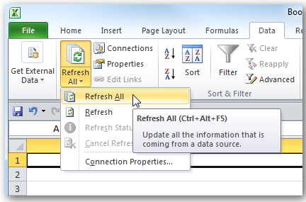
Obtain Most Current Data
Select one of the dynamic cells in Excel
Under the Data tab, click Refresh All

Slide 78
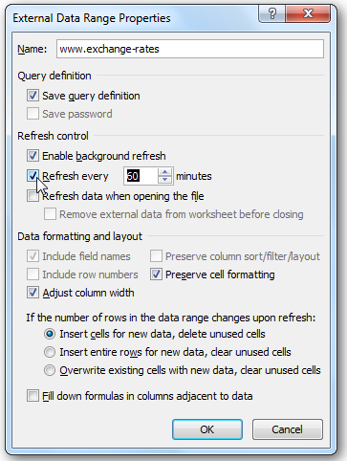
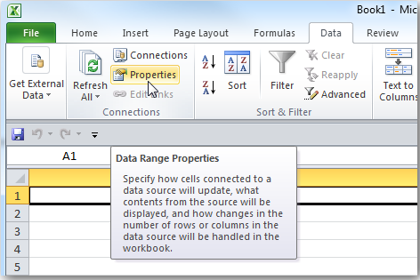
Automatic Data Refresh
Select one of the dynamic cells in Excel
Under the Data tab, select Connections
Click Properties button
Check the Refresh every box
Enter number of minutes

Slide 79
Module Summary
In this module you learned:
Excel can import data from a variety of sources, including text files, delimited files, CSV, XML, and others
When data is not available as a file, it can sometimes be imported by scraping the data from a web page

Slide 80
Module 3
Working with Data in Tables

Slide 81
Module Objectives
Upon completion of this module, you will be able to:
  Create named tables from data
  Apply sorting and filtering
  Define slicers

Slide 82
Tables
Slicers
Pivot Tables

Slide 83
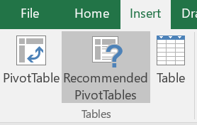

Converting Data to a Table
Any data in Excel can be converted to a table, which allows for easy sorting and filtering, plus banding of rows and columns.
SalesData.xlsx

Slide 84

Working with Data in Tables
Data in a table can be:
  Converted back to a range
  Summarized with a pivot table
  De-duplicated
  Filtered through headers or slicers
  Re-designed
  Resized as data is added or removed
  Named
SalesData.xlsx

Slide 85
Tables
Slicers
Pivot Tables

Slide 86


Adding Slicers to Filter Table Data
SalesData.xlsx

Slide 87
Tables
Slicers
Pivot Tables

Slide 88

Summarizing Data with Pivot Tables
Pivot tables are used in data analytics to summarize large data sets along various dimensions.
Pivot table
Fields included in table
Slicer for quick filtering

Slide 89
Module Summary
In this module you learned:
Tables are a convenient way to sort and filter data
Slicers are a simpler way to filter by multiple values
Pivot table can quickly summarize tables

Slide 90
Text Processing, Data Shaping and Extraction

Slide 91
Lesson Objectives
In this lesson you will learn:
Data does not often come in a ready to process form, and text processing helps shape data into analyzable columns
Text is not the same as numbers, and text must be converted to numbers before calculations can be performed on those values
The IF function is useful in cases where the pattern has exceptions

Slide 92
Data Shaping
Text Processing Functions
Converting Text to Numbers

Slide 93

Data does not always come ready for analysis…
salesdata.xlsx
How do we “parse” text in a cell and “break it apart” into its components?

Slide 94
Processing Text
Excel can not only be used to process numbers, but also text.
Processing text often involves taking apart the putting together text values (strings).
The process of taking text values apart is called parsing.

Slide 95
Data Shaping
Text Processing Functions
Converting Text to Numbers

Slide 96
Essential Text Processing Functions
Function | Quick Summary
LEN | Returns the number of characters in a text string
LEFT | Extracts a specified number of characters from the left side of a text string
RIGHT | Extracts a specified number of characters from the right side of a text string
MID | Extracts a specified number of characters from a given position within a text string
FIND | Returns the position of a specific character within a text string
VALUE | Returns a number parsed from digits
TRIM | Removes leading and trailing spaces from a text string

Slide 97
LEN Function
The LEN function returns the total number of characters in a text; i.e., the “length” of the text value:
=LEN(A9)

Slide 98

LEFT Function
The LEFT function extracts a specific number of characters from the left side of a text value:
The leftmost character in a text value (also called a string) is character 1, while the last character is at position LEN(A1).
=LEFT(A1,4)

Slide 99

RIGHT Function
The RIGHT function extracts a specific number of characters from the right side of a text value:
=RIGHT(A1,4)

Slide 100

MID Function
The MID function extracts some number of characters starting at some position within a text value:
=MID(A1,5,4)

Slide 101

FIND Function
FIND returns the position where a substring starts within a string.
  Finds the first occurrence only.
  Returns a #VALUE! error if the substring cannot be found.
=FIND("DEF",A1)
=FIND(" ",A2)
=FIND(",",A3)

Slide 102

Case Sensitivity
  Note that FIND is case sensitive.
  As an alternative, Excel has a SEARCH function, which is not case sensitive but otherwise works the same way as FIND.
=FIND("cde",A16)
=SEARCH("cde",A17)

Slide 103

IFERROR and FIND
Since FIND returns an error when a substring cannot be found, we need to use a sentinel value.
=FIND("[",A5)
=IFERROR(FIND("[",A5),"")

Slide 104
TRIM Function
  The TRIM function removes all spaces before and after a piece of text. Spaces between words are not removed.
    This is useful if the text you are trying to parse has trailing spaces which may result in errors later
    For example, if you need to use a result later in a VLOOKUP function.

Slide 105

A Simple Example: What’s the Recipe?
How would you extract the customer's name and the payment terms?
Before starting with formulas, think about your strategy.
  How can you recognize the beginning and end of the name component?
  How about the beginning and end of the term's component?
  Do we need intermediate values?

Slide 106
Steps to Devising a Text Parsing Strategy
You need think about your strategy:
  How do I detect where the term starts?
  Are there some delimiters?
  What is the delimiter?
  Does it always work?
  Is there always a value for terms?
Break the problem into several problems and create auxiliary or helper columns.

Slide 107
Data Shaping
Text Processing Functions
Converting Text to Numbers

Slide 108

VALUE Function
Numbers extracted from text with MID, LEFT, and RIGHT are not actually numbers but text and thus cannot be used in any calculation and cannot be formatted with number formats.
The VALUE function converts text to a number, assuming that it can be done; e.g., you can’t convert “L76”:
=MID(A19,5,3)
=VALUE(B19)
=SUM(B19:B20)
=SUM(C19:C20)

Slide 109
Parse Text, Extract Elements, and Shape Data
Exercise
Format: | Individually
Time: | 15 minutes + 5 minutes for review
Goal: | Extract text components from a string.
Materials: | Data set: textprocessing.xlsx Excel or Google Sheet
Instructions: | In the worksheet “Exercise” are two rows of text data. Extract the member's name and the fee and place them into the two columns. Note that it is possible that some text data fields do not have a member name. How would you deal with that scenario? Convert the fees to numbers and then calculate the sum of the fees. Format the fees column in Accounting format.

Slide 110
Module Summary
In this module you learned:
Data does not often come in a processable form, and text processing helps shape data into analyzable columns
Text is not the same as numbers, and text must be converted to numbers before calculations can be performed on those values
The IF function is useful in cases where the pattern has exceptions

Slide 111
Module 5
Exploring Data through Charts and Graphs

Slide 112
Module Objectives
Upon completion of this module, you will be able to:
  Construct pie, bar, column, high-low-close charts
  Build line graphs and scatter plots
  Create sparklines
  Customize charts and graphs

Slide 113
Common Charts
Customizing Charts
Sparklines

Slide 114

Charts and Graph for Data Exploration
  Data is often better explained through visualization as either a graph or a chart.
  Excel supports many common types of charts and graphs:
    Column Charts
    Pie Charts
    Bar Graphs
    Line Graphs
    Scatter Plots
    Area Graphs
    Stock Charts
    Radar Charts

Slide 115


Visualizing Proportions with Pie Charts
A pie chart shows proportions:
How much of the sales revenue comes from each client?
Who are our largest clients?
ChartData.xlsx

Slide 116

Visualizing Comparisons with Column Charts
Also known as a bar chart, with rectangular bars of lengths usually proportional to the magnitudes or frequencies of what they represent
Useful for illustrating comparisons
Categories organized on horizontal axis
Values on vertical axis
ChartData.xlsx

Slide 117

Visualizing Time-Series Data with a Line Graph
  Often used to plot changes in data over time, such as weekly temperature changes or stock market prices
  If plotting changes over time:
    Time is plotted along the horizontal or x-axis
    Data are plotted as individual points along the vertical axis
ChartData.xlsx

Slide 118



Visualizing Fluctuations with High/Low/Close Graph
Used to illustrate the fluctuation of prices or for scientific data
The data should be arranged with labels as row headings, and High, Low, and Close entered as column headings
Found under Stock Charts in Excel
ChartData.xlsx

Slide 119


Visualizing Correlations with a Scatter Plot
Useful for determining how things relate to one another; e.g., profits vs. expenditures, height vs. weight, etc.
ChartData.xlsx

Slide 120



Assigning a Series to a Secondary Axis
The line graph on the left shows two data series with widely differing ranges, so it’s hard to compare them.
The graph on the right plots one series on a secondary axis, making it much easier to compare and identify the inverse relationship.
To move a series to a secondary axis, right-click on the series, click Format Data Series, select Series Options then select Secondary Axis.
ChartData.xlsx

Slide 121
Common Charts
Customizing Charts
Sparklines

Slide 122


Customizing a Chart
Use the Chart Tools tabs to customize any chart
Design Tab
Format Tab

Slide 123

Customizing a Chart
  Use the Design tab to change the look of the chart or to add additional chart elements.
  Use the Format tab to rearrange items in the chart
ChartData.xlsx | ChartExamples.xlsx

Slide 124

Adding Transparency to Create Minimal Displays
  Choosing a transparent background for a chart is useful for creating a worksheet that minimizes chart details and simply shows a small graphic to support a set of numbers
ChartData.xlsx | ChartExamples.xlsx

Slide 125

Additional Formatting Options
  The ‘+’ icon allows you to add a new chart element
  The paintbrush icon allows you to change the format of the item
  The funnel icon allows you to limit the data in the chart
The Format Chart Area panel allows you to customize any chart element selected
ChartData.xlsx | ChartExamples.xlsx

Slide 126
Customizing a Scatter Plot
Data
Before – generic scatter plot with default format settings
After – custom tick marks, axis labels, mark color and size, title, data callouts, removed grid lines, custom label formatting
ChartData.xlsx | ChartExamples.xlsx

Slide 127



How to Remove Generic Data Labels
Data series are labeled with generic names like “Series1”…
How to fix:
Click on chart, then click on Select Data in Chart Tools/Design tab
Select data series to edit
Select the correct cell for the series name or type in a name
ChartData.xlsx | ChartExamples.xlsx

Slide 128
Common Charts
Customizing Charts
Sparklines

Slide 129

Sparklines
  New to Excel 2010, we can also create charts or graphs that live within one cell
  Their inventor, Edward Tufte, describes them as “intense, simple, word-sized graphics”
  Meant to be embedded into what they are describing
  Presents the general shape of variation in some measurement, in a simple and highly condensed way

Slide 130

Create Sparklines
Select the cell where you want the sparkline to appear
Click the Insert tab and
    look for the Sparklines group
Choose the data range and the location for the sparkline
Customize the sparkline
ChartData.xlsx

Slide 131

Merging Cells
To make sparklines bigger, you can merge multiple cells into a single cell.
  In the Home tab:

Slide 132
Module Summary
In this module you learned:
Pie charts, column charts, bar charts, scatter plots, line graphs, high-low-close charts are among the most common chart types, but Excel provides many more
Sparklines provide a quick visual summary of a row or column of data
Charts and graphs can be customized in many ways

Slide 133
Building Tabular Structures with Table Lookup

Slide 134
Module Objectives
Upon completion of this module, you will be able to:
Use VLOOKUP for table lookup
List the limitations of VLOOKUP
Use the INDEX function in combination with the MATCH function to perform more versatile table lookups
Catch and handle errors with IFERROR

Slide 135
Exact Match Lookup
Approximate Match
Handling Errors
Alternate Lookup Functions

Slide 136
An Employee Payroll
Example
PayrollData.xlsx
Job Status | full-time (FT) or part-time (PT)
Salary | annual compensation
Years Service | number of years employee has been with company
Life Ins | Y = employee wants life insurance, N = no life insurance
Health Plan | type of health plan employee participates in
Life Premium | amount of life insurance premium paid by employer
Health Premium | amount of health insurance premium paid by employer
Total Comp | total compensation paid to employee (salary + insurance)

Slide 137
Calculations
We need to calculate:
  Life Insurance Premium
  Health Insurance Premium
  Total Compensation

Slide 138
Health Insurance Rules
The health insurance premium is based on the type of plan selected:
Plan Type | Premium
HMOF | $2,300 per month
HMOI | $1,040 per month
PPOF | $1,755 per month
PPOI | $897 per month
DISF | $457 per month

Slide 139
Table Lookup: VLOOKUP and HLOOKUP
There are two primary Excel functions for looking up values in a table:
  VLOOKUP
    Table is arranged as columns
  HLOOKUP
    Table is arranged as rows
Both functions support exact or range lookup.

Slide 140

VLOOKUP Table Setup
Let’s start by building a lookup table to get the health insurance premium.
This table can optionally be turned into a named range for easier referencing.
Activity: Turn range A2:B6 into the named range HealthRates
Lookup value in column 1
Result value in column 2

Slide 141


Detailed Look at VLOOKUP
=VLOOKUP (F2, HealthRates, 2, FALSE)
Common Mistake:
The last parameter is omitted. In that case, Excel uses the default value that is TRUE resulting in an approximate (or interval) lookup producing incorrect results (but not always!)

Slide 142
VLOOKUP Parameters
General form of VLOOKUP:
  VLOOKUP (lookup_value, table_array, col, [option])
Definitions of the VLOOKUP parameters:
  lookup_value: value to be used as a key into the table_array
  table_array: table of values where first column is key
  col: column to be returned as value of VLOOKUP
  option: FALSE = exact match, TRUE = approximate (or interval/range) match

Slide 143
Exact Match Lookup
Approximate Match
Handling Errors
Alternate Lookup Functions

Slide 144

Setting up VLOOKUP Intervals
Insurance Rate is based on salary:
  Up to $50,000, premium is $250 per year
  From $50,000 to $69,999, premium is $350 per year
  From $70,000 to $89,999, premium is $475 per year
  From $90,000 to $109,999, premium is $545 per year

Slide 145
Reading the VLOOKUP Table
An interval lookup table only “codes” part of the interval, not both ends.
The table MUST start with the smallest value because the search stops once the value fits the range.
From
Value
To

Slide 146

Using VLOOKUP with Intervals
=VLOOKUP (C2, LifeRates, 2, TRUE)

Slide 147
VLOOKUP Table Setup Rules
The lookup value (key value) must be in the first column.
For an exact match lookup, the key values can appear in any order
For an approximate (or range) lookup, the values must start with the smallest value

Slide 148
Exact Match Lookup
Approximate Match
Handling Errors
Alternate Lookup Functions

Slide 149
Lookup Errors
  What happens when VLOOKUP cannot find the value?
    Returns error #N/A
  Use IFERROR to detect errors and provide an alternative.

Slide 150
Using IFERROR
IFERROR works almost like IF, except that there’s no condition to test:
  =IFERROR (value, value_if_error)
Using IFERROR with VLOOKUP:
  =IFERROR (VLOOKUP(F2,HealthRates,2,FALSE), 0)

Slide 151


Dealing with Missing Lookup Table Values
=IFERROR(VLOOKUP(B2,ClimateData,4,FALSE),"")
Named Range: ClimateData
RainfallLookup.xlsx

Slide 152

Flexible Models with Table Lookup
Exercise 6-1
Format: | Individually
Time: | 15 minutes + 5 minutes for review
Goal: | Use a table to find prices for commuter passes.
Materials: | Data set; Excel
Instructions: | In the data set, there are several missing column values. You are to complete column “Fare.” The price for the commuter pass is based on the zones traveled. Here’s what the result should look like:
CommuterData.xlsx

Slide 153
Exact Match Lookup
Approximate Match
Handling Errors
Alternate Lookup Functions

Slide 154
Limitations of VLOOKUP
  While VLOOKUP is the most commonly used search function in Excel, it has its limitations:
  The data must be sorted for approximate (interval) lookups to work
  The lookup value can only be in the first column of the lookup table
  The more powerful search function is INDEX, used most often in conjunction with MATCH. Which is why the duo is often called INDEX-MATCH.

Slide 155
Some Thoughts...
The search key must be in the first column of the lookup table.
How would you adjust this so that you can search by Zip Code?
VLOOKUP is too limited for a search like this where you might want to search by City or Zip Code.

Slide 156
The MATCH Function
The MATCH function finds the row in which a lookup value is found in an array of cells.
Use 0 as the third parameter if the lookup values are not ordered add you need a precise (exact) match.
=MATCH(lookup_value, lookup_array, match_type)
lookup_value — the value to match in lookup_array.
lookup_array — a range of cells with data.
match_type — specifies how Excel matches the lookup_value with values in the lookup_array. For exact matches, always use 0 for this argument.

Slide 157
The INDEX Function
The INDEX function returns the value in the specified cell from a range of cells.
=INDEX(reference, row_num, [column_num])
reference — a range of cells
row_num — the row in reference from which to return data.
column_num — optionally the column in reference from which to return data.

Slide 158

Examples of MATCH and INDEX
Example
=MATCH(A7,A1:A5,0)
=INDEX(A1:A5,B7)
=INDEX(A1:B5,B7,2)
PayrollData.xlsx

Slide 159


Example Revisited
Here's a solution to the problem we originally posed: how do you look up cities by zip codes if zip code is not the first column as required by VLOOKUP?
=MATCH(B8,Cities!B2:B6,0)
=INDEX(Cities!A$2:E$6,$C$10,5)
RainfallLookup.xlsx

Slide 160
Common Errors with Table Lookup
VLOOKUP or MATCH return a #N/A error, which means that lookup can't find what you are looking for, because:
Your lookup value is incorrect (in your case it was a negative number)
Your lookup value is not in the table because you set up the table incorrectly
You misspelled the key values when you entered them into the lookup table
You have an extra space after the value in the table
Your named range does not include all of the columns in the lookup table

Slide 161

Flexible Models with Table Lookup
Exercise 6-2
Format: | Individually
Time: | 15 minutes + 5 minutes for review
Goal: | Use a table to find prices for commuter passes.
Materials: | Data set; Excel
Instructions: | In the data set, there are several missing column values. You are to complete column “Discount.” The discount for the commuter pass is based on the years of employment. Less than 3 years, no discount 3 or more but less than 5 years, 10% At least 5 years but less than 10 years, 18% 10 or more years, 20% Here’s what the result should look like:
CommuterData.xlsx

Slide 162
Module Summary
In this module you learned:
If you need to only lookup based on the first column of the lookup table, then VLOOKUP will work
If you need the ability to look up based on a key that's not in the first column, then INDEX-MATCH is required

Slide 163
Module 7
Practicum

Slide 164
Module Objectives
Upon completion of this module, you will be able to:
  Combine the various techniques learned in this course
  Apply a variety of functions
  Practice building flexible models

Slide 165
Practicum
Exercise 7-1
Format: | Individually with collaboration
Time: | 50 minutes + 10 minutes for review
Goal: | Build a complete spreadsheet model based on the instructions provided over the next few slides.
Materials: | Practicum data set; Excel
Instructions: | Follow the instructions provided on the next few slides Construct and flexible model that does not hardcode values. Match the output provided whenever possible Collaborate with others when you run into difficulty Ask your instructor if you get stuck
PracticumData.xlsx

Slide 166
The data in the worksheet named “User Data” shows data from the marketing department at WebBuy which is conducting a study of its online shoppers. In particular, they want to determine which browsers are being used to access the website so that the new website can be designed to support the most popular browsers. So, they have asked the IT department to extract user information from the login database.
  The data file includes a single field that contains the following information about each shopper’s login: date of last login, e-mail address, operating system, browser code, and number of visits.
  You can assume that the operating system is always surrounded by angled brackets and the email is always followed by a colon.
  The operating system and the browser code are sometimes not present, but all other fields are always listed.

Slide 167
The last login is always surrounded by brackets. Here is an example:
[JAN 13 2016] mks8976@yahoo.com: <Windows 8.1> IE 61
The following are the browser codes commonly used along with their meanings:
The next slide shows what the result should look like. Study it before you answer the questions so that you know what’s being asked. Format your result as close to what is shown.
Browser Code | Browser
IE | Internet Explorer
FF | Firefox
CH | Chrome
SF | Safari
All others | Unknown

Slide 168

In the sample screen shot, column A is cut off as it’s provided.

Slide 169
Data Shaping Tasks
Extract the e-mail address, last login, operating system, and browser code, and put them into the columns provided. Create hidden columns as needed. You do not need to extract the number of visits.
Create a lookup table in the sheet “Lookup Tables” for the browser codes that can be used to look up their meanings. Define the lookup table as a named range with the name “BrowserTable.”
Look up the browser in the table create above and place it into the field provided. Your lookup function should be able to handle unknown browsers, including any others that may be added later.
Filter the browsers into columns so you can count how many there are of each kind of browser.

Slide 170
Data Analytics Tasks
Calculate how many times each browser was used.
Calculate the corresponding percentage of each browser use.
Determine the user who has the most logins (highest number of visits) and put the user's email into the cell provided (Hint: Use a hidden column, MAX, and INDEX/MATCH).
Determine the date of the most recent login and which user logged in most recently. The last login must be converted to a date value rather than text (Hint: Check out the DATE and VALUE functions; you’ll need a lookup table to map date names to numbers; e.g., MAR to 3).
What is the month with the most logins?

Slide 171

Exploratory Visualization Tasks
Construct the following customized pie chart to illustrate how often each browser was used.

Slide 172

Exploratory Visualization Tasks
Use data bars to show which browsers are most commonly used (Hint: Data bars are found under the Conditional Formatting tool).
Construct the following column chart to illustrate login behavior over time.

Slide 173
Hints and Requirements
Be mindful to remove any leading and trailing spaces, or your lookups or IF statements may not work.
Created as many hidden columns to store temporary results as needed.
Use TRIM to remove leading and trailing spaces.
Do NOT change any of the original data.
Make sure that as new rows are added to the data set that your model still works and that your charts are updated. Test it out by adding a new column with “made up” data.

Slide 174
Module Summary
In this module you learned:
Spreadsheets are powerful end-user programming environments

Slide 175
Module 8
Data Collection and Working with Excel® Summary

Slide 176
Session Summary
In this session, you learned how to:
  Build flexible models in Excel
  Load data from files and the web
  Analyze data in tables and pivot tables
  Shape data through text processing
  Handle errors in formulas
  Use lookup tables to link data in different tables
  Construct customized charts and graphs

