Slide 1
The Need for Databases An Introduction & Overview of Databases and Database Management Systems
Martin Schedlbauer, Ph.D.
m.schedlbauer@northeastern.edu

Slide 2
Lesson Objectives
At the completion of this lesson, you will be able to:
describe partitioning and sharding and explain the differences between them
use partitioning and sharding to improve query performance of very large databases

Slide 3
Databases

Slide 4
What is a Database?
An organized collection of data stored and accessed electronically
Designed to manage large amounts of information
Optimizes retrieval and modification
Separates data from applications

Slide 5
Is an Excel Workbook a database?

Slide 6
Is the file system on my computer a database?

Slide 7
Data Store
Database is often synonymous with relational database
Data store is used for any digital storage of data, including unstructured data

Slide 8
So, the answer is, yes, Excel Workbooks and your file system are data stores but is the data they contain managed?

Slide 9
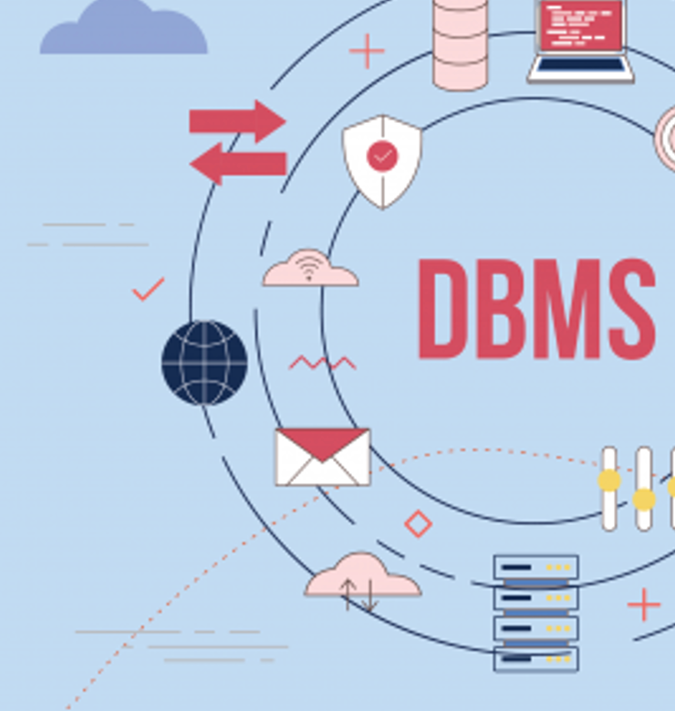
Database Management System
A Database Management System (DBMS) is software designed to maintain the data in a database.
Provides controlled concurrent multi-user access to data.
Stores data efficiently and provides abstraction to applications.
Protects the database from unauthorized access.
Ensures data can be recovered if the system fails.

Slide 10
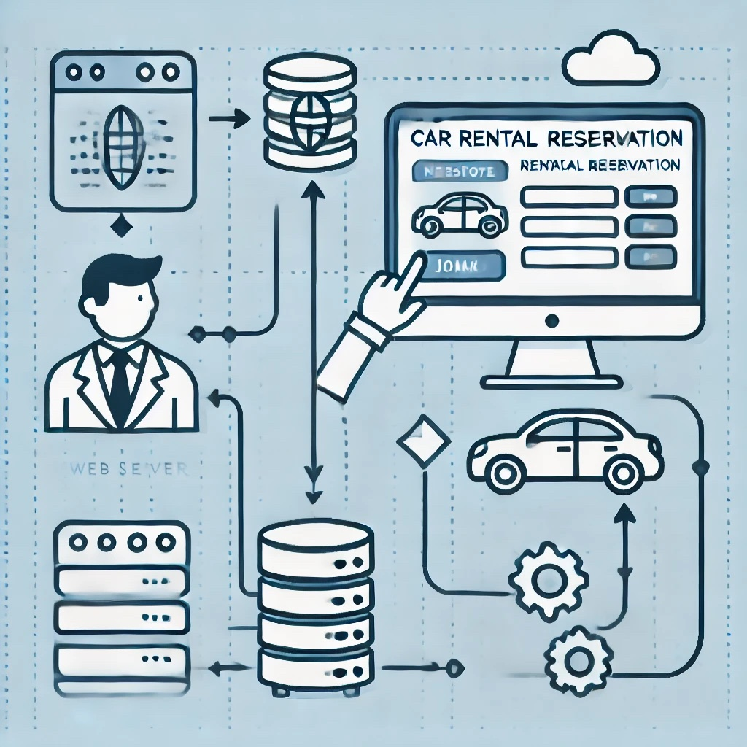
Databases Are Ubiquitous

Slide 11
Types of Databases
Hierarchical Database
NoSQL Database
Cloud Database
Relational Database
File-Based Database
Document Database
Key-Value Database
Distributed Database

Slide 12
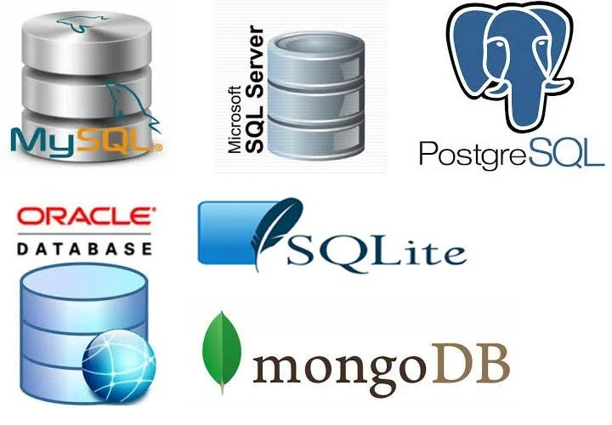
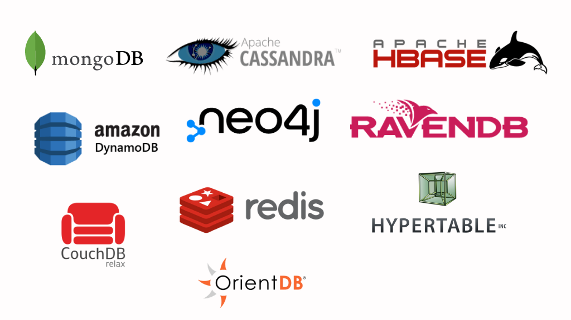
Popular Relational and NoSQL Database Products
Application Development
Web Development
Mobile App Development
Data Analytics
Data Mining
Embedded Applications

Slide 14
Concurrent Multi-User Access
Mobile Application
Ad Hoc Reporting
Concurrency control is critical for ensuring that multiple users or processes can access and modify a database simultaneously without leading to data inconsistencies, integrity violations, or other problems.
Database
Web Applications
DBMS
Analytics & Data Mining
IoT Devices & Applications

Slide 15
Genesis & History

Slide 16
Database Use Cases
Airlines & Railways
Banking, Insurance, & Finance
Education
Telecommunications
Payment Systems, Credit Card Processing
E-Commerce & Online Shopping
Health Care Information Systems
Digital Libraries
Sales & Order Management
Human Resource Management

Slide 17
Challenges & Considerations
Initial Acquisition Costs
Training Requirements
Backup and Recovery
System Failures
Data Security and Privacy
Migration Challenges
Maintenance Costs
Vendor Lock-In

Slide 18
Database Roles
Database Users
Systems Analysts
Application Programmers
Database Administrators (DBA)

Slide 19
Interacting with a Database
Interaction is via a management console such as MySQL Workbench or SQLite DB Browser or programs.
Specialized languages or access APIs:
Data Control Language
Transaction Control Language
Data Definition Language
Data Manipulation Language
For relational databases, SQL is the lingua franca.

Slide 20
Database Design & Development Process
Requirements Analysis
Conceptual Database Design
Selection of DBMS
Logical Database Design
Physical Design
Database Implementation
Testing and Evaluation
Optimization

Slide 21
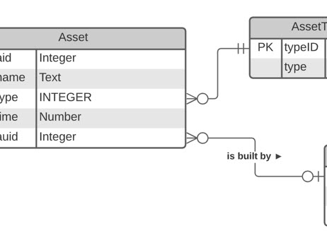
Database Design
Conceptual
Logical
Physical
UML Class Diagrams
Entity-Relationship Diagrams
Normalization
Table Design
Constraints
Indexing
Database Type Agnostics

Slide 22
Relational Databases
Data stored in rows within tables
Columns are attributes
Related data in different tables is connected through “foreign keys”
SQL is used to manipulate and retrieve data
Most common database format

Slide 23
Structure of Relational Database
Primary Key (Unique ID)
Columns (Attributes or Fields)
EMP_D | NAME | ROLE | SALARY | PROJECT_FK
E103 | Jeffrey Taylor | Manager | 135,400 | 301
E287 | Melanie Vargas | Dev Lead | 276,490 | 301
E887 | He Chen | Business Analyst | 109,800 | 123
…
Rows (Records)
Data Value
Domain {x : x ∈ ℝ ∧ x ≥ 1000}
Degree (Number of Columns): 4
Cardinality (Number of Rows): 3

Slide 24
Structure of NoSQL Database
Document Database
{
"Name": "Jeffrey Taylor",
"SalaryPayment" : [
{
"Month": 7,
"Amount": 11283
},
{
"Month": 8,
"Amount": 14283
}
],
"Role": "Manager"
}
E301

Slide 25
Two-Tier Client/Server Architecture

Slide 26
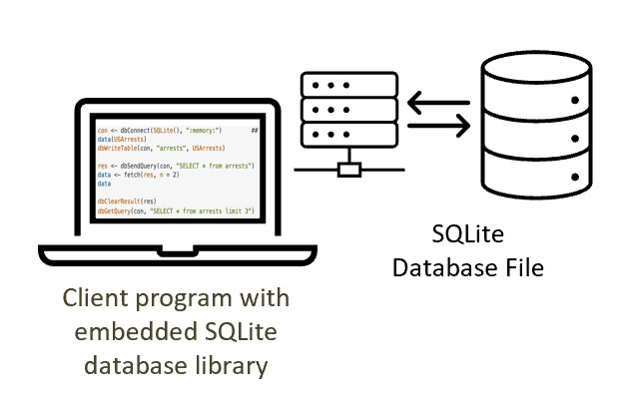
Server-Less Database: SQLite

Slide 27
Summary
In this lesson, we learned that:
there are many different types of databases and a plethora of vendors offering database products
database management systems manage the data in the database
concurrency control is paramount in multi-user databases
relational databases store data in tables, while NoSQL databases store them in documents (generally JSON)
relational databases have a fixed schema, while NoSQL databases are schema-less

