Slide 1
Data Warehousing, OLAP, and Data Mining
Copyright © 2011-2020 by Khoury College of Computer Sciences.
No Duplication or Distribution Without the Express Permission of Khoury.

Slide 2
Data Warehousing Concepts

Slide 3
Need for data warehouses
Benefits of a data warehouse
Data warehouse vs data mart
OLTP vs DSS vs OLAP

Slide 4
Data is Growing in Organizations
Organizations have accumulated large databases by collecting data about day-to-day activities.
Such databases range from a few gigabytes, to hundreds of gigabytes, or even terabytes.
Information systems that record and update data in such databases are known as online transaction processing (OLTP) applications, often supported by relational, hierarchical, and network database management systems.

Slide 5
OLAP and Data Warehousing
Data warehouses are databases that consolidate data from multiple sources, augmented with summary information, and historical data over a long time period.
OLAP refers to the analysis of complex data from the data warehouse, while data mining refers to the automated discovery of new information such as patterns, clusters, or association rules.

Slide 6
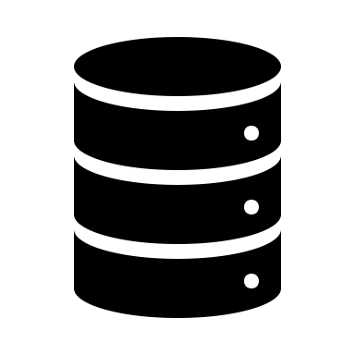
Enterprise Data Warehouses
Operations
(DB/2)
Accounting
(CSV)
Data Consolidation
Data publication
Data visualization
Periodic updates
Filtering
Summarization
Statistical analysis
Historical data
Pattern & Rule Mining
Marketing
(SQLite)
Data Warehouse
Production
(Oracle)
Public Data
(XML)

Slide 7
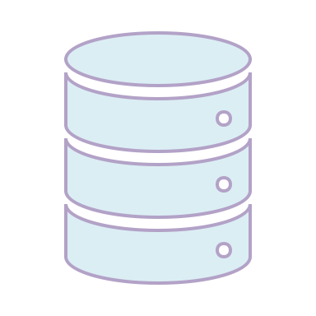
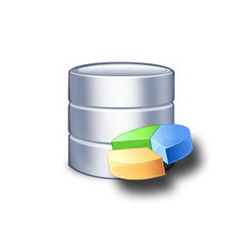
Definition: Data Warehouse
A data warehouse:
is an integrated and consolidated collection of data from multiple sources, that
is primarily queried and is non-volatile,
contains data records for a long time and retains historical data, and
provides users with a single consolidated interface to data, enabling decision-support systems.

Slide 8
Definition: Data Mart
Data marts are subject-specific subsets of a data in the data warehouse geared towards the needs of a particular user.

Slide 9
Data Warehouse Architecture
Source
Databases
ETL via
Tools, Scripts, Programs
Data
Warehouse
Data Distribution & Dissemination
replication
partitioning
summaries
...
Data Marts
extraction
subset of data
specific purpose
adjustments for efficiency
derived data
network
...
Analytics / DSS Dashboards / Visualization
Notes:
Data in a data warehouse is an integrated, consolidated collection of data from various sources. The data warehouse design is built on a common data model based on business understanding. The extraction and actual construction of the data warehouse is done via custom-developed programs, often written in C or C++ running on Unix servers. The data warehouse is often a relational database management system, such as Oracle or Sybase, a relational database modified for data warehousing, such as Sybase IQ, or a data warehouse database, such as Red Brick or Adabas. In most cases the data warehouse resides on a dedicated large-scale server with very large amounts of memory (gigabyte range) and storage capacity (terabyte range).
For analysis purposes, it is common to extract subsets from the database and place those subsets on data servers built around Unix and traditional relational database technology. Client programs that implement decision support systems (DSS) query the data in these data warehouse subsets. In many cases, further subsets are extracted and placed locally on the data analysis workstation running the DSS application. These local, purpose-specific data subsets are called data marts. It is not unusual to place additional derived or pre-computed data into data marts to speed up queries.

Slide 10
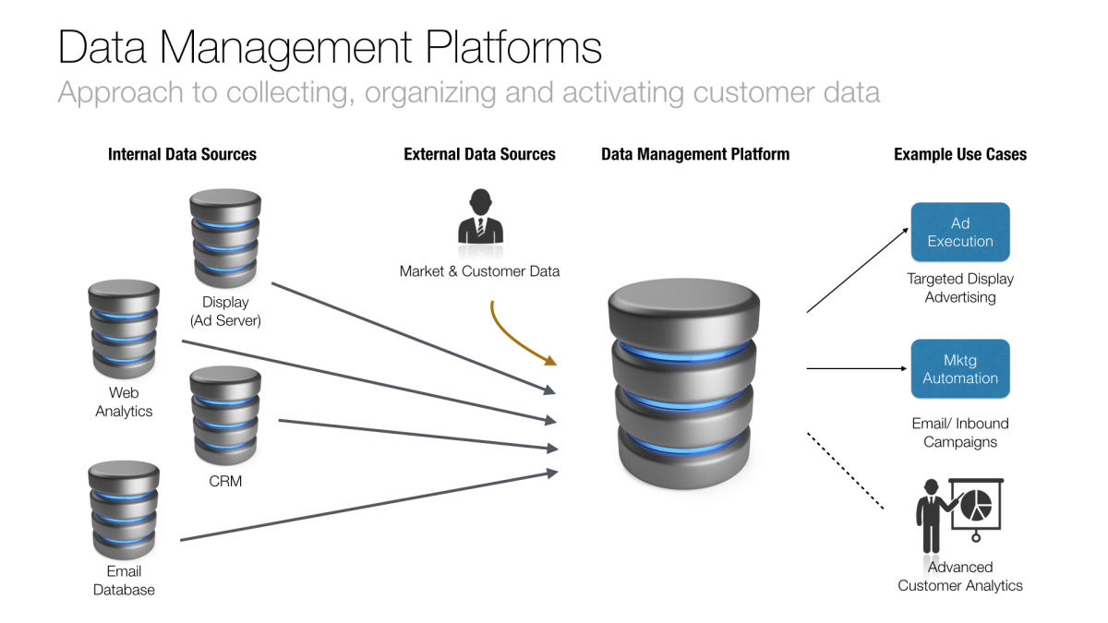

Slide 11
DSS and OLAP vs OLTP
Systems that extract high-level information stored in databases and use that information in supporting a variety of decision making processes are called decision-support systems (DSS).
Some of the tools and techniques used to build DSS include data warehousing, online analytical processing (OLAP), data mining, plus predictive and prescriptive modeling.

Slide 12
OLTP vs OLAP Databases
OLTP
OLAP
Used on-line by users for specific and defined purposes
Contains current data values
Contains unfiltered data
Single data source
Continuous data updates
Used by managers and executive for tasks not known a priori
Contains snapshots of data
Contains filtered and converted data
Multiple data sources
Periodic updates with versioning

Slide 13
Why Build a Data Warehouse?
Organizations are building data warehouses:
to have a more complete picture when making business decisions
to gain an advantage during competitive decision making
to find information that is otherwise not accessible
to reduce cost and increase profits
Data Warehouse

Slide 14
Design Differences
Unlike OLTP databases that hold operational data, data warehouses are not updated (changed) in real-time – only periodically.
Redundancy in data warehouses is often deliberately planned to improve access:
summarized data is stored
data is deliberately copied to several tables
relational schemas are denormalized
joins, aggregations, and grouping is avoided during retrieval

Slide 15
Inmon’s Definition…
Bill Inmon, considered to be one of the “fathers” of the modern data warehouse, defines a data warehouse as a
subject-oriented, integrated, time- variant, non-volatile collection of data in support of management’s decisions.

Slide 16
Subject-Orientation
A data warehouse is organized around a major subject such as accounts, products, and orders.
Unlike an operational database which supports an application, in a data warehouse data is organized according to a subject.
For example, an insurance company using a data warehouse might organize its data by customer, premium and claim instead of by different policies (auto sweep policy, joint life policy, etc.).

Slide 17
Non-Volatility
A data warehouse is always a physically separated store of data.
Due to this separation, data warehouses do not support transaction processing, recovery, or concurrency control.
The data is not overwritten or deleted once it enters the data warehouse, but is only loaded, refreshed, and accessed for queries.
The data in the data warehouse is retained for future reporting and trend analytics.

Slide 18
Time Variance
Data is stored in a data warehouse to provide historical perspective.
Consequently, the data in the data warehouse is time- variant or historical in nature.
It is not unusual for to hold several years or even decades worth of data for, in order to facilitate comparative analytics, trend analysis, and forecasting.
All values are stored so that reports and visualizations can be produced which show changes over time.

Slide 19
Integration
A data warehouse is usually constructed by integrating multiple, heterogeneous sources of data such as relational databases, XML files, and other flat files.
The database contains data from most, or all, of an organization’s operational applications.
The data is integrated and harmonized to ensure a consistent view of the data and reduce data quality issue.

Slide 20
Common Integration Issues
Among the most problematic integration issues are:
category encodings and formatting
field naming
primary key selection
duplicate data
default values
missing data and imputation
filtering and aggregation

Slide 21
Example: Data Integration
Operational databases must be integrated through programming or ETL scripts.
Example of lack of integration:
Encoding
Integration
DB₁: m/f
DB₂: 1/0
DB₃: male/female
DB₄: M/W
m, f

Slide 22
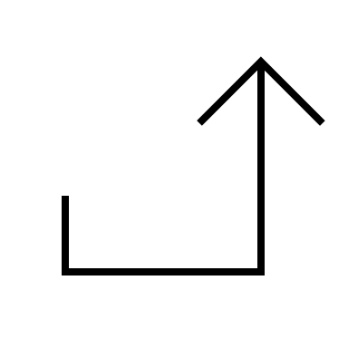
Backflushing
During integration of data from multiple sources, data quality issues are generally resolved, and the updated data is then often copied back to the operational data sources.
backflush cleaned data
Source
Databases
ETL via
Tools, Scripts, Programs
Data
Warehouse

Slide 23
Summary, Review, & Questions…

Slide 24
Multi-Dimensional Modeling

Slide 25
Multi-Dimensional Models
Denormalized Schemas
Star Schemas
Star vs Snowflake Schemas
Fact and Dimension Tables

Slide 26
Two-Dimensional Data Models
Normalized relational schemas are two dimensional:
all tables are equal, but
not all tables contain the same amount of data
Order
Part
...
Customer

Slide 27
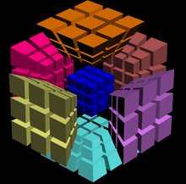
Multi-Dimensional Modeling
The data in a data warehouse built on a relational database is usually multidimensional data having measure attributes and dimension attributes.
Measure attributes “quantify” some value and can be aggregated.
On the other hand, the attributes that define the dimensions on which the measure attributes and their summaries are viewed are called dimension attributes.

Slide 28
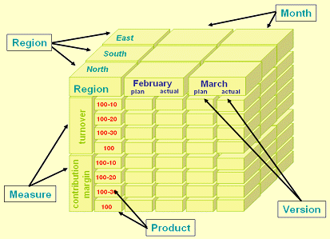
Multidimensional Databases
Multidimensional databases:
contain summarized data
use facts, dimensions, sparsity: values, counts, weights, occurrences
view data as a “slice of time” not a transaction
concentrate on modeling “facts” rather than entities

Slide 29
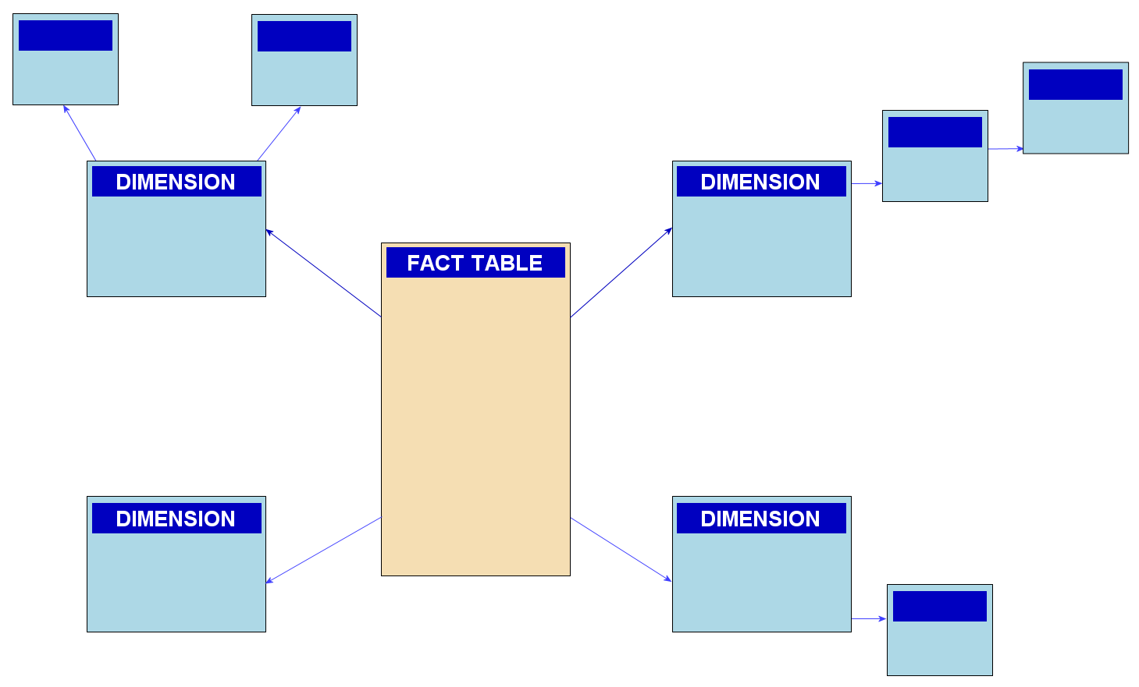
Schema Design: Star vs Snowflake
The multidimensional data in a data warehouse can be represented either using a star schema or a snowflake schema.

Slide 30
Star Schema
The star schema is the simplest data warehouse schema, which consists of a fact table with a single table for each dimension.
The dimension tables are also referred to as lookup tables.

Slide 31
Benefits of Star Schemas
Star schemas offer several benefits over normalized relational schemas:
streamlined access for OLAP queries
selective redundancy to simplify and speed up queries for decision support and data mining
pre-computation of derived data
Fact tables are not appropriate for OLTP databases that experience frequent, real-time updates.
Notes:
DSS and EIS are acronyms for Decision Support Systems and Executive Information Systems. These are names that are often used for integrated data stores that support analytical processing rather than transaction processing systems.

Slide 32
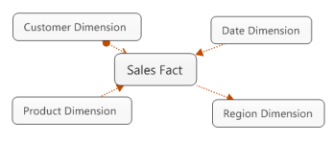
Fact Tables
The relations or tables that store multidimensional data are called fact tables.
The fact tables contain the primary information in a data warehouse and are often very large.

Slide 33
The Role of the Fact Table
Fact tables are tables that are:
heavily populated
are at the center of the star schema
contain pre-joined rows/tuples
aggregated data
Surrounding tables are called dimension tables:
fewer tuples
represent a single entity

Slide 34
Normalized OLTP Schema
ITEM
SALE
LINEITEM
SKU
ItemDesc
CurrPrice
Cost
DatePurch
VendID
SaleID
DateSale
CustID
SalePersID
SaleID
LineItem#
SKU
Quantity
SalePrice
ExtPrice
SALESPERSON
VENDOR
CUSTOMER
CustID
CustName
CustAdd
CreditRating
MemberSince
SalePersID
SPName
SPAddress
CommRate
VendID
VendName
VendAdd
Terms

Slide 35
OLAP Star Schema
ITEM
CUSTOMER
SALE
CustID
SnapDate
CustName
CreditRating
MaritalState
Age
SKU
ItemDesc
CatCode
CatDesc
DatePurch
SaleID
SKU
CustID
AddressID
SalePersID
LineItem#
Quantity
SalePrice
ExtPrice
Cost
Margin
VendorID
DateSale
TIME
DateSale
FisYr
Qtr
Month
Week
ADDRESSES
SALESPERSON
AddressID
AddLine1
AddLine2
City
State
Zip
SalePersID
SPName
SPAddress
FYMonth
YTDEarned

Slide 36
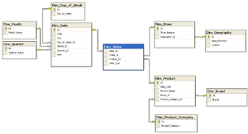
Snowflake Schema
The snowflake schema is a variation of star schema, which may have multiple levels of dimension tables.

Slide 37
Summary, Review, & Questions…

Slide 38
Star Schema Design

Slide 39
Need for data warehouses
Benefits of a data warehouse
Data warehouse vs data mart
OLTP vs DSS vs OLAP

Slide 40
Characteristics of Star Schemas
Star Schemas are organized around a process or event rather than an entity.
Two types of tables in each a star schema:
Dimension Tables – descriptive attributes used for filtering
Fact Tables – keys from dimension tables plus aggregated values in numeric columns
The dimension tables are not normalized:
all joins are through the fact tables
Star Schemas simplify finding counts, sums and averages and minimizing the joins.

Slide 41
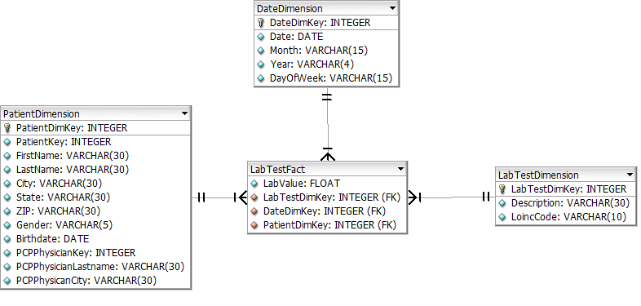
Data Mart Design
Data Marts can be designed around normalized or star schemas.
PatientDimension is not normalized
Can easily sum, average numerical values or count records

Slide 42
Advanced Star Schemas
Generalized Event Schema
Summary Schema
Dealing with data that changes over time

Slide 43
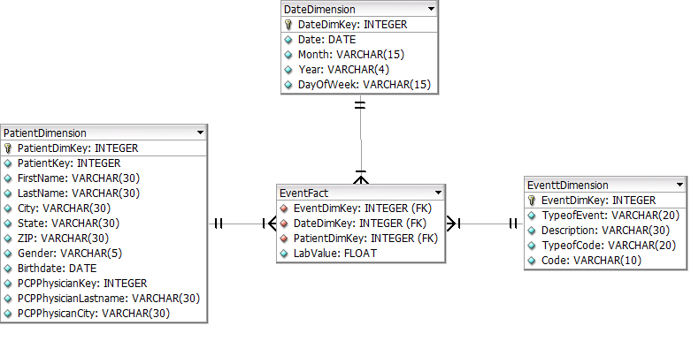
Generalized Event Schema

Slide 44
Demonstration Queries
Find the Physicians with Patients Named Carlson and the average lab values of the patients named Carlson
Count the number of patients who have had Hemoglobin A1c tests in the past year by Physician
Count the number of patients who have a diabetes condition for each Physician
Count the number of Diabetes patients who have had a Hemoglobin A1c test in the last year for each Physician

Slide 45
Creating a Star Schema
First create and load the Dimension Tables
Distinct values from the other tables plus a new DimKey column
Load the values from the operational system or a staging schema or database
After all the dimension tables are loaded, then load the fact table:
use the keys in the event table to look up the new DimKey’s
This is done during ETL and not in real-time.

Slide 46
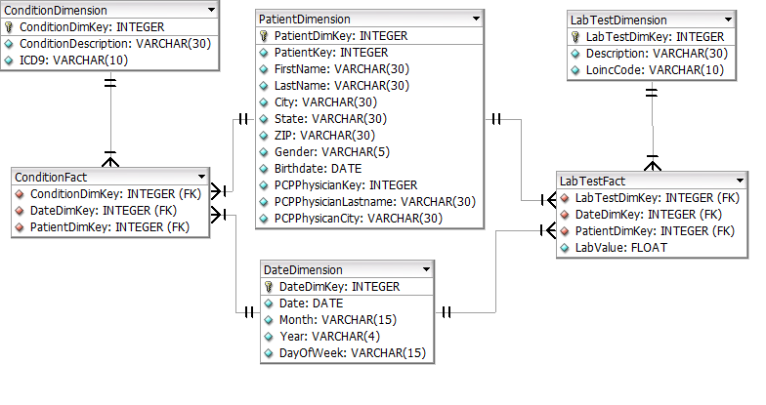
A Condition Star
The PatientDimension and DateDimension are called conforming Dimensions

Slide 47
Queries over the Generalized Event Star
Find everything that happened for Patient Bailey Morris.
Creating the Event Fact and Event Dimension

Slide 48
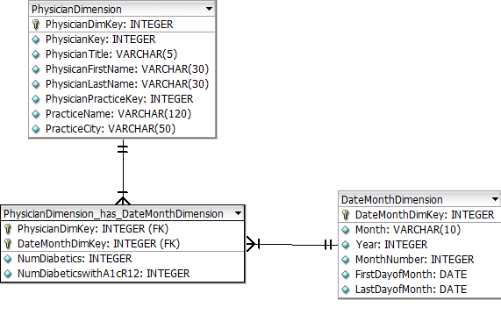
Summary Table Star Schema

Slide 49
Summary Tables
Some queries over stars are not simple.
Some queries over ‘fine grained’ stars can take a long time to run.
In contrast to OLTP, the OLAP approach is to:
Create and maintain summary tables
Update the summary tables ‘automatically’
Sometimes only summary data is stored

Slide 50
Managing Time
Most operational databases are concerned with current values.
May need to view data as of a point in time or need to track changes.
insurance handlers
intelligence operations
network management
data warehouses

Slide 51
Time, Region, and other Aggregations
Time is often aggregated by day, week, month, quarter, year, etc.
Region is often aggregated by city, county, state, province, country, or other region.
Data can also be aggregated by sales region, by store, by department, by category, etc.

Slide 52
Handling Time in Databases
Archiving moves data before some threshold date to an off-line archive or another database.
Data models and database must often track historical data or create audit trails:
create separate table for historical data along with date/time stamp and historical value
take snapshot of entire entity occurrence with version number

Slide 53
Methods for Handling Time
Audit Trail:
Record changes as they happen
Results in a “log” of past values and current values in different tables
Snapshot:
Copy of data at a point in time (“before”)
Easier to selectively archive
Review methods periodically to detect changes.

Slide 54
Star Schema Summary
The Good:
Very Popular in some circles – (Kimball Disciples)
Most useful when queries are around one type of event or process
Summary tables can simplify queries
Used in some of the analytic tools for sophisticated end users to develop their own reports.
Consistent approach to dealing with time
Some concerns:
To design a star schema, should understand the normalized data model
Queries that span more than one fact table can be harder to understand.
Dealing with bridge tables to capture sets of values can be difficult to understand.
Summary tables must be carefully designed and developed
Simplifications can lead to misleading results

Slide 55
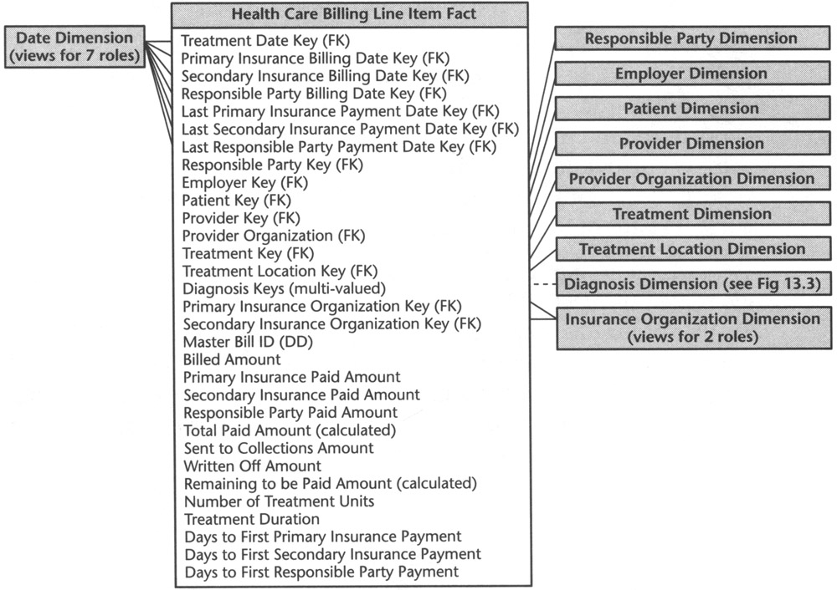
HealthCare Billing Star The Data Warehouse Toolkit: The Complete Guide to Dimensional Modeling, Second Edition by Ralph Kimball and Margy Ross. John Wiley & Sons, 2002.

Slide 56
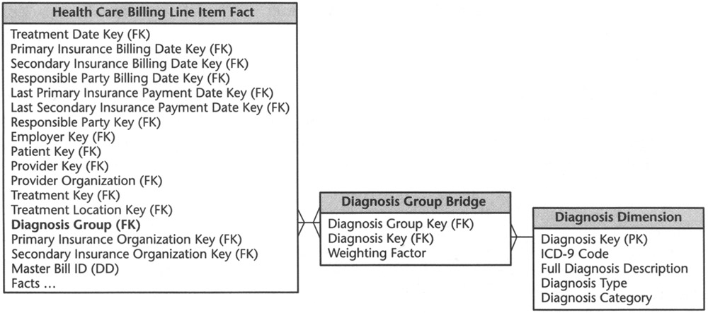
Diagnosis Dimension – Set of Diagnoses

Slide 57
Summary, Review, & Questions…

Slide 58
Data Mining and Knowledge Discovery

Slide 59
Need for data warehouses
Benefits of a data warehouse
Data warehouse vs data mart
OLTP vs DSS vs OLAP

Slide 60
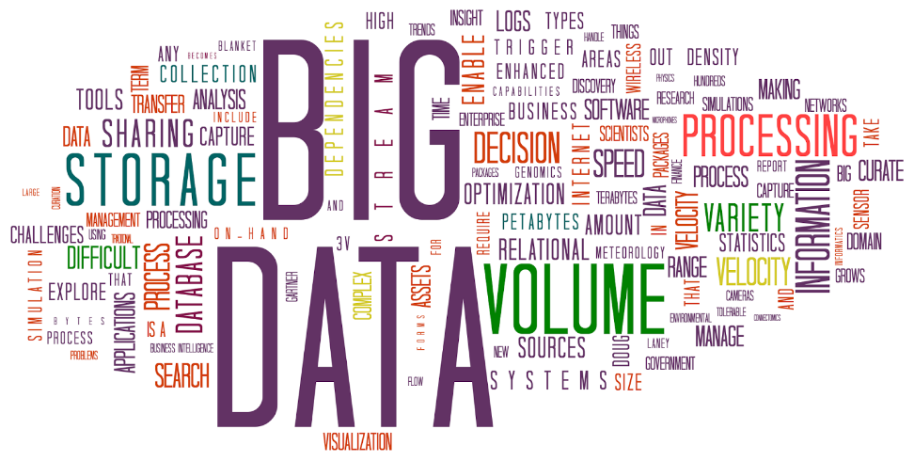
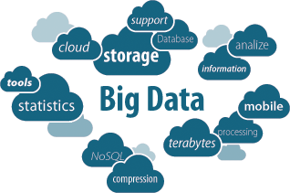
Mining the Data Warehouse
Data Mining requires a data warehouse where:
data is integrated and cleaned
data is easily and quickly accessible
Mining is used to find patterns in the data and to build models for forecasting, prediction, and classification.

Slide 61
Knowledge Discovery
Traditional query tools require the analyst to formulate questions (queries) and analyze the results.
Requires the analyst to develop and test each hypothesis
Data mining creates its own models:
predictive - answers questions
descriptive - finds relationships between data
prescriptive – defines automated behavior

Slide 62
Examples of Data Mining Goals
Predictive:
Descriptive:
“Which applicant will be a poor risk for a mortgage?”
“For which candidate is a voter going to vote?”
“What are the different segments of customers?”
“What is the likely selling price of this property?”
“Which songs would this customer like given her preferences and the songs others listen to?”
“How much more likely are customers who buy pasta to buy cheese?”

Slide 63
Example of a Predictive Model
A data mining algorithm uses a set of labelled “training data” to identify patterns and build a predictive model:
Independent Variables/Dimensions/Features
as “training data”
Target/
Want to predict!
Age Precinct Party Income Married? Vote?
37 Q1 D 40K yes D
74 Q1 R 22K no R
19 Q2 D 17K no R
54 Q1 I 83K yes R
…
28 Q2 R 72k no ???

Slide 64
Data Mining Process
There are six steps to data mining and model construction:
Defining the problem
Collecting, cleaning, and preparing the data
Mining the data
Validating the models
Deploying the models
Monitoring the models

Slide 66
Types of Data Mining Tasks
Binary Classification
Which applicant will be a poor risk for a mortgage?
For which candidate is a voter going to vote?
What are the different segments of customers?
What is the likely selling price of this property?
Which songs would this customer like given her preferences and the songs others listen to?
Classification
Clustering
Regression
Association Rules

Slide 67
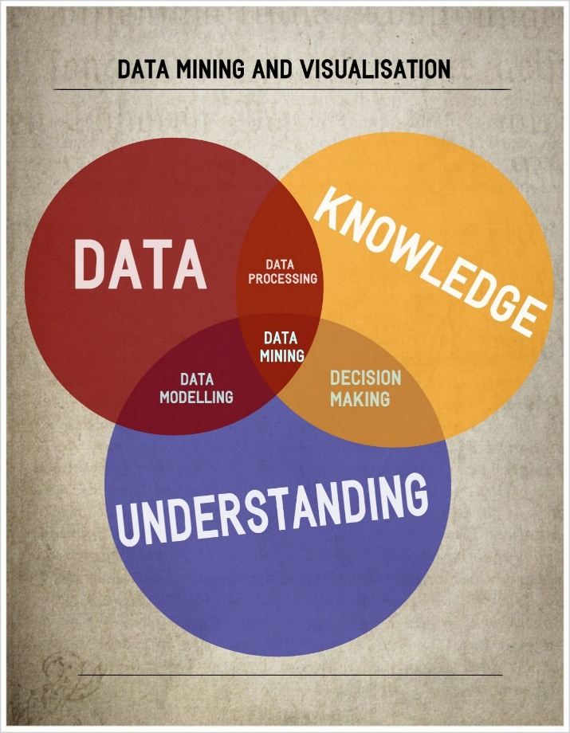
Data Mining vs Machine Learning
Data Mining is a common umbrella term for extracting knowledge from large databases.
Machine Learning often refers to the process of building computational predictive models.
supervised machine learning
labeled data sets are available
unsupervised machine learning
no pre-labeled data
focus is on discovery of patterns
also often called data mining
Data mining relies on very large amounts of data.
Problems of “Big Data”…

Slide 68
Common Algorithms
Association
Expectation Maximization
Clustering
k-means
Ridge
SVM
Regression
CART
Lasso
OLS
kNN
Random
Forest
Logistic
Classification
Naïve
Bayes
Ripper
ANN
SVM
1R
C5.0
kNN
Naïve
Bayes
categorical
numeric

Slide 69
6 Vs of Big Data
Volume
Velocity
Value
Variability
Terabyte+
Records/Archive
History
Tables & Files
Veracity
Variety
Batch
Real/Near-Real
Processes
Streams/IoT
Statistical
Analytics
Correlations
Predictions
Changing Data
Changing Model
Linkage
Trustworthiness
Authenticity
Provenance
Availability
Structured
Unstructured
Multi-Factor
Probabilistic
Linked

Slide 70
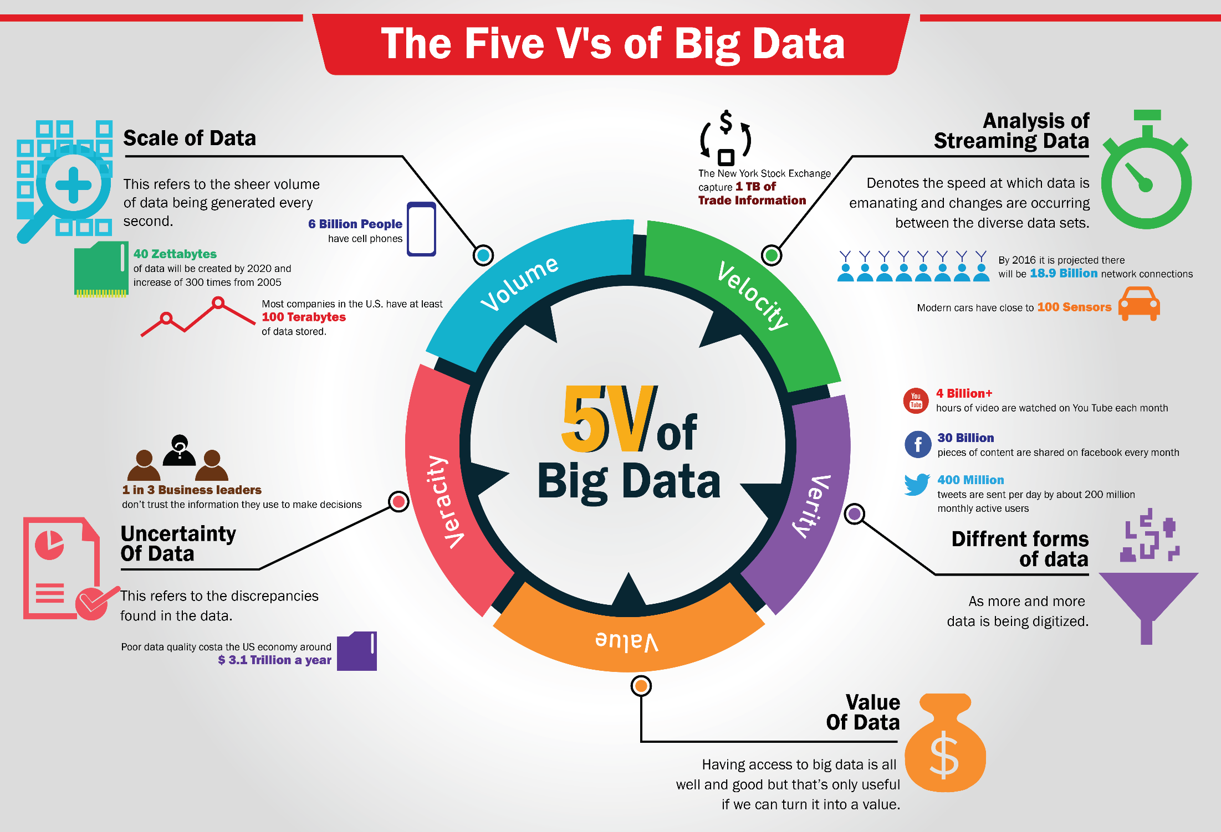

Slide 71
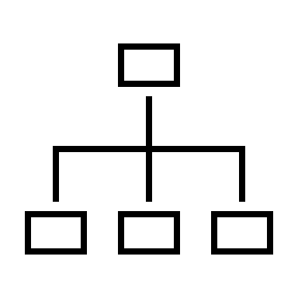
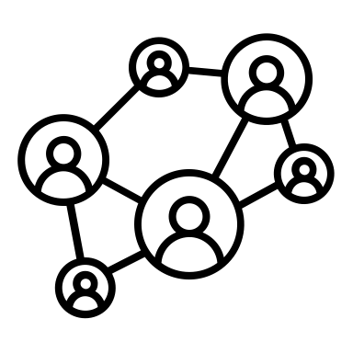
Data Volume
Documents
Video
Traffic
Data
Robotics
Automobile
IoT
Structured
Data
Mobile
44ZB
Machine Data
Web Click
Stream
Location
Data
Social
Networks
Texting
RFID
Point of
Sale
7.9ZB
Smart
Meter
Customer
Data
1 Terabyte (TB) = 1024 Gigabytes (GB)
1 Petabyte (PB) = 1024 Terabytes
1 Exabyte (EB) = 1024 Petabytes
1 Zettabyte (ZB) = 1024 Exabytes
1 Yottabyte (TB) = 1024 Zettabytes
Sensor Data
1.8ZB
2011
2015
2020

Slide 72
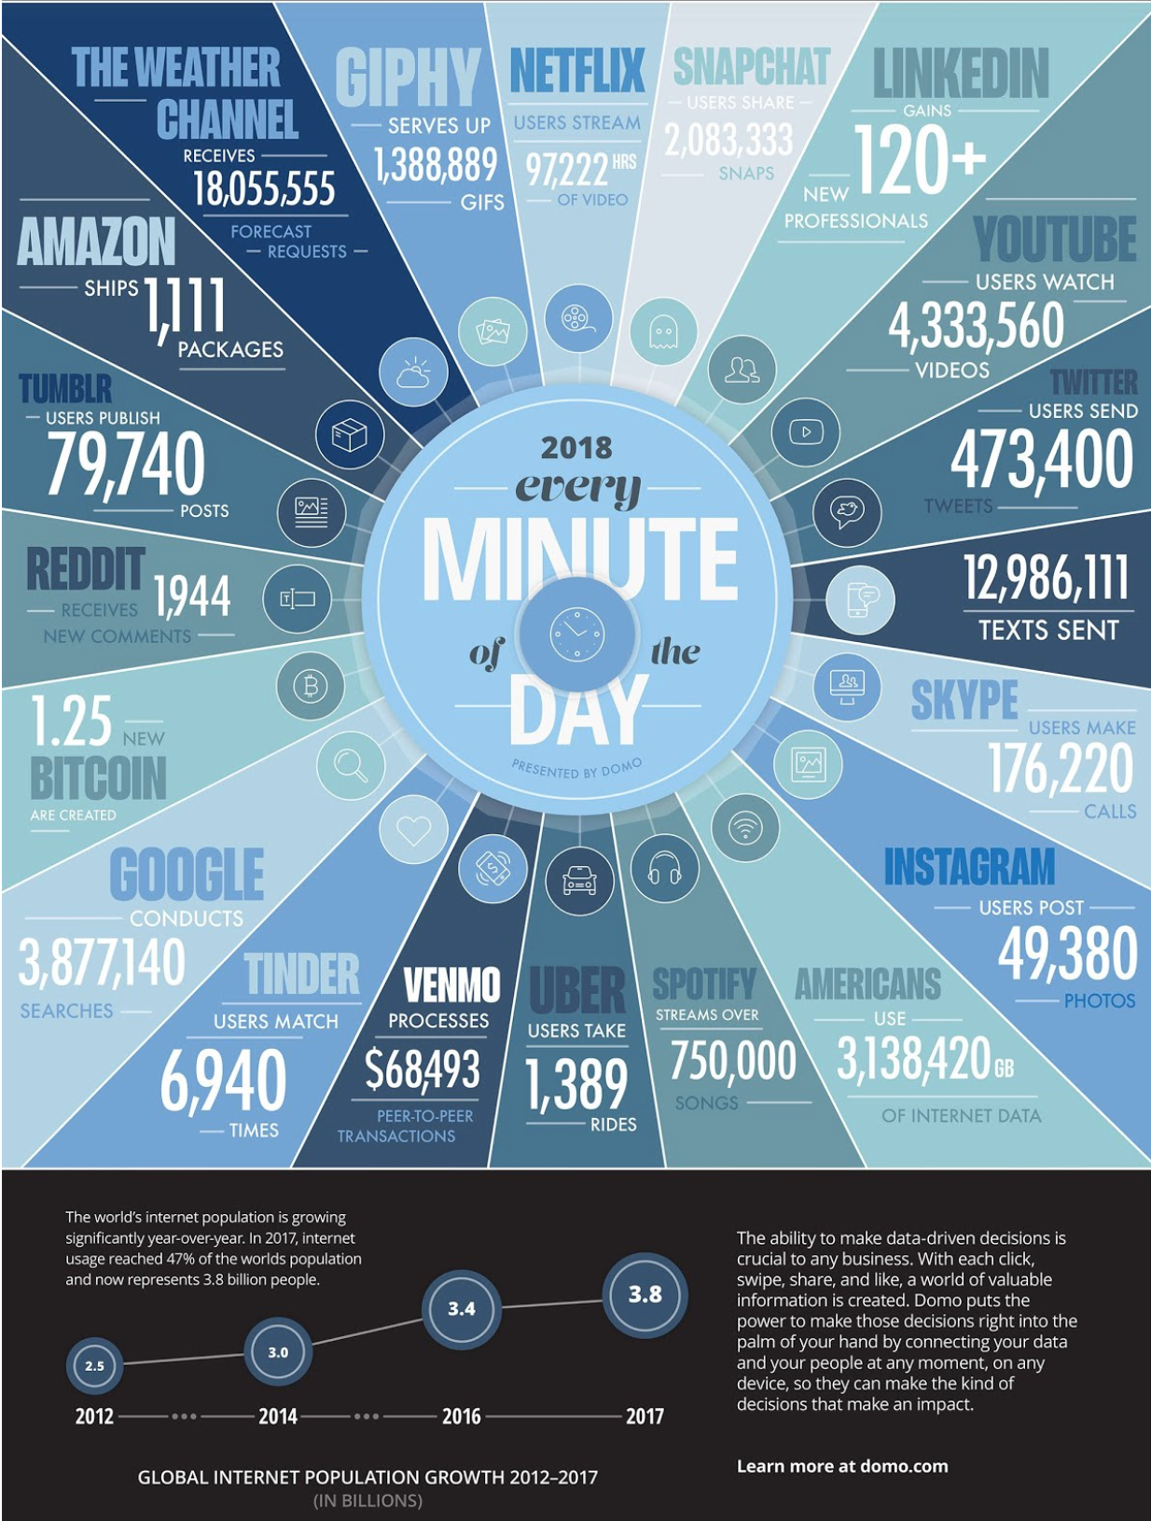
Data Growth

Slide 73
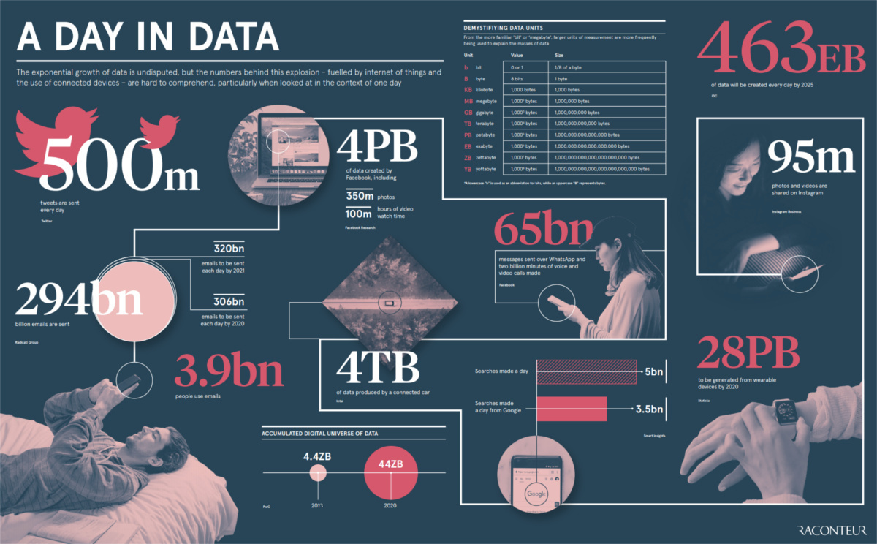
A Day in Data…
500 million tweets are sent
294 billion emails are sent
4 petabytes of data are created on Facebook
4 terabytes of data are created from each connected car
65 billion messages are sent on WhatsApp
5 billion searches are made
By 2025, it’s estimated that 463 exabytes of data will be created each day globally

Slide 74
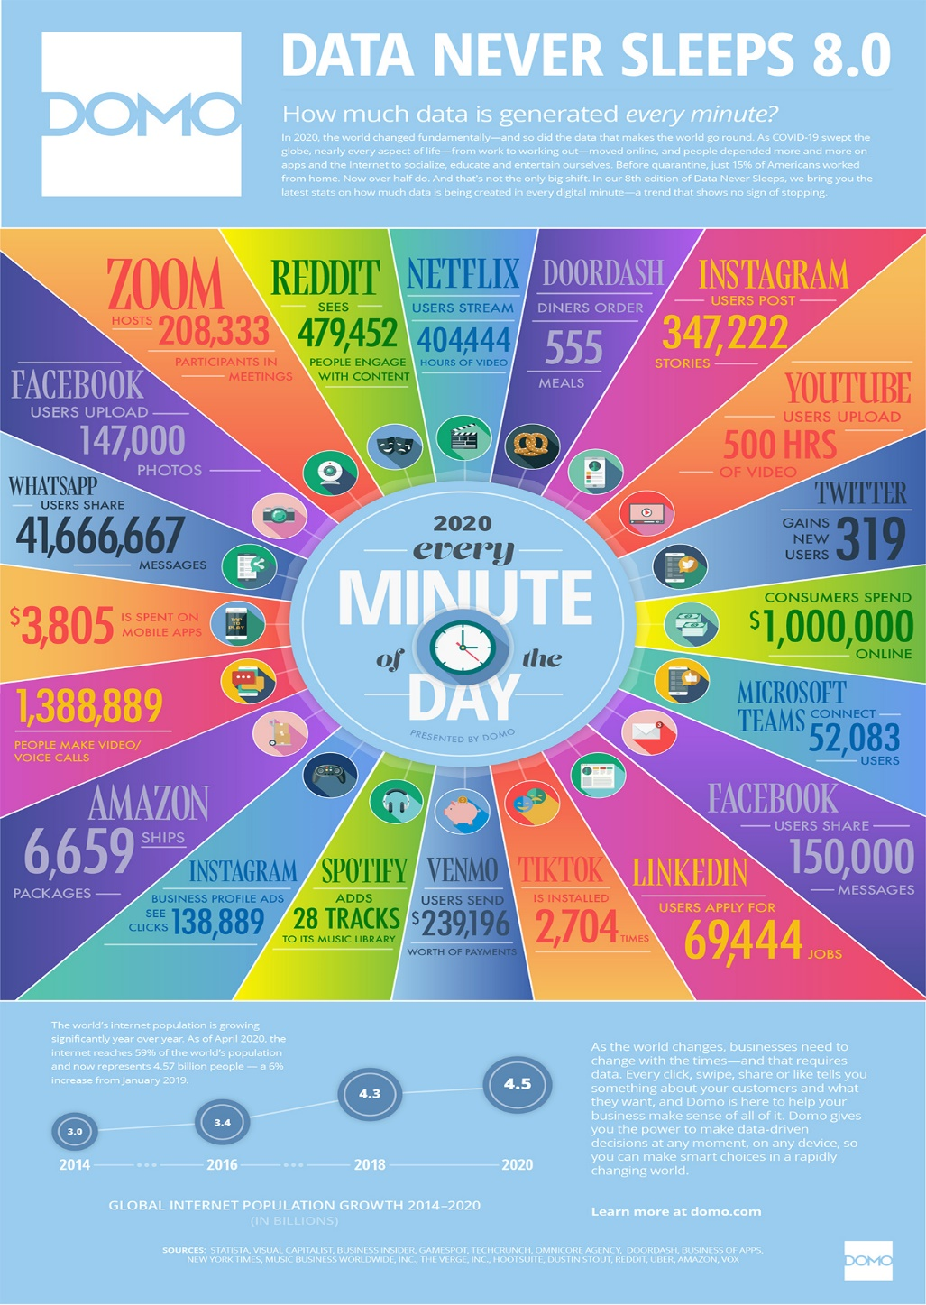
A Minute of Internet Data
Cash Transfers Nearly $240,000 worth of transactions occur on Venmo per minute.
E-Commerce It’s now estimated that $1 million is now spent per minute online. Amazon ships an astounding 6,659 packages every minute to keep up with this demand.
Collaboration Tools In a predominantly remote-working environment, tools like Zoom and Microsoft Teams host 208,333 and 52,083 users each minute, respectively.

Slide 75
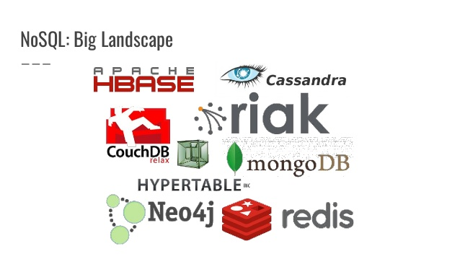
NoSQL Database Landscape

Slide 76
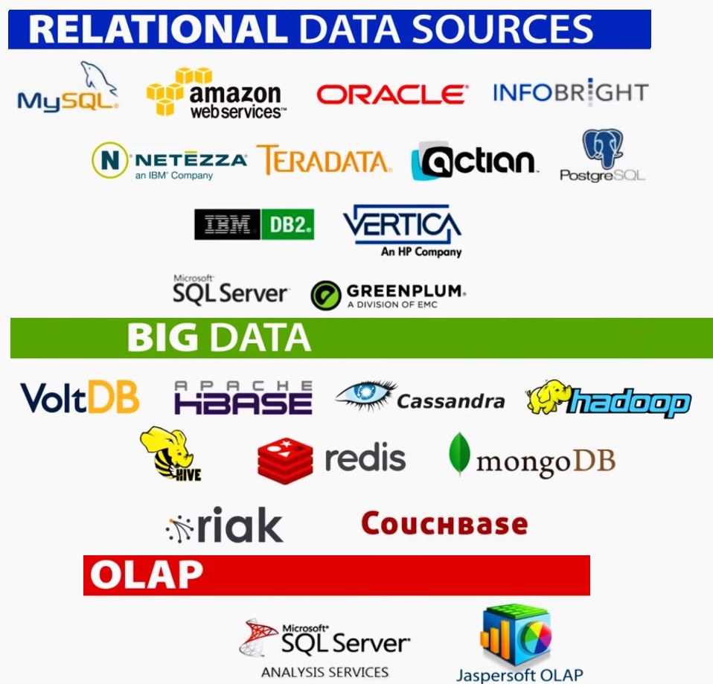
Relational vs Big Data vs OLAP Databases

Slide 77
SQL vs NoSQL
The need for database compliance with the requirements of ACID, which ensures the integrity of the database.
SQL databases excel at transaction and concurrency management, while NoSQL databases prioritize flexibility and speed, at the expense of data integrity.
SQL requires structured data that is stable and does not change frequently, while NoSQL supports flexible data structures.
Since the very appearance, NoSQL databases captured everyone's attention. However, despite high speed, scalability and other benefits, in some cases SQL is more efficient.

Slide 78
NoSQL Use Cases
NoSQL has several benefits… but many of those are not necessary for OLAP databases.
Data Warehouses might be NoSQL while data marts used for OLAP are often multi-dimensional or star schema based and implemented in a relational database.
Some NoSQL database are suitable for OLAP, including MongoDB and hBase, but otherwise NoSQL is best for situations where very high read throughput is desirable, data is unstructured, and schema cannot be defined up-front.
Large amounts of unstructured information storage. A NoSQL database does not impose restrictions on the types of stored data. New data types can be easily added.
Distribution and cloud support.
Often schema-less and thus amenable for agile and quick application development where requirements change frequently.

Slide 79
OLTP vs OLAP Database Landscape

Slide 80
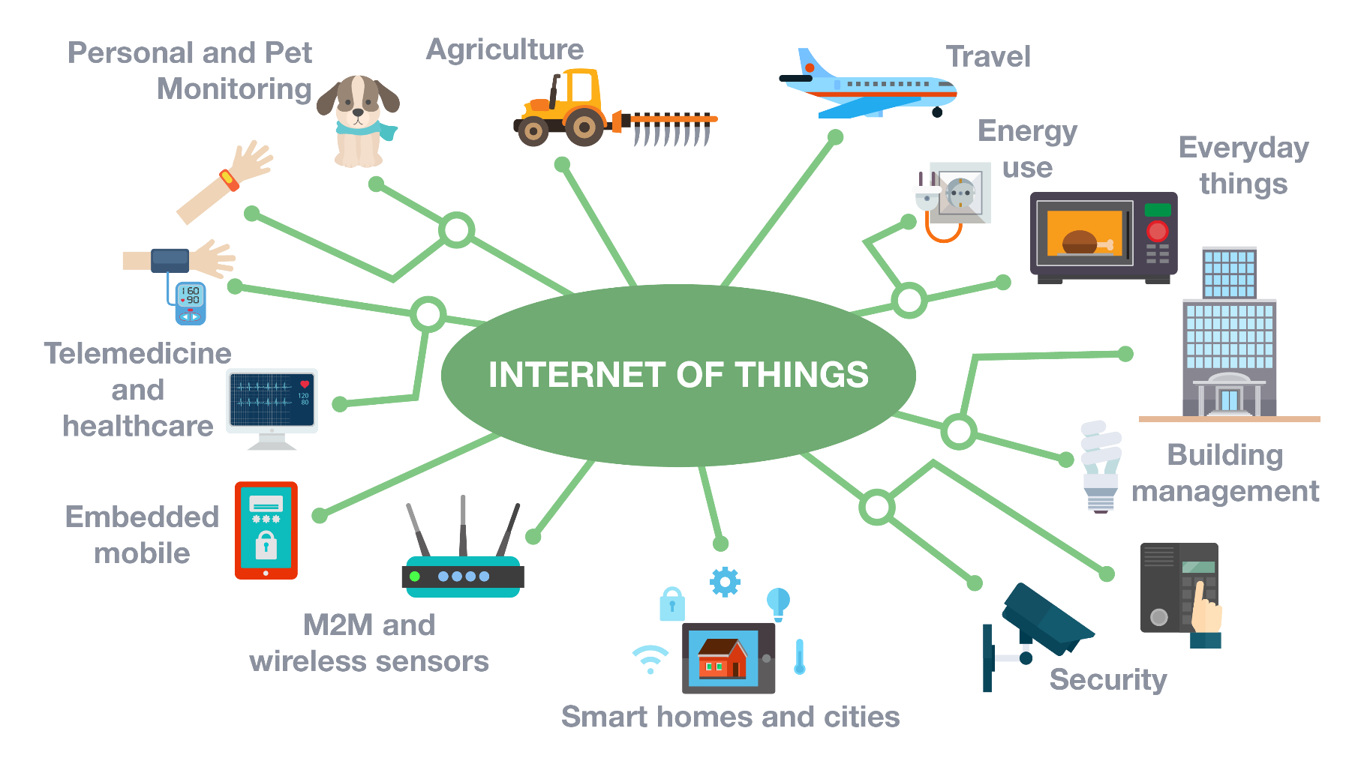
Internet of Things
IoT accelerates velocity and volume.

Slide 81
Data Mining is with us to stay as organizations are becoming increasingly digital and data-driven. The amount of data that must be managed and mined will increase manifold. Databases, data mining methods, and machine learning algorithms must grow alongside.

Slide 82
Summary, Review, & Questions…

