Slide 1
SQL Primer: SELECT
Guide to Retrieving Data from Relational Databases using SQL

Slide 2
The Role of SQL

Slide 3
Appreciate role of SQL
Understand flow of a SQL Query
Use tools to run ad hoc queries
Learn key terminology

Slide 4
SQL as a Query Language
SQL is the standard query language for retrieving data from relational databases.
SQL is a standard and is supported by virtually all relational databases in the same manner.
Queries built for one database generally run without modification against another database.
Many vendors provide extensions to SQL for analytics and special data types.

Slide 5
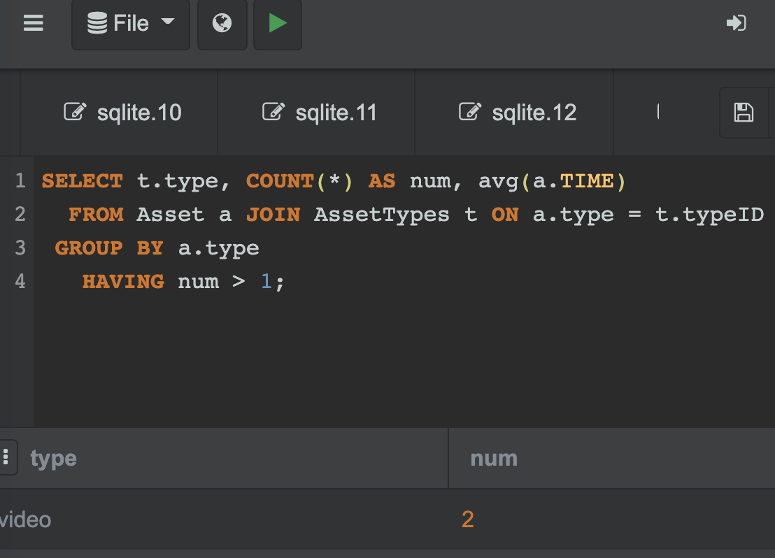
Performing Queries
SQL queries require a connection to the database and a means to execute a query:
query tool for ad hoc queries
embedded SQL for retrieving data into a programming language for analytics and further processing of the data
# connect to the SQLite database
db.conn <- dbConnect(SQLite(),
dbname="projdb.db")
# construct a SQL query
sqlCmd = "SELECT * FROM projects"
# send the SQL query
rs = dbGetQuery(db.conn, sqlCmd)
# print part of the result table
head(rs,3)

Slide 6
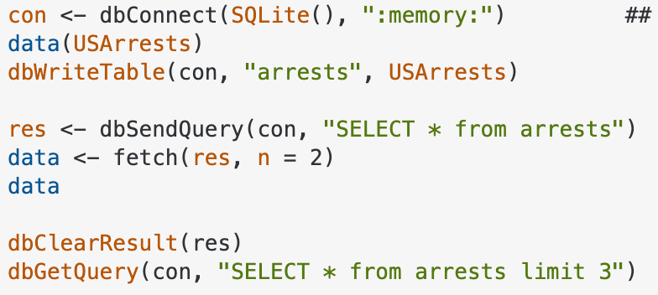
Flow of a Query
The client running a program containing embedded SQL or running an ad hoc query tool sends a SQL query (SELECT) to the database management system (typically running on a remote server). The DBMS interprets the query, formulates a query plan, and then accesses the stored data. The result of the query is returned to the client program as a result set in the form of a table. The client program then processes the data further, stores it locally, visualizes the data, or generates a report containing the data.
Query Result
Ad hoc query or reporting tool
SQL Query
Storage devices containing data
Database Management System
Client program with embedded SQL

Slide 7
Client/Server Model
Fat
Client
Fat
Server
Computational Process
Client
Server
DBMS
SQL
User
Database
Client
Manages user
interaction
Server
Manages shared
resources and
database
Notes:
Client/Server computing is a cost-effective, flexible architecture in which clients interact with servers. Clients typically manage user interaction, data presentation, formatting, validation, and reporting. Servers manage data access, data concurrency, validation, and business rules.
Both client and server processing are required to complete a business transaction. The system is an end-to-end architecture in which the separation of processing, the number of participating servers, and any networks involved are transparent to the user of the client/server system.
Critical points to remember:
clients manage user interaction
servers manage the data
clients request services
servers provide the service
both are required to complete a transaction
client and server are usually on separate computers
communication is usually over a network
separation is transparent to the user

Slide 8
File-Based Databases
While most database management systems are client/server databases, some are not. For example, SQLite and Microsoft Access are serverless, file-based databases where all database processing occurs within the application.
SQLite Database File
Client program with embedded SQLite database library

Slide 9
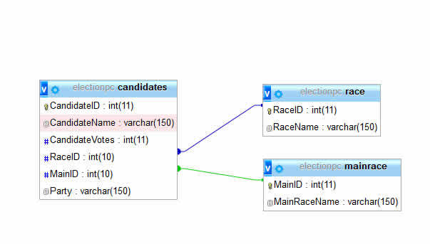
Relational Database Model
The relational data model is the most used database structure:
physical data storage aspects are hidden
data records are logically stored in tables
each table contains related entries in rows
each row represents a data record
SQL is used to access the data records
Notes:
The relational data model organizes all data records as two-dimensional data structures called tables.
Relational databases are typically accessed and manipulated using the Structured Query Language — SQL. SQL is an English-like language that has its foundation in set theory and predicate calculus. Through SQL, you work with sets of records at a time, organized in a tabular fashion. You tell the relational database management system (RDBMS) what data you want but not how to get it. The RDBMS determines the actual query path and execution steps on its own.
Oracle was the first company to offer a RDBMS in 1979. IBM followed with SQL/DS and DB2. Today, over 200 vendors offer SQL products on PCs, super-minis, and mainframes. Most RDBMSs incorporate SQL-89, some SQL-92, and very few the latest (not yet fully released) SQL-3 standard.
The emergence of SQL client tools that can work across servers is making SQL a horizontal industry where front-end tools can work with virtually any back-end server database.

Slide 10
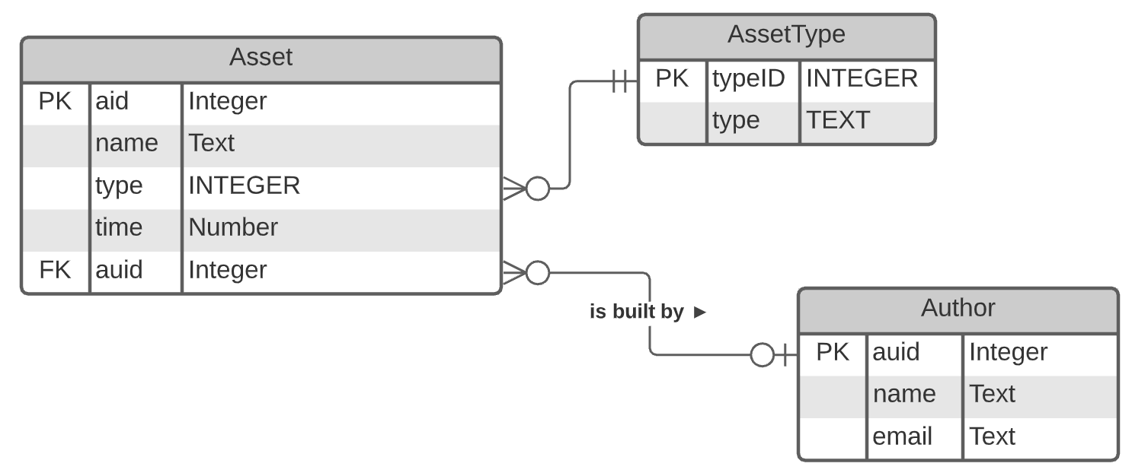
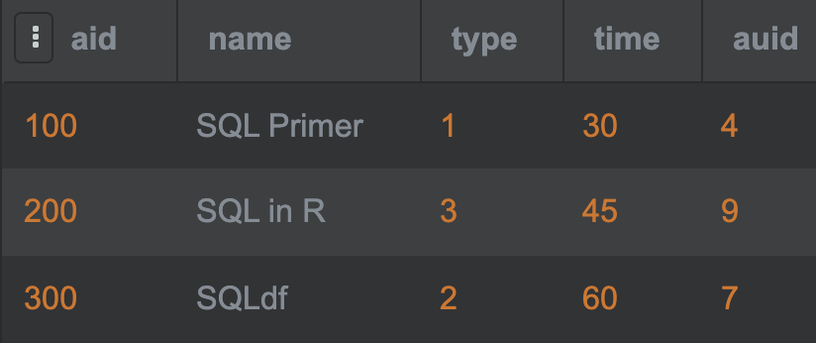
Simple Query from a Simple Schema
SELECT * FROM Asset;

Slide 11
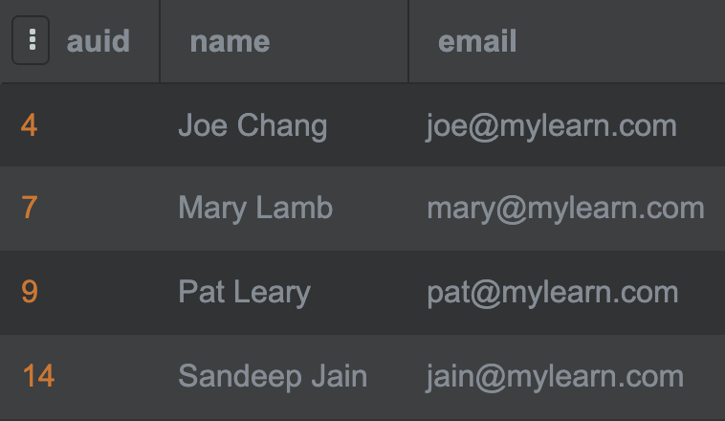
Schema Components
Primary Key = Unique Identifier
Foreign Key = Link to Author

Slide 12
Simple ad hoc Query in SQLite
Interactive (ad hoc) queries can be issued in SQLite in several ways:
console running locally when starting sqlite3
SQLite Online (sqliteliteonline.com)
R Studio using {sql} code block

Slide 13
Terminology
Term | Definition | Alternate Terms
Entity | A concept, event, role, place, or physical object that must be tracked, e.g., Customer. | Class, Concept, Table
Attribute | A property of an entity, e.g., email. | Property, Variable, Feature, Column, Dimension
Table | A database structure of columns and rows in which an entities instances are stored and held in either memory or on a storage device. | Record, Relation, Entity
Column | An attribute of an entity stored in a table. | Attribute, Feature, Variable
Row | An instance of an entity stored in a table. | Observation, Record, Instance
Primary Key | One or more columns whose values uniquely identify a row in a table. | PK, Unique Identifier
Foreign Key | A reference to a row in another table to which a row is related or linked. | FK, Link, Reference, Pointer
Result Set | A temporary table that holds the result of a SQL query. | RS
Query | A SQL SELECT statement specifying which rows should be retrieved from the database.

Slide 14
More Terminology
Term | Definition | Alternate Terms
Entity-Relationship Diagram | A visualization of a relational data model. | ERD, E-R Diagram, Logical Model
Crow’s Foot Notation | The colloquial term for E-R Diagrams in the Information Engineering (IE) | IE
IE | The name of a common notation for E-R Diagrams using specific symbols for entities, keys, and relationships. | Crow’s Feet, ERD
DDL | The commands in SQL for defining a relational database, i.e., the tables, keys, and attributes along with their constraints. | Data Definition Language
DML | The SQL commands for manipulating data in the database, including SELECT, UPDATE, DELETE, and INSERT. | Data Manipulation Language
SQL | DDL and DML statements for generating, manipulating, and using relational databases.

Slide 15
Even More Terminology
Term | Definition | Alternate Terms
Embedded SQL | SQL that is called from within a host program written in a programming language such as R, Python, Java, C++, C#, etc.
Database Server | A program running on a computer that manages the physical storage devices that contain the tables. | DBMS, Database Engine, Database
Schema | The table definitions for a relational database. | Relational Schema, Physical Model
Ad Hoc Query | A SQL query that is interactively issued from a console and that displays the result immediately in table form. | Interactive Query, Manual Query
Database | A collection of structured data in records and organized in a way that makes the data retrievable

Slide 16
Summary, Review, & Questions…

Slide 17
Retrieving Data from a Single Table

Slide 18
The Asset Database Schema
Fig 1. Asset Database (AssetDB)

Slide 19
Review of Query Process
Client connects to a specific database on the database server by supplying connection parameters (IP address, username, password)
Client stores connection information in a connection object
Client issues a query by a sending SQL statement to the database server over the network connection using the connection object
Server checks to ensure that connected user has permission to access data and that the SQL statement is syntactically correct
Server optimizes query and formulates a query plan based on least cost for time and memory
Server carries out the query by retrieving the data from the storage devices and packaging the result into a temporary table, the result set
Server sends result set back to the client
Client stores the result set in local memory and processes the data
Client disconnects from the database by closing the connection to the server and releasing all resources

Slide 20
Anatomy of a SQL Query: SELECT
Queries are issued through SELECT statements:
Only SELECT and FROM are required clauses.
SELECT [columns] FROM [tables]
WHERE [column conditions]
GROUP BY [column]
HAVING [group criteria]
ORDER BY [columns];
Note that SQL is not case sensitive, so SELECT and select are equally valid. By convention, SQL keywords are written in upper case. The semicolon is generally required by many ad hoc query tools but not when embedded unless multiple statements are sent at once.

Slide 21
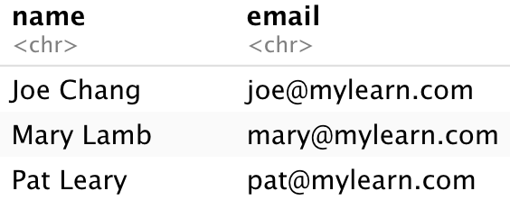
Simple Query from Single Table
Retrieve all rows and all columns from the table Author
SELECT * FROM Author;
Retrieve all rows and specific columns from the table Author
SELECT name, email FROM Author;

Slide 22
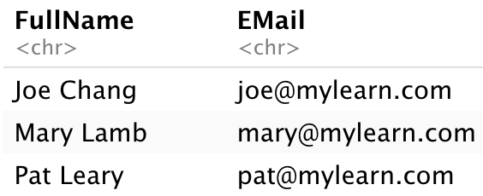
Defining Column Aliases
Retrieve all rows and specific columns from the table Author with renamed column names
SELECT name AS FullName, email AS EMail FROM Author;
Redefining column names can be useful for reporting or to simplify conditions for the WHERE clause.

Slide 23
Limit the Rows in Result Set
Limiting the rows returned from the server is important when a table is large.
Cannot specify which rows are returned.
Retrieve all rows and specific columns from the table Author but limit the result to the first n rows
SELECT name AS FullName, email AS EMail FROM Author LIMIT 2;

Slide 24
Results are returned in a table referred to as the result set.
The rows in the result set are not sorted.
Never rely on the order unless there is an ORDER BY clause.

Slide 25
Specify Order of Rows (Sorting)
Retrieve all rows and specific columns from the table Author and sort by name
SELECT name, email FROM Author
ORDER BY name;
Manage ties
SELECT name, email FROM Author
ORDER BY name, email;
Specify sorting direction
SELECT name, email FROM Author
ORDER BY name DESC;
Sorting order can be DESC or ASC. Text is sorted in alphabetic order according to UNICODE character sequence.

Slide 26
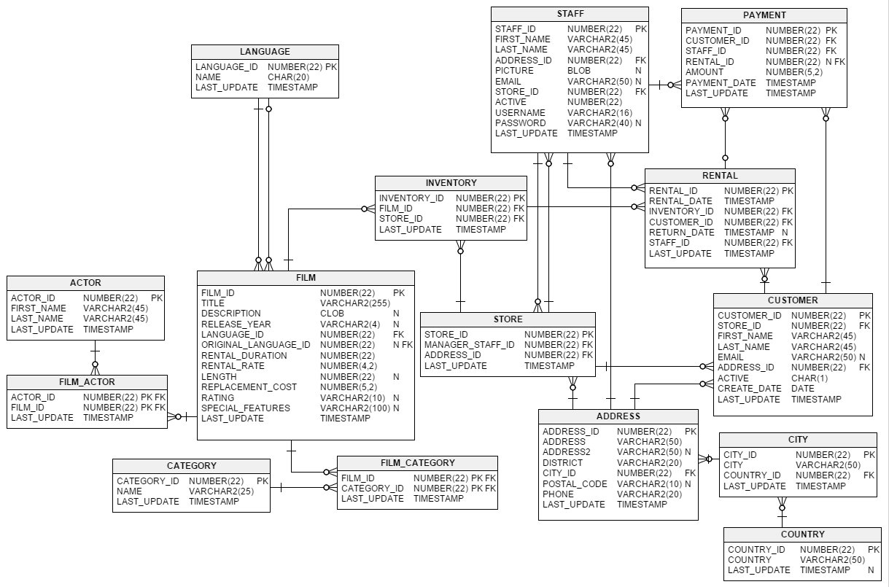
Retrieving Data from a Large Database
Demonstration of data retrieval and sorting of data from a large database (Sakila Demo Database from MySQL/Oracle).
Sakila Database is licensed under the New BSD License and may be used for any purpose with the provision that notice of © 2020 Oracle Corporation appears.

Slide 27
Literals
Queries can contain literals (a fixed value), expressions (including calculations), and various functions.
SELECT name, 'En' lang, email FROM Author;
String literals must be enclosed in either single or double quotes. Note that stylistic quotes are not the same as standard text quotes, e.g., ‘stylistic’ or not the same as 'stylistic'. Mixing quotes is often necessary when embedding quotes, e.g., "Parcival’s Code".

Slide 28
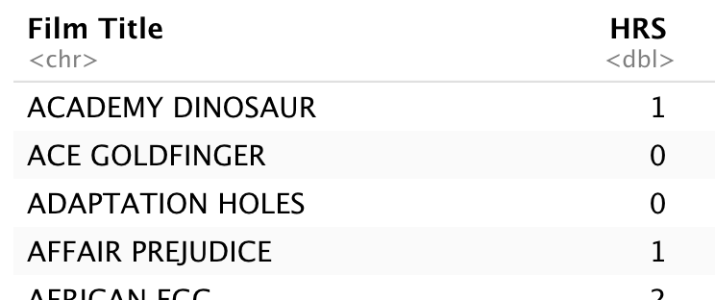
Expressions and Calculations
Queries can contain literals (a fixed value), expressions (including calculations), and various functions.
SELECT title AS `Film Title`,
length / 60 AS HRS
FROM Film;

Slide 29
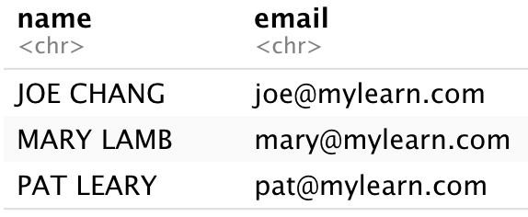
Functions
Queries can contain literals (a fixed value), expressions (including calculations), and various functions.
SELECT UPPER(name) AS name, email FROM Author;

Slide 30
Common Built-in Functions
ABS(m) | MOD(m, n) | POWER(m, n)
ROUND(m, [n]) | TRUNC(m [, n]) | FLOOR(n)
CEIL(n) | SIGN(n) | SQRT(n)
LN(n) | EXP(n) | SIN(n)
INITCAP(s) | LOWER(s) | UPPER(s)
CONCAT(s1, s2) | LENGTH(s) | SUBSTR(s, m [, n])
LTRIM(s [, set])
ADD_MONTHS(d, n) | LAST_DAY(d) | MONTHS_BETWEEN(d, e)
NEXT_DAY(d, day) | SYSDATE
This list is not exhaustive. Consult your database documentation or search online for additional functions, particularly those for text (string) and date/time processing. Alternatively, processing can also be done in client-side code, e.g., R, Java, Python.

Slide 31
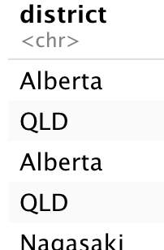
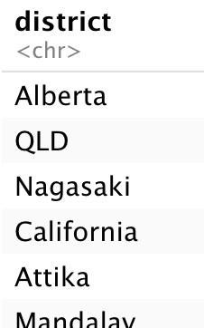
Removing Duplicates: DISTINCT
In some situations, a query might return duplicate rows.
DISTINCT applies to all selected columns.
SELECT district FROM Address;
SELECT DISTINCT district FROM Address;

Slide 32
Summary, Review, & Questions…

Slide 33
Retrieving Select Rows

Slide 34
The WHERE Clause
The WHERE clause allows filtering of unwanted rows and only return select rows.
SELECT * FROM Address
WHERE district = 'Alberta';
SELECT * FROM Address
WHERE district = 'Rio Grande do Sul'
OR district = 'Minas Gerais';
SELECT * FROM Address
WHERE district = 'Rio Grande do Sul'
AND phone IS NULL;

Slide 35
Testing for NULL
When data is missing, it has the value NULL – which is no value at all.
SELECT * FROM Address
WHERE district = 'Rio Grande do Sul'
AND phone IS NULL;
SELECT * FROM Address
WHERE phone IS NOT NULL;
NULL (or Null) is not a value, so using = is not defined. For example, using phone = NULL causes an error as one cannot ask if a value is equal to ‘nothing’. Also note that NULL is not the same as 0 or an empty text string with only spaces.

Slide 36
Order of Precedence
To ensure the correct evaluation of a logical expression, use parenthesis around the logical operators AND, OR, and NOT.
Boolean expressions can often be simplified using DeMorgan’s Laws:
¬(P∧Q)⊢(¬P∨¬Q), and (¬P∨¬Q)⊢¬(P∧Q).
Some databases support additional logical operators, including XOR. XOR is not strictly required as the following Boolean algebra equivalence holds: A xor B = (not A and B) or (A and not B)

Slide 37
Text Matching with the LIKE Operator
The LIKE operator is used for partial string matching.
While adequate for many situations, it does not support regular expressions and only supports two wildcards.
More complex text matching must be done within the client program code.
SELECT DISTINCT district FROM Address
WHERE phone LIKE '840%';
SELECT DISTINCT district FROM Address
WHERE phone LIKE '%840%';
SELECT DISTINCT district FROM Address
WHERE phone LIKE '_55%1212';
%
_
Matches zero or more characters
Matches exactly one character

Slide 38
Ranges with BETWEEN
The BETWEEN operator tests ranges and can be used to simplify WHERE clauses.
It is particularly useful for date ranges.
SELECT * FROM Payment
WHERE amount BETWEEN 5 AND 10;
equivalent to
SELECT * FROM Payment
WHERE amount >= 5 AND amount <= 10;

Slide 39
Match Sets with the IN Operator
The IN operator tests for set membership and can simplify complex OR logic.
SELECT DISTINCT district FROM Address
WHERE postal_code IN (45403,29444,26284);
SELECT DISTINCT district FROM Address
WHERE postal_code NOT IN
(45403,29444,26284);
SELECT * FROM Customers
WHERE 'Jones' IN (first_name, last_name);

Slide 40
Existential Qualifiers
There are two existential qualifiers on sets:
ANY
ALL
These are often combined with the set membership test operators IN and NOT IN.
The support for existential qualifiers differs among databases. For example, SQLite does not support the ALL and ANY operators.

Slide 41
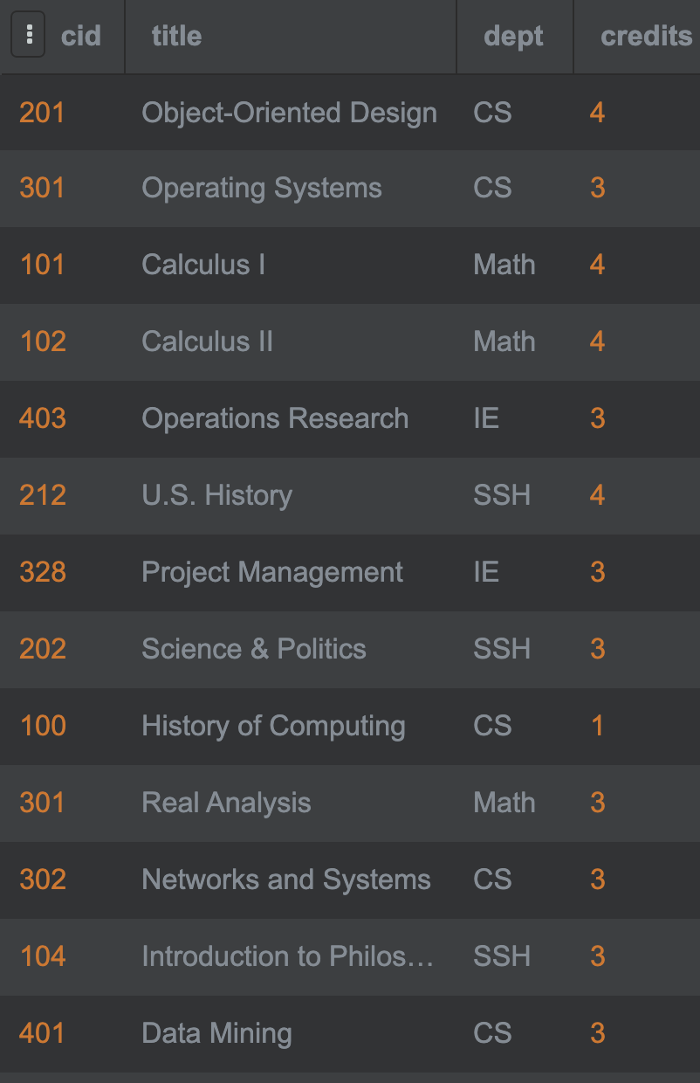
Example: Existential Quantifiers
SELECT * FROM Courses
WHERE credits > ANY (4, 2, 3);
SELECT * FROM Courses
WHERE credits > ALL (1, 2, 3);
The existential quantifiers are most useful when combined with subqueries that generate the sets.

Slide 42
Summary: Building Conditions
The condition in a WHERE clause is a Boolean expression that evaluates to True or False.
Conditional expressions are comprised of:
Literals (numbers or text, e.g., 5 or ‘James’)
Columns in a table or view that is in the FROM clause, e.g., a.name
Built-in functions, e.g., SQRT() or CEIL()
Sets, e.g., (‘Ell’, ’Church’, ’Berakis ’)
Logical operators:
=, !=, <>, <, >, <=, >=, LIKE, IN, IS , NOT
Arithmetic operators: +, -, *, and /
Parenthesis for precedence ordering: (, )
Booleans operators: AND, OR, NOT, XOR

Slide 43
Example: Conditional Expression
SELECT DISTINCT district
FROM Address
WHERE postal_code IN (45403,29444,26284)
AND (postal_code <> 66789
OR postal_code <> 11887)
AND ((city_id > 10000)
OR (city_id BETWEEN 500 AND 800))
AND address LIKE '%000'
AND city_id IS NOT NULL;

Slide 44
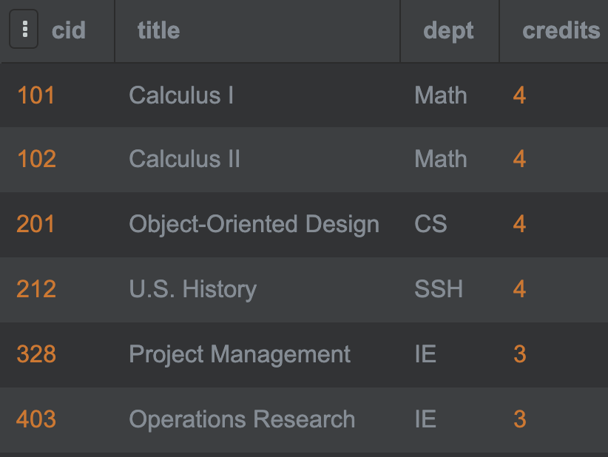
Unions: Combining Query Results
Unions are combinations of two or more results sets into a single result set.
The results sets must have the same number of columns with the same data types.
SELECT * FROM Courses
WHERE credits > 3
UNION
SELECT * FROM Courses
WHERE dept = 'IE'

Slide 45
Summary, Review, & Questions…

Slide 46
Working with Temporal Data: Dates and Times

Slide 47
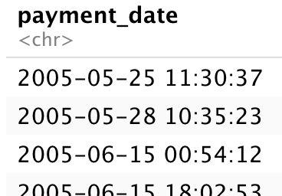
Date and Time Encoding in SQL
For date and time functions and comparisons to work properly, dates and times must be stored in a DATE, DATETIME, TIMESTAMP, or TIME column and not TEXT or VARCHAR.
Component
YYYY
MM
DD
HH
MI
SS
Definition
Year
Month
Day
Hours
Minutes
Seconds
Range
1000 to 9999
01 (Jan) to 12 (Dec)
01 to 31
00 to 23
00 to 59
00 to 59

Slide 48
Text vs Date Columns
A text column can store date information, but it is not the same as a Date column storing date fields recognized by SQL.

Slide 49
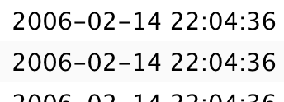
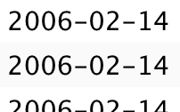
Extract Date from Time Stamp
A time stamp (DATETIME or TIMESTAMP) column contains date and time.
Use the date() function to extract the date.
SELECT create_date FROM Customer;
SELECT date(create_date) FROM Customer;

Slide 50
Extract Date Components
Different databases have varying support for date component extraction and date parsing.
SQLite
SELECT strftime('%Y’, create_date)
FROM Customer;
MySQL, Oracle, PostegreSQL
SELECT year(date(create_date))
FROM Customer;

Slide 51
Range Testing Dates
Use BETWEEN to test for date ranges.
SELECT * FROM Customer
WHERE create_date
BETWEEN '2019-01-01'
AND '2019-12-31';

Slide 52
Summary, Review, & Questions…

Slide 53
Aggregation

Slide 54
Appreciate role of SQL
Understand flow of a SQL Query
Use tools to run ad hoc queries
Learn key terminology

Slide 55
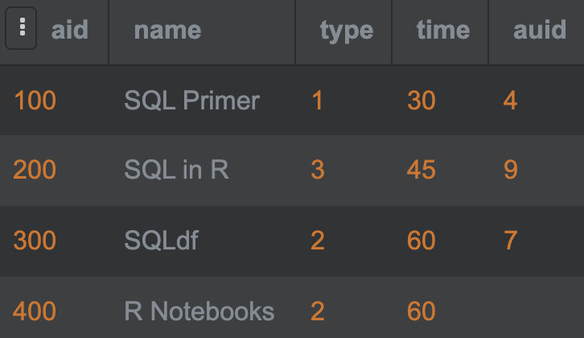
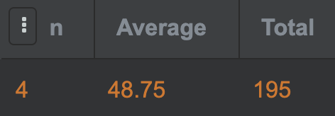
Aggregation Functions
Aggregation functions summarize the values of a single result column.
All functions require the name of a column that is in a table in the FROM clause except the COUNT() function.
NULL values are ignored by the aggregation functions.
SELECT COUNT(*) AS n,
AVG(time) AS Average,
SUM(time) AS Total
FROM Asset;

Slide 56
Common Aggregation Functions
Function | Description
MIN | smallest value in a column
MAX | largest value in a column
SUM | sum of all values in a column
AVG | average (mean) value
MEDIAN | median value
COUNT(*) | number of rows in a table
COUNT(col) | number of non-NULL values in a column
STDEV | standard deviation
VARIANCE | variance (square of standard deviation)
Many database vendors supports additional functions. For example, Oracle supports additional statistical functions, XML functions, and ordering functions.

Slide 57
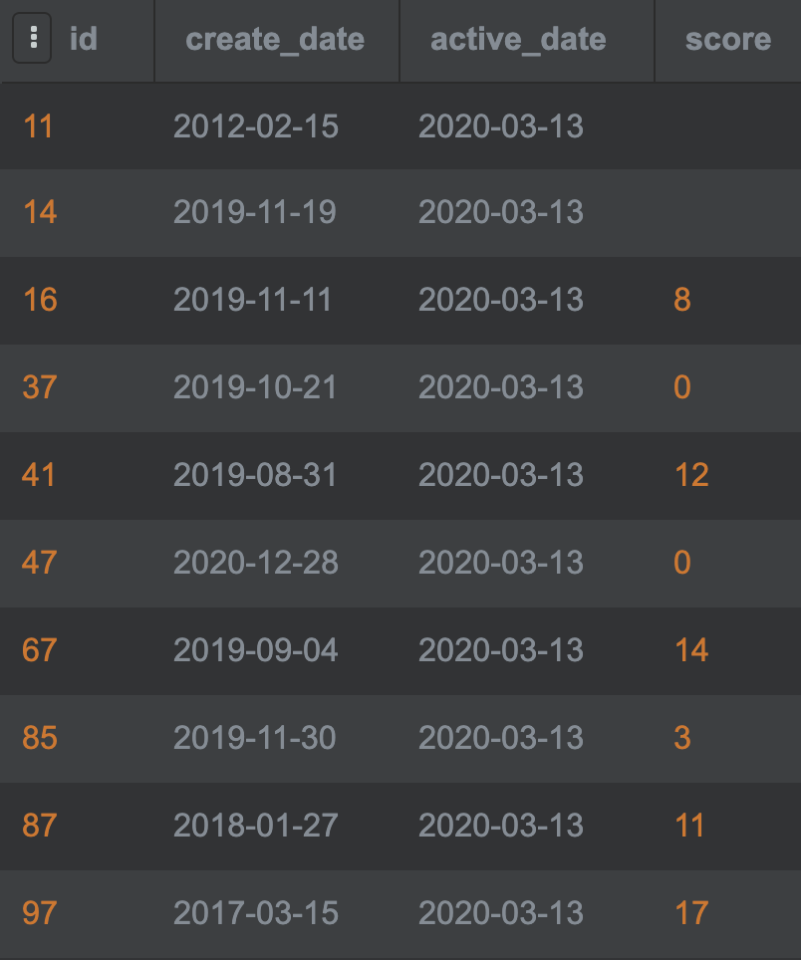
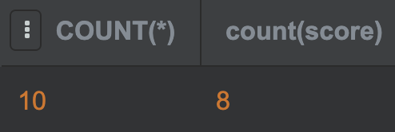
Effect of NULL on Counting
Counting columns differs when there are NULL values:
Null
CREATE TABLE Sandbox (
id INTEGER NOT NULL,
create_date DATE,
active_date TEXT,
score NUMERIC,
PRIMARY KEY (id)
);
Null
SELECT COUNT(*), COUNT(score)
FROM Sandbox;

Slide 58
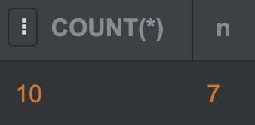
Counting Distinct Values
By default, COUNT counts all non-NULL values in a column.
Use the DISTINCT keyword to count unique non-NULL value.
Null
CREATE TABLE Sandbox (
id INTEGER NOT NULL,
create_date DATE,
active_date TEXT,
score NUMERIC,
PRIMARY KEY (id)
);
Null
SELECT COUNT(*),
COUNT(DISTINCT score) n
FROM Sandbox;

Slide 59
Aggregation with GROUP BY
When aggregation functions are used in a query that includes a GROUP BY clause then the functions are applied to each group rather than a column.
SELECT a.type AS Type,
COUNT(*) AS n,
AVG(time) AS Average,
SUM(time) AS Total
FROM Asset a
GROUP BY a.type;

Slide 60
Summary, Review, & Questions…

Slide 61
Grouping with GROUP BY and HAVING

Slide 62
Appreciate role of SQL
Understand flow of a SQL Query
Use tools to run ad hoc queries
Learn key terminology

Slide 63
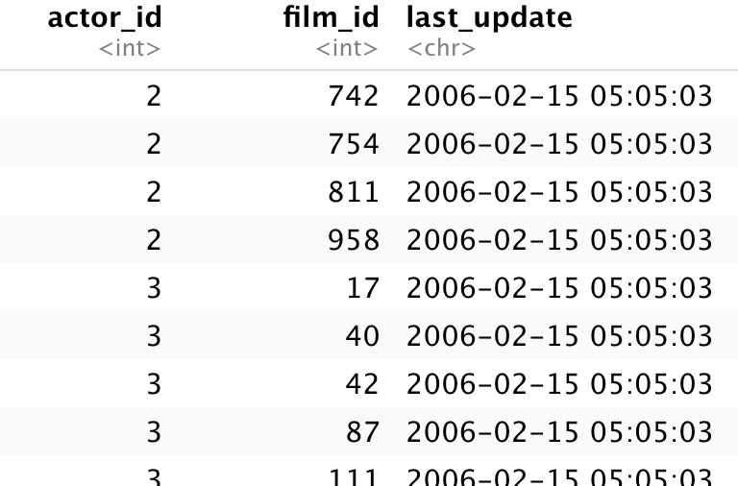
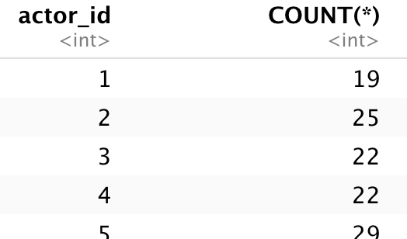
Generating Single-Column Groups
Groups are a form of aggregation where rows that have common values are treated as a single group of values.
SELECT actor_id, COUNT(*)
FROM film_actor
GROUP BY actor_id;

Slide 64
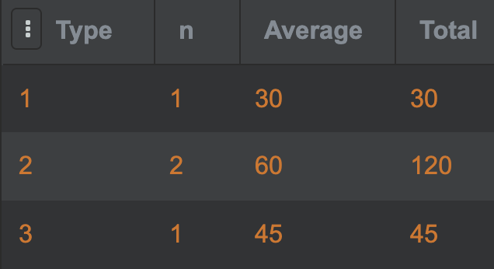
Grouping with Aggregate Functions
Aggregation functions summarize the values of a single result column in each group.
SELECT a.type AS Type,
COUNT(*) AS n,
AVG(time) AS Average,
SUM(time) AS Total
FROM Asset a
GROUP BY a.type;

Slide 65
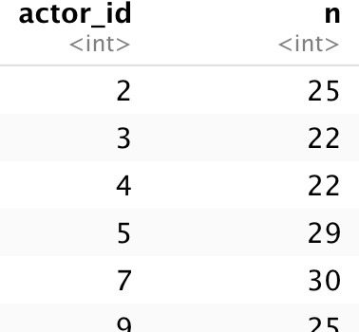
Selecting Specific Groups: HAVING
Groups can be restricted (filtered) through the HAVING clause.
The filter clause is applied after the groups have been generated.
SELECT actor_id, COUNT(*) AS n
FROM film_actor
GROUP BY actor_id
HAVING n > 20;

Slide 66
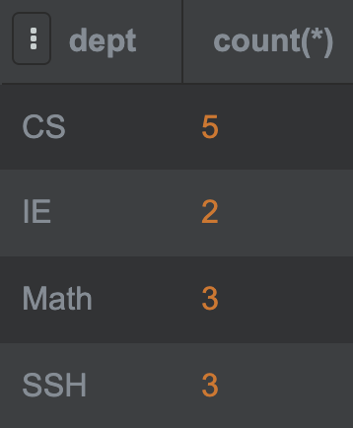
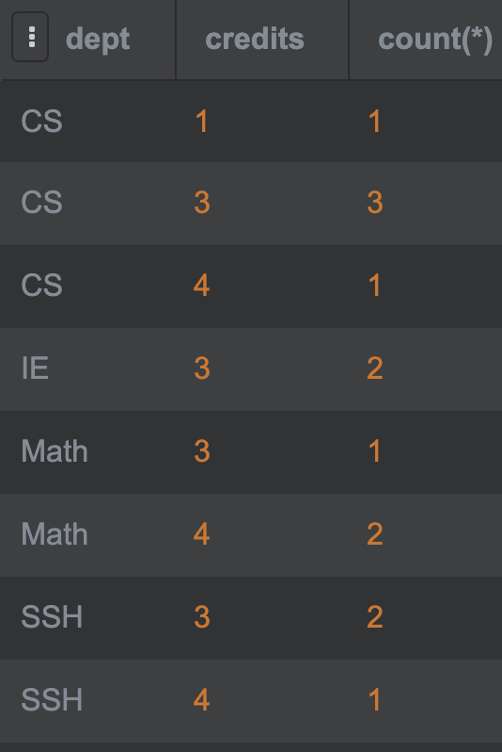
Multi-Column Grouping
SELECT dept, COUNT(*)
FROM Courses
GROUP BY dept;
SELECT dept, credits, COUNT(*)
FROM Courses
GROUP BY dept, credits;

Slide 67
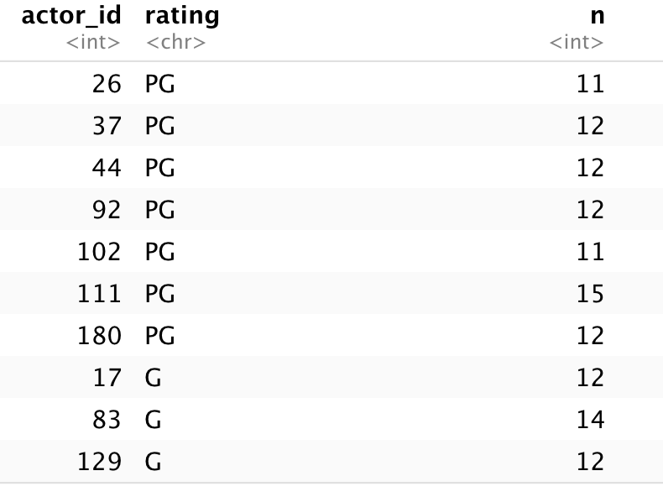
Combining Clauses
SELECT fa.actor_id, f.rating, count(*) AS n
FROM film_actor fa JOIN film f USING (film_id)
WHERE f.rating IN ('PG','G’)
GROUP BY fa.actor_id, f.rating
HAVING n > 10
ORDER BY f.rating DESC;

Slide 68
Summary, Review, & Questions…

Slide 69
Building Complex Queries with Subqueries and Views

Slide 70
Appreciate role of SQL
Understand flow of a SQL Query
Use tools to run ad hoc queries
Learn key terminology

Slide 71
Role of Subqueries
Subqueries are queries that are embedded within another SQL statements (a query or an update).
A subquery returns a result set that may be:
a single row and a single column: a value
multiple rows with a single column: a vector
multiple rows having multiple columns: a table
Memory and resources associated with a subquery are released after it is evaluated.

Slide 72
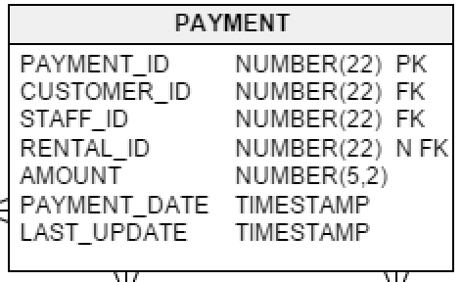
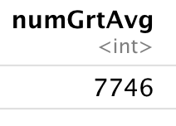
Example I: Single-Value Subquery
How many payments have a below average amount.
SELECT COUNT(payment_id) AS numGrtAvg
FROM Payment
WHERE amount < (SELECT AVG(amount) FROM Payment);

Slide 73
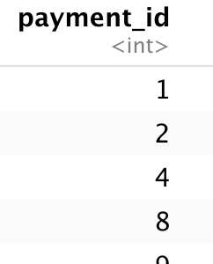
Example II: Single-Value Subquery
What are the payments with an above average amount?
SELECT payment_id
FROM Payment
WHERE amount > (SELECT AVG(amount) FROM Payment);

Slide 74
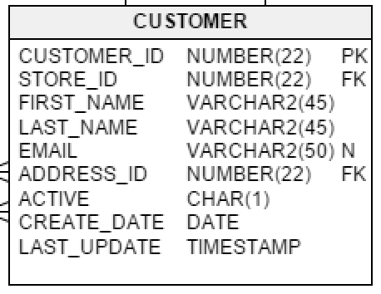
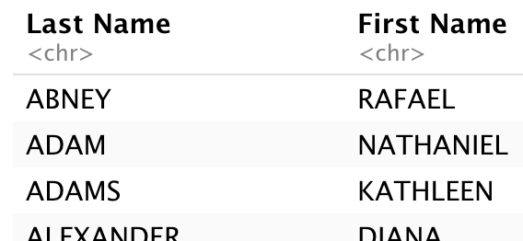
Example III: Multi-Value Subquery
Find all customers who have never received a free film rental.
SELECT last_name AS `Last Name`, first_name AS `First Name`
FROM Customer
WHERE customer_id NOT IN
(SELECT customer_id FROM Payment WHERE amount = 0)
ORDER BY last_name;

Slide 75
Summary, Review, & Questions…

Slide 76
Summary, Review, & Questions…

Slide 77
The Sakila Sample Database
Sakila Database is licensed under the New BSD License and may be used for any purpose with the provision that notice of © 2020 Oracle Corporation appears.

