Slide 1

SQL Primer: Joins
Guide to Retrieving Data from Relational Databases using SQL

Slide 2
Retrieving Data from Multiple Tables: Joins

Slide 3
Joins as Cartesian Products
Matching Primary and Foreign Keys
INNNER vs OUTER Joins
NATURAL Joins
ANTI Joins

Slide 4
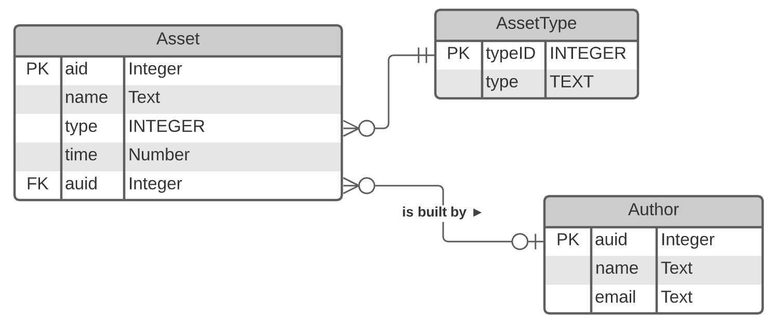
Data From Multiple Tables
When the FROM clause lists more than one table, SQL produces a cartesian product – each row is matched in each table.
SELECT * FROM Asset, Author;

Slide 5
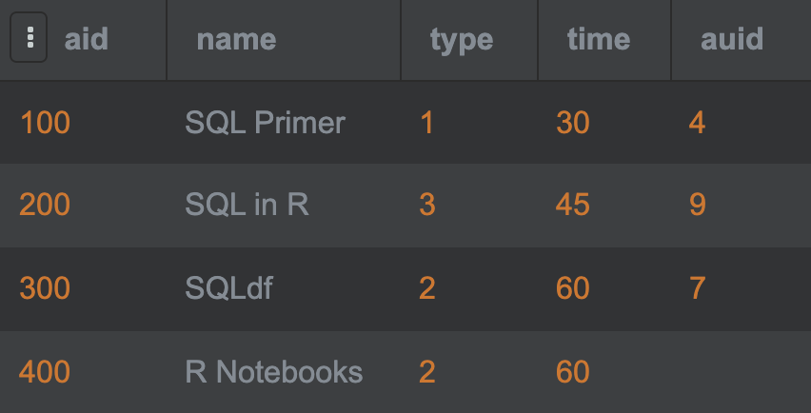
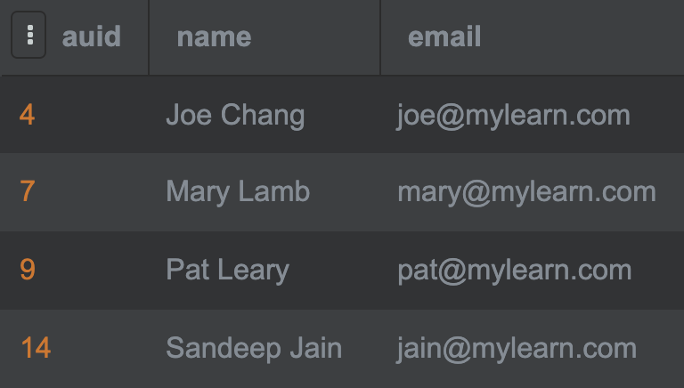
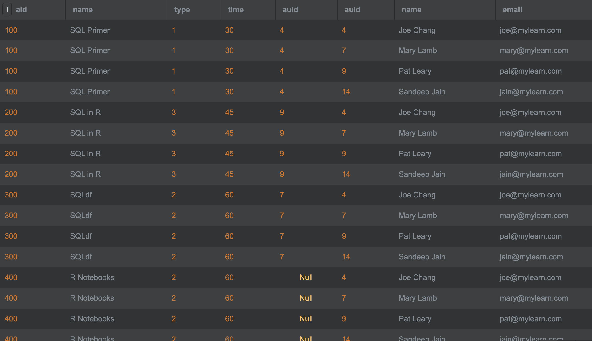
Cartesian Product
Asset
Author
SELECT *
FROM Asset, Author;

Slide 6
Join: Match Primary and Foreign Keys
Asset
Author
⋈
SELECT *
FROM Asset, Author
WHERE Asset.auid =
Author.auid;

Slide 7
Alternative Syntax: INNER JOIN
An INNER JOIN is an equi-join that selects rows that have matching values in both tables.
Asset
Author
⋈
SELECT *
FROM Asset
INNER JOIN Author
ON Asset.auid =
Author.auid;
The keyword INNER is optional.

Slide 8
Alternative Syntax: JOIN USING
SQL provides alternative syntax if the two tables are joined via the same column names
SELECT * FROM Asset JOIN Author USING (auid);

Slide 9
Alternative Syntax: NATURAL JOIN
A natural join automatically joins on columns that are named the same.
SELECT * FROM Asset NATURAL JOIN Author;

Slide 10
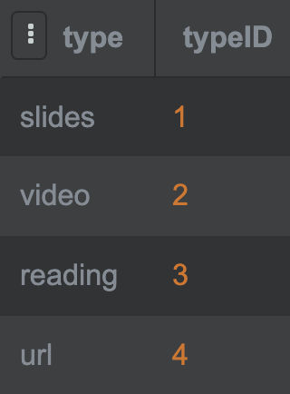
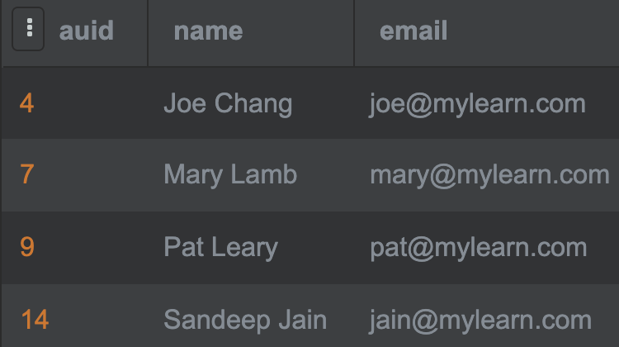
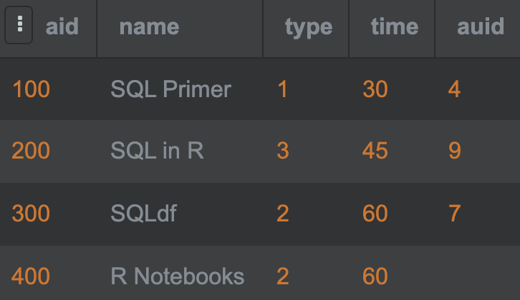
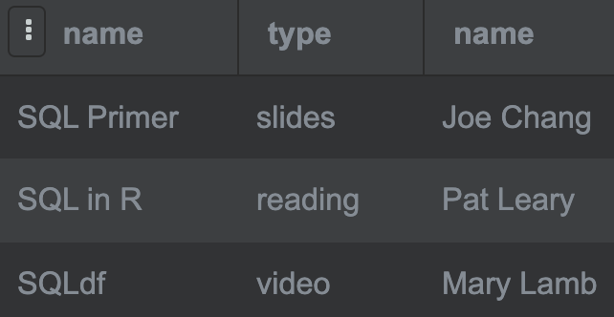

Multi-Tables Inner Joins
All tables must be connected in some way in a join or a cartesian product results.
SELECT a.name, t.type, u.name
FROM Asset a JOIN AssetTypes t
ON a.type = t.typeID
JOIN Author u
ON a.auid = u.auid;

Slide 11
Alternative SQL Syntax
The previous query could have been written in several ways, all producing the same result without any difference in performance.
SELECT a.name, t.type, u.name
FROM Asset a JOIN AssetTypes t
ON a.type = t.typeID
JOIN Author u
ON a.auid = u.auid;
SELECT a.name, t.type, u.name
FROM Asset a JOIN AssetTypes t
ON a.type = t.typeID
JOIN Author u USING (auid);
SELECT a.name, t.type, u.name
FROM Asset a, AssetTypes t, Author u
WHERE a.type = t.typeID AND a.auid = u.auid;
Most databases have a mechanism to view the query plan and assess relative performance differences in queries. For SQLite, for instance, the command is EXPLAIN.

Slide 12
Discussion
Why was it important and required to qualify the column names in the query below?
SELECT a.name, t.type, u.name
FROM Asset a JOIN AssetTypes t
ON a.type = t.typeID
JOIN Author u USING (auid);

Slide 13
Left and Right Outer Joins
The Left Join or Left Outer Join operation is a special type of join that takes two relations, A and B, and returns the inner join of A and B along with the unmatched rows of A.
A is the first relation defined in the FROM clause and is therefore the left relation.
The left outer join includes the unmatched rows of the left relation along with the matched columns in the result.
A Right Join is analogous except that it takes the unmatched rows of the right relational B.

Slide 14
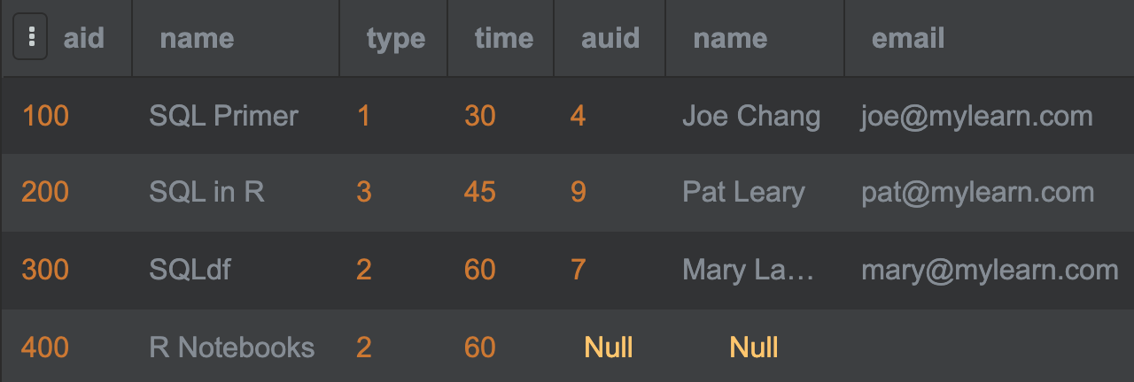

Example: Left Outer Join
Asset
Author
⋉
SELECT *
FROM Asset
LEFT OUTER JOIN
Author
USING (auid);
Note that support for outer joins varies among databases. For example, SQLite only support left outer joins, while SQL Server does not support full outer join. A right outer join can be achieved by reversing the tables in the FROM clause, while a full outer join is the union of a left and right outer join.

Slide 15
Full Outer Joins
A full outer join takes two relations, A and B, and returns the inner join of A and B along with the unmatched rows of A and B.
Essentially, a full outer join is the distinct union of a left and right outer join.

Slide 16
Learning Checkpoint
Produce the full outer join of tables A and B in SQLite considering that it only supports left outer join?
Using relational algebra, prove your approach.

Slide 17

Summary, Review, & Questions…

