Slide 1
Triggers in SQLite
Martin Schedlbauer, PhD

Slide 2
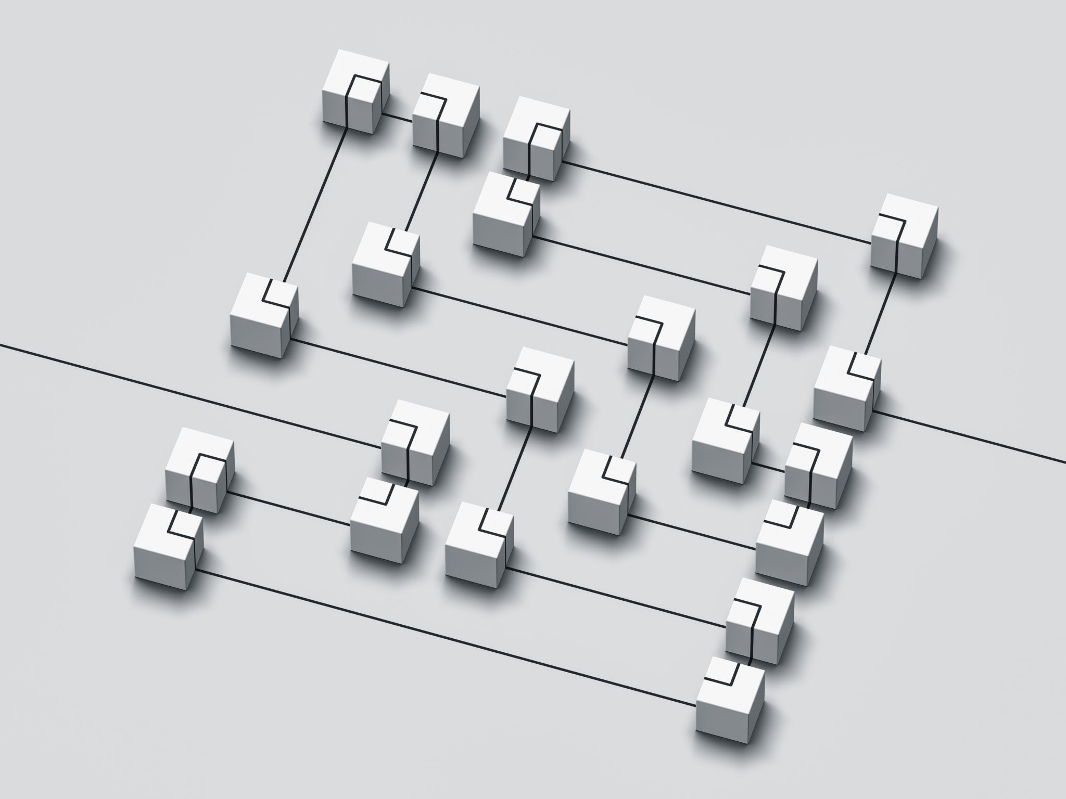
Overview
2-Tier Data Architectures
Centralized Business Constraints
Triggers
SQLite Syntax

Slide 3
Pattern I: Two-Tier Architecture with Business Logic on the Client
Data and business logic is distributed two tiers. The data is within a DBMS housed on a server while the user interacts through a client interface.
This client/server architecture is often called a “fat client” architecture.
Business logic, including constraint and integrity checking and calculations, are performed on the client (either a desktop client application, a mobile app, or a browser-based client).
Client also contains user interface logic.
Application & Business Logic
Data Retrieved via SQL over Network
Web Client
SQL
Data
Desktop Client User Interface
DBMS
Physical or Virtual Server
Mobile App

Slide 4
Pattern II: Two-Tier Architecture with Business Logic on the Server
Data and business logic is distributed two tiers. The data is within a DBMS housed on a server while the user interacts through a client interface.
This client/server architecture is often called a “thin client” architecture.
Business logic, including constraint and integrity checking and calculations, are performed on the database within the server using triggers and stored procedures.
Client hosts user interface logic only.
Application & Business Logic
Data Retrieved via Stored Procedure Calls over Network
EXEC
User Interface (Desktop Client, App, or Web Client)
DBMS
Physical or Virtual Server
Data

Slide 5
Triggers (SQLite)

Slide 6
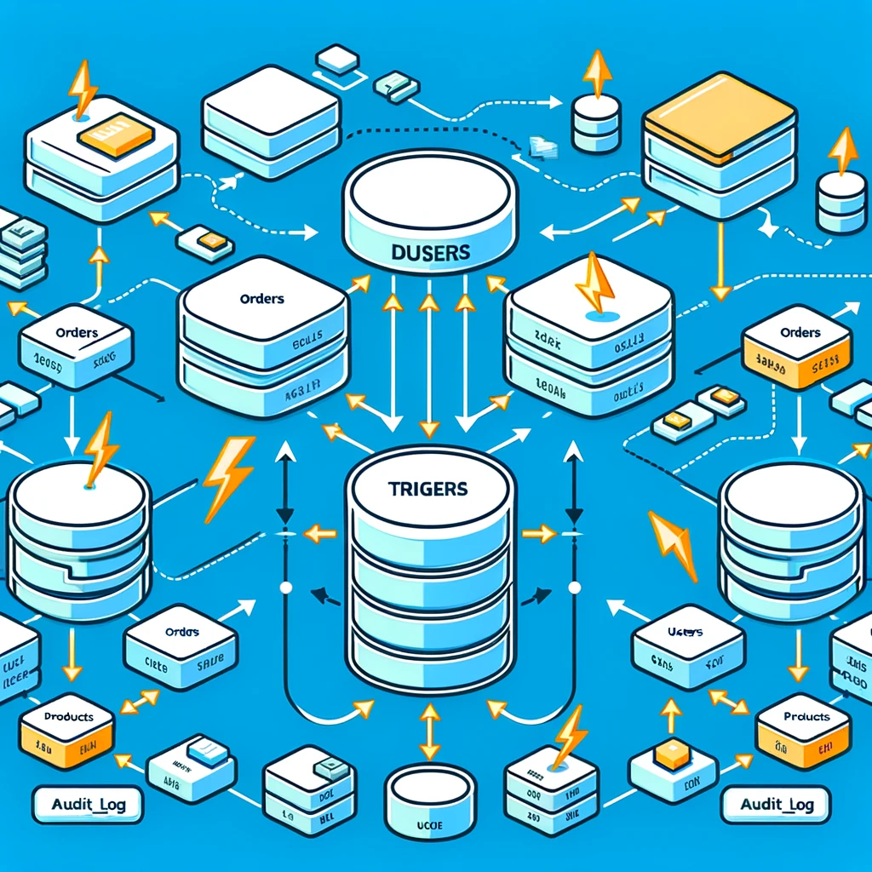
Triggers
Common uses of triggers include:
checking integrity and other user-defined constraints
auditing of updates to data, e.g., logging changes to sensitive data whenever they occur
enforcing complex business rules centrally in the database
preventing invalid actions on the data
recalculating the value of a derived attribute
A trigger is a database program object fired automatically when data in a table is changed in some way either through a delete, and update, or an insert.
Triggers are associated with a specific table and a specific action on the associated table.
Triggers can be defined to “fire” before or after some action on the table.
Triggers cannot be associated with a selection (retrieval) operation.

Slide 7
SQLite CREATE TRIGGER Statement
To create a new trigger in SQLite, you use the CREATE TRIGGER statement:
CREATE TRIGGER [IF NOT EXISTS] trigger_name
[BEFORE|AFTER|INSTEAD OF] [INSERT|UPDATE|DELETE] ON table
[WHEN condition]
BEGIN
statements;
END;

Slide 8
SQLite Trigger Definition Syntax & Limitations
SQLite is limited in its support for programming the logic of a trigger.
Unlike other DBMS implementations it does not support loops, variables, or conditional logic.
As of version 3.9.2, SQLite only supports FOR EACH ROW triggers; it does not yet support FOR EACH STATEMENT triggers.
Specify the name of the trigger after the CREATE TRIGGER keywords.
Determine when the trigger is fired: BEFORE, AFTER, or INSTEAD OF the action on the table. Note that INSTEAD OF triggers on apply to a view and not a table.
Specify the table to which the trigger belongs.
Place the trigger logic in between the BEGIN/END block, using any valid SQL statements.
Specifying a condition in the WHEN clause, invokes the trigger only invoked when the condition is true. Omitting the WHEN clause, executes the trigger for all affected rows.

Slide 9
Trigger Deletion
A trigger is deleted with the DROP TRIGGER statement.
Note that if a table is deleted (DROP TABLE), then all associated triggers are deleted, unless the trigger references other tables.

Slide 10
Accessing Old and New Data
CREATE TABLE leads (
id integer PRIMARY KEY,
first_name text NOT NULL,
last_name text NOT NULL,
phone text NOT NULL,
email text NOT NULL
);
Access to the data of the row being inserted, deleted, or updated is through the OLD and NEW references in the form:
OLD.column_name
NEW.column_name
The OLD and NEW references are available depending on the event that caused the trigger to be fired:
CREATE TRIGGER validate
BEFORE INSERT ON leads
BEGIN
SELECT
CASE
WHEN NEW.email NOT LIKE '%_@__%.__%'
THEN RAISE (ABORT,'Invalid email')
END;
END;
Action
Reference Available
INSERT
DELETE
UPDATE
NEW
OLD
NEW and OLD
Adapted from https://www.sqlitetutorial.net/sqlite-trigger

