Slide 1
Mapping Ontologies and Relational Schemas to XML
Martin Schedlbauer, Ph.D.
m.schedlbauer@neu.edu

Slide 2
Expressing a Conceptual model in xml

Slide 3
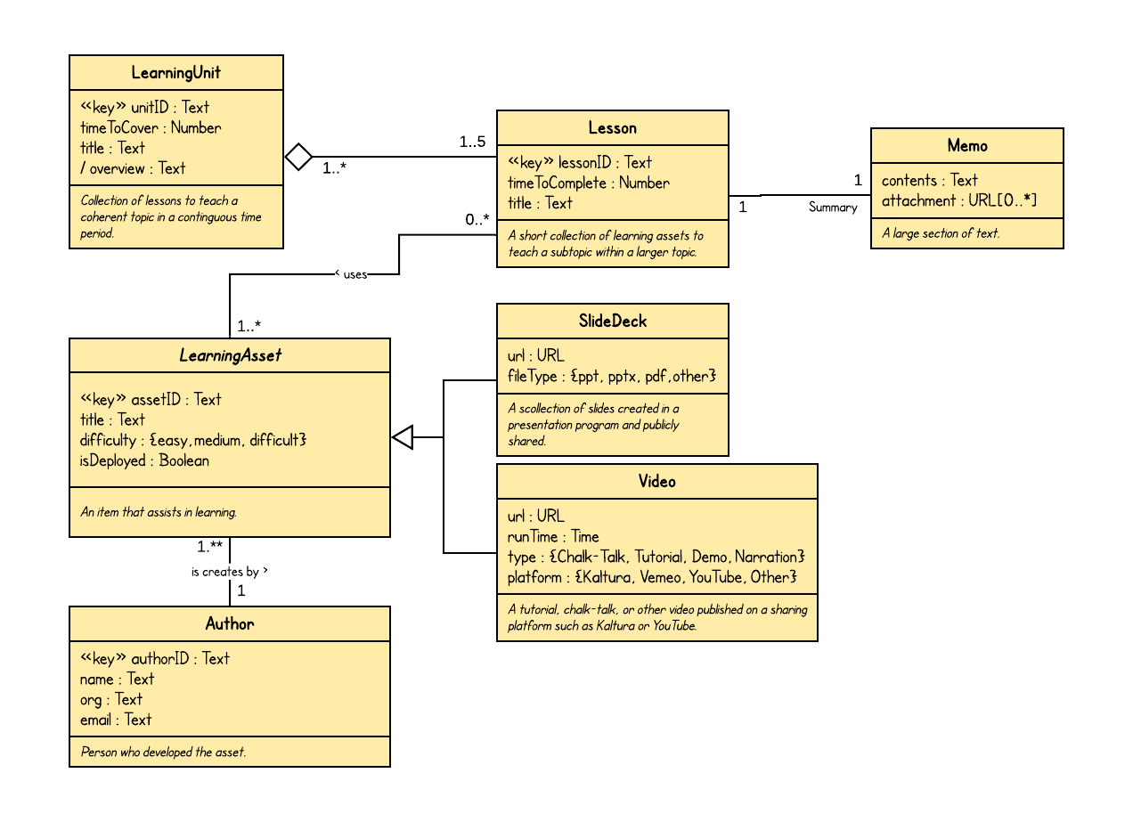
UML Conceptual Model
How would such a model be expressed in XML and how should an XML store for such a model be designed?

Slide 4
Designing an xml database

Slide 5
The following patterns provide a framework for expressing conceptual models in a DTD for the purpose of defining an XML data store.
They are best practices but much of the integrity and constraint enforcement is not possible through neither the DTD nor XML and must thus be relegated to application logic.

Slide 6
The use of attributes versus elements is suggestive rather than prescriptive.
Other representations are possible and equally valid. The representation patterns shown herein are based on experience and their demonstrated usefulness rather than being based on standards or being required.

Slide 7
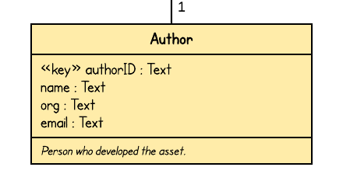
Pattern 1: Entity
<!DOCTYPE root [
<!ELEMENT root (Author*)>
<!ELEMENT Author
(authorID,name,org,email)>
<!ELEMENT authorID (#PCDATA)>
<!ELEMENT name (#PCDATA)>
<!ELEMENT org (#PCDATA)>
<!ELEMENT email (#PCDATA)>
]>
A single entity has its instances represented as nodes with:
entity name as element name
attributes as child nodes
key attribute(s) as element attributes
References and links as attributes
DTD has no explicit data types, only PCDATA.
<root>
<Author>
<authorID>101</authorID>
<name>Chloe Parker</name>
<org>Northeastern University</org>
<email>c.parker@neu.edu</email>
</Author>
...
<Author>
<authorID>102</authorID>
<name>Alison Chan</name>
<org>PWC Toronto</org>
<email>chan.alison@pwc.com</email>
</Author>
…
</root>

Slide 8
Pattern 2: Optional Attribute
<!DOCTYPE root [
<!ELEMENT root (Author*)>
<!ELEMENT Author
(authorID,name,org?,email)>
<!ELEMENT authorID (#PCDATA)>
<!ELEMENT name (#PCDATA)>
<!ELEMENT org (#PCDATA)>
<!ELEMENT email (#PCDATA)>
]>
<root>
<Author>
<authorID>101</authorID>
<name>Chloe Parker</name>
<org>Northeastern University</org>
<email>c.parker@neu.edu</email>
</Author>
<Author>
<authorID>102</authorID>
<name>Alison Chan</name>
<email>chan.alison@pwc.com</email>
</Author>
…
</root>

Slide 9
Pattern 3: Key Attribute
<!DOCTYPE root [
<!ELEMENT root (Author*)>
<!ELEMENT Author
(name,org,email)>
<!ATTLIST Author authorID CDATA>
<!ELEMENT name (#PCDATA)>
<!ELEMENT org (#PCDATA)>
<!ELEMENT email (#PCDATA)>
]>
<root>
<Author authorID="101">
<name>Chloe Parker</name>
<org>Northeastern University</org>
<email>c.parker@neu.edu</email>
</Author>
<Author>
<name>Alison Chan</name>
<org>PWC Toronto</org>
<email>chan.alison@pwc.com</email>
</Author>
…
</root>
Every entity should have a key attribute that uniquely identifies each instance.
Key attributes should be represented as element attributes.

Slide 10
Pattern 4: Required Key Attribute
<!DOCTYPE root [
<!ELEMENT root (Author*)>
<!ELEMENT Author
(name,org,email)>
<!ATTLIST Author authorID CDATA #REQUIRED>
<!ELEMENT name (#PCDATA)>
<!ELEMENT org (#PCDATA)>
<!ELEMENT email (#PCDATA)>
]>
Key attributes should be mandatory (required).
Attributes constraints:
#REQUIRED
#FIXED
#IMPLIED
<root>
<Author authorID="101">
<name>Chloe Parker</name>
<org>Northeastern University</org>
<email>c.parker@neu.edu</email>
</Author>
<Author authorID="102">
<name>Alison Chan</name>
<org>PWC Toronto</org>
<email>chan.alison@pwc.com</email>
</Author>
…
</root>

Slide 11
Pattern 5: Optional Key Attribute
<!DOCTYPE root [
<!ELEMENT root (Author*)>
<!ELEMENT Author
(name,org,email)>
<!ATTLIST Author authorID CDATA #IMPLIED>
<!ELEMENT name (#PCDATA)>
<!ELEMENT org (#PCDATA)>
<!ELEMENT email (#PCDATA)>
]>
Key attributes should be mandatory (required).
Attributes constraints:
#REQUIRED
#FIXED
#IMPLIED
<root>
<Author authorID="101">
<name>Chloe Parker</name>
<org>Northeastern University</org>
<email>c.parker@neu.edu</email>
</Author>
<Author>
<name>Alison Chan</name>
<org>PWC Toronto</org>
<email>chan.alison@pwc.com</email>
</Author>
…
</root>

Slide 12
Pattern 6: Unique Key Attribute
<!DOCTYPE root [
<!ELEMENT root (Author*)>
<!ELEMENT Author
(name,org,email)>
<!ATTLIST Author authorID ID #REQUIRED>
<!ELEMENT name (#PCDATA)>
<!ELEMENT org (#PCDATA)>
<!ELEMENT email (#PCDATA)>
]>
The DTD can be used to enforce uniqueness when the key attribute is represented as an XML element attribute.
ID, IDREF, and ENTITY are tokenized attributes that allow restrictions on values and enforced uniqueness rules.
The value of an ID attribute must start with a letter.
<root>
<Author authorID="i101">
<name>Chloe Parker</name>
<org>Northeastern University</org>
<email>c.parker@neu.edu</email>
</Author>
<Author authorID="i102">
<name>Alison Chan</name>
<org>PWC Toronto</org>
<email>chan.alison@pwc.com</email>
</Author>
…
</root>

Slide 13
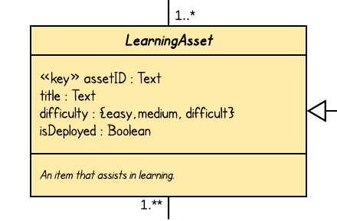
Pattern 7: Flags
<!DOCTYPE root [
<!ELEMENT root (Author*)>
<!ELEMENT Author
(name,org,email,isDeployed?)>
<!ATTLIST Author authorID ID #REQUIRED>
<!ELEMENT name (#PCDATA)>
<!ELEMENT org (#PCDATA)>
<!ELEMENT email (#PCDATA)>
<!ELEMENT isDeployed EMPTY>
]>
Some elements may be empty in which case there is only a beginning and an end tag but no content.
Often used to represent Boolean (true/false) values.
Empty elements can be defined using the shortcut <tag/>.
<root>
<Author authorID="i101">
<name>Chloe Parker</name>
<org>Northeastern University</org>
<email>c.parker@neu.edu</email>
</Author>
< Author authorID ="i102">
<name>Alison Chan</name>
<org>PWC Toronto</org>
<email>chan.alison@pwc.com</email>
<isDeployed />
</Author>
…
</root>

Slide 14
Learning Checkpoint
<!DOCTYPE [
]>
Create a DTD for the XML below assuming the following “rules”:
There is at least one section per course but no limit
time and location may appear in any order and location is optional
courseNumber and crn are required key attributes that must be unique
each course may or may not run and whether it’s running should be signaled with a Boolean attribute

Slide 15
Pattern 8: One-to-One Embedded
<!DOCTYPE root [
<!ELEMENT root (Lesson*)>
<!ELEMENT Lesson
(timeToComplete,title,Memo)>
<!ELEMENT timeToComplete (#PCDATA)>
<!ELEMENT title (#PCDATA)>
<!ELEMENT Memo (contents,attachment*)>
<!ELEMENT contents (#PCDATA)>
<!ELEMENT attachment (#PCDATA)>
]>
<root>
…
<Lesson>
…
<Memo>
<contents>contents of memo</contents>
<attachment>http://foo.bar.com/att1.docx</attachment>
<attachment>http://foo.bar.com/att2.docx</attachment>
</Memo>
</Lesson>
<Lesson>
…
</Lesson>
…
</root>

Slide 16
Pattern 9: One-to-One Linked
<!DOCTYPE root [
<!ELEMENT root (Lesson*, Memo*)>
<!ELEMENT Lesson
(timeToComplete,title)>
<!ATTLIST Lesson lessonID ID #REQUIRED>
<!ELEMENT timeToComplete (#PCDATA)>
<!ELEMENT title (#PCDATA)>
<!ELEMENT Memo (contents,attachment*)>
<!ELEMENT contents (#PCDATA)>
<!ELEMENT attachment (#PCDATA)>
<!ATTLIST Memo lessonIDFK IDREF #REQUIRED>
]>
<root>
…
<Lesson lessonID="i293">
…
</Lesson>
<Lesson lessonID="i482">
</Lesson>
<Memo lessonIDFK = "i293">
<contents>contents of memo</contents>
<attachment>http://foo.bar.com/att1.docx</attachment>
<attachment>http://foo.bar.com/att2.docx</attachment>
</Memo>
<Memo lessonIDFK = "i482">
<contents>contents of memo</contents>
<attachment>http://foo.bar.com/att1.docx</attachment>
<attachment>http://foo.bar.com/att2.docx</attachment>
</Memo>
…
</root>
Values used in IDREF are checked to ensure they point to a valid ID in the document at the time the XML document is read (parsed).
ID values must be unique in the document rather than for a type of entity.
IDREF must have the constraint #REQUIRED or #IMPLIED (if the attribute is not mandatory).

Slide 17
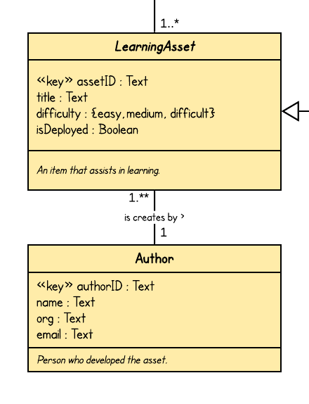
Pattern 10: One-to-Many Back-Linked
<root>
…
<LearningAsset assetID="i100" authorIDFK="a1">
…
</LearningAsset>
<LearningAsset assetID="i200" authorIDFK="a1">
…
</LearningAsset>
...
<Author authorID="a1">
…
</Author>
<Author authorID="a3">
</Author>
…
</root>
<!DOCTYPE courses [ <!ELEMENT root (LearningAsset*, Author*)
<!ELEMENT LearningAsset (…)>
<!ATTLIST LearningAsset assetID ID #REQUIRED>
<!ATTLIST LearningAsset authorIDFK IDREF #REQUIRED>
<!ELEMENT Author (…)>
<!ATTLIST Author authorID ID #REQUIRED> ]>

Slide 18
Pattern 11: One-to-Many Forward-Linked
<root>
…
<LearningAsset assetID="i100">
…
</LearningAsset>
<LearningAsset assetID="i200">
…
</LearningAsset>
<Author authorID="a1" assetIDs="i100 i200">
..
</Author>
<Author authorID="a3">
</Author>
…
</root>
<!DOCTYPE courses [ <!ELEMENT root (LearningAsset*, Author*)
<!ELEMENT LearningAsset (…)>
<!ATTLIST LearningAsset assetID ID #REQUIRED>
<!ELEMENT Author (…)>
<!ATTLIST Author authorID ID #REQUIRED>
<!ATTLIST LearningAsset assetIDs IDREFS #IMPLIED> ]>
IDREF and IDREFS must have the constraint #REQUIRED or #IMPLIED (if an attribute value is not mandatory).

Slide 19
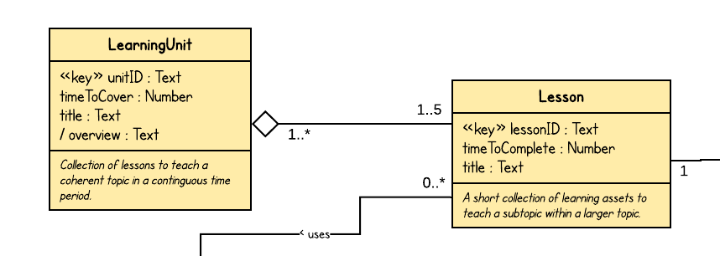
Pattern 12: Many-to-Many Junction
<!DOCTYPE root [
<!ELEMENT root (…)>
<!ELEMENT LearningUnit (…)>
<!ATTLIST LearningUnit unitID ID #required>
<!ELEMENT Lesson (…)>
<!ATTLIST Lesson lessonID ID #required>
<!ELEMENT Content>
<!ATTLIST Content lessonID IDREF #required>
<!ATTLIST Content unitID IDREF #required>
]>
<root>
…
<LearningUnit unitID="i100">
…
</LearningUnit>
<LearningUnit unitID="i200">
…
</LearningUnit>
<Lesson lessonID="i1">
…
</Lesson>
<Lesson lessonID="i3">
</Lesson>
<Content lessonID = "i1" unitID = "i100" />
<Content lessonID = "i1" unitID = "i200" />
<Content lessonID = "i2" unitID = "i100" />
…
</root>

Slide 20
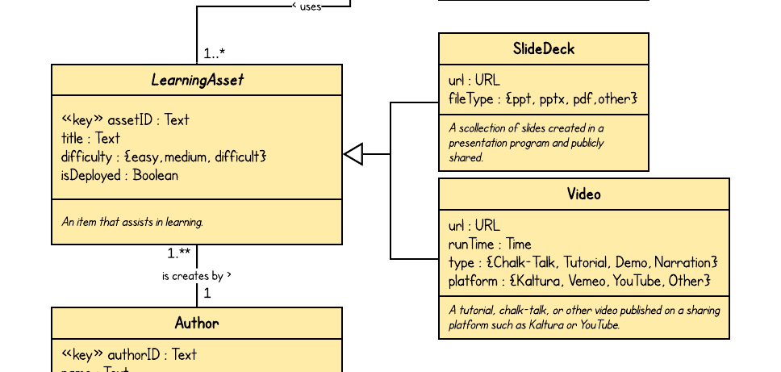
Pattern 13: Taxonomy / Repeated Attributes
<!DOCTYPE courses [ <!ELEMENT root ((SlideDeck|Video)*, Author*)>
<!ELEMENT Video (…)>
<!ATTLIST Video assetID ID #REQUIRED>
<!ATTLIST Video authorID IDREF #REQUIRED>
…
<!ELEMENT Author (…)>
<!ATTLIST Author authorID ID #REQUIRED>
… ]>
Strategy A: Repeated Attributes
<root>
<SlideDeck assetID="a100" authorID="a1">
<title>The Delphi Method</title>
<url>…</url>
<filetype>pptx</filetype>
</SlideDeck>
<Video assetID="a502" authorID="a1">
<title>Estimating Samples</title>
<url>…</url>
<platform>Kaltura</platform>
</Video>
…
</root>
LearningAsset is an abstract class which means that there are no instances of that class and only instances of the subclasses. So, there is no LearningAsset element needed in the XML. The relationship to Author is implemented in each subclass element.

Slide 21
Pattern 14: Taxonomy / Connected Classes
Strategy B: Connected Classes
<root>
<LearningAsset assetID="a100" authorID="a1">
<title>The Delphi Method</title>
</LearningAsset>
<SlideDeck assetID="a100">
<url>…</url>
<filetype>pptx</filetype>
</SlideDeck>
<LearningAsset assetID="a502" authorID="a1">
<title>Estimating Samples</title>
</LearningAsset>
<Video assetIDREF="a502">
<url>…</url>
<platform>Kaltura</platform>
</Video>
…
</root>
<!DOCTYPE courses [ <!ELEMENT root (((LearningAsset|SlideDeck)|
(LearningAsset|Video))*,
Author*)
<!ELEMENT LearningAsset (…)>
<!ATTLIST LearningAsset assetID ID #REQUIRED>
<!ATTLIST LearningAsset authorID IDREF #REQUIRED>
<!ELEMENT Video url,runtime,…)>
<!ATTLIST Video assetIDREF IDREF #REQUIRED>
…
<!ELEMENT Author (…)>
<!ATTLIST Author authorID ID #REQUIRED>
… ]>
LearningAsset is an abstract class which means that there are no instances of that class and only instances of the subclasses.

Slide 22
Pattern 15: Value Set with Default Value
<!DOCTYPE root [
<!ELEMENT root (LearningAsset*)>
<!ELEMENT LearningAsset (…)>
<!ATTLIST LearningAsset difficulty
(easy|medium|difficult) "easy">
…
]>
To enforce a value set (enumerated type) it must be defined as an attribute.
No validation can occur for parsed character data (#PCDATA).
<root>
<LearningAsset difficulty = "medium">
…
</LearningAsset>
<LearningAsset>
…
</LearningAsset>
…
</root>

Slide 23
Restricted Use of XML Element Attributes
The use of attributes for elements should be restricted to:
Primary keys
Foreign keys
Value sets (categorical)

Slide 24
The use of these representational patterns is suggestive rather than prescriptive.

Slide 25
Summary, Review, & Questions…

