Slide 1
Defining User Requirements with User Stories and Personas
Martin Schedlbauer, PhD
m.schedlbauer@northeastern.edu
Copyright © 2013-2023 by The Cathris Group, Ars Doceo, and Martin Schedlbauer. All Rights Reserved. Do Not Duplicate or Distribute Without Written Consent of the Author.

Slide 2
Personas
Segmenting users into classes
Understanding differences between users of the same class
Finding better requirements
Prioritizing features

Slide 3
The Persona Method
The persona method has been used since the late 1990s in market research, user interface design, communication planning, and service design.
Personas force the designer to consider different perspectives rather than inadvertently only their own perspective.
A persona is a description of a fictitious user based on either assumptions or data collected through research.
Personas represent different types of users within a single social group.
For example, a shopper at a department store might be:
A young person looking for their first suit
A businessperson looking for casual wear
A woman looking for accessories

Slide 4
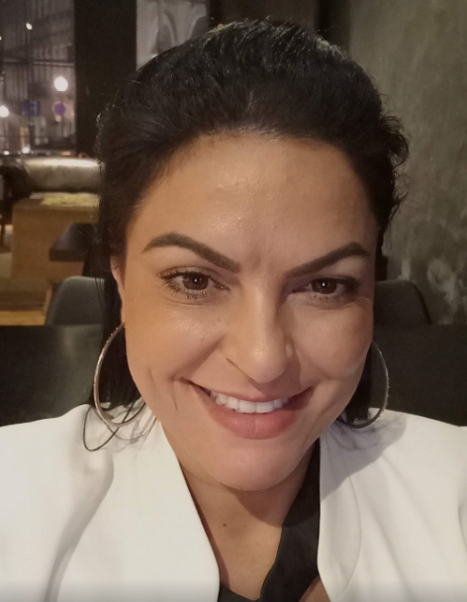
Example of a Persona
Below is an example of a persona representing a shopper at a department store:
Sally
Sally is a 32-year-old importer of beach and summer wear living in Palm Beach, FL. Sally has a background in modeling and always looks to accessorize her outfits with handbags, scarves, and jewelry. She is a smart and careful shopper who looks for brand name apparel at discounts.
She has a computer at home that she uses only when her iPad or Android phone are not sufficient. Sally routinely purchases clothing and apparel online through fashion outlets and large retailers. She carries several major credit cards.
Sally rarely tries on clothing as common sizes fit her well, although occasionally she needs to return items that don’t fit.

Slide 5
Personas vs. Archetypes or Persons
A persona is not a description of an archetype or person but rather a partial description of the aspects relevant for the design effort.
Personas generally include:
Demographic profile (name, gender, age, picture)
Background (education, experience, job, income)
Likes and dislikes
Needs and goals
Approach to work or problem solving
The persona method is still somewhat undefined and has only recently been applied to requirements activities and business analysis.

Slide 6
Benefits of the Persona Method
Personas provide several distinct benefits to analysts and solution designers:
a better understanding of product users, customers, and stakeholders
shorter and more focused design cycles
improved product fit
more likely to address user needs
more usable solutions, products, or services

Slide 7
Identifying Personas
Personas must be carefully crafted to ensure that they represent the user space accurately.
To identify personas, use:
Market research
Surveys
Focus groups

Slide 8
What Makes a Good Persona?
A good persona should be relevant and serious (no humor in the description).
It should remind the designers of someone they know, and they can relate to.
“Oh. That reminds me of my mom.”

Slide 9
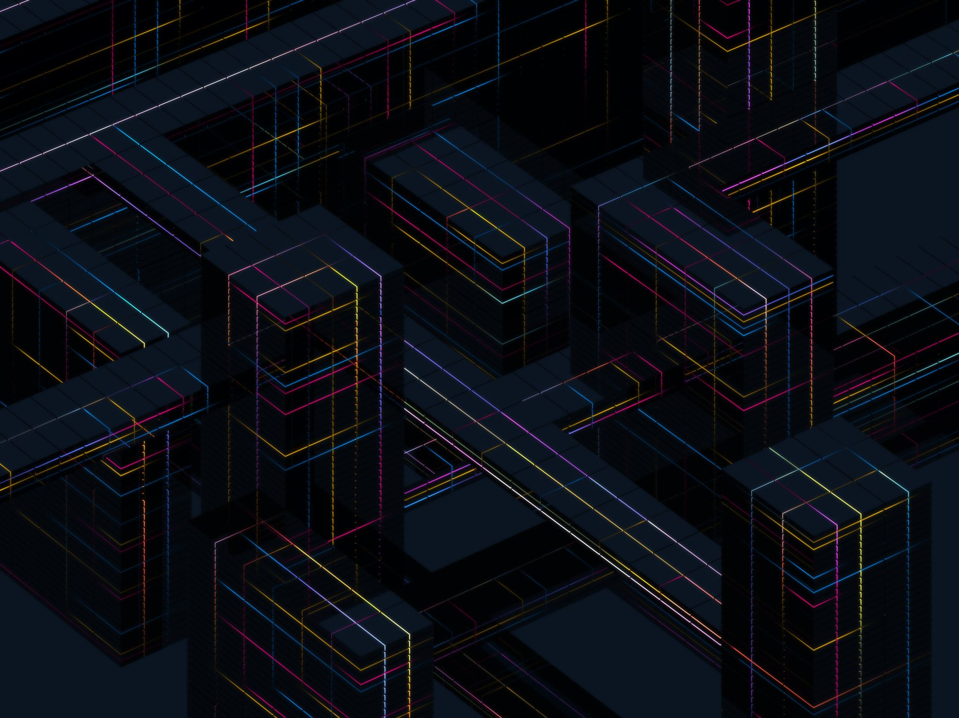
Persona Design Approaches
There are four perspectives used for persona design:
Goal-directed perspective
Role-based perspective
Engaging perspective
Fiction-based perspective
The first three are based on data and research while the last one is based on the designer’s assumptions and intuition.

Slide 10
Goal-Directed Perspective
In this method, personas are not average users but rather extreme characters highlighting the stratification within a class of user or a role.
Start with many personas identified through ethnographic research, surveys, or focus groups.
Describe the work goals, workflows, and processes carried by each persona.
Group the personas by similar needs, goals, and relationship with the product to be designed.
Reduce the number of personas to a few that highlight the needs of different users.
Rank the personas based on priority and start analyzing the needs of the highest priority persona.

Slide 11
Role-Based Perspective
Role-based personas are also data-driven and based on qualitative and quantitative research like goal-directed personas.
Personas are used in this approach to communicate insights from market research and are based on actual data.
Each persona should include information about:
Size of market share for this persona
Computer proficiency
Demographic profile
Hopes and fears
Typical day or week in the life of the persona

Slide 12
Engaging Perspective
While this approach is also rooted in research and data, it considers also the psychological characteristics of the personas to provide designers with a more complete understanding of the person rather than building a stereotypical representation.
Personas include not only demographic profiles, goals, and needs, but also:
Social background
Psychological characteristics
Emotional relationship with the product or domain
In this persona perspective, the designer can add assumptions and fictitious information.

Slide 13
Fiction-Based Perspective
In this approach, designers construct ad-hoc descriptions based on intuition, assumptions, or “gut feelings” about their prospective users.
This method focuses on generating extreme personas to explore the edges of the design space and needs of outliers.
Proto-personas emerge not from market research or ethnography, but rather from brainstorming sessions.
Names are fictional and might even be based on fictional characters, such as “Bridget Jones” or “James Bond”.

Slide 14
Persona Design Continuum
Sketch
Hypothesis
Provisional
Robust
Complete

Slide 15
Scenarios and Personas
Once personas have been identified through one or more of the methods described before, continue by describing usage scenarios for each persona.
Start by identifying the most common usage scenario and then venture into alternate and exception scenarios.
At each step of the normal scenario, ask:
Is this step always done like this?
Does it have to be done this way or can it be done differently?
Does everyone do it this way? Who doesn’t?
When is it done differently? If so, why?
What happens when it’s done differently?

Slide 16
Prioritizing Personas
It may not always be possible to address the needs of all personas.
Personas need to be prioritized and ranked based on:
Anticipated number of instances of a persona
Frequency of use
Influence of persona instances
Market potential
Competitive or market opportunities
Alignment with core competencies

Slide 17
Scope Management with Personas
Note that it may not always be possible or practical to accommodate the needs of all personas.
Product owners may be forced to focus the product on specific personas and therefore limit the “marketability”, “applicability”, or “relevance” for certain users.
This may require different products or designs for different users.
In an incremental approach, different releases may address the needs of different personas, starting with the most important persona.

Slide 18
Summary of Persona Design Process
Collect
Collect data from existing sources, market research, interview, surveys
Form
Form a hypothesis of user classes and how they differ
Validate
Validate the hypothetical personas
Reduce
Reduce the number of personas
Describe
Describe the personas using one or more perspectives
Construct
Construct user stories for each persona
Validate
Validate the user stories through scenario walkthroughs
Document
Document the personas and user stories
Communicate
Communicate the personas and stories to the solution designers

Slide 19
Story Writing Process
Identify roles and actors
1
Develop personas for roles
2
Identify user stories for each persona
3
Write INVESTed stories with acceptance criteria
4
Identify and decompose epics
5
Organize stories into themes
7
Assign story points to size stories
6

Slide 20
Using Personas During Requirements Activities
When designing the product or gathering requirements, the team should ask for each persona:
“Would Sally use this?”
“Would this feature be valuable for Sally?”
“What does Sally need to achieve her goals?”
“Does this only apply to Sally or to others as well?”
Disagreements on scope, design, or needs can be resolved by referring to the personas and whose needs they address.

Slide 21
Collecting Requirements
How do you think personas and user stories could help you in your requirements and business analysis activities?
Do you believe they can help you in addressing some of your challenges? How?
What conflicts do you foresee in integrating personas and user stories into your business analysis methodology?
Do you think that user stories alone are sufficient to describe requirements? What other artifacts do you believe you will need to adequately describe and communicate requirements?

Slide 22
Analysis vs. Documentation Techniques
As analysts we need to distinguish between analysis techniques and documentation techniques.
Analysis techniques help us understand the need and discover requirements.
Documentation techniques help us communicate what we’ve uncovered to various audiences.
Different audiences will need different types of documentation to understand the requirements.

Slide 23
Personas for Gap Analysis
When new personas emerge, does the system accommodate them or are there “gaps”?
Also address “idiot” personas and “hostile” personas, like hackers, and potentially “adversarial” personas, perhaps like regulators.

Slide 24
Summary
In this lesson, you learned how to:
describe requirements from the user's perspective with light-weight user stories
understand users better and more thoroughly through personas
write user stories using a narrative template
develop personas using one or more perspectives
understand requirements through personas and user stories

