Slide 1
Interaction Devices
Martin Schedlbauer, Ph.D.
m.schedlbauer@northeastern.edu

Slide 2
Resources & References
The content and discussion of this lesson are based on the following resources:
Shneiderman, B., Plaisant, C. (2010). Designing the User Interface, 5th Edition. Addison-Wesley.
Schedlbauer, M. (2011). Input Devices. Technical Report, University of Massachusetts Lowell.

Slide 3
User Interactions
Users of computers must be able control an application through its user interface.
The interactions can be categorized as either command selection, command response, or data input and output.

Slide 4
Input & Output
Input is commonly in the form of text, selection of an on-screen object, command activation, or sensor input, camera input.
Output is commonly is the form of on-screen displays, auditory feedback, simulated tactile feedback, synthesized speech, printing, video and/or animation, and QR and barcodes.

Slide 5
Exploration
In a small group or individually, create a list of input devices.
Identify at least 5 different input devices.
What kind of device would you propose be used in a food ordering kiosk or for an in-car multimedia system?

Slide 6
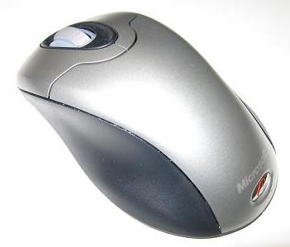
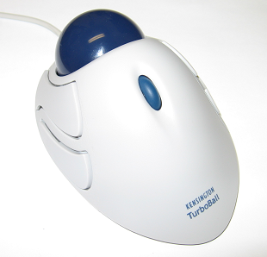
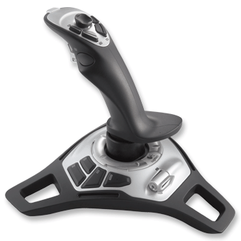
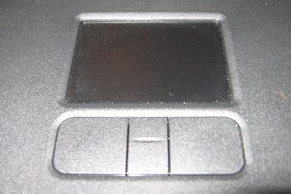
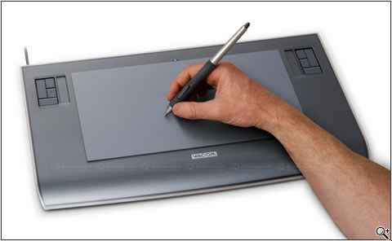
What are These?

Slide 7
What are These?
Mouse
Trackball
Joystick
Joystick
Touchpad
Graphics Tablet

Slide 8
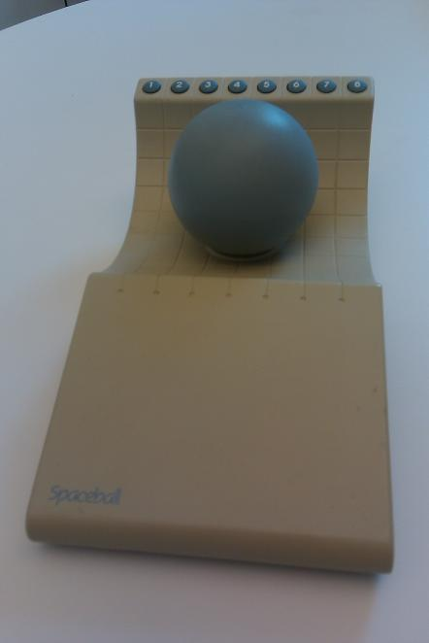
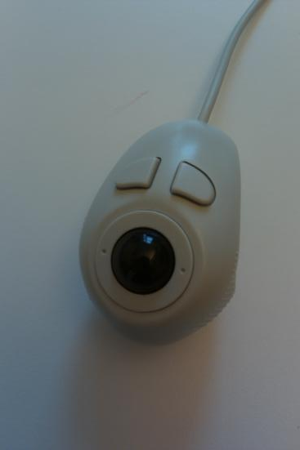
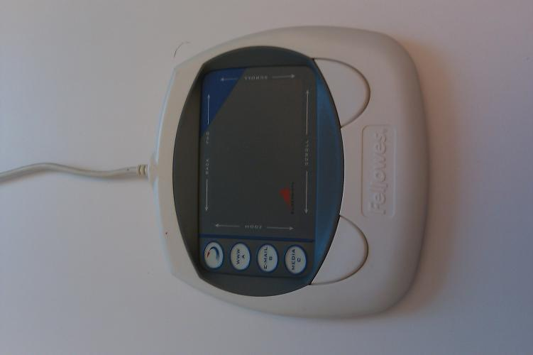
What about These?

Slide 9
What about These?
Handheld Thumb Controlled Trackball
Touchpad
Space Mouse

Slide 10
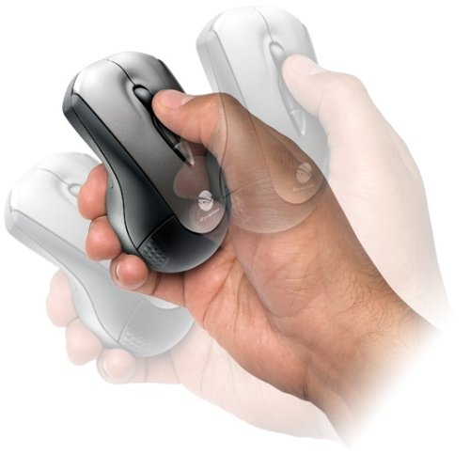
And This?

Slide 11
And This?
Gyroscopic Mouse

Slide 12
Input Device Characteristics
An input device gathers physical information and translates the analog signal into a digital one for interpretation by the computer application.
In some cases, the input device supports output and may provide tactile, haptic, visual, or auditory feedback to the user.

Slide 13
Properties of Input Devices
Property | Explanation
Sampling rate | The sampling rate determines how often measurements from the physical sensors embedded in the input device are taken and sent to the computer system. Increased sampling rates produce finer control and increase the sensitivity of manipulations.
Resolution | Resolution is a metric of the number of unique measurements the input device can send to the computer.
Latency | Latency, or lag, is the time that elapses between the physical actuation of the input device and the resulting on-screen feedback. Latencies above 100 msec. frequently interfere with cognitive performance.
Noise | Noise is the result of sensing errors due to hardware malfunctions or design inadequacies. Increased noise leads to sampling problems and loss of accuracy.

Slide 14
Properties of Input Devices (cont.)
Property | Explanation
Position mode | The position mode can be either absolute or relative. For an absolute input device, each position on the sensing surface corresponds to a specific location on the screen. In a relative positioning mode, each input is a functional translation from the current point. A touch screen is an absolute input device, whereas a mouse is a relative input device.
Gain | Gain is also referred to as the Control-Display (C-D) ratio. C-D is the ratio of the distance that the on-screen cursor moves in relation to the physical movement of the input device. An increased gain allows for a smaller footprint, i.e., less space is necessary for the input device. The function that controls the gain (C-D ratio) is frequently configurable through software. Studies have shown that there is no optimal setting for gain and that increased gain frequently leads to higher error rates.

Slide 15
Properties of Input Devices (cont.)
Property | Explanation
Degrees of freedom | Degrees of freedom is a measure of the number of dimensions that the input device senses.
Direct vs. indirect | If the input surface is also the display surface, then the input device is direct. An example of such a device is a touch-screen. Most other input devices are indirect in that the on-screen cursor is controlled through an intermediary device such as a mouse, joystick, or stylus.
Footprint | Footprint refers to the amount of space that is required for input. For example, a mouse has a large and variable footprint, whereas a trackball has a smaller but fixed footprint.
Device acquisition time | Device acquisition time refers to the time it takes to grasp the input device before control can be exerted.
Reliability | Reliability refers to the resilience of the device to environment influences, such as heat, cold, humidity, dust, vibrations, etc.

Slide 16
Breakout
Characterize the five input devices below:
Add one from your list and characterize it in the same way.
Input Device | Position Mode | Direct or Indirect? | Degrees of Freedom | Footprint (fixed or variable) | Reliability
Optical Mouse
Trackball
Stylus Touch
Finger Touch
Touchpad

Slide 17
Summary, Review, & Questions…

Slide 18
Keyboard Input Devices
Interaction Devices

Slide 19
Keyboard Characteristics
Physical vs. virtual (soft) keyboard
Keyboard layout
QWERTY
Dvorak
ABCD
Ergonomic keyboard forms
Chord keyboards

Slide 20
Keyboard Design Trends
The trend of keyboard design appears to go in two directions.
On the one hand, ergonomic considerations have forced manufacturers to redesign the keyboard to alleviate discomfort during prolonged use. Such design changes include splitting keyboards into angled arrangements, resizing and re-spacing keys, adding wrist resting pads, and increasing tactile key-level feedback.
On the other hand, keyboards are being miniaturized to accommodate mobile computing devices.

Slide 21
Keyboard Layouts
QWERTY
Dvorak
1870 Christopher Latham Sholes
most common layout
good mechanical design and a clever placement of the letters that slowed down the users enough that key jamming was infrequent
put frequently used letter pairs far apart, thereby increasing finger travel distances
1920 August Dvorak
reduces finger travel distances by at least one order of magnitude
Acceptance has been slow despite the dedicated efforts of some devotees
it takes about 1 week of regular typing to make the switch, but most users have been unwilling to invest the effort

Slide 22
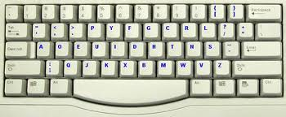
QWERTY vs. Dvorak

Slide 23
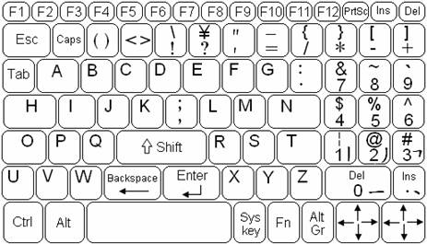
ABCD Keyboard

Slide 24
CHUBON Keyboard

Slide 25
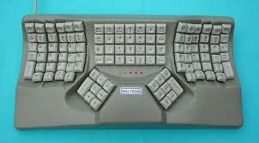
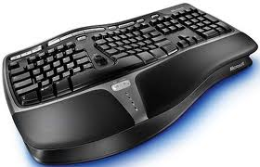
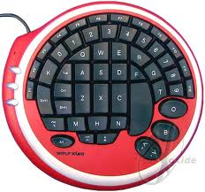
Ergonomic Keyboards
Reduce strain on wrist while typing to reduce carpal tunnel syndrome.

Slide 26
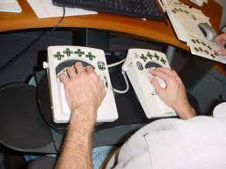
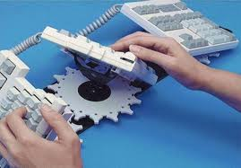
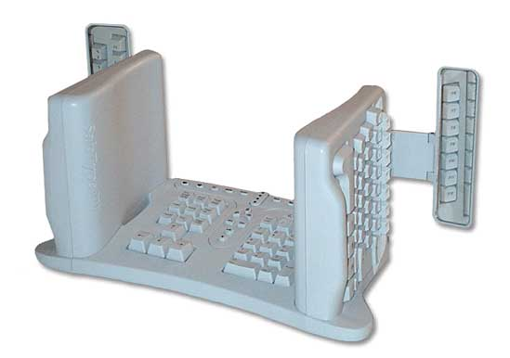
Data Hands Keyboard

Slide 27
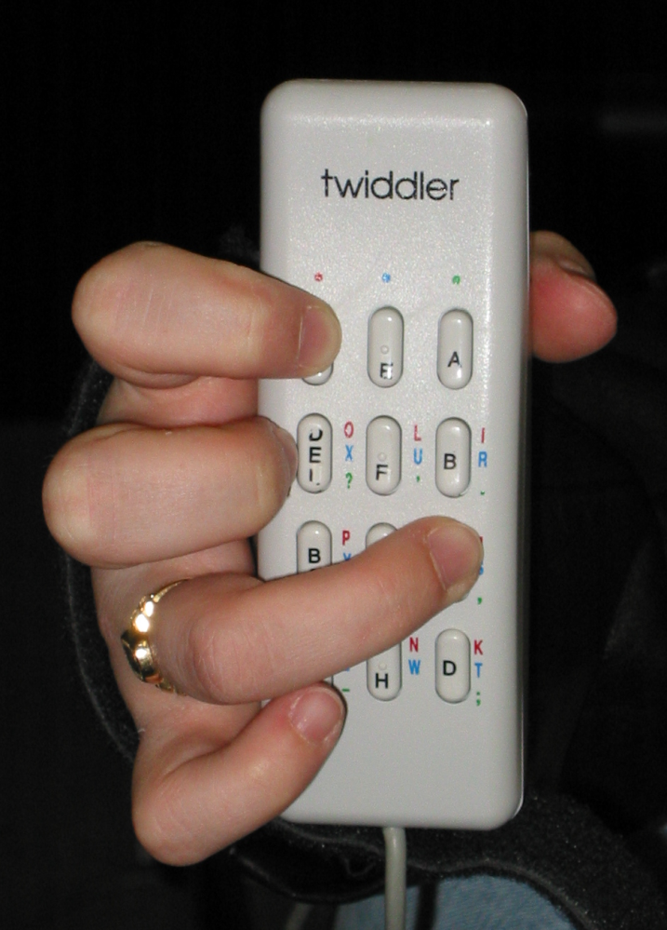
Chord Keyboards
Smaller and fewer keys
Sequential, one-at-a-time key presses
Chording requires multiple simultaneous keystrokes

Slide 28
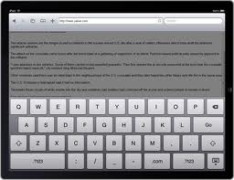
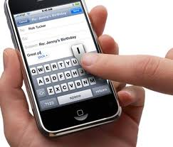
Virtual Keyboards
For systems where a physical keyboard is not practical, a soft, or virtual, keyboard is often constructed using a touch-sensitive screen .

Slide 29
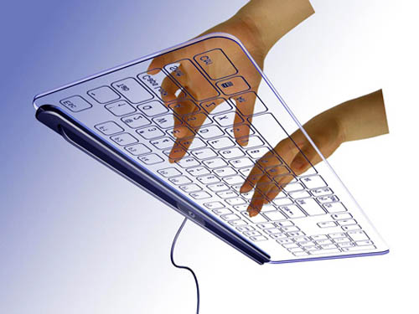
Dedicated Virtual Keyboard
This keyboard is not created on screen but is stand-alone and touch based.
New layouts can be created via software.

Slide 30
Acer Iconia Dual-Touch Laptop

Slide 31
Virtual Keyboard Design Considerations
While soft keyboards have been adopted by designers of ubiquitous computing devices, their use requires significant visual attention due to the absence of tactile feedback.
There’s been success with embedding tactile force-feedback mechanisms into touch screens to make it possible to operate soft keyboards in low-visibility situations.
In the absence of physical tactile feedback, simulated tactile or auditory feedback is often accepted as natural and users did accept a soft keyboard when feedback was present.
Auditory feedback works best in situations when the user is distracted and cannot look at the screen long enough.

Slide 32
Hand-Writing Text Entry Methods
Another method is to handwrite on a touch sensitive
surface, typically with a stylus using Graffiti® on the Palm devices

Slide 33
Summary, Review, & Questions…

Slide 34
Indirect Input Devices
Interaction Devices

Slide 35
Indirect Input Devices
Input Device | Characteristics
Mouse (optical and mechanical) | Relative and indirect; large, variable footprint
Gyroscopic Mouse | Relative and indirect; no desk footprint
Joystick | Relative and indirect; fixed footprint
Touchpad | Relative and indirect; fixed footprint
Trackball | Relative and indirect; fixed footprint
Thumbball | Relative and indirect; fixed footprint
Handheld Thumbball | Relative and indirect; fixed footprint
Graphics Tablet | Absolute and direct; fixed footprint

Slide 36
Joysticks
A joystick is an input device that pivots about its center.
The angle of displacement from the center controls an on-screen cursor.
Like the touchpad, a joystick has a fixed footprint. The angle of displacement can be measured in one of two ways:
an actual deflection from the center (isotonic joystick) or
a sensing of the force applied to the joystick (isometric joystick).
Isometric joysticks have a tiny footprint and thus work well in space constrained environments.

Slide 37
On-Screen Cursors
For indirect input devices, such a mouse or joystick, feedback is in the form of on-screen movement of a cursor.
While the actual shape of the cursor is programmable, an arrow head has become the de facto standard.
To accommodate smaller screen sizes and visually impaired users, designers of graphical user interface have resorted to enlarged on-screen cursors.
While a larger cursor may help with selecting on-screen objects, the shape and form of the cursor may be distracting. There is empirical evidence that suggests that the size of the cursor has a negative impact on reaction time and correct target acquisition.

Slide 38
Haptic Feedback
In some application areas, haptic, or force feedback may be useful.
A pointing device that provides haptic feedback can guide the user along a particular path. As the user veers off the correct path, the pointing device makes further movement in that direction more difficult.
Often implemented with joysticks.

Slide 39
Summary, Review, & Questions…

Slide 40
direct Input Devices
Interaction Devices

Slide 41
Direct Pointing Devices
Tablet PCs and Mobile Devices:
Natural to point on the LCD surface
Stylus
Keep context in view
Pick up & put down stylus
Gestures and handwriting recognition

Slide 42
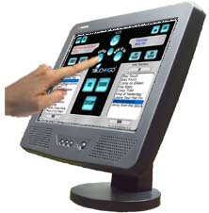
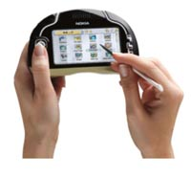
Finger vs. Stylus Touch Input
Finger Touch Input
Stylus Touch Input

Slide 43
Touch Input Technology
Touch screens are essentially translucent touch pads mounted on top of a display.
The use of touch screen technology eliminates the need for additional input devices such as a keyboard or a pointing device.
Pointing to an object on a touch screen is natural, direct and proceeds without an intermediary device that might distort the interaction.
Touch technology requires a high sampling rate; otherwise the user will encounter selection errors when trying to hit a target that is close to other targets.
Since touch screens do not provide push buttons, separate actions are complex to implement.
In addition, dragging, dropping, and scrolling are more cumbersome to achieve.
Depending on the touch technology in use, selection of an on-screen target can be done with either a finger or a stylus. While less convenient, pointing with a stylus is often found to be more accurate.

Slide 44
Summary, Review, & Questions…

Slide 45
Novel Input Devices
Interaction Devices

Slide 46
Novel Devices
Foot controls
Eye-tracking
Multiple-degrees-of-freedom devices
DataGlove
Haptic feedback
Bimanual input
Tabletop touch screens
Game controllers (Wii, Kinect)
Paper-based pen computers

Slide 47
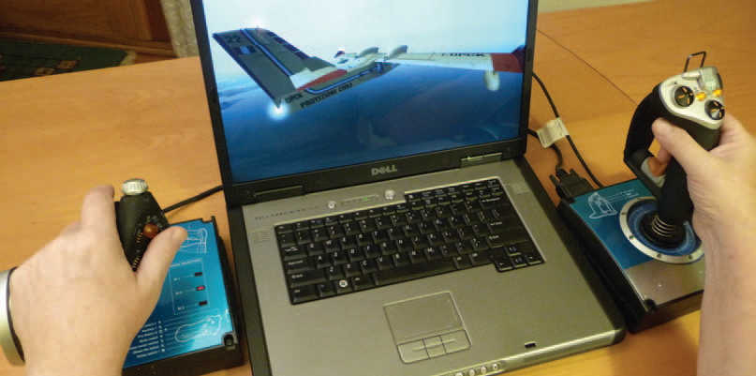
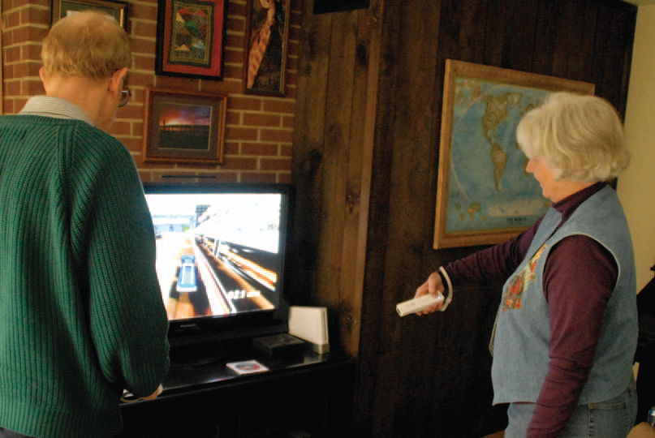
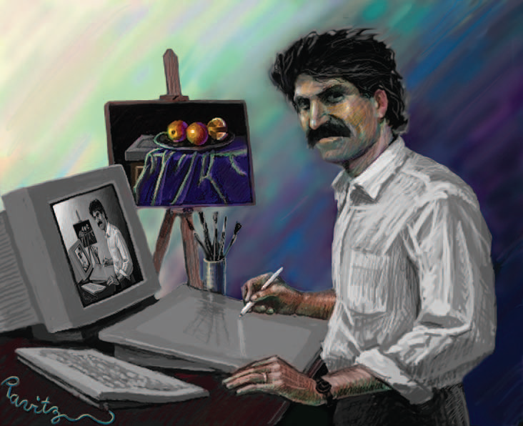
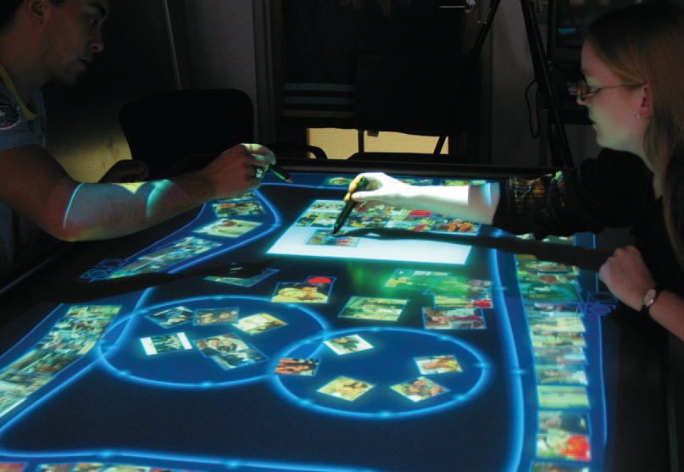
Novel devices (cont.)

Slide 48
GestureTek Tabletop

Slide 49
Microsoft Surface

Slide 50
3D Multi-Touch Surface

Slide 51
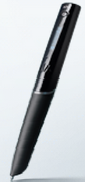
LiveScribe Paper-Pen Platform
LiveScribe is a smartpen, a ballpoint pen with an embedded computer, camera, OLED display, and digital audio recorder.
When used with special paper, it records what it writes for later uploading to a computer, and synchronizes those notes with any audio it has recorded. This allows a user to replay portions of a recording by tapping on the notes he or she was taking at the time the recording was made. It is also possible to select which portion of a recording to replay by clicking on the relevant portion of a page on-screen

Slide 52
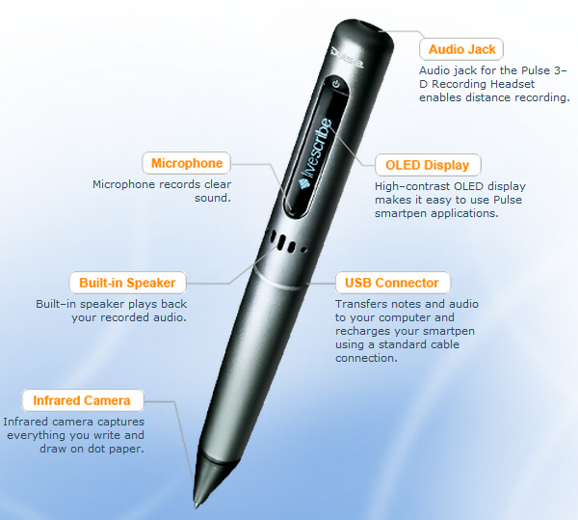
LiveScribe Pen Architecture
From www.livescribe.com

Slide 53
LiveScribe Pulse SmartPen
http://www.youtube.com/watch?v=k7OOevasSak

Slide 54
Summary, Review, & Questions…

Slide 55
Comparing Input Devices
Interaction Devices

Slide 56
Comparison of pointing devices
Human-factors variables
speed of motion for short and long distances
accuracy of positioning
error rates
learning time
user satisfaction
Other variables
cost
durability
space requirements
weight
left- versus right-hand use
likelihood to cause repetitive-strain injury
compatibility with other systems

Slide 57
Comparison of Input Devices
direct pointing devices faster, but less accurate
graphics tablets are appealing when user can remain with device for long periods without switching to keyboard
mouse is faster than isometric joystick
for tasks that mix typing and pointing, cursor keys a faster and are preferred by users to a mouse
muscular strain is low for cursor keys

Slide 58
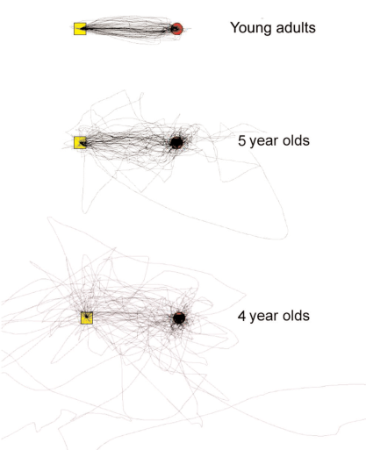
Fitts’ Law and ISO9241
Fitts’ Law
Index of difficulty ID = log₂ (D/W + 1)
Time to point T = a + bID
a and b are constants that depend on the device and are determined empirically through regression analysis

Slide 59
Taxonomy of Input Devices
Input Device | Footprint | Positioning | Control | Feedback | Impacted by Humidity | Impacted by Dirt
Physical Keyboard | Fixed | N/A | Indirect | Tactile & Auditory | No | Somewhat
Soft Keyboard | Fixed | N/A | N/A | Visual & Auditory | No | No
Mouse | Variable | Relative | Indirect | None | No | Yes
Trackball | Fixed | Relative | Indirect | None | No | Somewhat
Touch Screen | Fixed | Absolute | Direct | Visual | No | Yes
Touchpad | Fixed | Relative | Indirect | None | Yes | Yes
Isometric Joystick | Fixed | Relative | Indirect | None | No | No
Isotonic Joystick | Fixed | Relative | Indirect | Visual | No | No

Slide 60
Summary, Review, & Questions…

Slide 61
Voice Interfaces
Interaction Devices

Slide 62
Voice Interfaces
Input:
Voice recognition
Example: Nuance NaturalSpeak
Example: Interactive Voice Response (IVR)
Output:
Speech synthesis
Example: Adobe Acrobat Narration

Slide 63
Speech and auditory interfaces
Speech recognition still does not match the fantasy of science fiction:
demands of user's working memory
background noise problematic
variations in user speech performance impacts effectiveness
most useful in specific applications, such as to benefit handicapped users

Slide 64
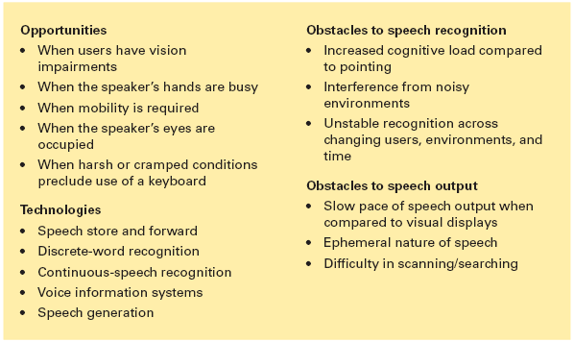
Voice Interface Applicability

Slide 65
Speech and Auditory Interfaces
Continuous-speech recognition
Not generally available:
difficulty in recognizing boundaries between spoken words
normal speech patterns blur boundaries
many potentially useful applications if perfected
Speech store and forward
Voice mail users can
receive messages
replay messages
reply to caller
forward messages to other users, delete messages
archive messages
Systems are low cost and reliable.

Slide 66
Speech and Auditory Interfaces
Voice information systems
Stored speech commonly used to provide information about tourist sites, government services, after-hours messages for organizations
Low cost
Voice prompts
Deep and complex menus frustrating
Slow pace of voice output, ephemeral nature of speech, scanning and searching problems
Voice mail
Handheld voice recorders
Audio books
Instructional systems

Slide 67
Audible Feedback
Audio tones, audiolization, and music
Sound feedback can be important:
to confirm actions
offer warning
for visually-impaired users
music used to provide mood context, e.g., in games
can provide unique opportunities for user, e.g., with simulating various musical instruments

Slide 68
Summary, Review, & Questions…

Slide 69
Display Devices
Interaction Devices

Slide 70
Displays – Small and Large
The display has become the primary source of feedback to the user from the computer
The display has many important features, including:
Physical dimensions (usually the diagonal dimension and depth)
Resolution (the number of pixels available)
Number of available colors, color correctness
Luminance, contrast, and glare
Power consumption
Refresh rates (sufficient to allow animation and video)
Cost
Reliability

Slide 71
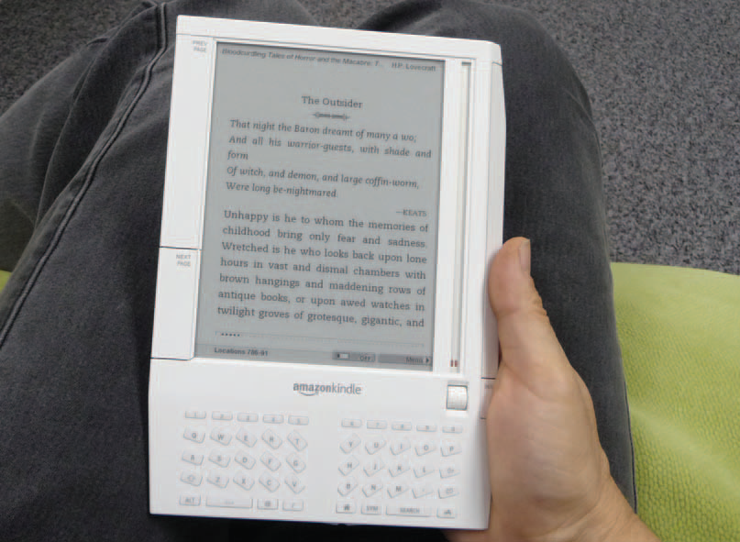
Displays – Small and Large (cont.)
Usage characteristics distinguish displays:
Portability
Privacy
Saliency
Ubiquity
Simultaneity

Slide 72
Display Technologies
Monochrome displays, e.g., electronic ink
are adequate, and are attractive because of their lower cost
Raster-scan cathode-ray tube (CRT)
electron beam sweeping out lines of dots to form letters
refresh rates 30 to 70 per second
Liquid-crystal displays (LCDs)
voltage changes influence the polarization of tiny capsules of liquid crystals
flicker-free
size of the capsules limits the resolution
Plasma panel
rows of horizontal wires are slightly separated from vertical wires by small glass-enclosed capsules of neon-based gases
Light-emitting diodes (LEDs)
certain diodes emit light when a voltage is applied
arrays of these small diodes can be assembled to display characters

Slide 73
Display technology (cont.)
Braille displays
Pins provide output for the blind

Slide 74
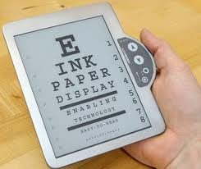
Electronic Ink (eInk)
Electronic ink
Paper like resolution
Tiny capsules with negatively and positively charged particles
Requires no electricity to sustain
Requires ambient light to view; no backlight
used on Kindle

Slide 75
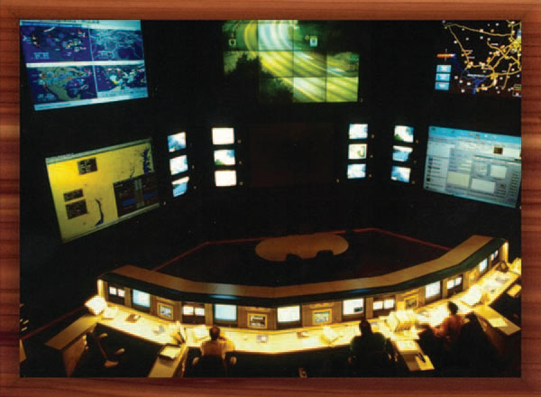
Large Displays
Large displays
Informational wall displays
Interactive wall displays
Multiple desktop displays

Slide 76
Heads-Up & Helmet Displays
Heads-up and helmet mounted displays
A heads-up display can, for instance, project information on a partially silvered widescreen of an airplane or car
A helmet/head mounted display (HMD) moves the image with the user
3D images

Slide 77
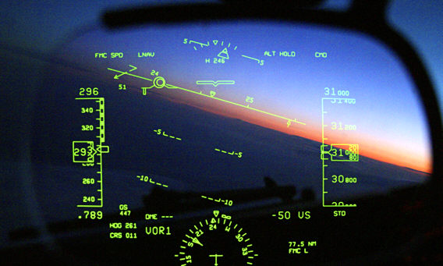
Heads-Up & Helmet Displays

Slide 78
Summary, Review, & Questions…

