Slide 1
Analyzing Reliability & Availability of Databases, Servers, Networks, and Storage Systems
Martin Schedlbauer, Ph.D.
m.schedlbauer@neu.edu

Slide 2
Estimating System Reliability
When designing systems an effort must be made to assess the system’s reliability.
When assessing reliability, the estimated reliability of each system component must be determined.
Related to reliability is the concept of availability.
Users care about both…

Slide 3
Reliability vs Availability
Both are measures of the degree to which a system is usable by its users and can perform its expected tasks.
The two concepts are closely related but are different measures.
Both capture a non-functional solution requirement: quality of service.

Slide 4
Availability
Availability is a measure of when a system is available for use to its users.
Generally expressed as a percentage, such as 99.35% availability during some time period.
The percentage can be interpreted as a probability that a system is available at some specific point in time.

Slide 5
Reliability
Reliability measures how long a system is operating as expected between failures.
It measures how well, in terms of “uptime”, a system functions.

Slide 6
Simply put, availability is a measure of the % of time the system is in an operable state while reliability is a measure of how long the system performs its intended function.

Slide 7
Availability or Reliability?
Availability matters when service or system “uptime” is important.
Availability captures in its measure both
“Mean Time to Failure” (MTTF)
“Mean Time To Restore” (MTTR)
Alternatively, we can measure “Mean Time Between Failure” (MTBF) rather than MTTF.

Slide 8
Anticipated Availability
The times during which a system is expected to be available to its users (subject to the system's reliability) is generally expressed in time intervals.
For example:
Available Monday through Sunday from 5:00am to 11:59pm and Sunday from 7am to 11:59pm.
System may be down for maintenance during the other times

Slide 9
Determining Availability
Availability is calculated as:
This generally requires empirical observation of time of failure in a specific time period, $e.g.$, the amount of time a system was unavailable during the past four weeks.
$$A=1−\frac{sum of time of failures}{total time}$$

Slide 10
Example: Calculating Availability
A system component C experienced the following outages during the past four weeks:
What is the estimated availability expressed as a probability?
9/3 | 10 min | 9/3 | 1 min
9/7 | 11 min | 9/8 | 28 min
9/18 | 92 min | 9/19 | 4 min
9/21 | 4 min | 9/23 | 2 min
9/30 | 6 min | 9/30 | 1 min

Slide 11
Solution: Calculating Availability

Slide 12
System Availability
A system is a collection of interconnected components that must all be available for the system to be available.
System availability is the joint probability that all n components are available at the same time:
$$A_{System}=\prod_{i=1}^{n}{A_{i}}$$

Slide 13
Availability Specifications
Availability expressed as a percentage assumes a uniform distribution of unanticipated failures.
System designers must also plan for anticipated times during which a system is not available.
Generally, becomes part of a Service Level Agreement (SLA).

Slide 14
Practice Questions
A system S consists of four components having annual availability of 99.9%, 99.999%, 94.3%, and 99%. What is the overall annual availability of the system assuming uniform distribution of failures? Answer: 93.3%
What would you focus on improving first?
Assume that for an online shopping cart system each minute of downtime costs $147 in lost sales due to abandoned carts. What is the annual loss assuming the above availability? Answer: (365 * 24 *60) * (1 – A) * C = $5,176,634.

Slide 15
Building Better Systems
Systems can be made more available through:
Duplication and use of redundancy, e.g., multiple CPUs, power supplies, hard drives (RAID)
Faster recoverability to reduce MTTR
Data backup to avoid catastrophic loss of information
Hot swap capability to repair components to reduce MTTR and MTBF
Continuous power through uninterruptible power supplies (UPS) and backup power sources

Slide 16
Reliability
Reliability is a measure of how long a system functions correctly without breaking.
Generally expressed as
“Mean Time to Failure (MTTF)”, and
“Mean Time Between Failures (MTBF)”
For example, the MTBF for the Seagate Barracuda 7200 Serial ATA 1TB hard drive is 0.75 million hours with an annualized failure rate of 0.32%.

Slide 17
Mean Time To Restore (MTTR)
MTTR is the delta between the time a system becomes unavailable and then again available.
MTTR is determined by:
Time to detect failure
Time to triage failure
Time to diagnose failure
Time to repair failure

Slide 18
Example: Canvas LMS
When using Canvas to submit an assignment, it matters what the chance is that it’s available when you need it, not when it was last down.
If it is down, then knowing how long it’ll take to repair it becomes important.
What matters is the mean time between failures and the mean time to restore.
Availability captures both measures.

Slide 19
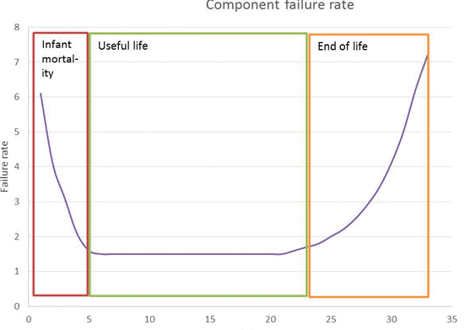
Hardware Failure Characteristics
Hardware and software systems have different failure characteristics:

Slide 20
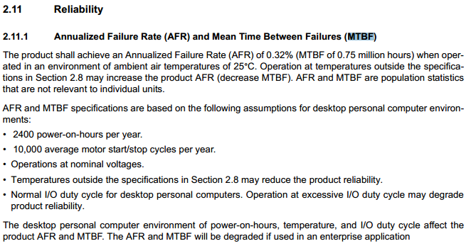
Reliability Specifications
From product manual:

Slide 21
Mean Time Between Failures
MTBF is a measure of the average time that elapses between two consecutive system failures during which the system becomes unavailable.
(total elapsed time – sum of downtime)
MTBF =
number of failures

Slide 22
Mean Time to Repair/Restore
MTTR is a metric that represents the time duration to repair/restore a failed system component until the overall system is available as per the agreed SLA commitment.

Slide 23
Availability and MTTR/MTBF
Availability can be defined in terms of reliability:
and analogously,
$$A=\frac{MTBF}{MTBF+MTTR}$$
MTBF$=A×\frac{MTTR}{(1−A)}$

Slide 24
Reliability as a Probability
Like availability, reliability can be expressed as the likelihood that a system is functioning properly during some time period t.
The reliability can be calculated as follows:
$$R=e^{−t/{MTBF}}$$

Slide 25
Availability
Reliability
The percentage of time a system remains operational under acceptable parameters of operations and serves its intended purpose.
The probability that a system functions correctly for some period.

Slide 26
Service-Level Agreements
Example:
An IT service specified a 90 percent for its availability in the negotiated SLA, the yearly service downtime could be as much as 876 hours.
For an SLA of 99.999 percent availability, the yearly service downtime could be as much as 5.256 minutes.

Slide 27
Practice Questions
Assuming continual operation and an availability of 99.8%, how many minutes of downtime can be expected in a year? Answer: 1,051
What is the MTBF in hours in the above scenario assuming it takes on average 15 minutes to repair the system after a failure?

Slide 28
Practice Questions
If a system has a MTBF of 750,000 hours, what is its expected annual reliability expressed as a probability? Answer: e^(-(365*24/750000) = 0.9884
What is the probability that the above system is not available (down) at some point during the year? Answer: 1 - R

Slide 29
Practice Questions
Razor LLC is planning to provide a web hosting service to its customers and wants to guarantee 99.98% availability in its Service Level Agreements (SLAs). The QA team has estimated a MTBF of 3 years and a MTTR of 4 hours. Are you confident you can deliver on the guarantee?
A key customer requests reliability of 99.9% during any given 30-day period for the above system. Can you deliver?

Slide 30
Solutions
Downtime of 1051.2 minutes per year
MTBF = 124.75 hours
Improve weakest component first, i.e., the one with the lowest reliability
Annual loss = $5,205,445
Reliability = 98.84%
1.16%
Actual availability = 99.98% which equals desired availability (but barely and agreeing to this would be very risky)
Reliability = 97.3% in 30 days

Slide 31
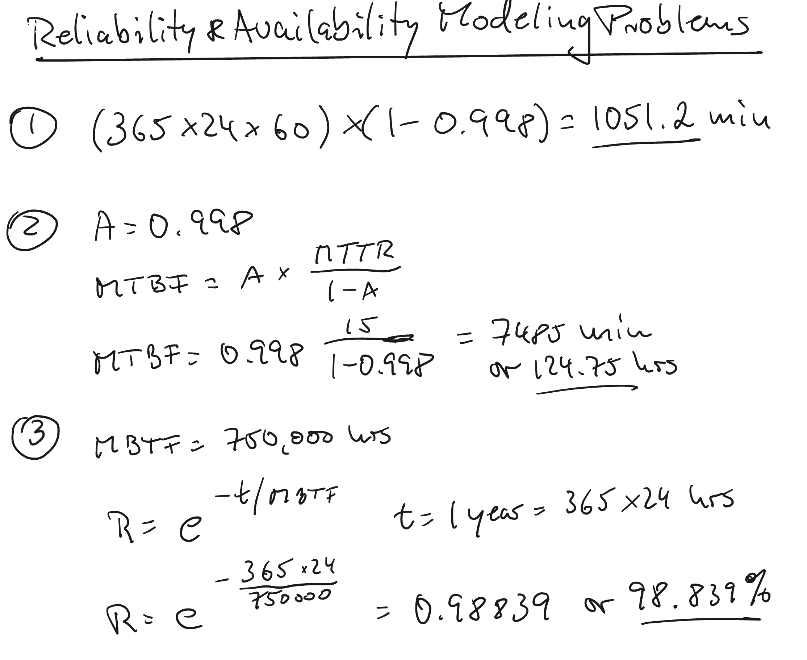
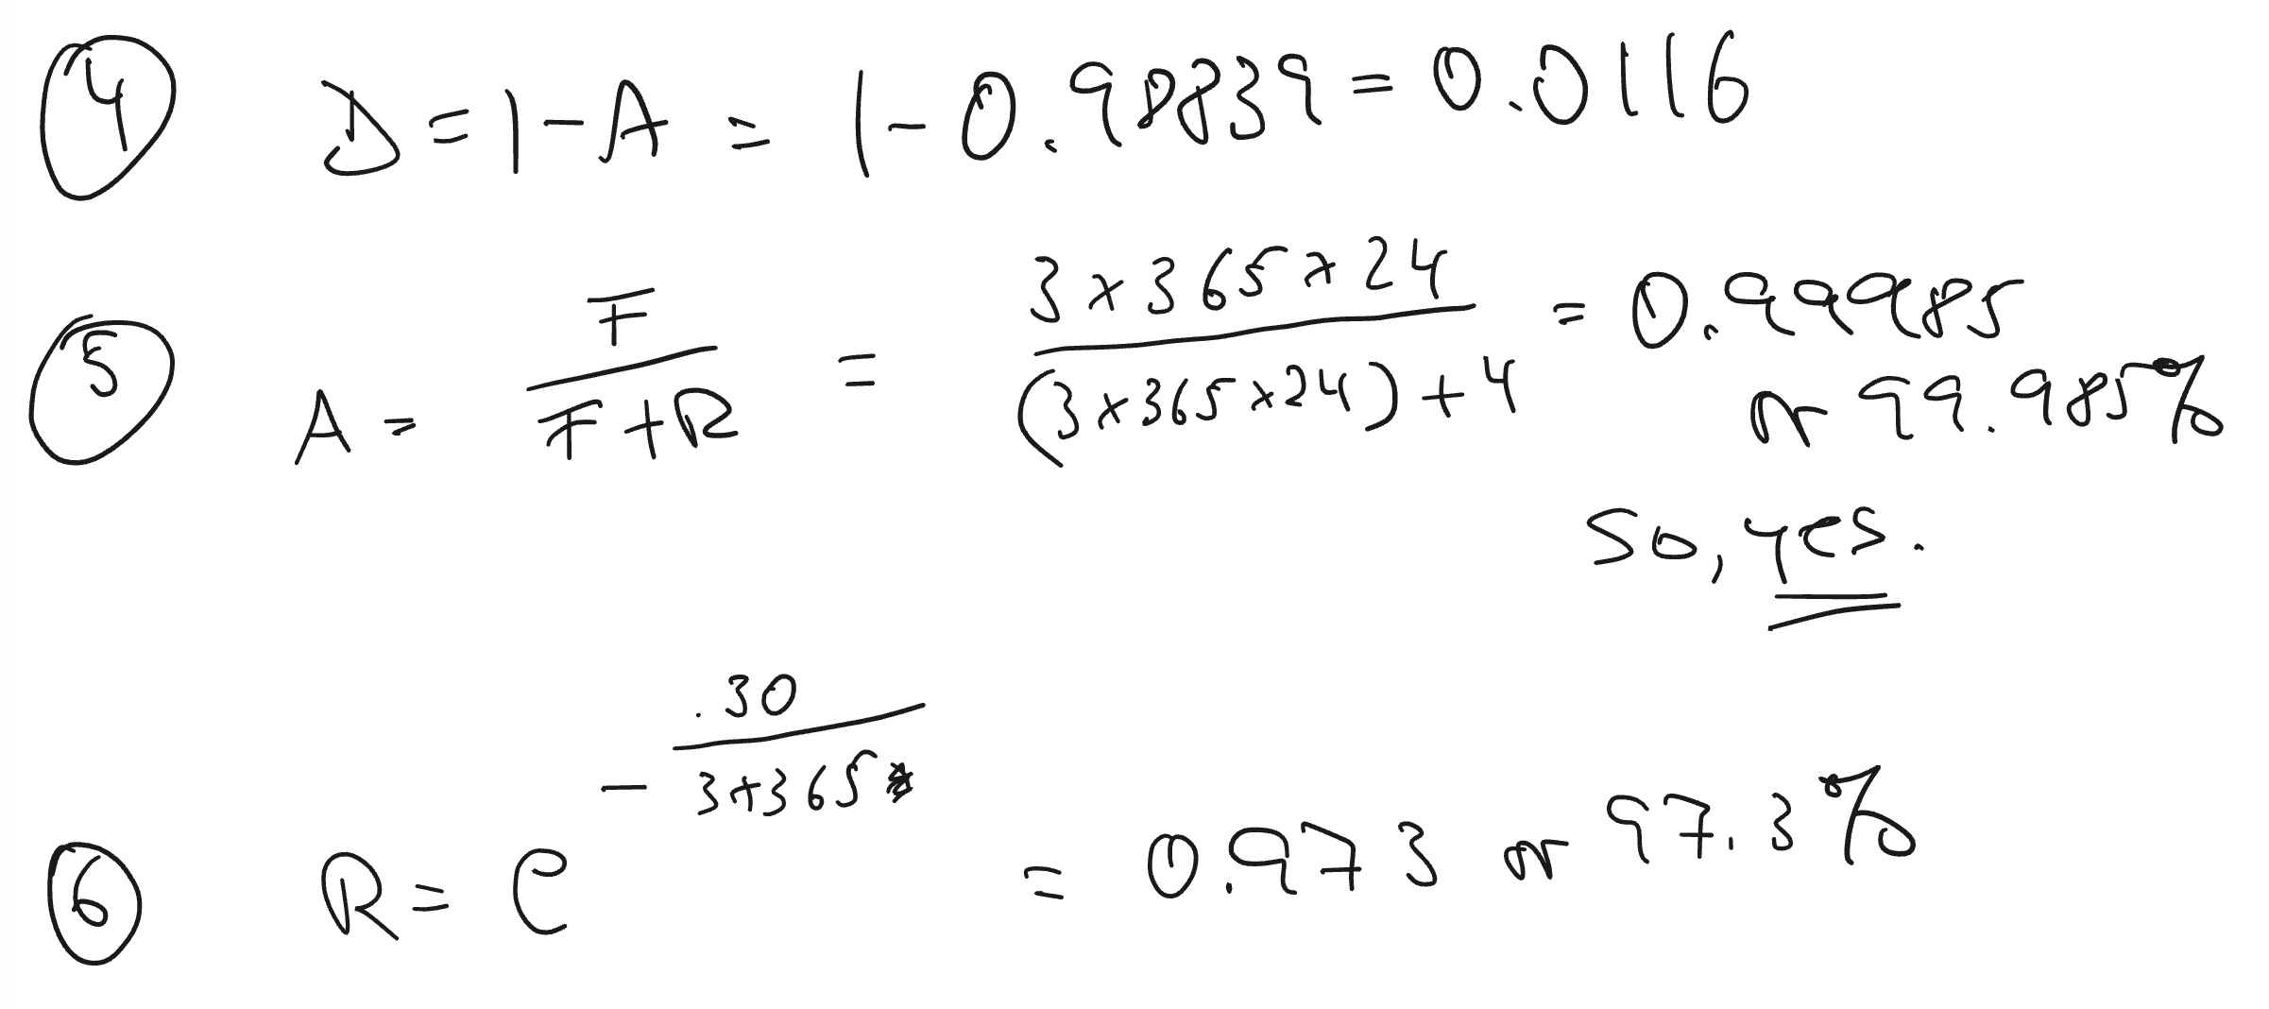
Solutions

Slide 32
Summary, Review, & Questions…

